Slide 1
Leveraging OSLC and Linked Data for the Creation of Assurance Cases
Damir Nešić EPIX (Management Systems and Digital Thread)

Slide 2
About me
Method developer for the management system(s) for functional safety, cybersecurity, etc.
Defining methods, processes, IT support within the management system
Previously a PhD student at KTH, division of mechatronics and embedded control systems
Topic: assuring functional safety of highly configurable systems (via assurance cases)
Prior to KTH, embedded systems R&D engineer

Slide 3
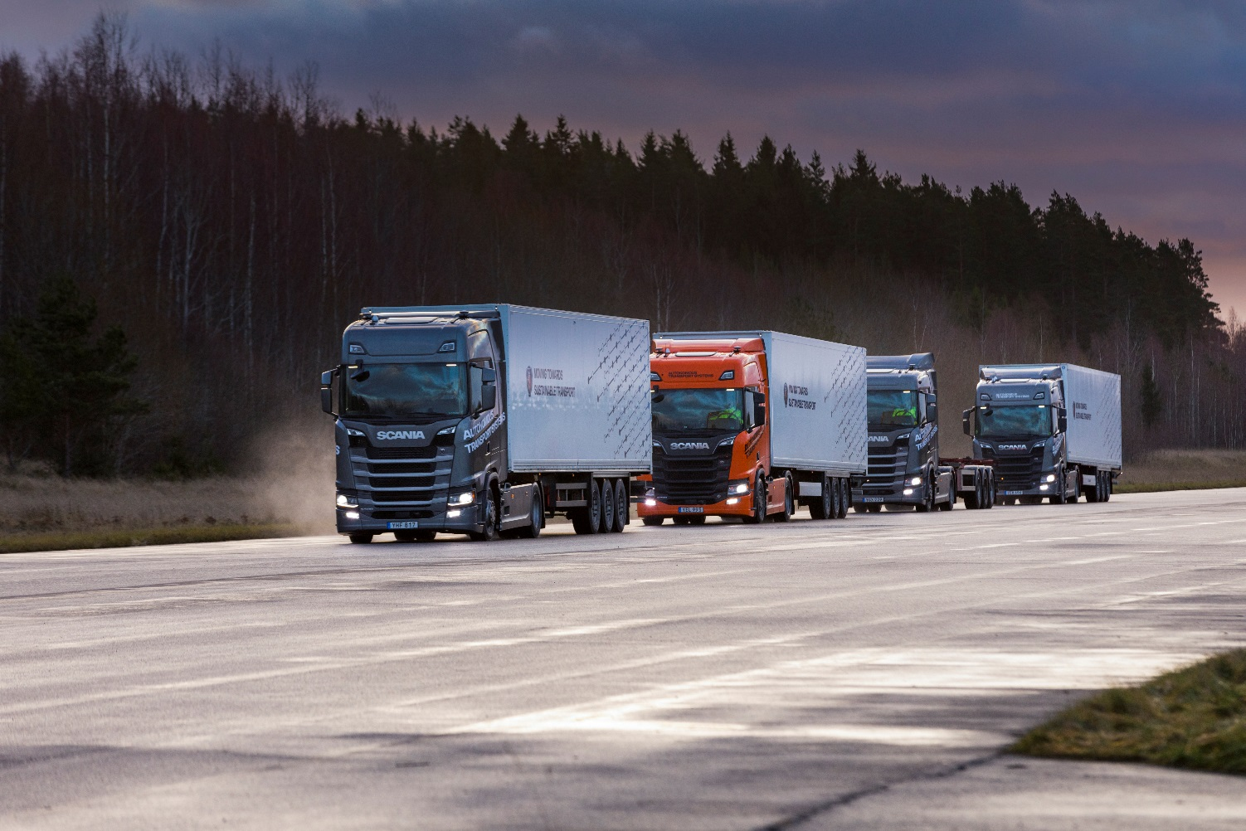

Founded in 1891
Part of VW group
Main products are heavy trucks and buses
Worldwide production and sales
50 000 employees
5000 engineers
2000 engineers in electronics and software
100 000 sold vehicles per year
Vehicles in operation:
> 1 000 000
> 400 000 connected

Slide 4
Outline
The Scania context and trends in automotive
The need for assurance cases
An approach to assurance-case creation based on OSLC and Linked Data

Slide 5
The Scania context

Slide 6
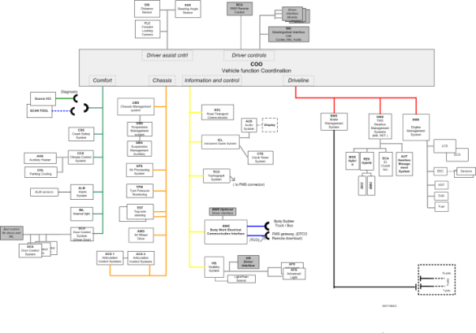
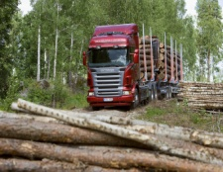
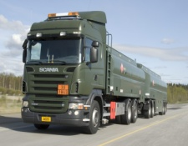
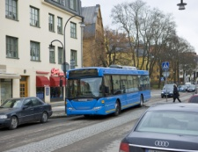
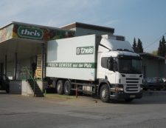
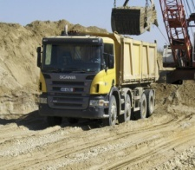
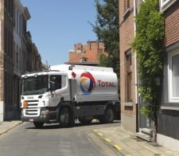
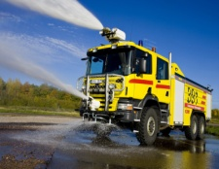

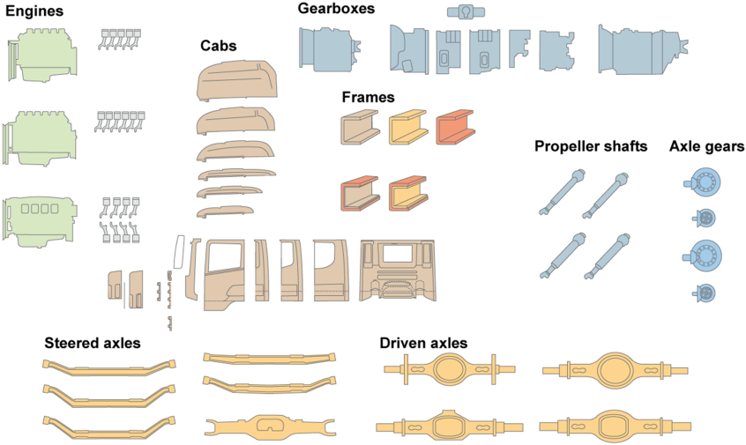
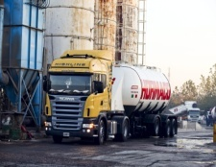
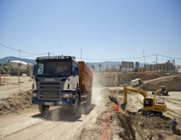
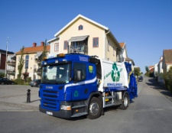
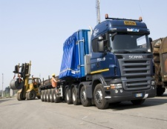
The Scania ”Modular System”
Modular electrical system
Scania vehicles are ONE evolving product line. Every week, some parts are changed.
Modular chassis and drivetrain

Slide 7
Automotive Trends
Electrification
Autonomous vehicles
Transport systems
Increased complexity
Safety-critical
Cyber security
Faster development:
Agile
Continuous Integration
Notes:
Increased product complexity, safety-critical systems…. taking the driver out-of-the-loop: higher confidence in our software and systems. Same time, we want faster dev. Speed (cont. integration, agility)… vi ändrar varje vecka!... no time to do as in avionic industry: triple redundancy, complete exhaustive testing, manual reviews → We need ways to achieve higher confidence without loosing effectiveness… ➔ Formal verification

Slide 8
Assurance Cases

Slide 9
Assurance Cases
“An assurance case is a structured argument, supported by evidence, intended to justify that a system is acceptably assured relative to a concern in the intended operating environment.” [Handbook of System Safety and Security, 2017]
Typical “concerns”:
Safety → Safety assurance case
Cybersecurity → Cybersecurity assurance case
Assurance cases are important since
it is a (the only?) holistic, systematic, and reasonably established industrial practice to conclude if a product is safe/secure or not
Claim
Claim
Claim
Argument
Argument
Evidence
Evidence
CAE Notation

Slide 10
The need for assurance cases
Existing standards require assurance cases but offer little guidance
ISO 26262 functional safety – requires a safety assurance case
ISO 21434 cybersecurity – requires a cybersecurity case
Upcoming standards for autonomous systems (e.g. UL 4600, ISO 5083) emphasize assurance cases even more
Basis for near real-time tracking of product status w.r.t. a concern
A living artefact that spans across the whole lifecycle

Slide 11
Problems with assurance cases
There are problems with all activities related to assurance cases
Building them
Reviewing them
Maintaining them
Reusing them
Problems result from:
volume of material; size
little structuring support
ad hoc usage of evidence
…
Managing such large and complex artefact through the lifecycle requires automation and tool support

Slide 12
Tool Support based on Linked Data

Slide 13
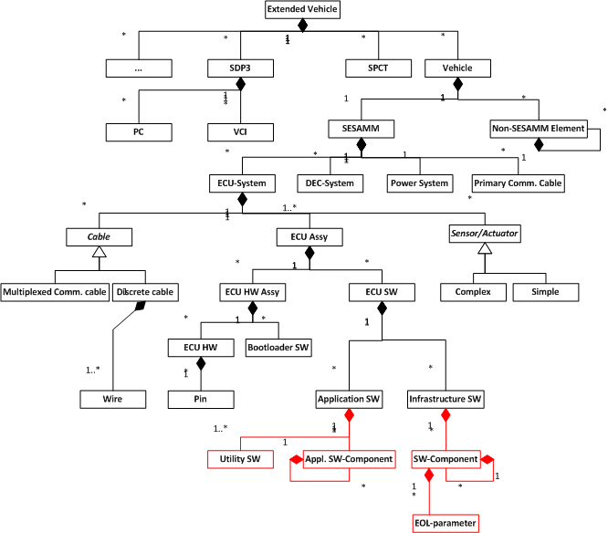
Prerequisites: Cross-tool Data Integration
Requirements
Architectures
Specifications
Vehicle, systems, SW, HW,…
Hazard analyses, FMEA
Test Management
…
Links to
diagnosis / workshop info
Issue tracking system
…
.doc
DB
.xls
Common Information Model
Common Information Model

Slide 14



Tool Chain Architecture based on Linked Data
Test Management System
OAS
PDM System
JIRA
Issue Tracking
PSM
Configuration DB
Adapter (OSLC Core)
Adapter (OSLC Core)
Adapter (OSLC Core)
Adapter (OSLC Core)
Assurance case generator
Linked Data information layer
Information layer - not storage - information is abstracted from tools - tools are not aware of each other
Semantics (common agreed interpretation) of data defined in Linked Data Schemas
Adapter (OSLC Core)
Adapter (OSLC Core)
Assurance cases
Source Code Architecture
Requirements Management System
14

Slide 15
High-level architecture
Assurance case
Tool 1
Tool n
Adapter generation
Assurance case tool
(Eclipse)
…
LD Schema Editor:
Eclipse Lyo
LD schema / info model synchronization
Adapter (OSLC Core)
Adapter (OSLC Core)
Linked Data
Data integrator SPARQL endpoint
Query results

Slide 16
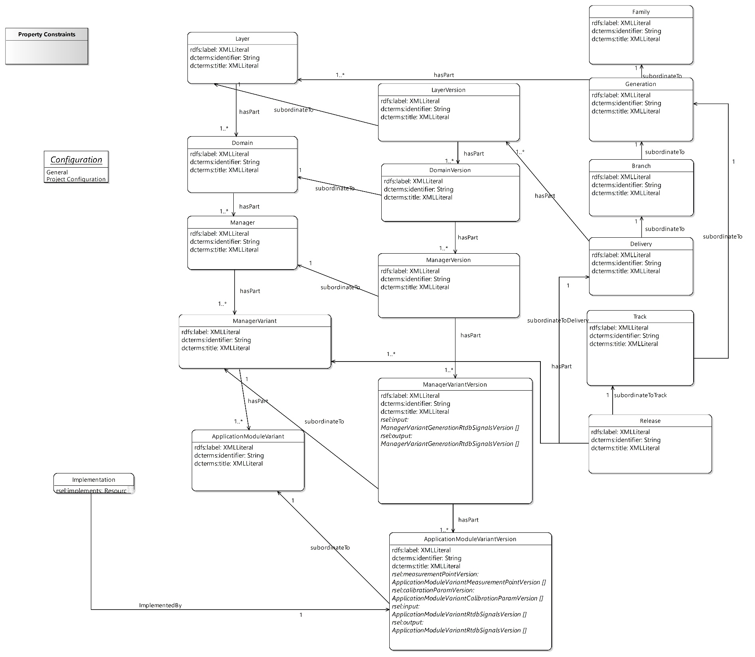
LD Schema per adapter
Tool
Adapter (OSLC Core)
Each tool has at least one LD adapter
Each LD adapter has an LD schema
Defines hard syntactical constraints on the data
which classes and subclasses are allowed
which attributes are allowed for instances of each class
which links are allowed from instances of each class
which cardinality

Slide 17
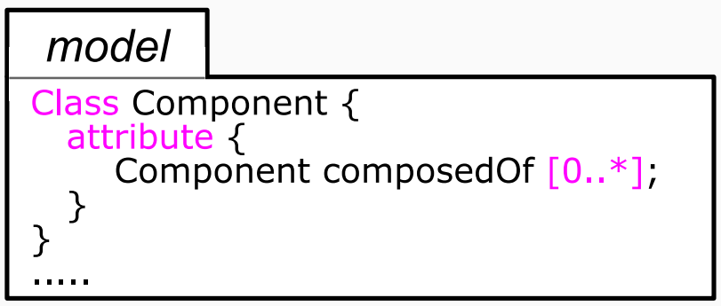
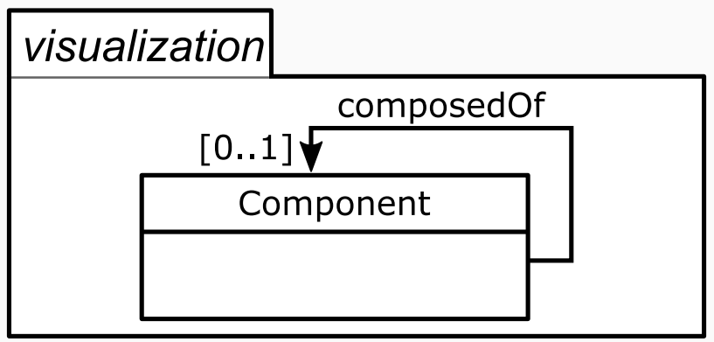
Assurance Case Tool (ACT)
• Information modeling
• Definition of assurance case structure, e.g. - assurance case patterns - definition of claim types, e.g. “safe vehicle”, “sufficient” amount of testing
LD adapter
LD Schema editor (Eclipse Lyo)
LD adapter
Adapter generation
LD adapter
LD adapter
LD adapter
Error message
Consistency checks, import/export
SPARQL endpoint
Data quality check
Textual model-editor (Xtext)
Model visualization (Sirius)
• Dashboard for dynamic tracking of status
• Generates PDF documents for archiving
Theorem prover (Z3)
SPARQL queries
Warning, errors
Claim & Evidence analysis engine
Model verification
Syntactic-constraints verification (ConceptBase)
ACT
(Eclipse)
Assurance
case
Assurance case builder
Programmatic verification, e.g. unique IDs (Xtend methods)

Slide 18
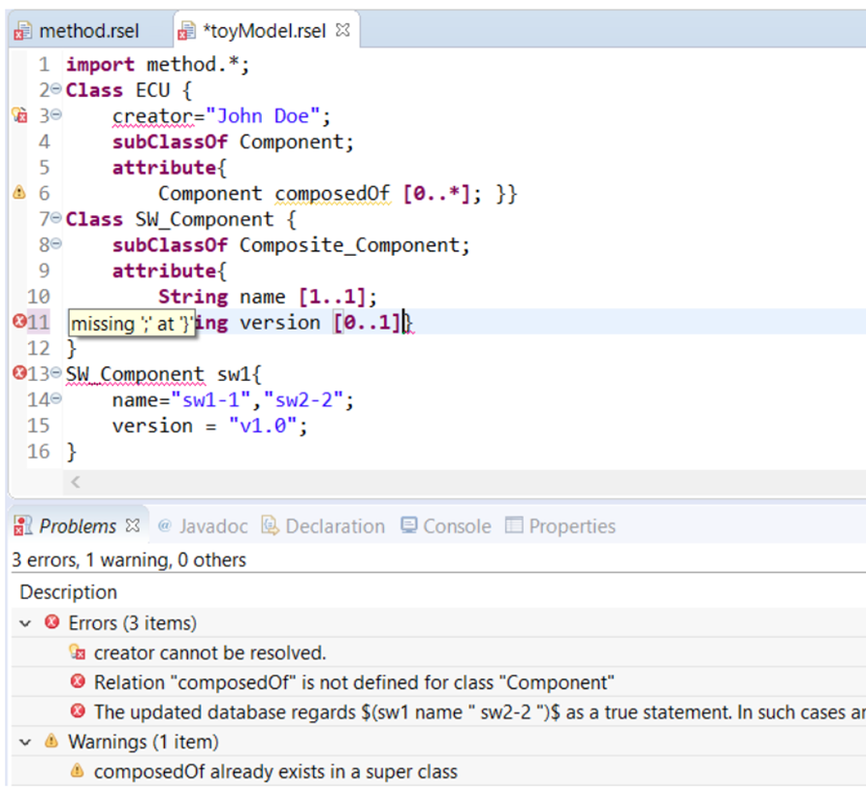
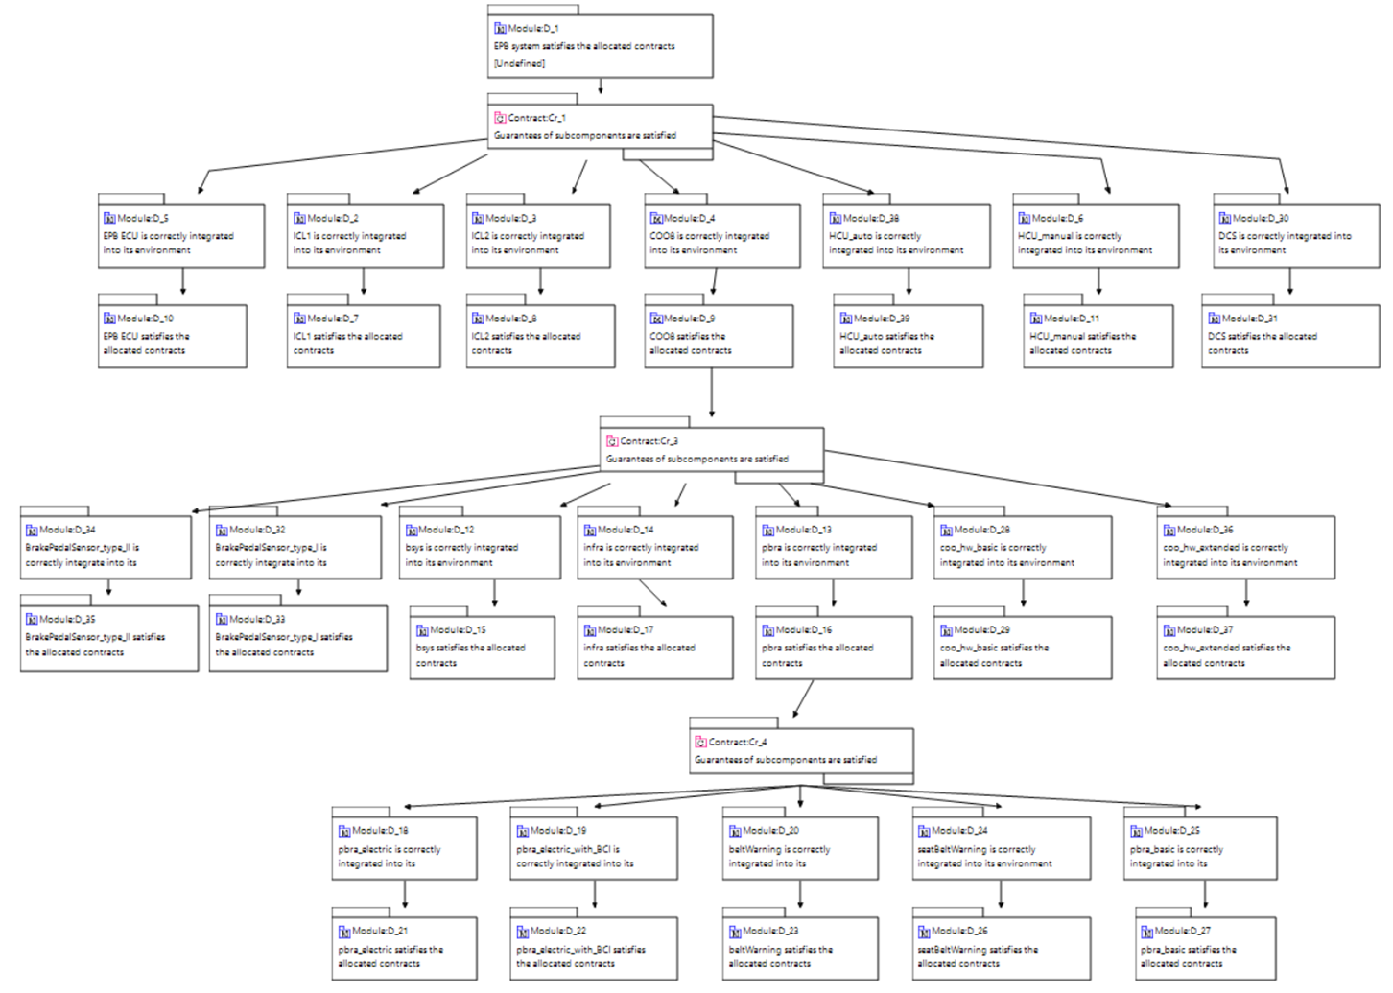
Case study example: Electro-pneumatic Parking Brake (EPB)
Definition of the EPB system and related claims
Generated fragment of the assurance case

Slide 19
Next steps – Scaling up
Creating LD schemas for more tools
Allows automatic creation of greater parts of the assurance case
Provide a web-based UI for the assurance-case tool
Release LD guideline documents to the organization (URI management, modeling patterns,…)
Improve the infrastructure to expose/maintain the Linked Data layer
Building adaptors without Lyo
Linked Data layer maintained in a production environment

Slide 20
Conclusion
Assurance cases are becoming one of the central artefacts in automotive
Their size and complexity warrant the need for sophisticated tool-support
Cross-tool data-integration is a key prerequisite
Due to the dependencies to many artefacts across the lifecycle, OSLC and LD are a highly suitable technology to support the creation of assurance cases
OSLC Core Specification good foundation for tool API development
Tool-agnostic data-integration on the information model (LD schema) level

