Slide 1
Cross Domain Configuration Management a new way to think PLM in engineering
Martin Ulrich, CI/PLM5, 15.11.2022

Slide 2








Our business sectors
Who we are
Mobility Solutions
Industrial Technology
Energy and Building Technology
Consumer Goods
Notes:
402,600
associates worldwide
78.7
billion euros sales revenue
76,100
researchers and developers worldwide
440
subsidiaries and regional companies in some 60 countries
2.8
billion euros EBIT
6.1
billion euros on research and development

Slide 3





What is MB(S)E: Document based vs. Model based
Future Needs for MB(S)E Integration
Document based
Model based
Safety / Security
Software
Verification & Validation
Requirements
Verification & Validation
Safety / Security
Common Engineering Model
Requirements
Variant
-handling
Architecture
System Simulation
Architecture
Software
Variant
-handling
Electronics
System Simulation
Electronics
Mechanics
Each engineering task creates a new copy of a part of the product knowledge
- Inconsistent product description
- Accidental complexity
Essential complexity is in the model
Specific view for each engineering task
+ Reuse information that is already available
+ Consistent product description
Notes:
From Doc Based to Model Based: Digital Transformation of Engineering
All Engineers work in a Model Based environment using their known environment.
A single source of truth is established. All relevant Engineering Information is connected.
Engineering is connected to other business functions based on hPLM. Data can flow in and out.
Documents are only generated for documentation purpose.

Slide 4
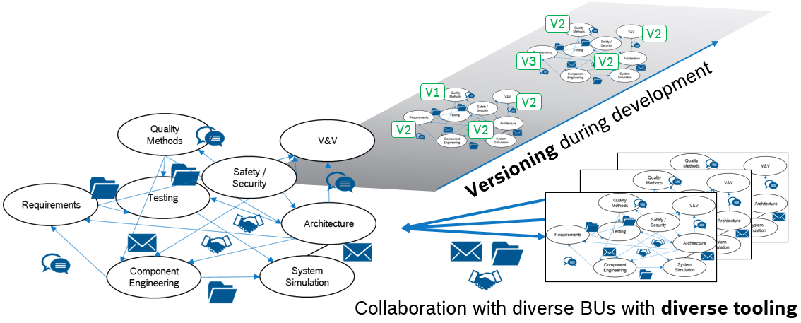
Need for CDCM
CDCM – Cross Domain Configuration Management
The complexity of Bosch products is steadily increasing → e.g. cyber-physical products
This is also reflected in an increasing complexity of the development organization
For this, cross-domain and cross-organizational collaboration in engineering must be enabled and strengthened
Today, products with all their descriptions are managed over time in Excel as a configuration item list
Sharing information requires a high degree of personal communication
Benefits with CDCM: Time saving, error-reduction, up-to-date product data, accessible across organizations, automatable

Slide 5
Cross Workproduct Traceability Links
Future Needs For MB(S)E Integration
Traceability means tracing relationships between the artifacts of the development process such as requirements, system elements and software components
As required by ASPICE, traceability must be managed both within a development discipline, and across disciplines for the used toolset(s)
Requirements
Engineering
Validation
System
Functional Development
Verification
Subsystem
Logical
Architecture
Integration
Component
Component Specification
Component Validation
Software
Electrics/Electronics
Mechanics
CDCM required to ensure link consistency and bidirectional traceability
depending on the configuration context

Slide 6
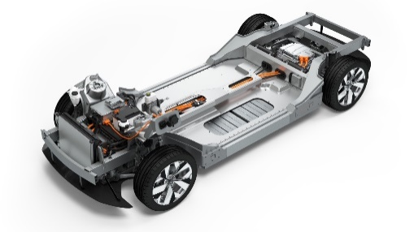
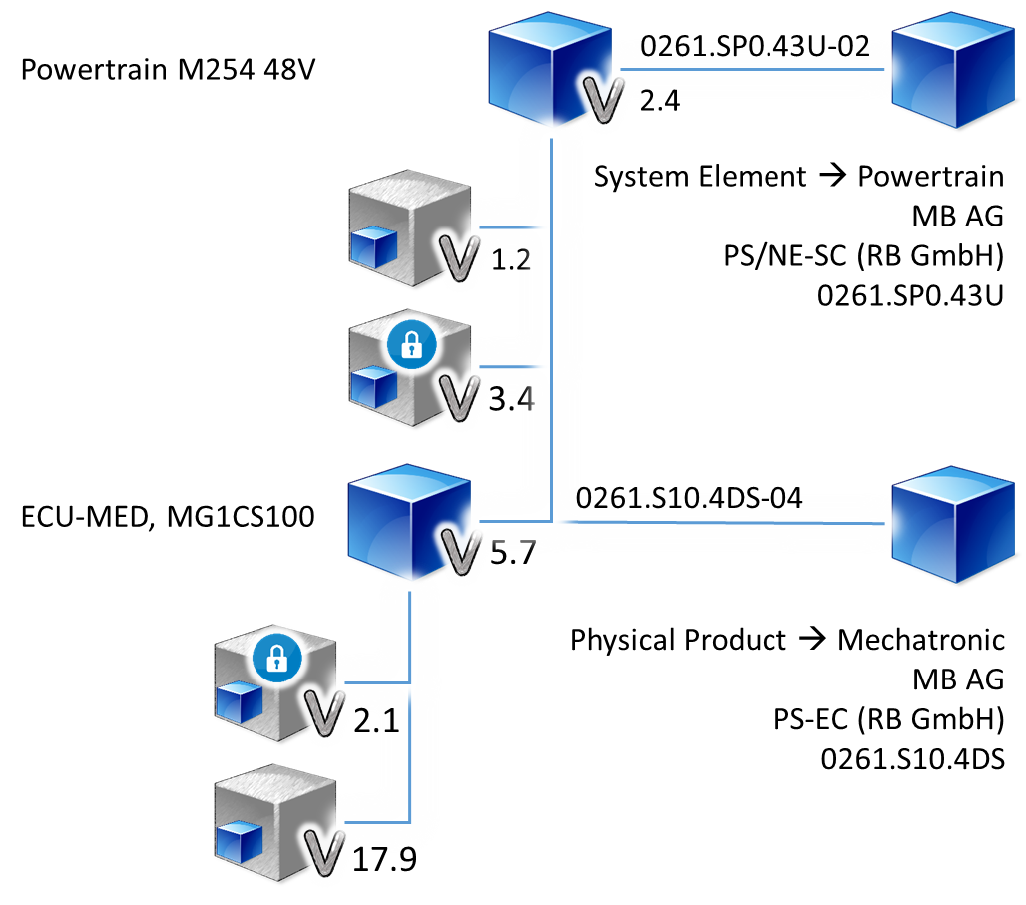


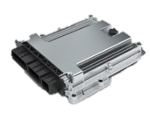
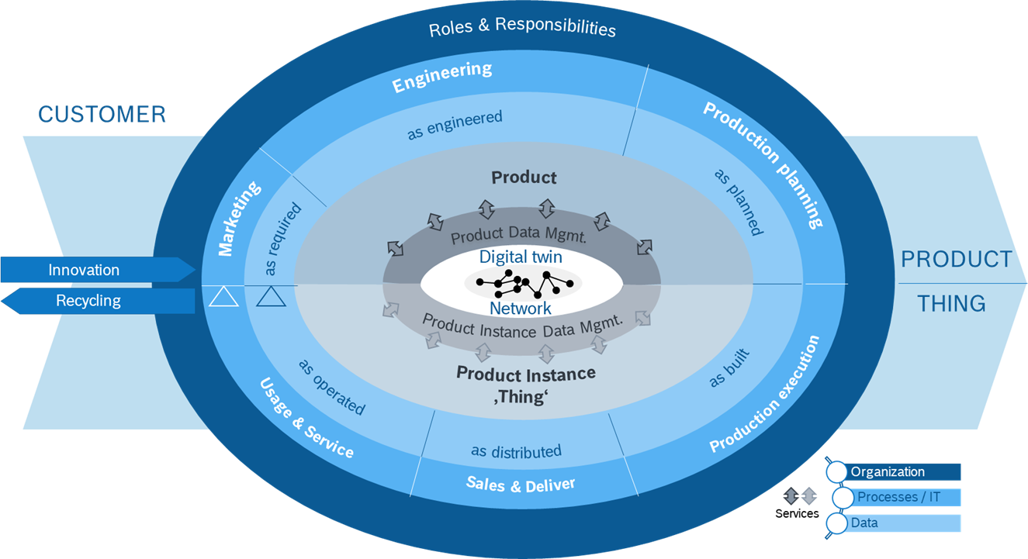

High level concept
CDCM – Cross Domain Configuration Management
System
Requirements
Enabler to let engineering data flow
Architecture
Requirements
M254
Source Code
0261.S10.4DS
0261.S10.4DS
ME2N X 072
CDCM interrelates and structures today’s models, maps data and ensures uniform access
“Digitalization in engineering starts with the digitalized eBOM”
Notes:
OSLC Components = Products
Configurations
OSLC Contributions = Configuration Items

Slide 7

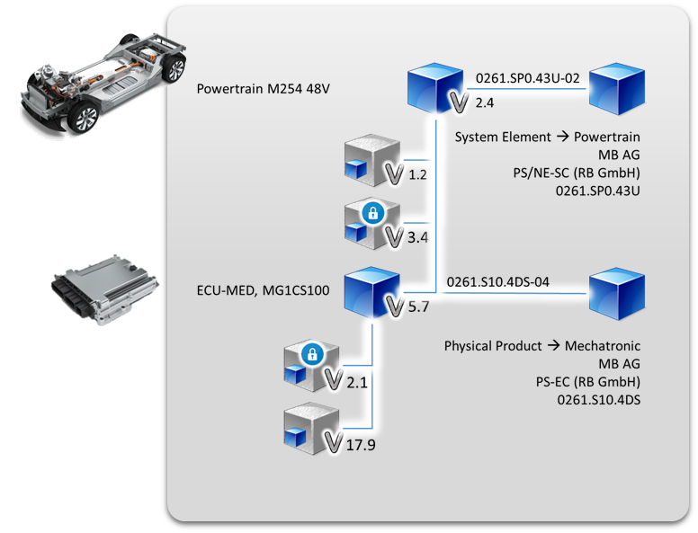


In a nutshell
CDCM – Cross Domain Configuration Management
Integrates engineering tools via industry standard
. . .
SPES Matrix
Enables seamless MBSE integration
Common Engineering Model
Fundamental asset of the core model
Facilitates communication
via model references
CDCM accepts todays engineering brown field, still empowering Model based engineering

Slide 8





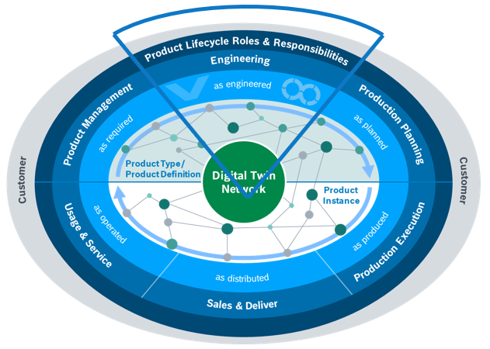

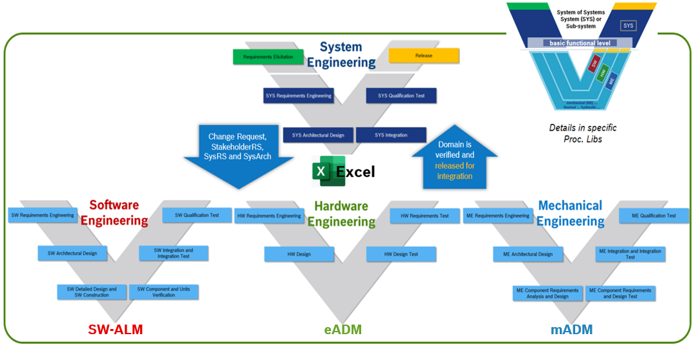

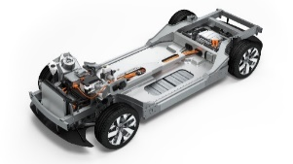


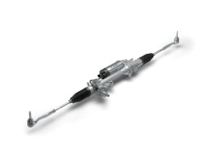

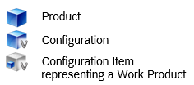
Approach
CDCM – Cross Domain Configuration Management
CDCM addresses Configuration Management for products on cross-domain level
Linking of relevant engineering data from all individual development domains (across the whole development-V)
Provisioning a single source of truth for products (incl. SW and Services)
The product description consists of up to 300 different work products
With CDCM, complete and up-to-date transparency of the products is ensured
CDCM provides the basis for the Digital Twin integration of Engineering Data, with which we integrate the product life cycle
Vehicle
Current Focus of hPLM
Vehicle Specification
Vehicle Architecture
Vehicle EE
Chassis
Chassis Feature Model
Chassis Architecture
Steering
Steering CAD-Model
Steering Software

Slide 9
Design Principles
CDCM – Cross Domain Configuration Management
Modularity A modular, open architecture instead of monoliths and vendor lock
Semantic of Data For all exchanged data a clearly defined semantic is required
model based approach model-based, not a document-based approach.
Brown Field Approach
Single source of truth for each data object / avoidance of redundancies
REST/SOAP APIs
Open/Industry standards If available open/industry standards should be used
Interoperability
Extensibility
…

Slide 10
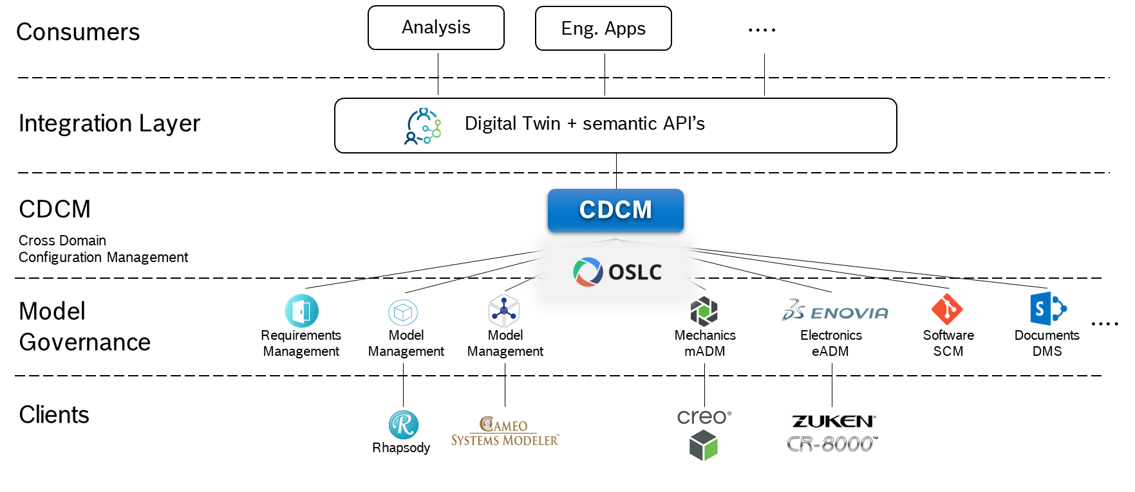
Architecture for Linked Engineering Data
CDCM – Cross Domain Configuration Management
>100 brownfield applications
Integrate engineering tools via a widely accepted industry standard: OSLC*
Yet a significant number of tools need to be OSLC enabled
* OSLC = Open Services for Lifecycle Collaboration

Slide 11
Architecture driven by OSLC standard
CDCM – Cross Domain Configuration Management
OSLC Configuration Management perfectly supports CDCM
Best suited standard after intense research
CDCM implements global configurations
Model Governance layer need to implement local configurations and interlink via OSLC Core considering the configuration context
OSLC Configuration Management is the key enabler

Slide 12
Architecture – PLM reduced to the eBOM
CDCM – Cross Domain Configuration Management
Atomic scope of CDCM
Configuration Management (eBOM)
Product Master Data (partnumber, responsibility, status, …)
Out of scope – yet typical for PLM-systems:
Content Management
Engineering Workflows
Federated Search-Engines
…
“A new way to think PLM in engineering”
Yet no offering available in the market which fulfils our requirements

Slide 13
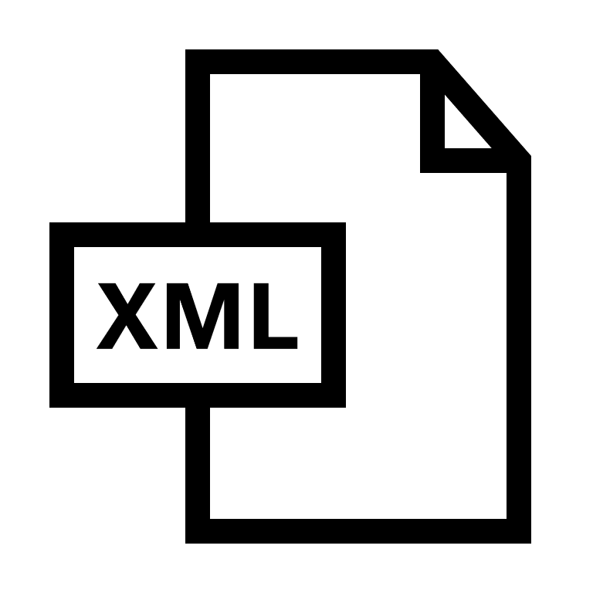



Alternative integration patterns
CDCM – Cross Domain Configuration Management
export
Both tools need to understand exchange format
When and how to sync?
What was the source of the export?
import
Replication of Data between Tools
{Exchange Format}
Tool A
Tool B
publish
publish
When to publish?
Data enrichment in Graph
What was the source of the publication?
Publication of Data in neutral format
HTML</>
Graph
Tool A
{Neutral Format}
Tool B

Linked Data
Tools need to make data accessible
Link is stored in the logically dependent side
True
North
Tool A
Tool B

Slide 14

Linking evolution from OSLC Core to Configuration Management
CDCM – Cross Domain Configuration Management
Static Links with
OSLC Core
Tools need to make data accessible
Link is stored in the logically dependent side
Tool A
Tool B

Link is dependant on the selected configuration context
Tools need to support concept resources
Configuration-aware Links with
OSLC Config. Mgmnt.
True
North
Tool A
Tool B
Concept Resource
Versioned Resource
Any artifact with his related links need to be under configuration control.
OSLC Configuration Management mandatory to fulfil this requirement.

Slide 15
Were good to move forward ! …still facing challenges
CDCM – Cross Domain Configuration Management
Primary focus is an OSLC-based toolchain for MBSE
incl. Requirements-, Architecture- and Configuration-Management
Implement CDCM in collaboration with external partner
Implement OSLC-integrations to gain integration experience, e.g. for Bosch custom tools
Challenge: Engineering Tools supporting OSLC
Motivate OSLC support to increase number of OSLC enabled tools with focus on OSLC Configuration Management, OSLC Core and OSLC TRS
Motivate adherence to design principles
Challenge: OSLC Standard Integration of Link index, link validity
We need your support to face the challenges!

Slide 16

Your support is appreciated
THANK YOU

