Slide 1
HEF Demonstrator

Slide 2
Agenda
Our Use Case
Hybrid Electric Propulsion
Digital Twin Masters
Co-Simulation for Digital Twins
Our Requirements
Our Architecture
OSLC…
Notes:
Präzisierung:
Es sollen im Rahmen der Studie nur Modelle und Simulationen betrachtetet werden, die Bezug zu einer angestrebten Industrie 4.0-Intelligenz, wie bspw. Im Rahmen
des Erstellens eines Industrie 4.0-Systementwurfs bzw. einer Industrie 4.0 Lösungsarchitektur oder
des Überwachens und Vorausschauens im Betrieb von Industrie 4.0-Lösungen (siehe Themenfelder Industrie 4.0),
notwendig oder möglich werden oder zukünftig erwünscht sind.
Eine Simulation stellt dabei die Abbildung und Ausführung realer Szenarien in Simulationsmodellen dar, um diese Szenarien zu verstehen, vorherzusagen oder zu optimieren.

Slide 3
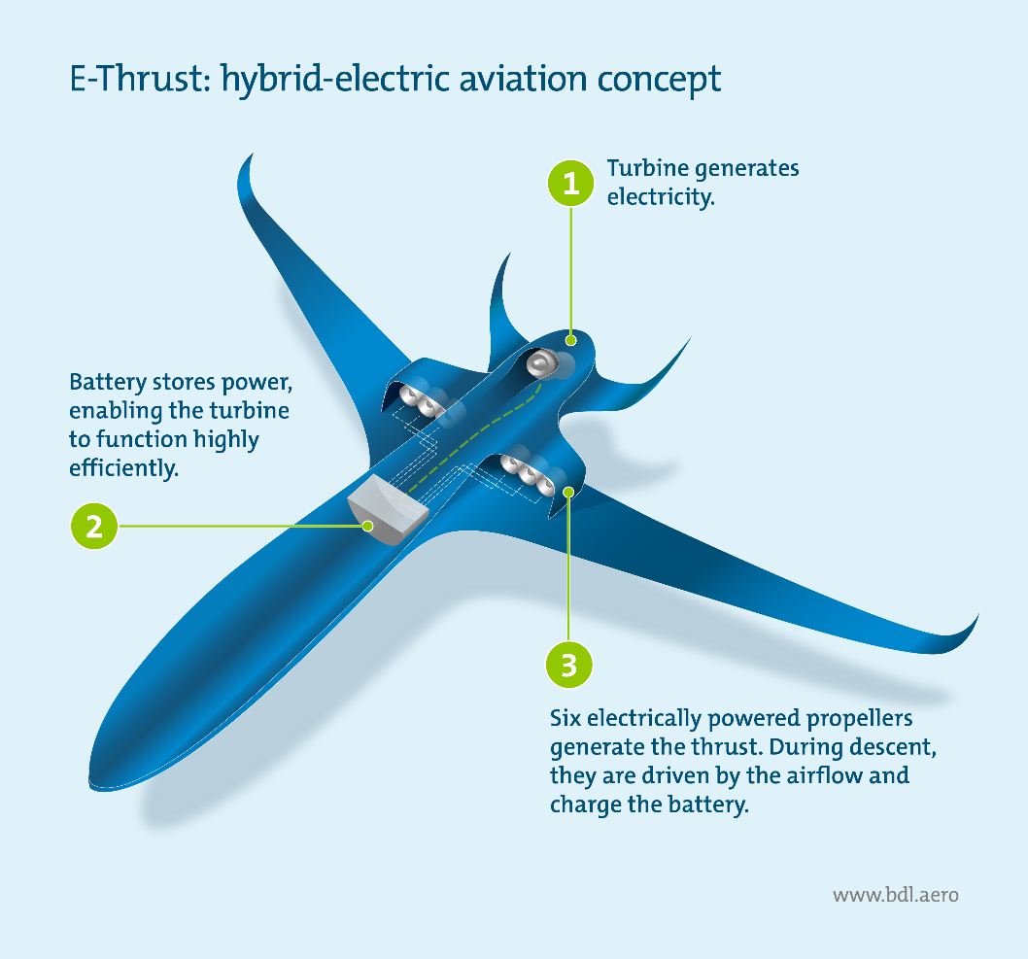
Our Use Case
Context: Development of hybrid-electric propulsion demonstrator aircraft
Demonstrate Digital Twin usage across development and manufacturing lifecycle
Leverage Co-Simulation with open standards to allow for ad-hoc generation of digital masters

Slide 4
Our Use Case
Context: Development of hybrid-electric propulsion demonstrator aircraft
Demonstrate Digital Twin usage across development and manufacturing lifecycle
Leverage Co-Simulation with open standards to allow for ad-hoc generation of digital masters derived from descriptive MBSE models

Slide 5
Our Use Case
Research / Innovations
Source: Fraunhofer IPK / TU Berlin
Product Planning
Architecture Reflection
Requirements
Product
Production System
Requirements Analysis
Integrated Product-oriented Prototyping
Product Level
System Level
Function and System Architecture Definition
Subsystem Level
Integrated System Design
Verification
Integrated Hybrid
Prototyping
System Level
Product Level
Integrated Confirmation of Function and Properties
Concept Choice
Prototype-Based Integration
Subsystem Level
Preliminary Design of the System Model &
Logical and Dynamic Behavioral Simulation
Integrated Virtual
Prototyping
Services
Domain
Prototyping
Partitioning of Requirements,
Functions and the System Model
Mechanics
E/E
Software
Process & Resources

Slide 6
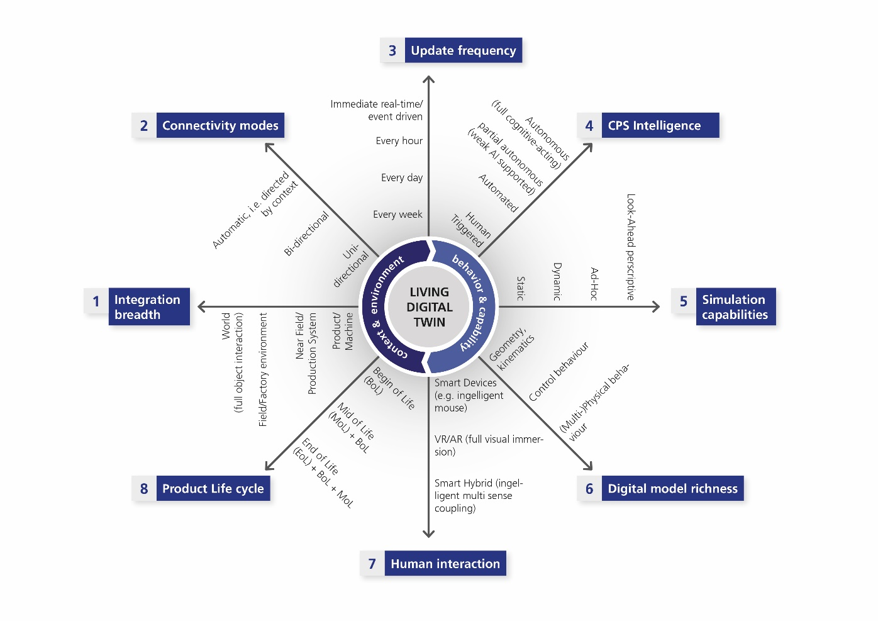
Our Requirements
Integration breadth: Scalable network of data sources, models and simulations
Connectivity modes: “intelligent” connections, object driven parameter exchange, context-driven exchange
Update Frequency: Immediate real-time / event driven parameter exchange
Simulation capabilities: ad-hoc availability of parameters and requirements
Digital model richness: Scalable model granularity
Human interaction: VR/AR support

Slide 7





Our Use Case
Context: Development of hybrid-electric propulsion demonstrator aircraft
Demonstrate Digital Twin usage across development and manufacturing lifecycle
Leverage Co-Simulation with open standards to allow for ad-hoc generation of digital masters derived from descriptive MBSE models
Co-Sim Config
Modelio
U/I App
COE
Export Interface
Structure
Co-Sim Config
System Architecture
Multi-Model Description
FMU Import
Import
Import
Import
Papyrus
FMI++ Python
OpenModelica
20-SIM
Import*
Export
Export
Export
Export
FMU - Tool Wrapper
FMU - Model Exchange
A/C
Battery
ECU
Battery
Range
Indicator
Propeller
E-Motor

Slide 8



Our Use Case
20-SIM
Context: Development of hybrid-electric propulsion demonstrator aircraft
Demonstrate Digital Twin usage across development and manufacturing lifecycle
Leverage Co-Simulation with open standards to allow for ad-hoc generation of digital masters derived from descriptive MBSE models
Future.FMU
Papyrus
Future.FMU
Modelio
Pass / Fail
Future.FMU
OSLC
GitLab
FMI++ Python
Future.FMU
Requirements (Natural Language)
OpenModelica
Parameter
Search
Interface Control Document
Future.FMU

Slide 9
OSLC…
…provides an open standard supported by various commercial tools , but also open source solutions as well as in-house tools can be connected through adaptors
Augments our FMI-based concept with a way to query data and connect auxiliary life-cycle information
…already supports various existing concepts, RM, CM etc. and can connect to PLM and ALM and customized resources can be created
…provides a scalable and reliable solution for traceability and linking across various tools, including our own demonstrators

Slide 10
Kontakt
Thomas Zimmermann
Research Associate
Business Unit Virtual Product Creation
Fraunhofer IPK
+49 (0) 30 / 3 90 06-473
thomas.zimmermann@ipk.fraunhofer.de

