Slide 1
Modern Layout
CSS Flexbox, CSS Regions
& CSS Shapes
19 March 2014

Slide 2

Hello!
I’m Razvan Caliman
@razvancaliman

Slide 3


Slide 4

Stuff I work on:
CSS Regions
CSS Shapes
CSS Custom Filters
CSS that has never seen the light of day
polyfills, prototypes,
demos & tools

Slide 5
Let’s talk about layout

Slide 6
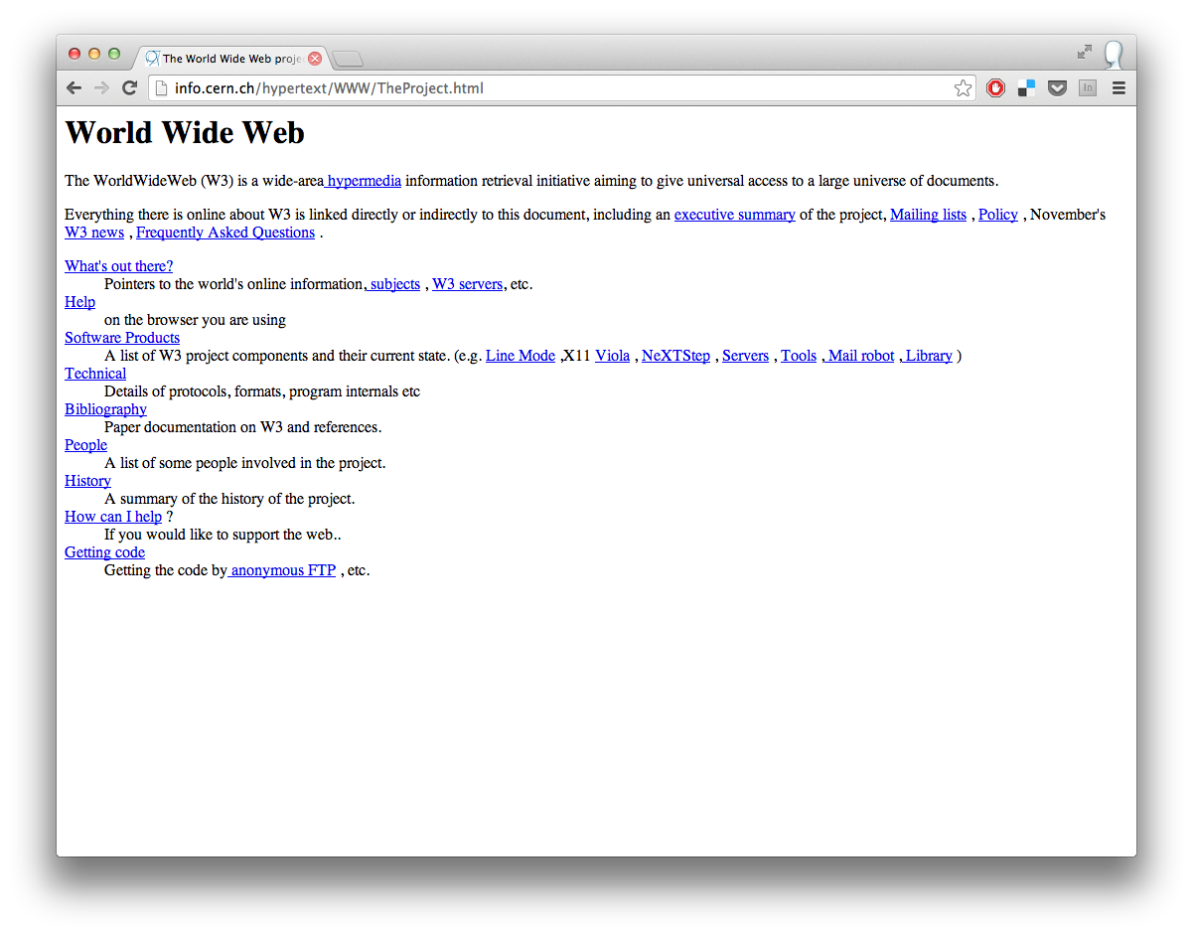

Slide 7
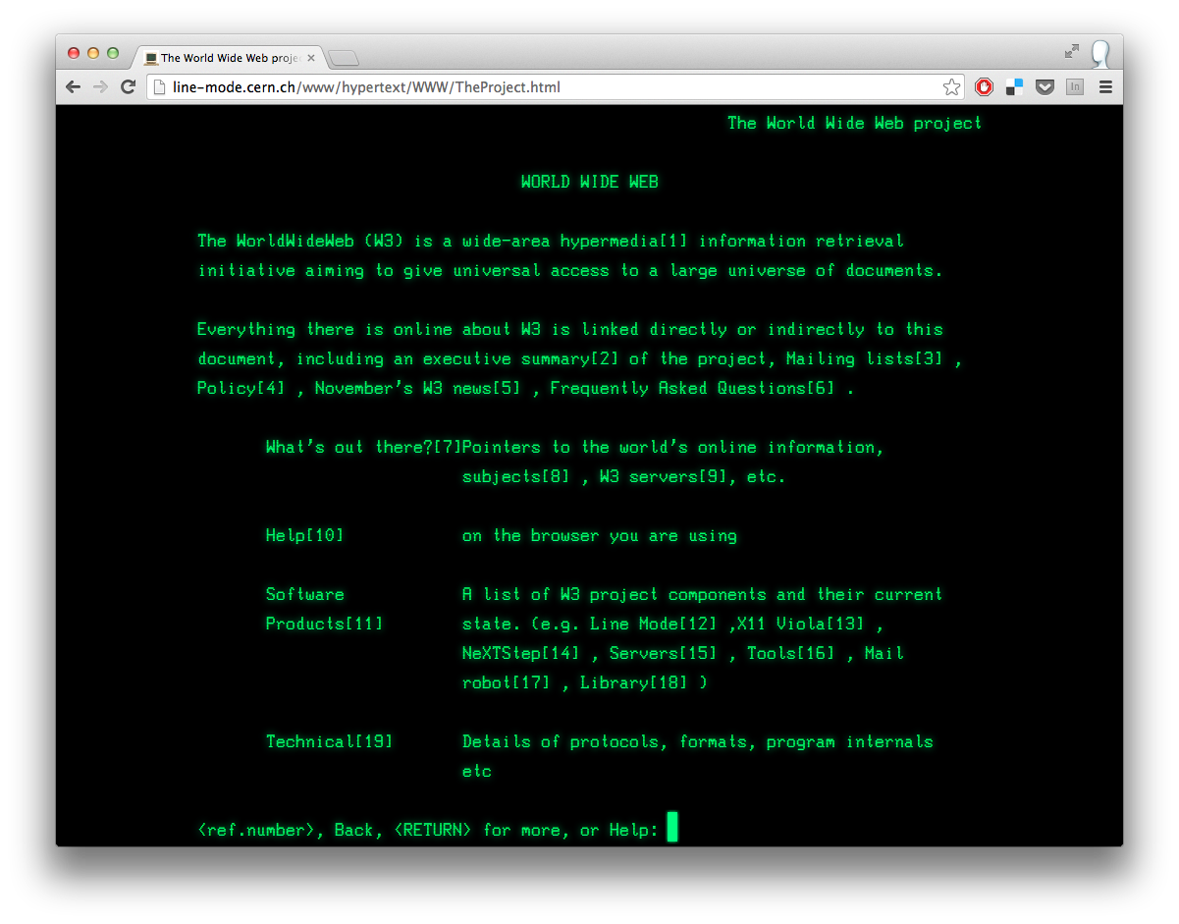

Slide 8
we call them
“web pages”

Slide 9
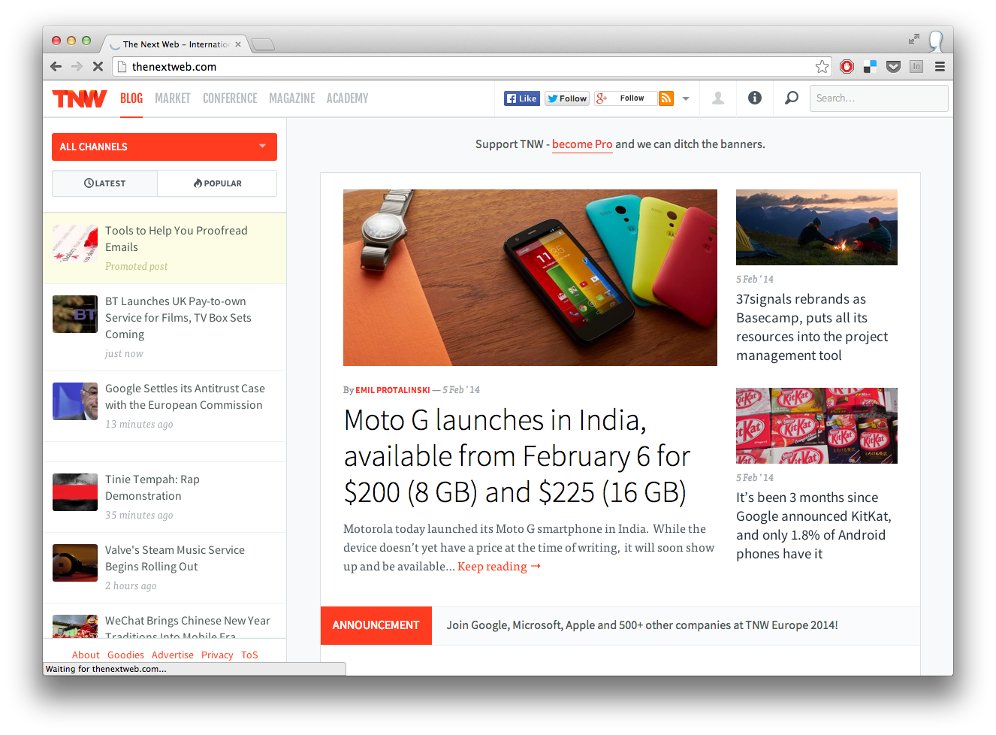

Slide 10
we actually mean
“web corkboards”

Slide 11
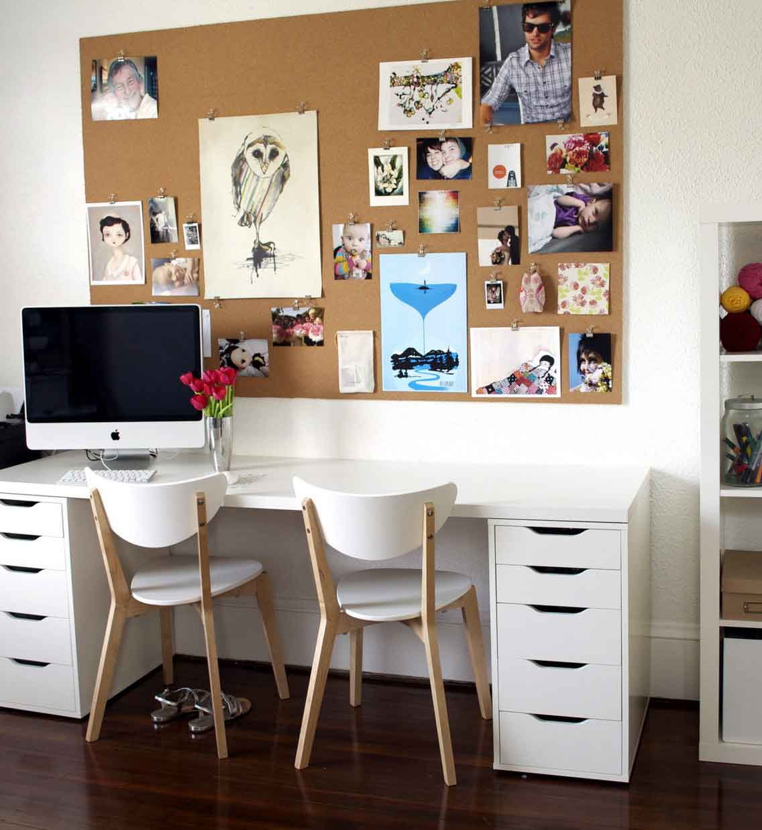

Slide 12
<table>
semantics WTF
a pain to maintain
“spacer.gif” anyone?

Slide 13
position: absolute;
..come on!

Slide 14
float: left;
“good enough” solution
what about:
“top”, “bottom” or “center”
practical grids
vertical alignment
portability

Slide 15
CSS Flexbox
position, flex, order

Slide 16
Prefixes
best thing ever *
* if working in a perfect, sterile, purely rational world

Slide 17
Prefixes
worst thing ever

Slide 18
Flexbox evolution
2009
display: box
2011
display: flexbox
today
display: flex

Slide 19
“44 years ago we put a man on the Moon, but we still can’t vertically
center things in CSS”
Anonymous
circa August 2013

Slide 20
display: flex
flex-container
flex-item
flex-item
regular element

Slide 21
flex-direction
how to arrange flex-items
row
default
row-reverse
column
column-reverse

Slide 22
flex-direction: row;
main-axis
cross-axis

Slide 23
flex-direction: column;
cross-axis
main-axis

Slide 24
justify-content
how to align along the main axis
flex-start
center
flex-end
space-between

Slide 25
align-items
how to align flex-items along the cross-axis
flex-start
flex-end

Slide 26
align-items
how to align flex-items along the cross-axis
center
stretch

Slide 27
Mind the axes
otherwise it gets confusing

Slide 28
justify-content: flex-start;
align-items: center;
flex-direction: row;
flex-direction: column;

Slide 29
justify-content: flex-start;
align-items: center;
flex-direction: row;
flex-direction: column;
main-axis
cross-axis
cross-axis
main-axis

Slide 30
order: <integer>;
shift visual order of flex-items.
DOM order stays the same.
order: -1

Slide 31
Flex
creating fluid layout

Slide 32
flex: 1 0 100px;
how much can a flex-item grow and shrink along the main-axis, and its initial size.
shorthand notation means:
flex: flex-grow flex-shrink flex-basis;

Slide 33
flex-grow
- by what proportion can a flex-item grow
flex-shrink
- by what proportion can a flex-item shrink
flex-basis
- initial size of flex-item, before grow or shrink

Slide 34
w
w
w
300px available space
flex-grow: 1;
w + 300/3
w + 300/3
w + 300/3
each flex-item gets an even share
of the available space

Slide 35
w
w
w
300px available space
flex-grow: 2;
flex-grow: 1
flex-grow: 1;
w + 300/4 * 2
w + 300/4
w + 300/4
first flex-item gets twice as much space as others

Slide 36
flex: 1 0 100px;
grow by one proportion of the shared available space (flex-grow: 1)
do not shrink (flex-shrink: 0)
get an initial size of a hundred pixels (flex-basis: 100px), which means min-width here, because it must not shrink

Slide 37
Careful!
flex: 1 0 100px;
when flex basis is other than zero (0),
flex-grow does not distribute
all unused space as you might expect.
The flex-basis is subtracted
before space is distributed.

Slide 38







Browser support
latest syntax
2011
2009

Slide 39
cross-browser support
.container {
display: -webkit-box;
display: -ms-flexbox;
display: -webkit-flex;
display: flex;
-webkit-box-direction: normal;
-webkit-box-orient: horizontal;
-ms-flex-direction: row;
-webkit-flex-direction: row;
flex-direction: row;
}
2009
Android
Safari 3 - 6
2011
IE 10
latest syntax
Chrome
Chrome Android
Firefox
Safari 7, iOS 7
Opera
credit: Zoe Gillenwater (zomigi.com)

Slide 40


Slide 41
<html class=“flexbox flexbox-legacy no-regions …”>
<script src=“modernizr.js”></script>
<style>
.container { … }
.flexbox .container {
display: -webkit-flex;
display: flex;
}
</style>

Slide 42
CSS Regions
flow content between boxes

Slide 43
CSS Regions
A

Slide 44
Google removed CSS Regions

Slide 45

Apple keeps CSS Regions

Slide 46
chrome://flags
CSS Regions are disabled by default in Chrome.

Slide 47
How to enable CSS Regions
go to chrome://flags
find “Experimental Web Platform features” and click enable
restart Chrome

Slide 48
-webkit-
CSS Regions are prefixed

Slide 49
2-step process
flow-into: myFlow;
collects content into a named flow
flow-from: myFlow;
renders content from a named flow

Slide 50
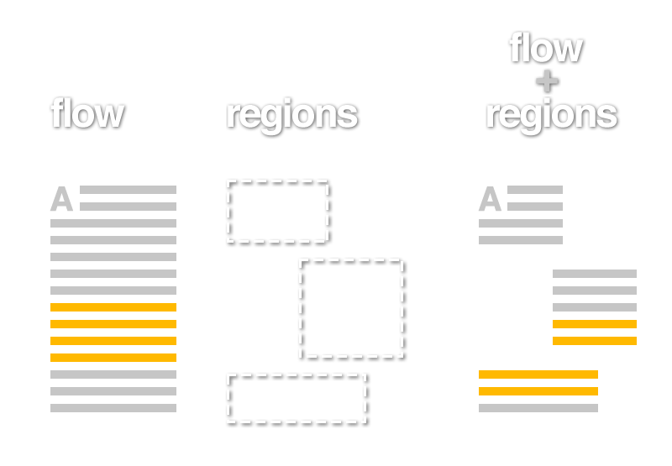

Slide 51
regions
are only visual containers,
they don’t reorder the DOM.

Slide 52
good
event handlers on content still work
original styles for content still apply
meh
tricky to add event handlers to a region
limited styling of content in a specific region

Slide 53
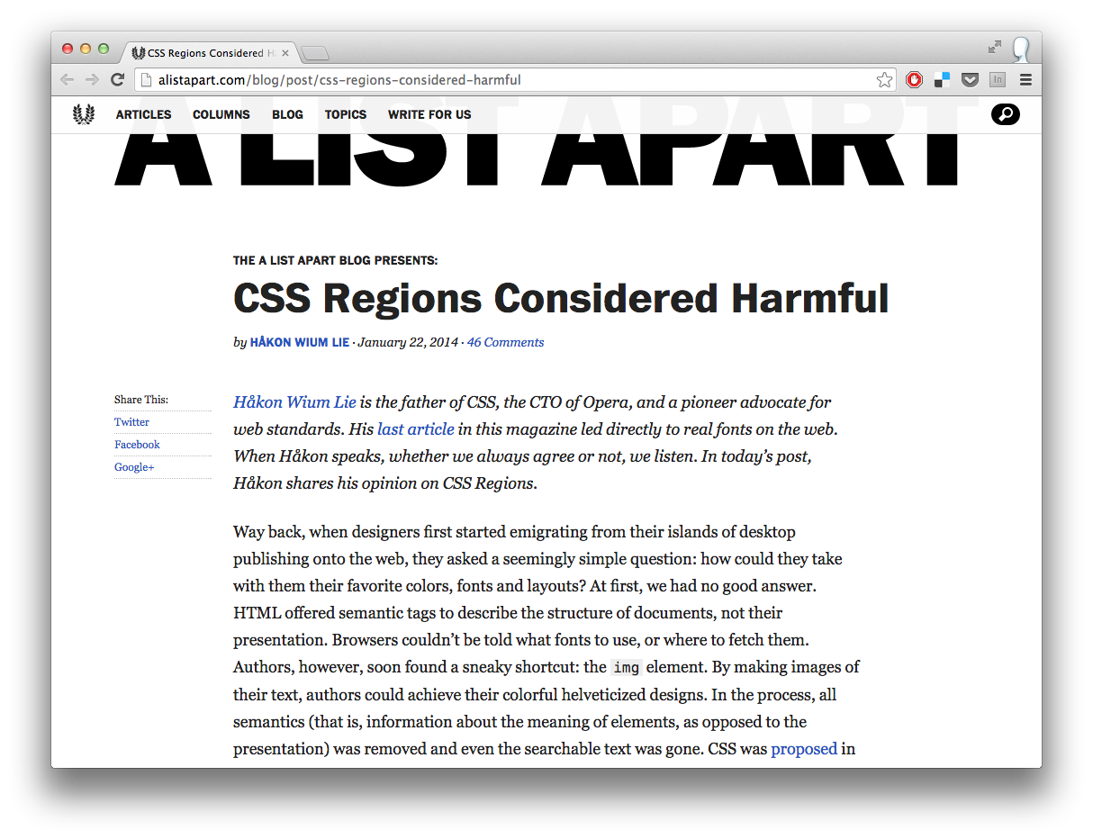

Slide 54
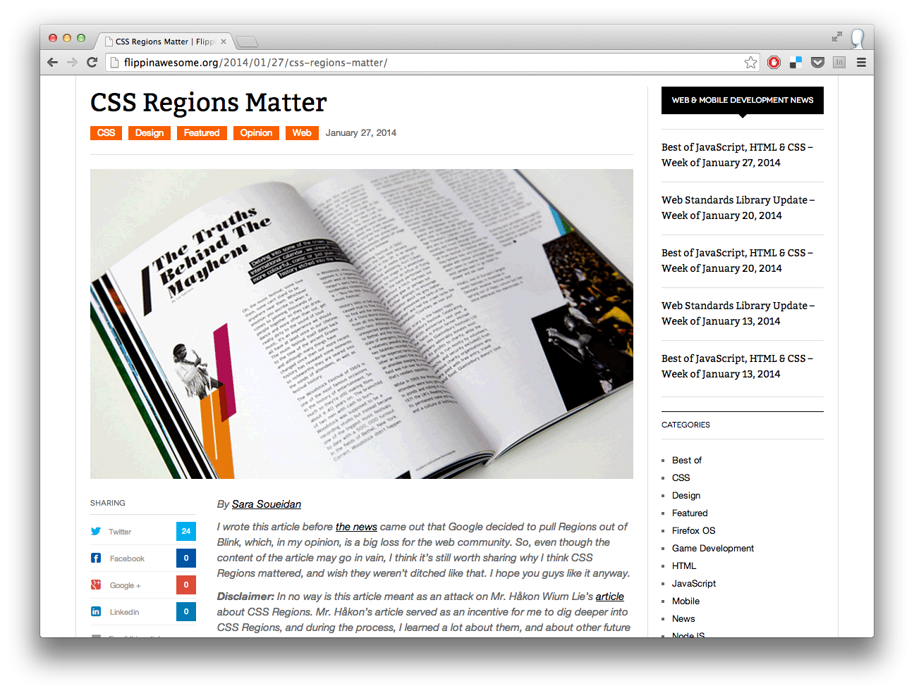

Slide 55
Myth
Regions require empty placeholder <div>s
any block-level item can become a region
::before, ::after
upcoming block-generating specs like CSS Grids, overflow: fragment

Slide 56
Myth
Regions are not responsive
regions work with every layout model
regions can auto-size to their content
not a replacement for CSS Multi-column

Slide 57
Myth
Regions are a bad layout model
regions are not a layout model, such as Flexbox or Multi-col
regions are a fragmentation model
building blocks

Slide 58
CSS Regions Object Model
JavaScript API for flows and regions
document.getNamedFlows()[‘myFlow’]
myFlow.getRegions()
myFlow.getContent()
myFlow.overset

Slide 59
Responsive Menu with CSS Regions
http://cdpn.io/tdHEg

Slide 60
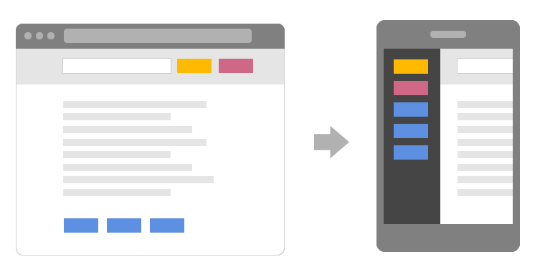
Adaptive UI with CSS Regions

Slide 61
Browser support
enabled by default
behind chrome://flags
older implementation
IE 10

Slide 62
Polyfill
github.com/FremyCompany/css-regions-polyfill
9+
post-Presto

Slide 63
CSS Shapes
wrap content inside and around custom shapes

Slide 64
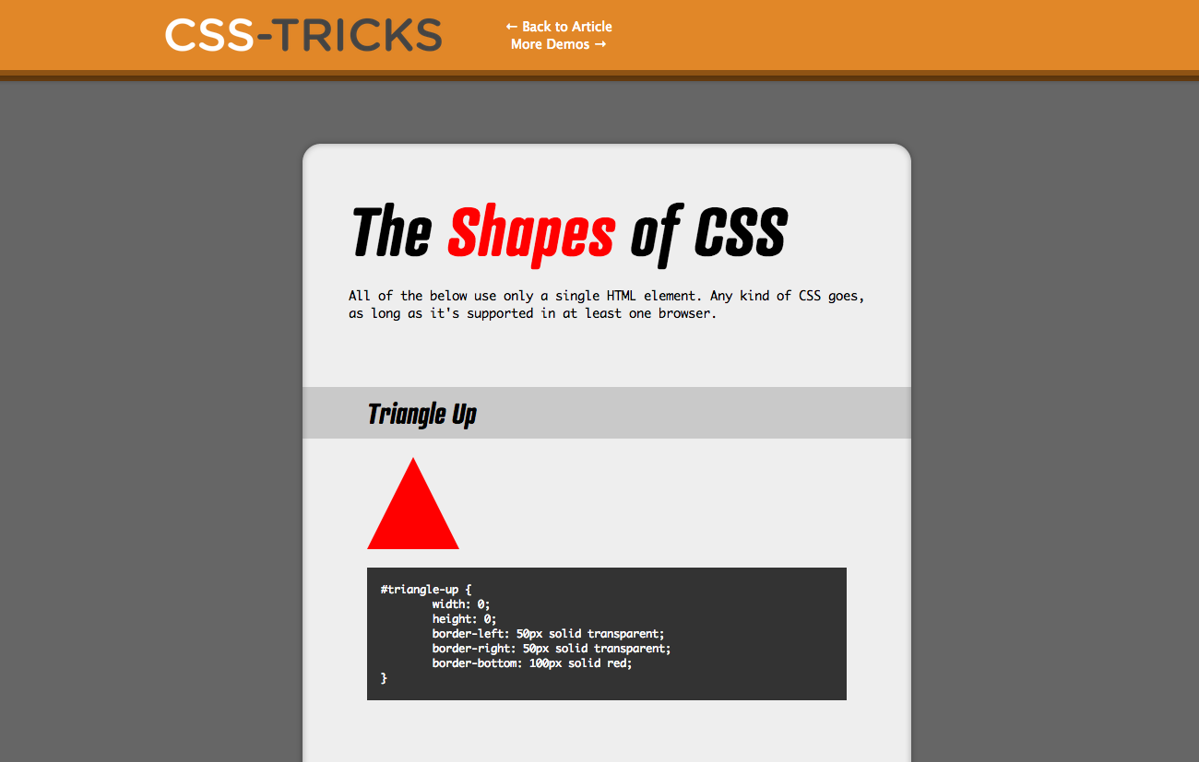

Slide 65

shape-inside
wrap content inside of a custom shape

Slide 66
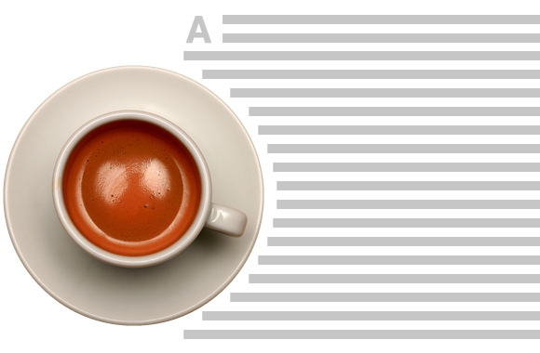
shape-outside
wrap content around a custom shape

Slide 67
How to enable CSS Shapes
go to chrome://flags
find “Experimental Web Platform features” and click enable
restart Chrome

Slide 68
Browser support
behind chrome://flags

Slide 69
Resources for CSS Shapes
Creating Non-Rectangular Layouts with CSS Shapes
CSS Shapes on html.adobe.com
Alice in Wonderland demo with CSS Shapes

Slide 70
CSS Flexbox
position, align, flex and order elements
CSS Regions
control flow of content
@razvancaliman
CSS Shapes
wrap content inside/around shapes

Slide 71
Experiment!
@razvancaliman

