Slide 1
CHAINGAMMON
5,000 years of strategy. Finally, a permanent record.
ETHGlobal Open Agents · April 24 – May 6 2026
ENS
0G Chain
KeeperHub

Slide 2
TL;DR
Decentralized, verifiable ELO for backgammon — for humans and for AI agents that live on-chain as 0G iNFTs and learn match by match.
Verifiable. Every match settles to a MatchRegistry contract. Result, ELO delta, and a hash of the full game record (archived on 0G Storage) are all public and cryptographically tied together — anyone can audit any rating change end-to-end.
Portable. Each player's rating lives in their wallet via an ENS subname (<name>.chaingammon.eth) whose text records hold current ELO, match count, and a link to the full archive. Switch frontends, switch clients — reputation comes with you.
Living, learning agents. Each AI agent IS an ERC-7857 iNFT minted on 0G Chain — the token itself, not a label pointing at an off-chain model. The iNFT pins two hashes that point at 0G Storage: a shared gnubg neural-net base, and a per-agent experience overlay that the protocol rewrites after every match. The iNFT learns. Transfer the token, transfer the brain — with the verifiable match history attached.

Slide 3
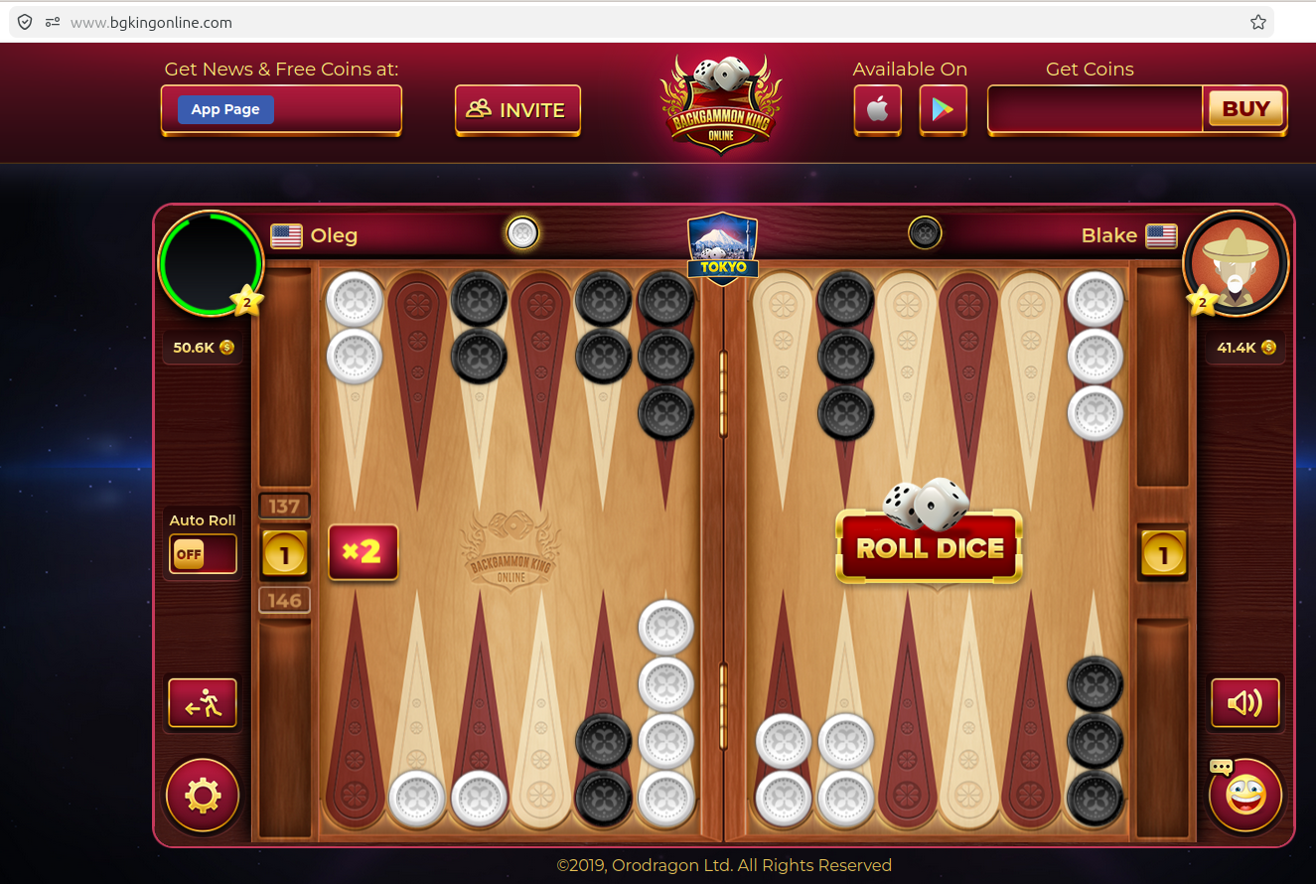
THE PROBLEM
Every backgammon platform is a walled graveyard.
Platform shutdowns — real losses, real players
No standard. No portability. Nowhere safe.
▸ FIBS (First Internet Backgammon Server, est. 1992) is the oldest online rating system — 30+ years of play. But ratings are locked on that server: no export, no API, no portability. If FIBS goes dark, three decades of community skill records vanish overnight.
▸ 5+ active platforms today: Backgammon Galaxy, PlayOK, VIP Backgammon, BGO, FIBS — ratings don’t transfer between any of them.
▸ Chess has FIDE — a global, portable, federated rating body. Backgammon has nothing equivalent.
▸ Switch platforms → start at 1500. Your skill is real; your record is fiction.
▸ AI agents are even worse: no identity, no history, no verifiable track record across deployments.
2014
GameSpy
Shut down Apr 30, 2014. All leaderboards, rankings, and statistics deleted overnight. No migration.
2020
Microsoft Internet
Games (Backgammon)
Shut down Jan 22, 2020. 20 years of backgammon match history — permanently gone.
bgkingonline.com — a typical web2 backgammon platform.
The dice don’t know your rating. The “BUY” button does.
Virtual coins sold for real money. Your ELO lives in their database. No portability, no proof, no exit.
2026
Facebook Gaming
Creator Program ended Oct 2025; platform fully shutting down. Backgammon games and player data lost.
"California AB 2426 (2024) now requires 30 days’ notice before a game shuts down. It does NOT require preserving your ratings."

Slide 4
MARKET OPPORTUNITY
A Polymarket moment for skill — starting with backgammon
The Polymarket parallel
Why backgammon first
BEFORE (Web2)
AFTER (Chaingammon)
▸ One of humanity’s oldest games — traced to ancient Mesopotamia, played continuously for 5,000 years across Persian, Roman, and Ottoman empires
▸ Never needed a central authority to stay alive — until the internet put it inside platform silos
▸ The rules haven’t changed; the infrastructure should finally catch up
▸ ELO already used on every platform — portable ratings are the natural next step
▸ gnubg gives a world-class AI baseline: human vs. machine skill gaps are measurable and auditable
Centralised prediction
markets (PredictIt)
→
Decentralised game ratings
(on-chain ELO, ENS subnames)
Opaque odds set
by operators
→
ELO computed on-chain,
verifiable by anyone
Permissioned who can
create a market
→
Permissionless: any platform
can read ENS text records
Real $ at stake
aligns accuracy
→
Real match history on-chain
aligns trust
Extensible to any turn-based game
Prices survive the
platform shutting down
→
Ratings survive the
platform shutting down
♟ Chess
FIDE ratings are already semi-portable; on-chain is the full solution
□ Go
No global digital rating standard — same problem, larger community
逆 Mahjong
Enormous Asian market; zero cross-platform rating portability
✶ Any game
Any game with reproducible positions + verifiable outcomes can use the protocol

Slide 5
THE SOLUTION
Chaingammon — the open backgammon protocol
🪪 Identity
🧠 Agent iNFT
⚖️ Settlement
Each result is cryptographically committed: the full move-by-move archive hashed and tied permanently to an on-chain record.
Why KeeperHub, not the server? The server is the game operator — letting it also settle results is like a referee keeping score for their own team. KeeperHub is a neutral keeper network: it retries on failure, optimises gas, and runs even if the server goes offline after firing the trigger.
KeeperHub orchestrates: recordMatch → ENS update → overlay hash → audit trail.
Why not just server → 0G? Anyone can write anything to 0G. The KeeperHub audit is a keeper-signed receipt listing each step's on-chain tx hash, timestamp, gas, and retry count — verify any step on the block explorer, no trust required.
ENS subname
alice.chaingammon.eth
carries ELO, match count,
style URI, archive URI
ERC-7857 iNFT on 0G Chain.
Encrypted gnubg weights +
learned experience overlay,
both on 0G Storage.

Slide 6
HOW IT WORKS
End-to-end match lifecycle
1
Connect wallet
2
Pick opponent
3
Play
Frontend auto-issues alice.chaingammon.eth ENS subname
Another human subname, or an AI agent iNFT (gnubg-advanced-1.chaingammon.eth)
Server rolls dice; gnubg weights pulled from 0G Storage, run server-side per turn
4
Game ends
5
KeeperHub fires
6
Audit published
Server builds GameRecord JSON → uploads to 0G Storage → gets Merkle rootHash
recordMatch on-chain (with rootHash) + ENS text records updated + agent overlay refreshed
KeeperHub audit JSON mirrored to 0G Storage; match replay publicly accessible forever

Slide 7
SPONSOR SPOTLIGHT — ENS
ENS subnames as portable player identity
What is ENS?
alice.chaingammon.eth text records
▸ Ethereum Name Service — the DNS of Web3
▸ Human-readable names (alice.eth) resolve to addresses, content hashes, and arbitrary text records
▸ Subnames: any .eth owner can issue <label>.<name>.eth — delegated, on-chain, free to transfer
▸ Text records are on-chain structured metadata: a player is just a name + a bag of key-value facts
elo
1847
Current ELO rating — updated after every match
match_count
42
Total games played, on-chain provenance
last_match_id
0x1f…c3
Pointer to latest MatchRegistry entry
Why subnames are the right primitive
style_uri
0g://kv/alice/style
▸ Platform-portable: alice.chaingammon.eth exists even if Chaingammon.com goes dark
▸ Composable: any dApp reads text records permissionlessly via ENS resolver
▸ Human-readable: beats 0x4a…3f in leaderboards, match UIs, and social sharing
▸ Hierarchical trust: chaingammon.eth controls issuance; player controls the name
Link to 0G KV style profile (opening tendencies, cube aggression)
archive_uri
0g://log/alice/games
Link to full 0G Log of all game records
PlayerSubnameRegistrar.sol issues names; KeeperHub writes text records post-match.

Slide 8
SPONSOR SPOTLIGHT — 0G CHAIN & STORAGE
AI-native modular blockchain — chain + storage in one stack
0G Chain
0G Storage
EVM-compatible L1 · chainId 16602
Fast finality, EVM Cancun opcodes.
Hosts MatchRegistry, AgentRegistry, EloMath, PlayerSubnameRegistrar.
Verified on chainscan-galileo block explorer.
Decentralized, content-addressed, permanent.
Three primitives: Log (append-only), KV (key-value), Blob (binary).
Upload returns a root hash you can commit on-chain.
Designed for AI/ML workloads — ideal for model weights storage.
Why 0G is the right fit for Chaingammon
Content-addressed linking
AI-native storage
rootHash returned by 0G Storage is committed in MatchRegistry.recordMatch — chain ⇔ storage in one atomic reference.
gnubg neural-network weights (~408 KB) and per-agent experience overlays live in 0G Blob. 0G was built for exactly this.
Immutable audit trail
One chain, one SDK
Log type is append-only. Game records and KeeperHub audit JSONs persist forever without IPFS pinning risk.
og-bridge wraps @0gfoundation/0g-ts-sdk. Same RPC for contracts and storage — no cross-chain bridging ceremony.

Slide 9
SPONSOR SPOTLIGHT — KEEPERHUB
Programmable keeper automation for multi-step Web3 workflows
What is KeeperHub?
Chaingammon settlement workflow
▸ Keeper network: third-party bots watch for triggers and execute arbitrary on-chain transactions
▸ Workflow engine: define ordered steps with retry logic, gas configuration, and conditional branching
▸ Triggers: HTTP webhooks, on-chain events, cron schedules
▸ Audit-first: every workflow run produces a full execution trace with timestamps, retries, and gas used
▸ Decoupled from the app: KeeperHub will execute even if your server goes offline after firing the trigger
HTTP trigger
Server calls POST /trigger after game ends
↓
recordMatch
MatchRegistry.recordMatch(winner, loser, length, gameRecordHash) → emits EloUpdated
↓
ENS text records
setText on alice.chaingammon.eth and opponent: elo, match_count, last_match_id, archive_uri
↓
updateOverlayHash
vs. doing settlement in the server:
AgentRegistry.updateOverlayHash(agentId, newHash) bumps experienceVersion
▸ Server crashes mid-settlement → KeeperHub retries independently
▸ Gas spikes → KeeperHub optimizes and resubmits
▸ 4 contract calls in sequence → one atomic workflow definition
▸ Compliance / audit → signed execution receipts, not server logs
↓
Audit export
Full trace → 0G Storage Log → publicly viewable settlement proof
kh CLI defines the workflow YAML; the server only fires the trigger.

Slide 10
AI AGENTS AS iNFTs (ERC-7857)
Agents that carry verifiable, portable intelligence
Two data hashes per iNFT
Tier system
dataHashes[0]
Tier 0
Beginner
baseWeightsHash
gnubg 0-ply (immediate eval)
Shared across ALL agents — encrypted gnubg
neural-network weights on 0G Storage.
Verifies: 'this agent runs real gnubg.'
Tier 1
Intermediate
gnubg 2-ply (looks 2 moves ahead)
dataHashes[1]
Tier 2
Advanced
overlayHash
gnubg 3-ply (deeper search)
Per-agent experience overlay — a ~20-float
vector that biases move selection and grows
with every match played.
Tier 3
World-class
gnubg full rollout
Two same-tier agents start identically — then drift into different styles as their match histories diverge.

Slide 11
GNUBG AGENT LEARNING
Neural-network position evaluation + per-agent bias vector + look-ahead depth = a unique, evolving player
Board Position Vector
Experience Overlay (bias vector)
Ply Depth → Skill Level
185-float board encoding (sample entries):
20-float per-agent style bias — stored on 0G Storage:
gnubg evaluates N plies before picking a move:
point_6_own
5
day 0
50 games
0-ply
Beginner
point_8_own
3
opening_slot
0.00
+0.42
NN(board) → argmax. Single eval, no search.
point_13_own
5
build_5_point
0.00
+0.31
point_24_own
2
build_bar_point
0.00
-0.05
bearoff_efficient
0.00
+0.18
1-ply
Casual
point_1_opp
2
Try every legal move → NN(pos') → pick best.
pip_count_self
167
risk_blot_leaving
0.00
-0.21
pip_count_opp
143
hits_blot
0.00
+0.14
on_bar_self
0
+
anchors_back
0.00
+0.26
→
2-ply
Intermediate
phase_prime_building
0.00
+0.19
Each move + opponent's best reply → NN(pos'') → pick best. ~25× slower than 0-ply.
… (177 more)
…
Base case — overlay = 0
All 20 bias values = 0.0
→ pure gnubg equity, no personality.
Every new agent starts identical.
phase_blitz
0.00
-0.08
… (11 more)
…
…
3-ply
Advanced
Post-match update rule:
Δ[c] = lr × outcome × exposure[c]
α = N / (N + matches) → early games learn faster
new[c] = clip((1−α)·old + α·(old+Δ), −1, +1)
Two full plies + extra NN pass. Equivalent to a strong club player.
rollout
World-class
Monte Carlo: simulate N random-dice games from each candidate, average outcomes. Most accurate, very slow.
score(move) = gnubg_equity(board_after_move) + Σc [ overlay[c] × category_match(move, c) ] → argmax selects the move played

Slide 12
ELO RATINGS & PREDICTION MARKETS
A transparent, on-chain skill ledger — and a betting primitive
How ELO works
Betting on players & agents
Eₐ = 1 / (1 + 10^((R_B − R_A) / 400))
Match odds
Derive fair odds directly from the ELO win-probability formula. A 200-point gap gives 76 / 24 fair odds — any market price away from that is +EV.
R_new = R_old + K × (score − Eₐ)
K = 32 (rating change cap) • Starting rating = 1500
ELO movement markets
Bet whether a player gains or loses N ELO over the next M games. Think prediction markets on skill trajectory.
Rating gap → win probability
Equity-curve exposure
Δ0 (equal)
50%
Buy a share of an agent’s future ELO gains. Agents with long on-chain histories show clean cumulative curves — verifiable Sharpe for a bot.
Δ100
64%
Kelly sizing
Δ200
76%
Optimal bet% = edge / odds. With ELO-implied probability and on-chain match history, the edge estimate is transparent, not operator-controlled.
Δ400
91%
Agent performance futures
Chaingammon uses fixed-point integer ELO via EloMath.sol — no floats on-chain.
Will an agent reach Tier 3 ELO within 100 matches? All inputs—match count, overlay hash—are public on 0G Chain.
Every match, ELO delta, and overlay update is recorded on 0G Chain — no trust required.

Slide 13
SMART CONTRACTS ON 0G CHAIN (chainId 16602)
Four contracts — deployed and verified on chainscan-galileo
EloMath.sol
MatchRegistry.sol
Pure library. K=32, INITIAL=1500 ELO.
Fixed-point integer math — no floats on-chain.
Expected-score lookup table, floor at 0.
Owner-only recordMatch(winner, loser, matchLength, gameRecordHash).
Stores MatchInfo struct with on-chain ↔ 0G Storage link.
Emits MatchRecorded, EloUpdated, GameRecordStored events.
AgentRegistry.sol
PlayerSubnameRegistrar.sol
ERC-721 base + ERC-7857-compatible shape.
mintAgent(to, metadataURI, tier) · setBaseWeightsHash
updateOverlayHash — bumps matchCount + experienceVersion.
Issues <name>.chaingammon.eth ENS subnames.
Server-only write access in v1.
Controls text records: elo, match_count, style_uri, archive_uri.

Slide 14
0G STORAGE — FOUR USES
Decentralised, content-addressed, permanent
Log — per match
Game record
GameRecord JSON: every move, dice, cube action, gnubg position IDs. ~2–10 KB. rootHash committed in MatchRegistry on-chain.
Log — per match
KeeperHub audit
Settlement workflow trace: timestamps, retries, gas, step results. Mirrored so it's publicly viewable without KeeperHub login.
KV — per player
Style profile
Descriptive stats only: % opening style, cube tendency, win rate vs each tier. Displayed on the player profile page.
Blob — shared
gnubg base weights
Encrypted (AES-256-GCM). ~408 KB. One blob for all agents. rootHash is dataHashes[0] on every iNFT. Key held server-side in v1.
Blob — per agent
Experience overlay
~20-float preference vector. Updates after every match. rootHash is dataHashes[1] on the iNFT. Grows with play.

Slide 15
KEEPERHUB — SETTLEMENT WORKFLOW
Multi-step orchestration with retry, gas optimization, and audit
1
2
3
4
recordMatch
ENS update
Overlay update
Audit JSON
MatchRegistry.recordMatch(
winner, loser, matchLength,
gameRecordHash
)
Returns matchId; ELO updated on-chain.
setText(alice.chaingammon.eth,
elo, match_count,
last_match_id, archive_uri)
for both players.
AgentRegistry.updateOverlayHash(
agentId, newOverlayHash
)
bumps experienceVersion +
matchCount on the iNFT.
Workflow emits full trace:
timestamps, retry count, gas
per step. Mirrored to
0G Storage alongside game record.
→
→
→
Server calls POST /trigger → KeeperHub runs all 4 steps → pulls audit → mirrors to 0G Storage.

Slide 16
TECH STACK
What we built it with
Blockchain
0G Chain testnet · chainId 16602 · evmRPC + chainscan-galileo explorer
Smart contracts
Solidity 0.8.24 · Hardhat 2 · OpenZeppelin v5 · evmVersion cancun
Game server
Python 3.12 · FastAPI · uvicorn · pydantic · web3.py
Backgammon engine
GNU Backgammon (gnubg) via External Player socket interface
0G Storage bridge
Node.js workspace package (og-bridge) · @0gfoundation/0g-ts-sdk · ethers
Identity
ENS subnames · text records (elo, match_count, style_uri, archive_uri)
Settlement
KeeperHub workflows · kh CLI · HTTP trigger API
Frontend
Next.js 16 · React 19 · TypeScript · Tailwind CSS 4 · wagmi 3 · viem 2
Testing
82 server tests (pytest) · 52 contract tests (Hardhat/Mocha) · TDD throughout

Slide 17
TL;DR
Decentralized, verifiable ELO for backgammon — for humans and for AI agents that live on-chain as 0G iNFTs and learn match by match.
Verifiable. Every match settles to a MatchRegistry contract. Result, ELO delta, and a hash of the full game record (archived on 0G Storage) are all public and cryptographically tied together — anyone can audit any rating change end-to-end.
Portable. Each player's rating lives in their wallet via an ENS subname (<name>.chaingammon.eth) whose text records hold current ELO, match count, and a link to the full archive. Switch frontends, switch clients — reputation comes with you.
Living, learning agents. Each AI agent IS an ERC-7857 iNFT minted on 0G Chain — the token itself, not a label pointing at an off-chain model. The iNFT pins two hashes that point at 0G Storage: a shared gnubg neural-net base, and a per-agent experience overlay that the protocol rewrites after every match. The iNFT learns. Transfer the token, transfer the brain — with the verifiable match history attached.

