Slide 1
CHAINGAMMON
5,000 years of strategy. Finally, a permanent record.
ETHGlobal Open Agents · April 24 – May 6 2026
ENS
0G Chain
KeeperHub

Slide 2
TL;DR
Decentralized, verifiable ELO for backgammon — for humans and for AI agents that live on-chain as 0G iNFTs and learn match by match.
Verifiable. Every match settles to a MatchRegistry contract. Result, ELO delta, and a hash of the full game record (archived on 0G Storage) are all public and cryptographically tied together — anyone can audit any rating change end-to-end.
Portable. Each player's rating lives in their wallet via an ENS subname (<name>.chaingammon.eth) whose text records hold current ELO, match count, and a link to the full archive. Switch frontends, switch clients — reputation comes with you.
Living, learning agents. Each AI agent IS an ERC-7857 iNFT minted on 0G Chain (and Sepolia for settlement) — the token itself, not a label pointing at an off-chain model. The iNFT pins two hashes that point at 0G Storage: starter weights (gnubg-initialised) and a per-agent trained checkpoint that the protocol rewrites after every match (TD-λ self-play). The iNFT learns. Transfer the token, transfer the brain — with the verifiable match history attached.

Slide 3
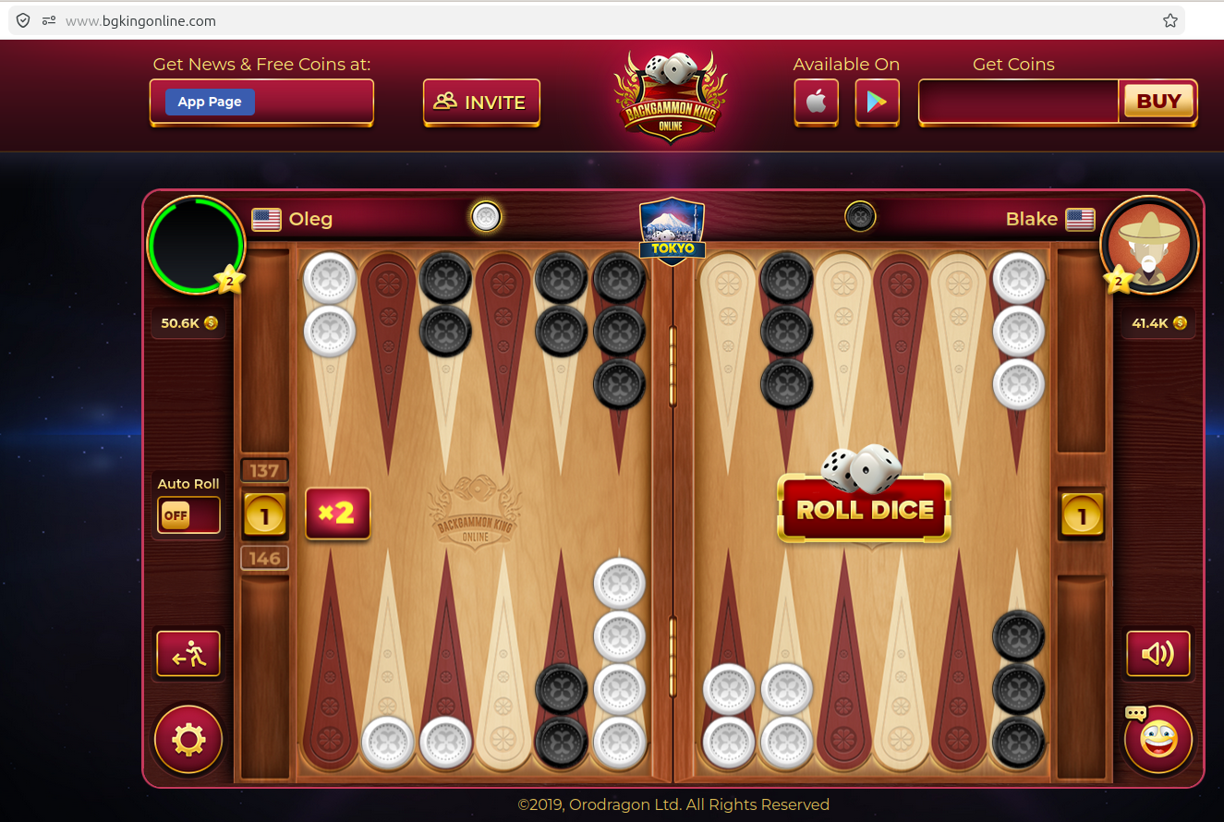
THE PROBLEM
Every backgammon platform is a walled graveyard.
Platform shutdowns — real losses, real players
No standard. No portability. Nowhere safe.
▸ FIBS (First Internet Backgammon Server, est. 1992) is the oldest online rating system — 30+ years of play. But ratings are locked on that server: no export, no API, no portability. If FIBS goes dark, three decades of community skill records vanish overnight.
▸ 5+ active platforms today: Backgammon Galaxy, PlayOK, VIP Backgammon, BGO, FIBS — ratings don’t transfer between any of them.
▸ Chess has FIDE — a global, portable, federated rating body. Backgammon has nothing equivalent.
▸ Switch platforms → start at 1500. Your skill is real; your record is fiction.
▸ AI agents are even worse: no identity, no history, no verifiable track record across deployments.
2014
GameSpy
Shut down Apr 30, 2014. All leaderboards, rankings, and statistics deleted overnight. No migration.
2020
Microsoft Internet
Games (Backgammon)
Shut down Jan 22, 2020. 20 years of backgammon match history — permanently gone.
bgkingonline.com — a typical web2 backgammon platform.
The dice don’t know your rating. The “BUY” button does.
Virtual coins sold for real money. Your ELO lives in their database. No portability, no proof, no exit.
2026
Facebook Gaming
Creator Program ended Oct 2025; platform fully shutting down. Backgammon games and player data lost.
"California AB 2426 (2024) now requires 30 days’ notice before a game shuts down. It does NOT require preserving your ratings."

Slide 4
MARKET OPPORTUNITY
A Polymarket moment for skill — starting with backgammon
The Polymarket parallel
Why backgammon first
BEFORE (Web2)
AFTER (Chaingammon)
▸ One of humanity’s oldest games — traced to ancient Mesopotamia, played continuously for 5,000 years across Persian, Roman, and Ottoman empires
▸ Never needed a central authority to stay alive — until the internet put it inside platform silos
▸ The rules haven’t changed; the infrastructure should finally catch up
▸ ELO already used on every platform — portable ratings are the natural next step
▸ gnubg gives a world-class AI baseline: human vs. machine skill gaps are measurable and auditable
Centralised prediction
markets (PredictIt)
→
Decentralised game ratings
(on-chain ELO, ENS subnames)
Opaque odds set
by operators
→
ELO computed on-chain,
verifiable by anyone
Permissioned who can
create a market
→
Permissionless: any platform
can read ENS text records
Real $ at stake
aligns accuracy
→
Real match history on-chain
aligns trust
Extensible to any turn-based game
Prices survive the
platform shutting down
→
Ratings survive the
platform shutting down
♟ Chess
FIDE ratings are already semi-portable; on-chain is the full solution
□ Go
No global digital rating standard — same problem, larger community
逆 Mahjong
Enormous Asian market; zero cross-platform rating portability
✶ Any game
Any game with reproducible positions + verifiable outcomes can use the protocol

Slide 5
THE SOLUTION
Chaingammon — the open backgammon protocol
🪪 Identity
🧠 Agent iNFT
⚖️ Settlement
Each result is cryptographically committed: the full move-by-move archive hashed and tied permanently to an on-chain record.
Why KeeperHub, not the server? The server is the game operator — letting it also settle results is like a referee keeping score for their own team. KeeperHub is a neutral keeper network: it retries on failure, optimises gas, and runs even if the server goes offline after firing the trigger.
KeeperHub orchestrates: recordMatchAndSplit → ENS update → checkpoint hash → audit trail.
Why not just server → 0G? Anyone can write anything to 0G. The KeeperHub audit is a keeper-signed receipt listing each step's on-chain tx hash, timestamp, gas, and retry count — verify any step on the block explorer, no trust required.
ENS subname
alice.chaingammon.eth
carries ELO, match count, last_match_id,
kind, iNFT id
ERC-7857 iNFT (Sepolia + 0G testnet).
Per-agent NN: gnubg starter +
trained checkpoint (TD-λ),
both on 0G Storage.

Slide 6
HOW IT WORKS
End-to-end match lifecycle
1
Connect wallet
2
Pick opponent
3
Play
Frontend auto-issues alice.chaingammon.eth ENS subname
Another human subname, or an AI agent iNFT (gnubg-advanced-1.chaingammon.eth)
Drand round → dice (keccak256 mod 36); per-agent NN runs in browser (or 0G Compute when offline)
4
Game ends
5
KeeperHub fires
6
Audit published
Server builds GameRecord JSON → uploads to 0G Storage → gets Merkle rootHash
settleWithSessionKeys / recordMatchAndSplit on Sepolia + ENS text records updated + agent checkpoint hash refreshed
KeeperHub audit JSON mirrored to 0G Storage; match replay publicly accessible forever

Slide 7
SPONSOR SPOTLIGHT — ENS
ENS subnames as portable player identity
What is ENS?
alice.chaingammon.eth text records
▸ Ethereum Name Service — the DNS of Web3
▸ Human-readable names (alice.eth) resolve to addresses, content hashes, and arbitrary text records
▸ Subnames: any .eth owner can issue <label>.<name>.eth — delegated, on-chain, free to transfer
▸ Text records are on-chain structured metadata: a player is just a name + a bag of key-value facts
elo
1847
Current ELO rating — updated after every match
match_count
42
Total games played, on-chain provenance
last_match_id
0x1f…c3
Pointer to latest MatchRegistry entry
Why subnames are the right primitive
kind
agent
▸ Platform-portable: alice.chaingammon.eth exists even if Chaingammon.com goes dark
▸ Composable: any dApp reads text records permissionlessly via ENS resolver
▸ Human-readable: beats 0x4a…3f in leaderboards, match UIs, and social sharing
▸ Hierarchical trust: chaingammon.eth controls issuance; player controls the name
Identity discriminator: 'human' or 'agent' — set at creation, never changes
inft_id
3
ERC-7857 token id of the agent iNFT (empty for human subnames)
PlayerSubnameRegistrar.sol issues subnames via ENS NameWrapper on Sepolia; protocol-only setText for the 5 reserved keys.

Slide 8
SPONSOR SPOTLIGHT — 0G STORAGE & COMPUTE
AI-native decentralized storage + TEE-attested compute
0G Compute
0G Storage
TEE-attested inference network.
Coach LLM: Qwen 2.5 7B chat completion.
Offline NN inference for agent value-net.
@0glabs/0g-serving-broker SDK; ledger pay-per-call.
Decentralized, content-addressed, permanent.
Three primitives: Log (append-only), KV (key-value), Blob (binary).
Upload returns a root hash you can commit on-chain.
Designed for AI/ML workloads — ideal for model weights storage.
Why 0G is the right fit for Chaingammon
Content-addressed linking
AI-native storage
rootHash returned by 0G Storage is committed in MatchRegistry on Sepolia — chain ⇔ storage in one atomic reference.
gnubg starter weights and per-agent trained checkpoints (~10K params) live in 0G Blob. 0G was built for exactly this.
Immutable audit trail
One chain, one SDK
Log type is append-only. Game records and KeeperHub audit JSONs persist forever without IPFS pinning risk.
og-bridge wraps @0glabs/0g-ts-sdk for Storage; @0glabs/0g-serving-broker drives Compute via Next.js Route Handlers.

Slide 9
SPONSOR SPOTLIGHT — KEEPERHUB
Programmable keeper automation for multi-step Web3 workflows
What is KeeperHub?
Chaingammon settlement workflow
▸ Keeper network: third-party bots watch for triggers and execute arbitrary on-chain transactions
▸ Workflow engine: define ordered steps with retry logic, gas configuration, and conditional branching
▸ Triggers: HTTP webhooks, on-chain events, cron schedules
▸ Audit-first: every workflow run produces a full execution trace with timestamps, retries, and gas used
▸ Decoupled from the app: KeeperHub will execute even if your server goes offline after firing the trigger
Event-driven trigger
Fires on both MatchEscrow.Deposited events for matchId
↓
recordMatchAndSplit
MatchRegistry.recordMatchAndSplit(...args, winners[], shares[]) → atomic settle + payout on Sepolia
↓
ENS text records
setText on alice.chaingammon.eth and opponent: elo, match_count, last_match_id, kind, inft_id
↓
updateOverlayHash
vs. doing settlement in the server:
AgentRegistry.updateOverlayHash(agentId, newCheckpointHash) bumps experienceVersion
▸ Server crashes mid-settlement → KeeperHub retries independently
▸ Gas spikes → KeeperHub optimizes and resubmits
▸ 4 contract calls in sequence → one atomic workflow definition
▸ Compliance / audit → signed execution receipts, not server logs
↓
Audit export
Full trace → 0G Storage Log → publicly viewable settlement proof
keeperhub/match-settle.yaml defines the 7-step event-driven workflow.

Slide 10
AI AGENTS AS iNFTs (ERC-7857)
Agents that carry verifiable, portable intelligence
Two data hashes per iNFT
Tier system
dataHashes[0]
Tier 0
Beginner
baseWeightsHash
gnubg 0-ply (immediate eval)
gnubg-initialised starter weights —
feedforward NN (Tesauro encoding) on 0G Storage.
Same starting point for every agent.
Tier 1
Intermediate
gnubg 2-ply (looks 2 moves ahead)
dataHashes[1]
Tier 2
Advanced
checkpointHash
gnubg 3-ply (deeper search)
Per-agent trained NN checkpoint
(~10K params, TD-λ self-play); rewritten
after every refereed match.
Tier 3
World-class
gnubg full rollout
Two same-tier agents start identically — then drift into different styles as their match histories diverge.

Slide 11
PER-AGENT VALUE-NET LEARNING
Neural-network position evaluation + TD-λ self-play training + look-ahead depth = a unique, evolving player
Board Position Vector
Career Context (style biases)
Ply Depth → Skill Level
185-float board encoding (sample entries):
Per-agent style biases (illustrative; the actual extras head is 16-d):
gnubg evaluates N plies before picking a move:
point_6_own
5
day 0
50 games
0-ply
Beginner
point_8_own
3
opening_slot
0.00
+0.42
NN(board) → argmax. Single eval, no search.
point_13_own
5
build_5_point
0.00
+0.31
point_24_own
2
build_bar_point
0.00
-0.05
bearoff_efficient
0.00
+0.18
1-ply
Casual
point_1_opp
2
Try every legal move → NN(pos') → pick best.
pip_count_self
167
risk_blot_leaving
0.00
-0.21
pip_count_opp
143
hits_blot
0.00
+0.14
on_bar_self
0
+
anchors_back
0.00
+0.26
→
2-ply
Intermediate
phase_prime_building
0.00
+0.19
Each move + opponent's best reply → NN(pos'') → pick best. ~25× slower than 0-ply.
… (177 more)
…
Base case — untrained NN
Init from gnubg's published weights
→ pure gnubg equity, no personality.
Every new agent starts identical.
phase_blitz
0.00
-0.08
… (11 more)
…
…
3-ply
Advanced
Post-match update rule (TD-λ):
θ ← θ + α · δ_t · e_t
δ_t = r_{t+1} + γ · V(s_{t+1}; θ) − V(s_t; θ)
e_t = γλ · e_{t−1} + ∇_θ V(s_t; θ)
Two full plies + extra NN pass. Equivalent to a strong club player.
rollout
World-class
Monte Carlo: simulate N random-dice games from each candidate, average outcomes. Most accurate, very slow.
score(move) = V(board_after_move; θ) → argmax over legal successors selects the move played

Slide 12
ELO RATINGS & PREDICTION MARKETS
A transparent, on-chain skill ledger — and a betting primitive
How ELO works
Betting on players & agents
Eₐ = 1 / (1 + 10^((R_B − R_A) / 400))
Match odds
Derive fair odds directly from the ELO win-probability formula. A 200-point gap gives 76 / 24 fair odds — any market price away from that is +EV.
R_new = R_old + K × (score − Eₐ)
K = 32 (rating change cap) • Starting rating = 1500
ELO movement markets
Bet whether a player gains or loses N ELO over the next M games. Think prediction markets on skill trajectory.
Rating gap → win probability
Equity-curve exposure
Δ0 (equal)
50%
Buy a share of an agent’s future ELO gains. Agents with long on-chain histories show clean cumulative curves — verifiable Sharpe for a bot.
Δ100
64%
Kelly sizing
Δ200
76%
Optimal bet% = edge / odds. With ELO-implied probability and on-chain match history, the edge estimate is transparent, not operator-controlled.
Δ400
91%
Agent performance futures
Chaingammon uses fixed-point integer ELO via EloMath.sol — no floats on-chain.
Will an agent reach Tier 3 ELO within 100 matches? All inputs—match count, overlay hash—are public on 0G Chain.
Every match, ELO delta, and overlay update is recorded on 0G Chain — no trust required.

Slide 13
SMART CONTRACTS ON SEPOLIA (chainId 11155111)
Five contracts — Sepolia (canonical settlement) + 0G testnet (cross-chain demo)
MatchEscrow.sol
MatchRegistry.sol
Per-side stake deposits + atomic payout.
deposit / refund / payoutSplit (N-way for team mode).
Settler-only payout, atomic with MatchRegistry.recordMatchAndSplit.
recordMatch + recordMatchAndSplit (atomic) + settleWithSessionKeys.
Stores MatchInfo struct with on-chain ↔ 0G Storage link via gameRecordHash.
EloMath library inside; emits MatchRecorded + EloUpdated events.
AgentRegistry.sol
PlayerSubnameRegistrar.sol
ERC-721 base + ERC-7857-compatible shape.
mintAgent(to, metadataURI, tier) · setBaseWeightsHash
updateOverlayHash — bumps matchCount + experienceVersion.
Issues <name>.chaingammon.eth ENS subnames.
ENS NameWrapper subnames on Sepolia.
5 reserved text records: elo, match_count, last_match_id, kind, inft_id.

Slide 14
0G STORAGE — FOUR USES
Decentralised, content-addressed, permanent
Log — per match
Game record
GameRecord JSON: every move, dice, cube action, gnubg position IDs. ~2–10 KB. rootHash committed in MatchRegistry on-chain.
Log — per match
KeeperHub audit
Settlement workflow trace: timestamps, retries, gas, step results. Mirrored so it's publicly viewable without KeeperHub login.
KV — per player
Style profile
Descriptive stats only: % opening style, cube tendency, win rate vs each tier. Displayed on the player profile page.
Blob — shared
gnubg starter weights
AES-256-GCM (opt-in). ~408 KB. Same starting point for all agents. rootHash is dataHashes[0] on every iNFT.
Blob — per agent
Trained checkpoint
Full per-agent NN weights (~10K params). Updates after every match (TD-λ). rootHash is dataHashes[1] on the iNFT.

Slide 15
KEEPERHUB — SETTLEMENT WORKFLOW
Multi-step orchestration with retry, gas optimization, and audit
1
2
3
4
recordMatchAndSplit
ENS update
Checkpoint update
Audit JSON
MatchRegistry.recordMatchAndSplit(
...recordMatch args,
winners[], shares[]
)
Atomic settle + payout on Sepolia.
setText(alice.chaingammon.eth,
elo, match_count,
last_match_id, kind, inft_id)
for both players.
AgentRegistry.updateOverlayHash(
agentId, newCheckpointHash
)
bumps experienceVersion +
matchCount on the iNFT.
Workflow emits full trace:
timestamps, retry count, gas
per step. Mirrored to
0G Storage alongside game record.
→
→
→
Event-driven (both MatchEscrow.Deposited) → KeeperHub runs 7 steps → atomic recordMatchAndSplit on Sepolia → audit to 0G Storage.

Slide 16
TECH STACK
What we built it with
Blockchain
Sepolia (chainId 11155111, canonical settlement) · 0G testnet (chainId 16602) for cross-chain demos · drand BLS12-381 dice VRF
Smart contracts
Solidity 0.8.24 · Hardhat 2 · OpenZeppelin v5 · evmVersion cancun
Game server
Python 3.12 · FastAPI · uvicorn · pydantic · web3.py · drand-derived dice
Backgammon engine
Per-agent value net (PyTorch, TD-λ self-play, gnubg-initialised); gnubg only for audit replay + baseline-strength check
0G Storage bridge
og-bridge (Storage) + og-compute-bridge (Compute) · @0glabs/0g-ts-sdk · @0glabs/0g-serving-broker · ethers v6
Identity
ENS subnames via NameWrapper (Sepolia) · 5 reserved text records (elo, match_count, last_match_id, kind, inft_id)
Settlement
KeeperHub event-driven workflows · kh CLI · MatchEscrow.Deposited triggers · 0G Storage audit mirror
Frontend
Next.js 16 · React 19 · TypeScript · Tailwind CSS 4 · wagmi 3 · viem 2
Testing
305 server + 300 agent (pytest) · 200 contract (Hardhat) · 21 Playwright e2e specs · TDD throughout

Slide 17
TL;DR
Decentralized, verifiable ELO for backgammon — for humans and for AI agents that live on-chain as 0G iNFTs and learn match by match.
Verifiable. Every match settles to a MatchRegistry contract. Result, ELO delta, and a hash of the full game record (archived on 0G Storage) are all public and cryptographically tied together — anyone can audit any rating change end-to-end.
Portable. Each player's rating lives in their wallet via an ENS subname (<name>.chaingammon.eth) whose text records hold current ELO, match count, and a link to the full archive. Switch frontends, switch clients — reputation comes with you.
Living, learning agents. Each AI agent IS an ERC-7857 iNFT minted on 0G Chain (and Sepolia for settlement) — the token itself, not a label pointing at an off-chain model. The iNFT pins two hashes that point at 0G Storage: starter weights (gnubg-initialised) and a per-agent trained checkpoint that the protocol rewrites after every match (TD-λ self-play). The iNFT learns. Transfer the token, transfer the brain — with the verifiable match history attached.

