Slide 1


Benchmarking large language models from open and closed source models to apply data annotation for free-text criteria in the healthcare
Under review: Journal MDPI (Multidisciplinary Digital Publishing Institute)
Ali Nemati, Mohammad Assadi Shalmani
,Dr. Qiang Lu, and Dr. Jake Luo
Notes:
This is an example!

Slide 2
Objective
Evaluate
Evaluate Large Language Model (LLM) performance
Extract
Extract patient characteristics from free-text eligibility criteria
Inform
Inform LLM development and implementation in clinical research

Slide 3
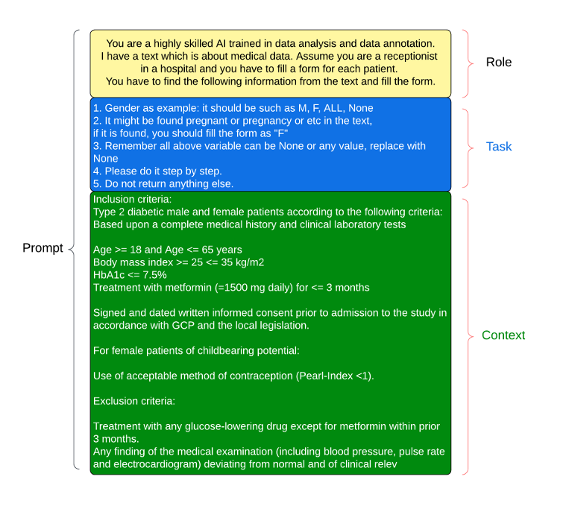
A structured framework for prompt

Slide 4
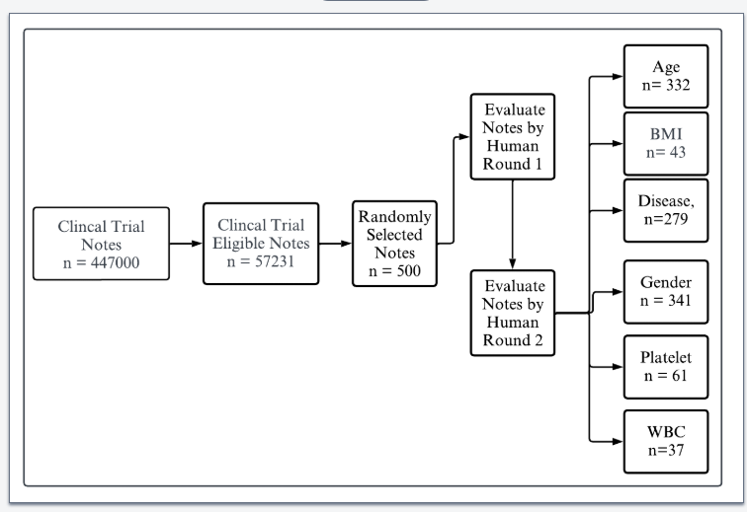
Dataset
Patient characteristic descriptions (patient eligibility criteria)
From Clinical Trials Transformation Initiative (CTTI) database – Publicly Available
500 descriptions for evaluation tests
Characteristics
Diverse therapeutic areas (cardiovascular diseases, oncology, neurological disorders, infectious diseases)
Various study types (randomized controlled trials, observational studies, pragmatic trials)
Data Source
Clinical Trials Transformation Initiative (CTTI)
Public-private partnership for improving clinical trial quality and efficiency
Preprocessing
Text cleaning
Anonymization
Standardization
Stemming and lemmatization

Slide 5
Metrics
- HV (Human Validation): Assesses how well the model’s outputs align with human judgment.
- F1 (F1 Score): Measures the balance between precision and recall, indicating the model’s accuracy.
Prec. (Precision): Evaluates the correctness of the model’s positive predictions.
- Cos. Sim. (Cosine Similarity): Calculates the similarity between two vectorized texts.
- Fact. Cons. (Factual Consistency): Verifies the accuracy of the information provided by the model.
- Coh. (Coherence): Evaluates the logical and smooth flow of the text.
- Cons. (Consistency): Checks for uniform responses to similar inputs.
- Flu. (Fluency): Assesses the smoothness and naturalness of the text.
Relev. (Relevance): Measures how well the model’s outputs correspond to the input prompts.
MCDA : stands for Multi-Criteria Decision Analysis (or Multi-Criteria Decision Making, MCDM). It is a structured decision-making framework used to evaluate, compare, and prioritize multiple competing criteria or alternatives to arrive at a decision.

Slide 6
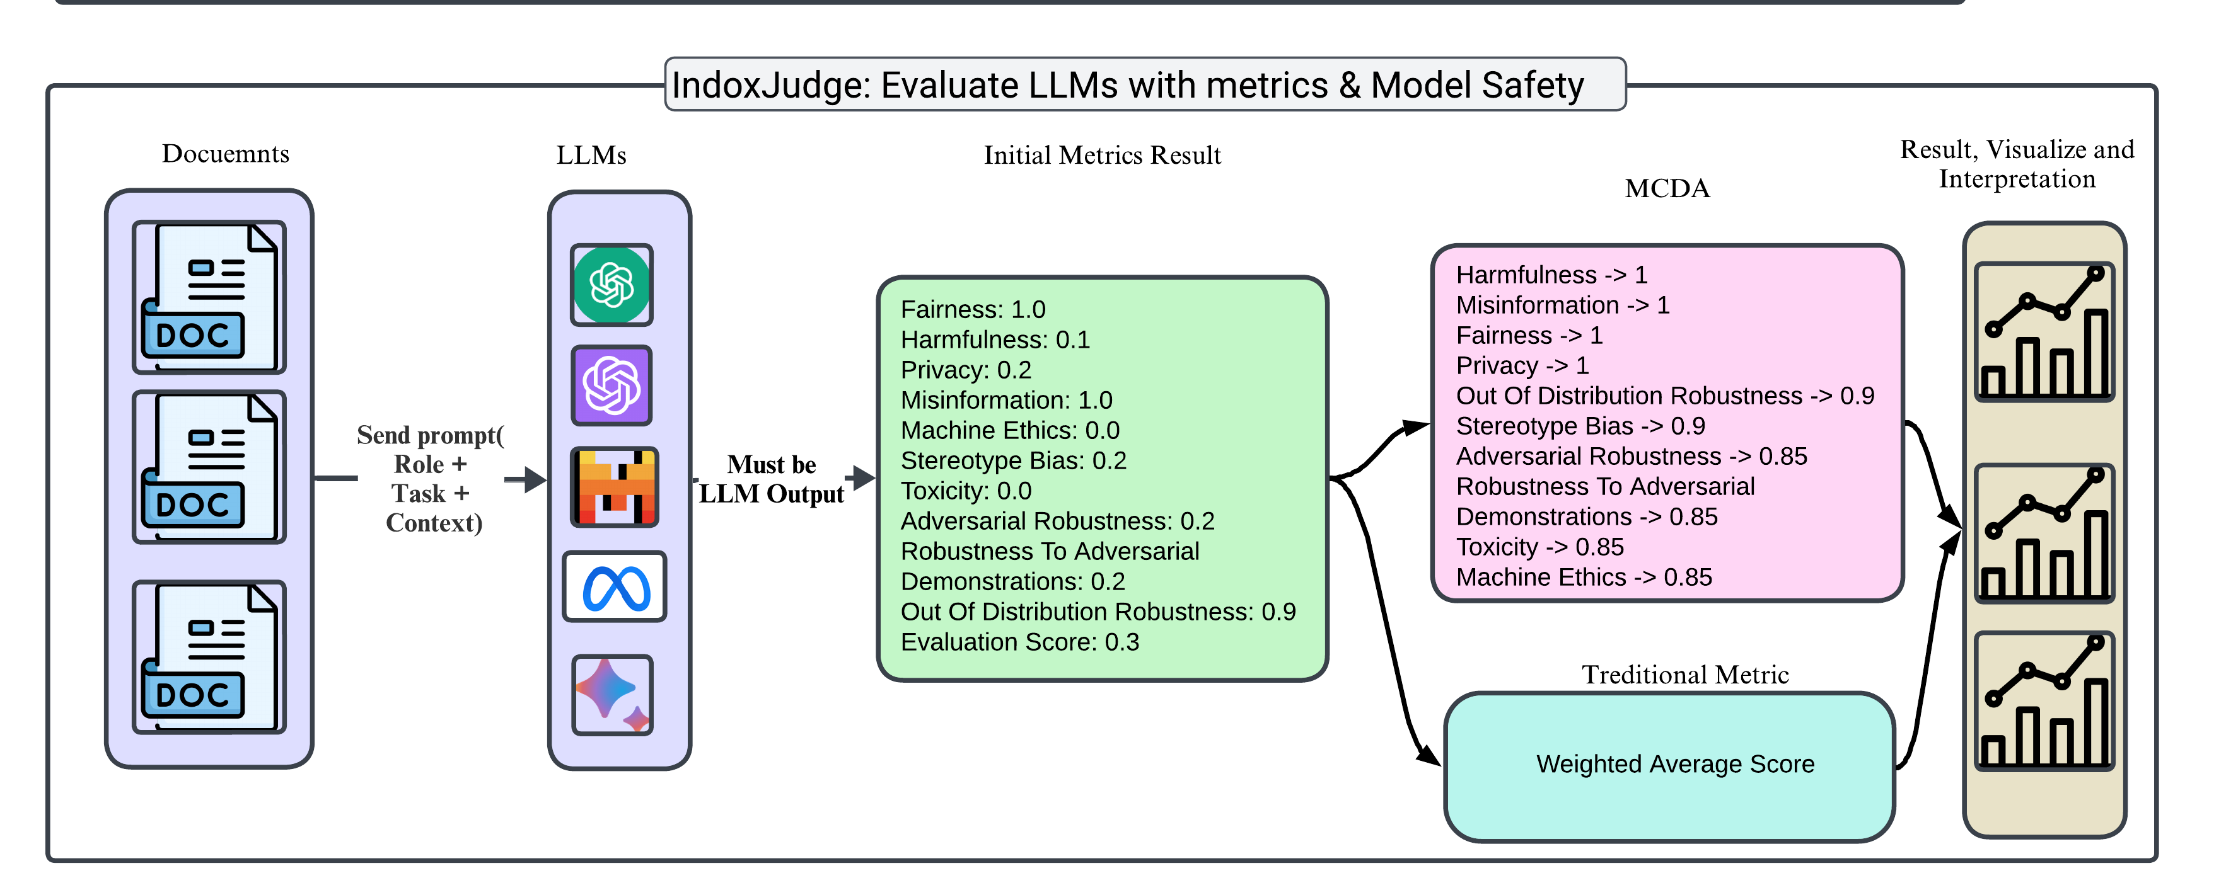
Evaluation Large Language Models Metrics Pipeline

Slide 7
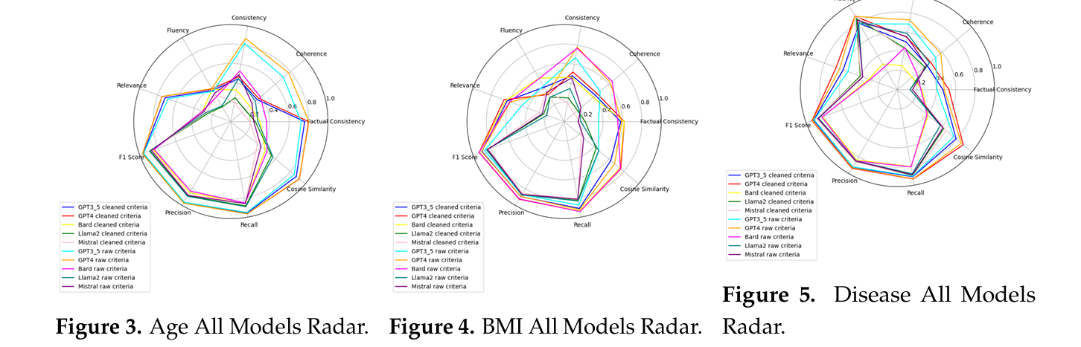
Results

Slide 8
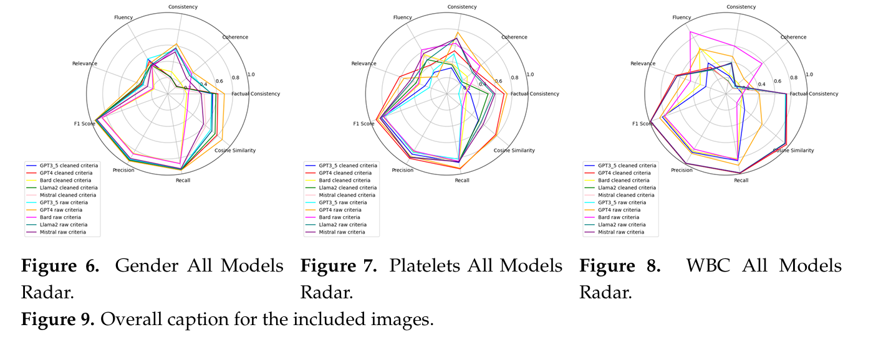
Results

Slide 9
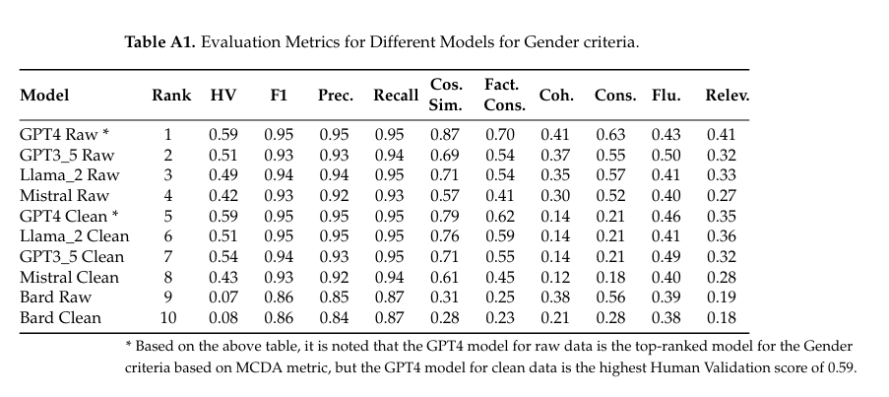

Slide 10
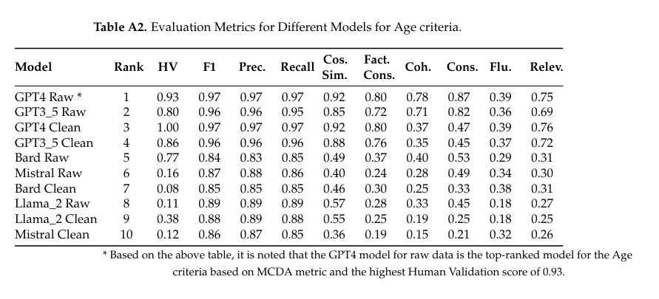

Slide 11
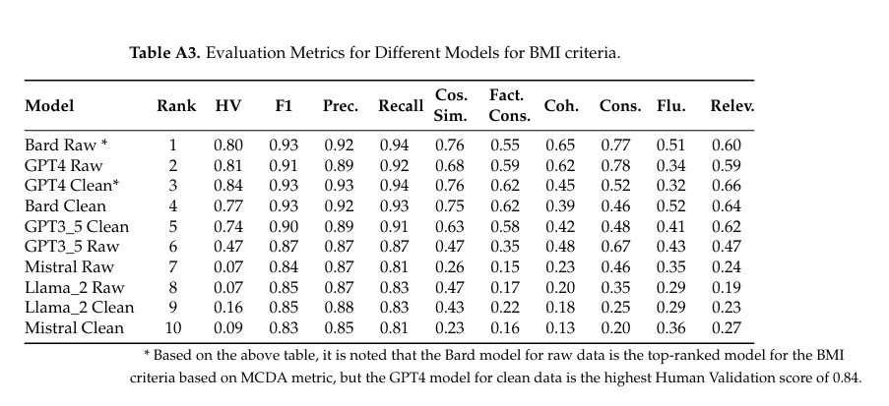

Slide 12
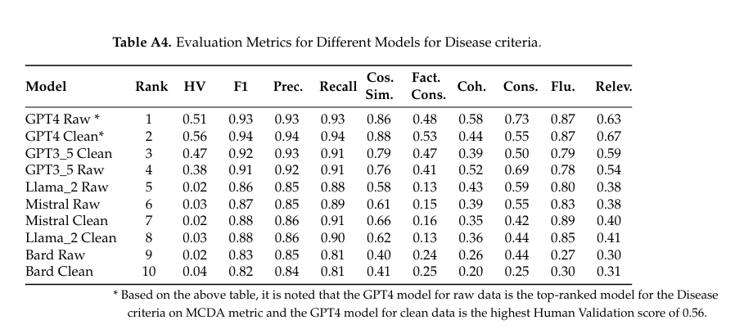

Slide 13
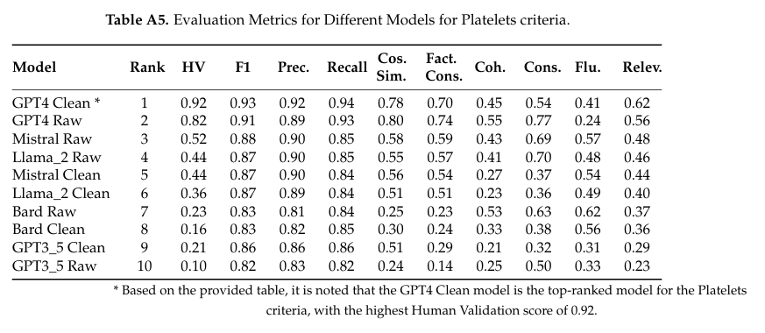

Slide 14
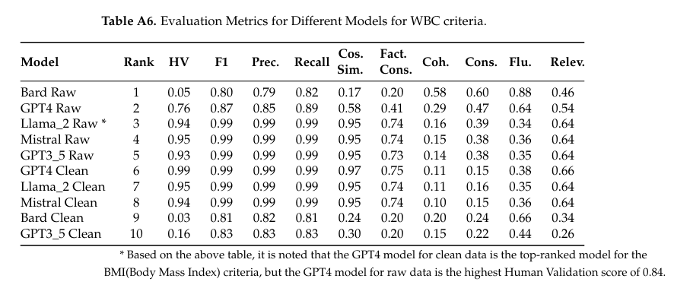

Slide 15
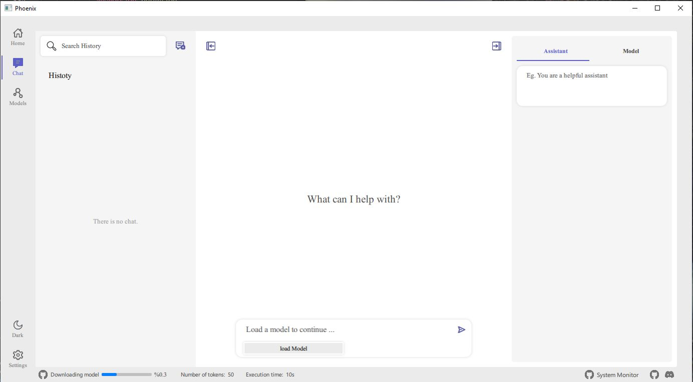

Future works
includes the following metrics, with more being added:
BertScore: Measures the similarity between generated and reference sentences.
Bias: Analyzes the potential biases in LLM outputs.
Hallucination: Identifies instances where the model generates false or misleading information.
Faithfulness: Checks the alignment of generated content with source material.
ContextualRelevancy: Assesses the relevance of responses in context.
Rouge: Measures the overlap of n-grams between generated and reference texts.
BLEU: Evaluates the quality of text generation based on precision.
AnswerRelevancy: Assesses the relevance of answers to questions.
METEOR: Evaluates machine translation quality.
Gruen: Measures the quality of generated text by assessing grammaticality, redundancy, and focus.
Overallscore: Provides an overall evaluation score for LLMs which is a weighted average of multiple metrics.
MCDA: Multi-Criteria Decision Analysis for evaluating LLMs.

Slide 16


Future works
Indox for Retrieval Augmentation: A cutting-edge, open-source application designed to simplify the extraction of relevant data from various document formats, including text files, PDFs, HTML, Markdown, and LaTeX. Indox efficiently handles both structured and unstructured data with precision.
indox: https://github.com/osllmai/inDox
IndoxJudge: A free, open-source tool created specifically for evaluating LLMs and ensuring their safety. It provides essential metrics to assess model performance and reliability. indoxJudge: https://github.com/osllmai/indoxJudge
Phoenix: A multi-platform, open-source application built with Qt QML. It features a chatbot interface that interacts with documents locally, eliminating the need for an internet connection or a GPU. Phoenix leverages Indox and IndoxJudge to deliver high accuracy and eliminate hallucinations, ensuring reliable results, particularly in the healthcare field. Phoenix: https://github.com/osllmai/phoenix
Phoenix_CLI: A versatile, multi-platform, open-source command-line tool that operates on Windows, Linux, and Mac. It supports running LLaMA models with up to eight concurrent tasks using advanced multithreading techniques, optimizing performance and efficiency. Phoenix_cli: https://github.com/osllmai/phoenix_cli

Slide 17
References
[1] W.X.Zhao,K.Zhou,J.Li,etal.,“ASurveyofLargeLanguageModels,”arXivpreprintarXiv:2303.18223,2023. 598
[2] H. Touvron, L. Martin, K. Stone, et al., “Llama 2: Open Foundation and Fine-tuned Chat Models,” arXiv preprint arXiv:2307.09288, 2023.
[3] M. Agrawal, S. Hegselmann, H. Lang, Y. Kim, and D. Sontag, “Large Language Models Are Few-shot Clinical Information Extractors,” arXiv preprint arXiv:2205.12689, 2022.
[4] D. Roussinov, A. Conkie, A. Patterson, and C. Sainsbury, “Predicting Clinical Events Based on Raw Text: From Bag-of-Words to Attention-based Transformers,” Frontiers in Digital Health, vol. 3, p. 810260, 2022.
[5] P. J. Ollitrault, M. Loipersberger, R. M. Parrish, et al., “Estimation of Electrostatic Interaction Energies on a Trapped-ion Quantum Computer,” arXiv preprint arXiv:2312.14739, 2023.
[6] F. Tustumi, N. A. Andreollo, and J. E. d. Aguilar-Nascimento, “Future of the Language Models in Healthcare: The Role of ChatGPT,” ABCD. Arquivos Brasileiros de Cirurgia Digestiva (São Paulo), vol. 36, e1727, 2023.
[7] K. Denecke, R. May, and O. Rivera-Romero, “Transformer Models in Healthcare: A Survey and Thematic Analysis of Potentials, Shortcomings and Risks,” Journal of Medical Systems, vol. 48, no. 1, p. 23, 2024.
[8] K. He, R. Mao, Q. Lin, et al., “A Survey of Large Language Models for Healthcare: From Data, Technology, and Applications to Accountability and Ethics,” arXiv preprint arXiv:2310.05694, 2023.
[9] R. Tang, X. Han, X. Jiang, and X. Hu, “Does Synthetic Data Generation of LLMs Help Clinical Text Mining?” arXiv preprint arXiv:2303.04360, 2023.
[10] V. Liévin, C. E. Hother, A. G. Motzfeldt, and O. Winther, “Can Large Language Models Reason About Medical Questions?” Patterns, 2023.

Slide 18
References
[11] Y.-J. Park, A. Pillai, J. Deng, et al., “Assessing the Research Landscape and Clinical Utility of Large Language Models: A Scoping Review,” BMC Medical Informatics and Decision Making, vol. 24, no. 1, pp. 1–14, 2024.
[12] T. R. McIntosh, T. Susnjak, T. Liu, P. Watters, and M. N. Halgamuge, “Inadequacies of Large Language Model Benchmarks in the Era of Generative Artificial Intelligence,” arXiv preprint arXiv:2402.09880, 2024.
[13] G. Doron, S. Genway, M. Roberts, and S. Jasti, “New Horizons: Pioneering Pharmaceutical R&D with Generative AI from Lab to the Clinic – An Industry Perspective,” arXiv preprint arXiv:2312.12482, 2023.
[14] I. Jahan, M. T. R. Laskar, C. Peng, and J. X. Huang, “A Comprehensive Evaluation of Large Language Models on Benchmark Biomedical Text Processing Tasks,” Computers in Biology and Medicine, p. 108189, 2024.
[15] C. Shivade, C. Hebert, K. Regan, E. Fosler-Lussier, and A. M. Lai, “Automatic Data Source Identification for Clinical Trial Eligibility Criteria Resolution,” in AMIA Annual Symposium Proceedings, American Medical Informatics Association, vol. 2016, 2016, p. 1149.
[16] U.S. National Library of Medicine, ClinicalTrials.gov. Available: https://www.clinicaltrials.gov/, Accessed: 2024-06-21.
[17] “Clinical Trials Transformation Initiative.” Available: https://ctti-clinicaltrials.org/, Accessed: 2024-03-31.
[18] Clinical Trials Transformation Initiative, “Patient Engagement Collaborative Framework,” Available: https://ctti-clinicaltrials.org/wp-content/uploads/2023/05/PEC-Framework_Compliant-Apr-10-2023_FINAL.pdf, May 2023.
[19] C. D. Manning, P. Raghavan, and H. Schütze, “Stemming and Lemmatization,” Available: https://nlp.stanford.edu/IR-book/html/htmledition/stemming-and-lemmatization-1.html, Accessed: 2024-06-21.
[20] J.-M. Torres-Moreno, “Beyond Stemming and Lemmatization: Ultra-stemming to Improve Automatic Text Summarization,” arXiv preprint arXiv:1209.3126, 2012.
[21] T. B. Brown, B. Mann, N. Ryder, et al., “Language Models Are Few-shot Learners,” arXiv preprint arXiv:2010.15980, 2020. Available: https://arxiv.org/pdf/2010.15980.
[22] B. Kroll and J. Reid, “Guidelines for Designing Writing Prompts: Clarifications, Caveats, and Cautions,” Journal of Second Language Writing, vol. 3, no. 3, pp. 231–255, 1994.
[23] Z. Lin, “How to Write Effective Prompts for Large Language Models,” Nature Human Behaviour, pp. 1–5, 2024.
[24] J. Behan and J. Smith, “A Survey of Data Science Education,” arXiv preprint arXiv:2301.12867, 2023. Available: https://arxiv.org/pdf/2301.12867.
[25] J. Yuan, R. Tang, X. Jiang, and X. Hu, “Large Language Models for Healthcare Data Augmentation: An Example on Patient-Trial Matching,” in AMIA Annual Symposium Proceedings, American Medical Informatics Association, vol. 2023, 2023, p. 1324.
[26] S. Ye, D. Kim, S. Kim, et al., “Flask: Fine-grained Language Model Evaluation Based on Alignment Skill Sets,” arXiv preprint arXiv:2307.10928 [cs.CL], 2023.
[27] P. Liang, R. Bommasani, T. Lee, et al., “Holistic Evaluation of Language Models,” arXiv preprint arXiv:2211.09110, 2022.
[28] K. Singhal, S. Azizi, T. Tu, et al., “Large Language Models Encode Clinical Knowledge,” Nature, vol. 620, no. 7972, pp. 172–180, 2023.
[29] Google, “Our Responsible Approach to Building Guardrails for Generative AI,” Available: https://blog.google/technology/ai/our-responsible-approach-to-building-guardrails-for-generative-ai/, Accessed: 2024-03-31, Mar. 2023.

