Slide 1

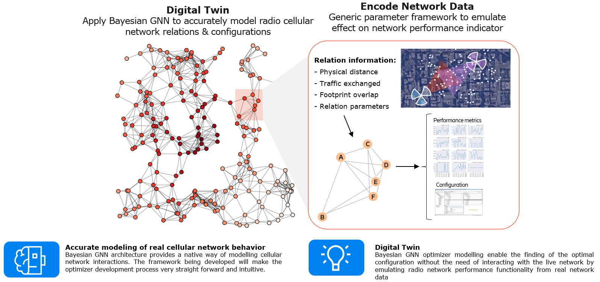
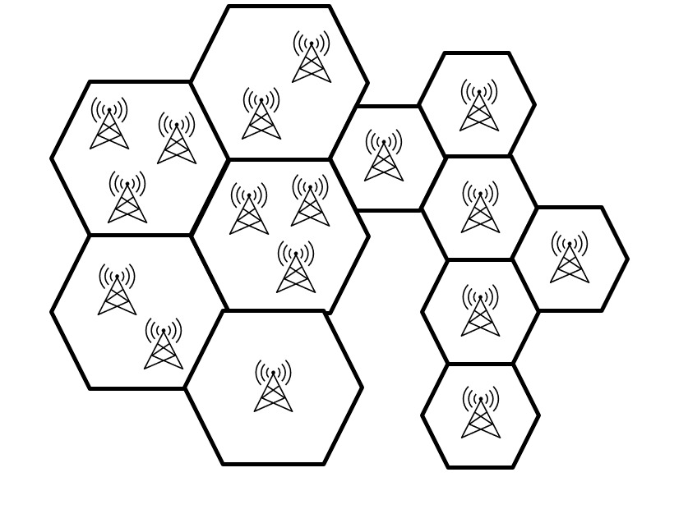
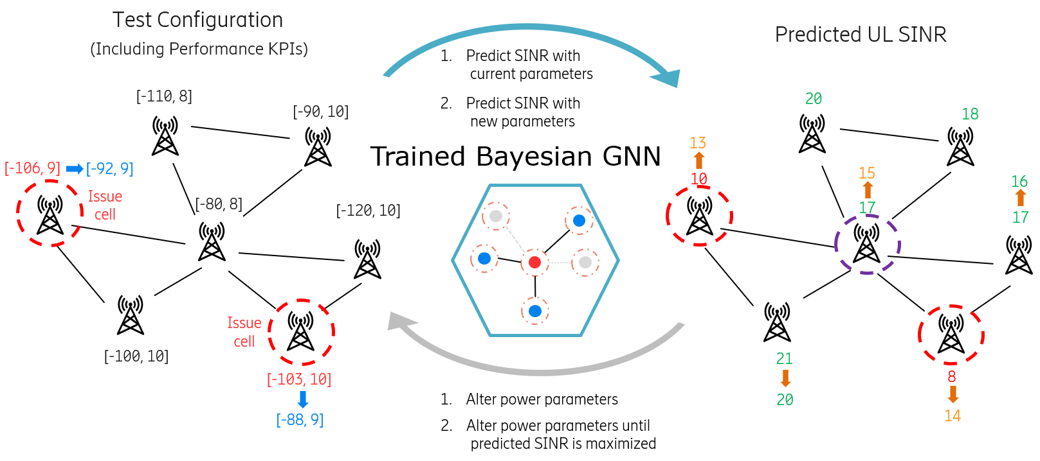
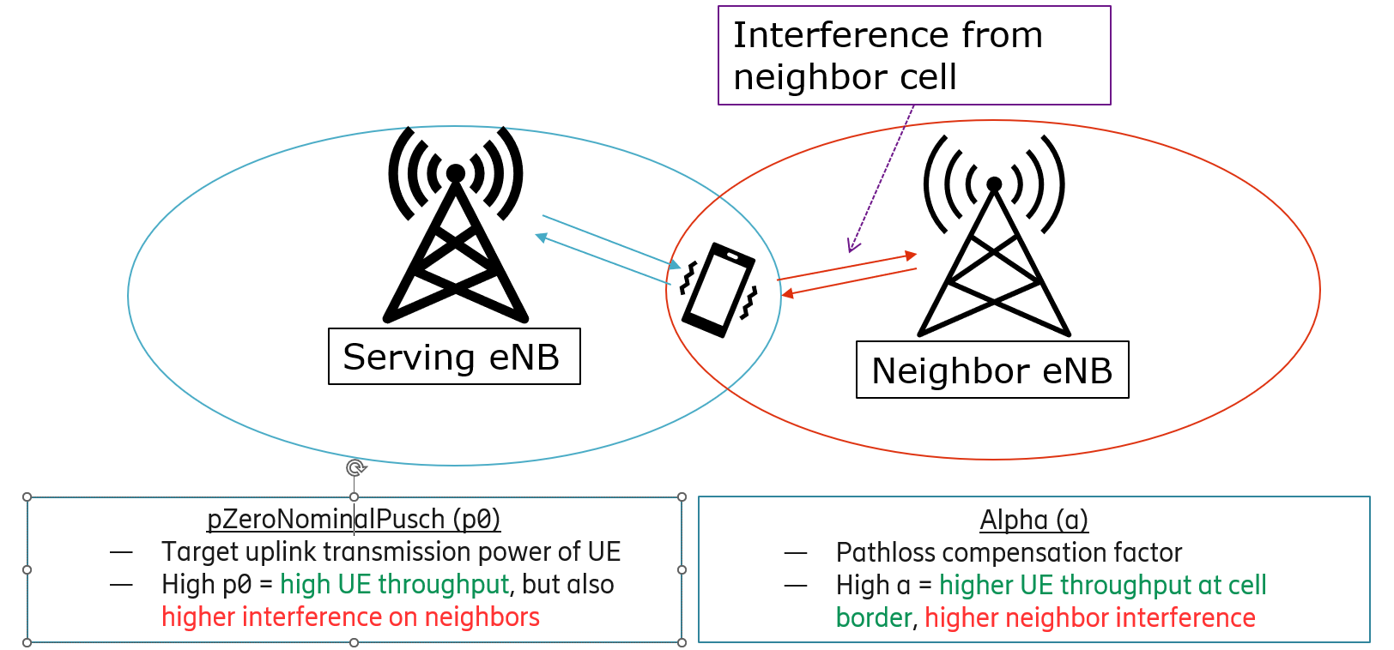
Solutions and challenges to optimize a cellular network with Graph Neural Networks
Oscar Llorente Gonzalez
Ericsson
How to optimize a cellular network
Use a Bayesian GNN like a “digital twin”
In a cellular network there are certain parameters that we can tweak to modify the behavior of the cells of the network. However, those parameters affect the neighbor cells and if we use a reinforcement learning algorithm and iterate over the real network, we can degrade the cells during the process. Therefore, our approach is to simulate the network with a Bayesian GNN and optimize the parameters with respect to the model output
Performance Indicator
Bayesian GNN
KPIs
Parameters
Optimization algorithm
Our use-case, the uplink interference problem
Optimization Framework
The specific use-case we are trying to solve here is the uplink interference problem, that occurs when users from a neighbor cell are causing interference in the transmission of information to the network. To solve it we can modify two power control parameters of the issue cells (cells that have the interference problem)
The framework will provide new configuration parameters for the issue cell, the expected gain for the performance indicator (SINR in this case) and confidence intervals of expected values of the gain, thanks to the combination of Bayesian Neural Networks and GNNs
oscar.llorente.gonzalez@ericsson.com
Notes:
Behavioral results: make bar graphs of RT?
fMRI results: labels, figure caption, make blues in graph the same color
References: add marcel 2004, add numbers, rearrange

