Slide 1
Uplink Interference Optimizer
How to Optimize a Cellular Network in a Single Shot with GNNs

Slide 2
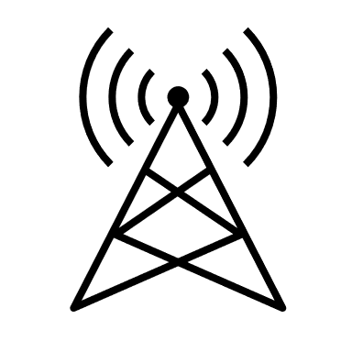
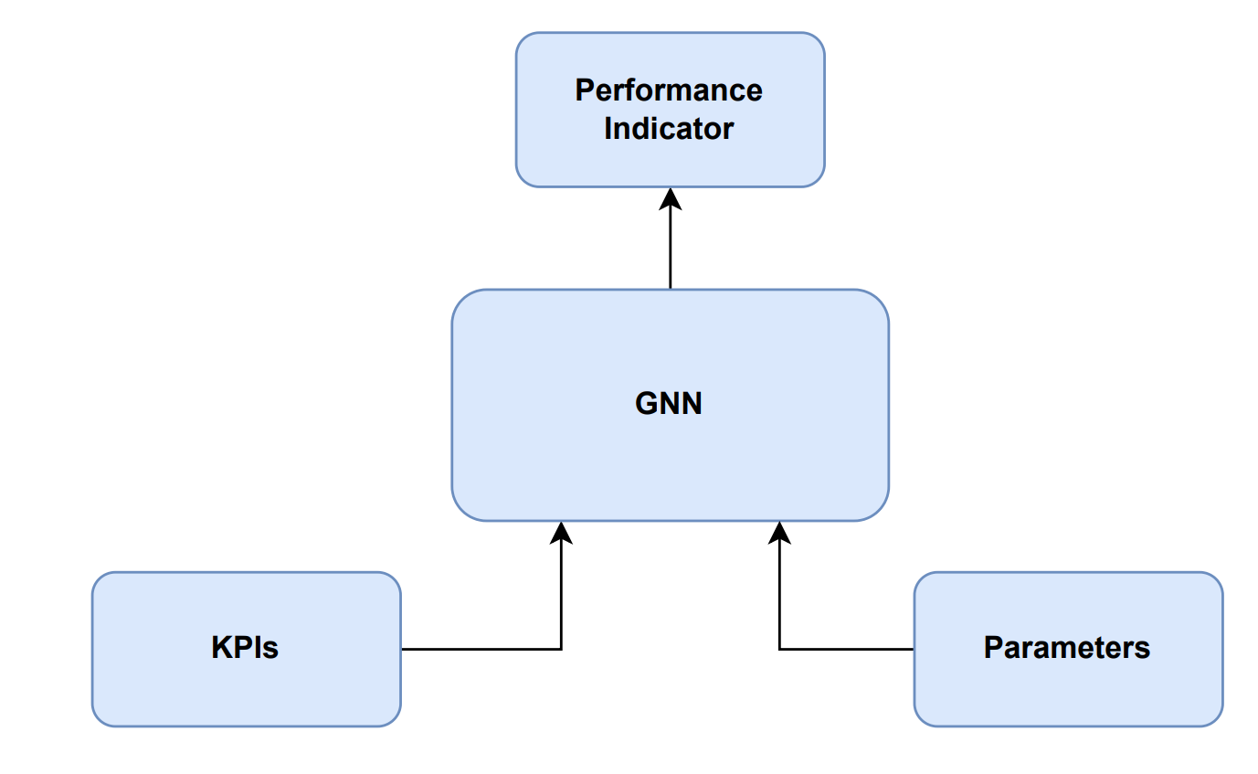
How to optimize a cellular network
Cellular Network
Solution Architecture
Optimization

Slide 3


Uplink Interference
Interference from neighbor cell
Serving eNB
Neighbor eNB
pZeroNominalPusch (p0)
Target uplink transmission power of UE
High p0 = high UE throughput, but also higher interference on neighbors
Alpha (a)
Pathloss compensation factor
High a = higher UE throughput at cell border, higher neighbor interference

Slide 4
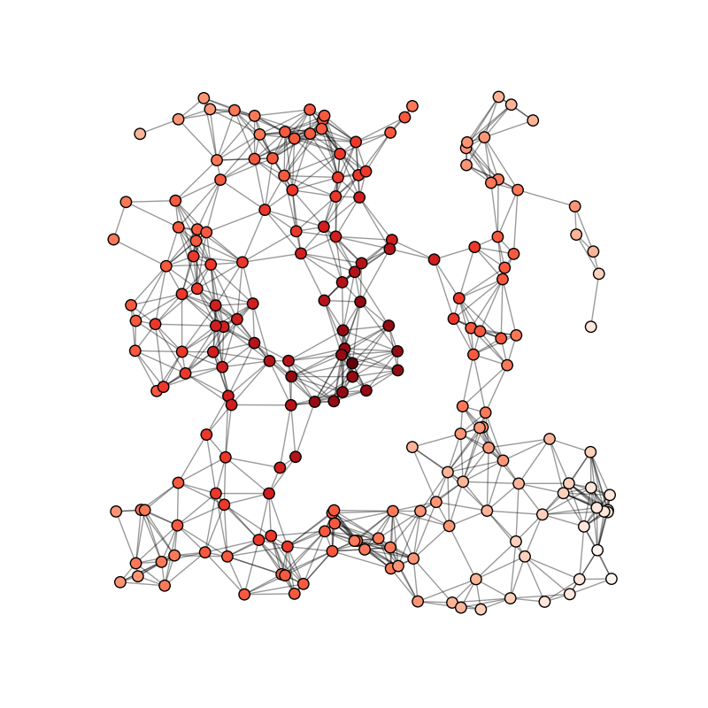
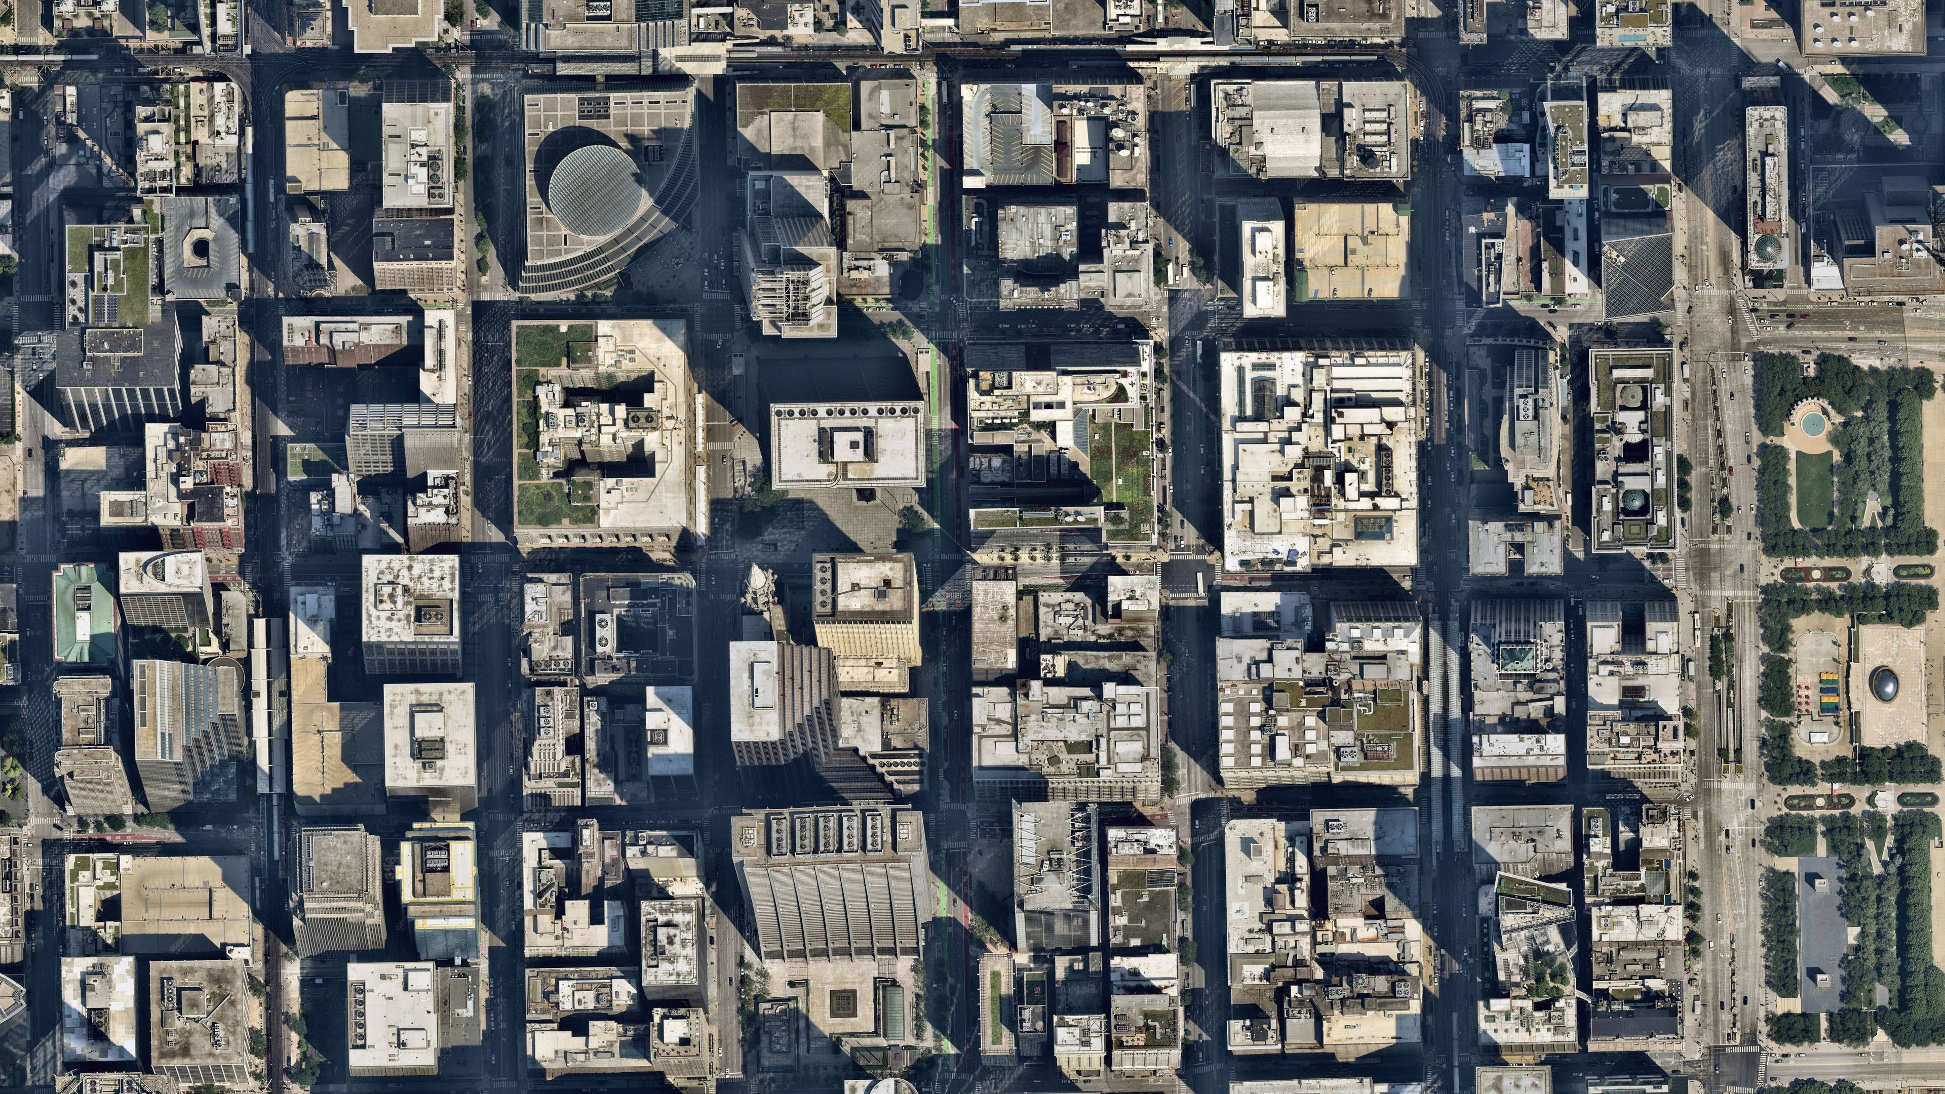
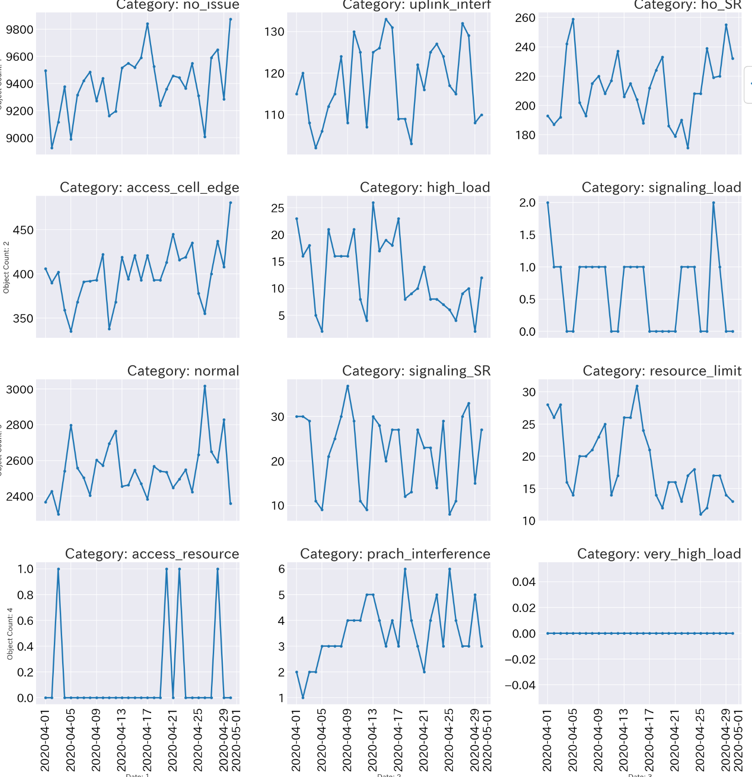
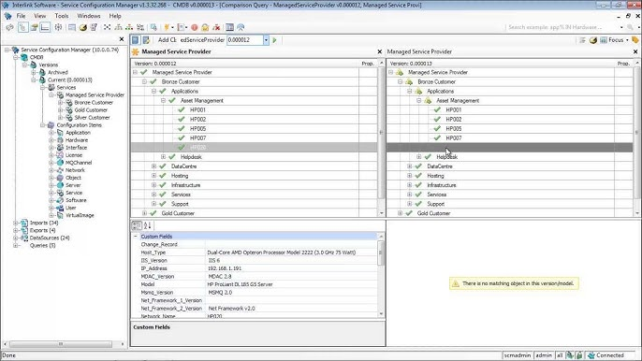


Use GNN as a “digital twin”
Digital Twin
Apply Graph Neural Network (GNN) to accurately model radio cellular network relations & configurations
Encode Network Data
Generic parameter framework to emulate effect on network performance indicator
Relation information:
- Physical distance
- Traffic exchanged
- Footprint overlap
- Relation parameters
Performance metrics
C
A
D
E
Configuration
F
B
Accurate modeling of real cellular network behavior
GNN architecture provides a native way of modelling cellular network interactions. The framework being developed will make the optimizer development process very straight forward and intuitive.
Digital Twin
GNN optimizer modelling enable the finding of the optimal configuration without the need of interacting with the live network by emulating radio network performance functionality from real network data

Slide 5
Optimization Framework
Test Configuration
Predicted UL SINR
(Including Performance KPIs)
1. Predict SINR with
current parameters
[-110, 8]
2. Predict SINR with
new parameters
20
[-90, 10]
18
13
Trained GNN Model
[-106, 9]
[-92, 9]
10
15
16
Issue cell
[-80, 8]
17
[-120, 10]
17
Issue cell
[-100, 10]
21
[-103, 10]
8
1. Alter power parameters
20
[-88, 9]
2. Alter power parameters until
predicted SINR is maximized
14

Slide 6
Q & A

