Slide 1
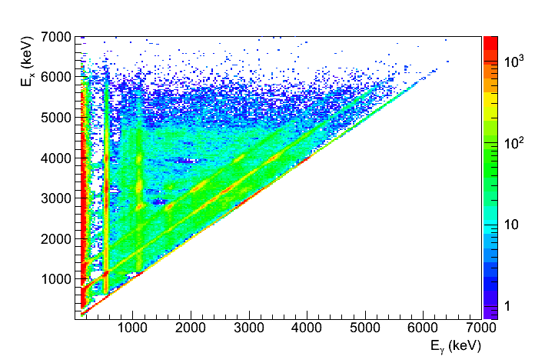

The beta-Oslo method
Beta-decay of ⁷⁶Ga -> ⁷⁶Ge
NSCL/MSU workshop Dec 1 – 4
Day 3 – Dec 3, 2015
Ann-Cecilie Larsen

Slide 2
Today’s menu
Short intro to the beta-Oslo method
Potential challenges – spin
Case study: ⁷⁶Ga -> ⁷⁶Ge
Unfolding, two segments of SuN
First-generation method
Extract level density and γ-strength function
Normalization – first try
Github: https://github.com/oslocyclotronlab/MSU_workshop_2015

Slide 3
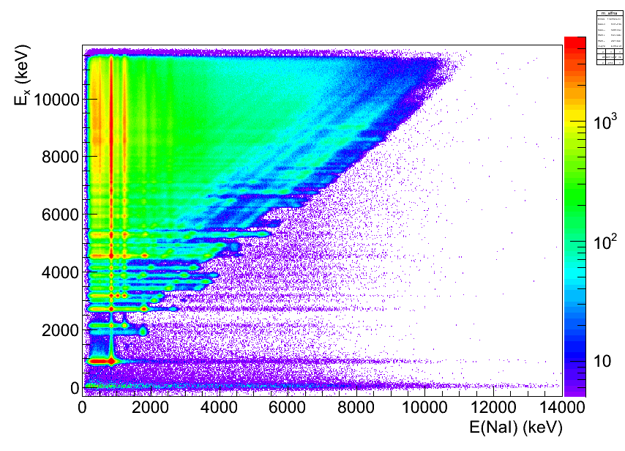
1. The beta-Oslo method
Goal: get an E_{γ} vs E_{x} matrix for an exotic (neutron-rich) nucleus
Remember, for the “standard” Oslo method:
Charged-particle reaction
Measure particle-γ coincidences
Starting point: (Eγ,Ex) matrix
⁵⁶Fe(p,p’γ)
Ex (keV)
NaI(Tl)
α
Si ΔE-E
telescope
³He
40 – 54º
Target nucleus
Eγ (keV)

Slide 4
1. The beta-Oslo method
Goal: get an E_{γ} vs E_{x} matrix for an exotic (neutron-rich) nucleus
Options:
radioactive-beam inverse kinematics experiments
beta-Oslo method [A. Spyrou, S.N. Liddick, A.C. Larsen, M. Guttormsen et al., PRL 113, 232502 (2014)]
Recipe:
1) Implant a neutron-rich nucleus (preferably with Q_{b} ≈ S_{n}) in a segmented total-absorption spectrometer
2) Measure β-particle in coincidence with γ rays from the daughter nucleus

Slide 5
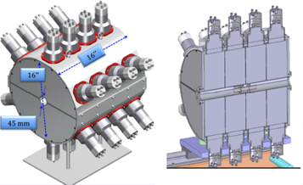
1. The beta-Oslo method
Beta-decay of ⁷⁶Ga -> ⁷⁶Ge
Segmented, total absorption spectrometer SuN
[A. Simon, S.J. Quinn, A. Spyrou et al, NIM A 703, 16 (2013)]
[A. Spyrou, S.N. Liddick, A.C. Larsen, M. Guttormsen
et al., Phys. Rev. Lett. 113, 232502 (2014)]

Slide 6
2. Challenges, beta-Oslo method
Populated spins in the standard Oslo method: J ≈ 0-10
Beta-decay populates a few spins, much more selective (mainly Gamow-Teller, i.e. same parity as the mother nucleus and spins J_{initial} = J_{mother}-1, J_{mother}, J_{mother}+1)
Spin distribution for ⁷⁶Ge from Goriely et al. [PRC 78, 064307 (2008)]
for Ex ≈ 1-5.8 MeV, (b) for Ex ≈ 6-10.9 MeV, and
(c) for a projection for Ex ≈ 7-7.5 MeV. Blue histograms: J_{initial} of ⁷⁶Ge.

Slide 7
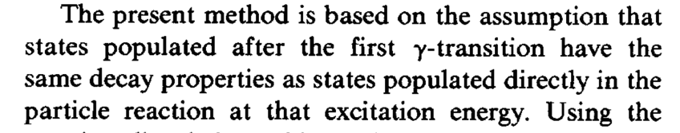
2. Challenges, beta-Oslo method
Populated spins in the standard Oslo method: J ≈ 0-10
Beta-decay populates a few spins, much more selective (mainly Gamow-Teller, i.e. same parity as the mother nucleus and spins J_{initial} = J_{mother}-1, J_{mother}, J_{mother}+1
Why is this a potential problem?
Assumption behind the first-generation method
[M. Guttormsen, T. Ramsøy, and J. Rekstad, NIM A255, 518 (1987)]

Slide 8
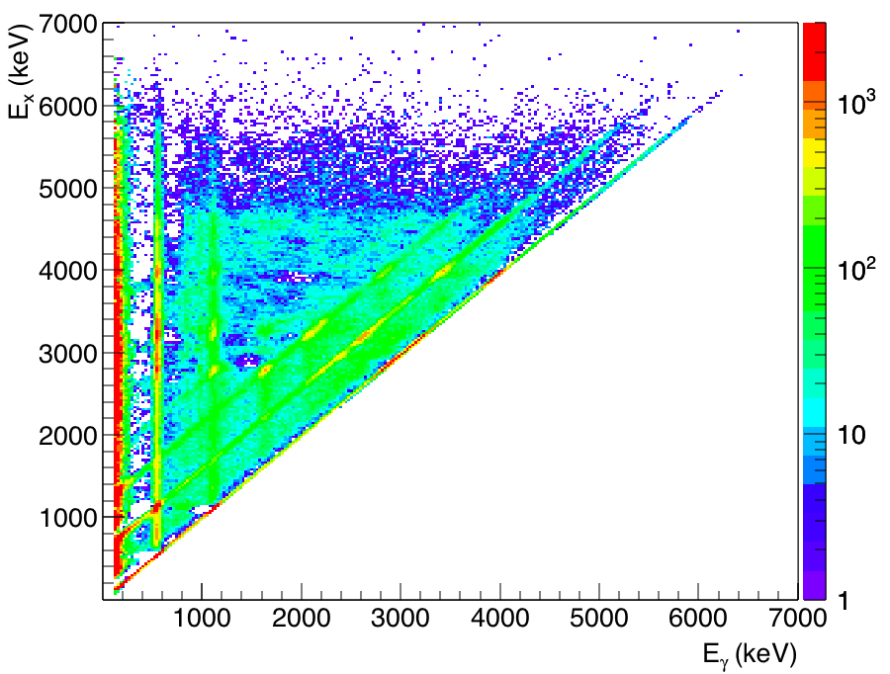
2. Challenges, beta-Oslo method
Populated spins in the standard Oslo method: J ≈ 0-10
Beta-decay populates a few spins, much more selective (mainly Gamow-Teller, i.e. same parity as the mother nucleus and spins J_{initial} = J_{mother}-1, J_{mother}, J_{mother}+1)
Need the shape of the γ spectra to be ≈the same
After one dipole transition: J_{final} = J_{mother}-2, …, J_{mother}+2
… and the normalization of the NLD and γSF might be more tricky…

Slide 9
3. Case study: ⁷⁶Ga -> ⁷⁶Ge
Experiment @ NSCL/MSU:
⁷⁶Ge primary beam, 130 MeV/nucleon on thick Be target -> ⁷⁶Ga
Through gas cell -> 30-keV ⁷⁶Ga implanted in Si detector inside SuN
≈ 500 pps, tag on β
Sum of γ-rays = E_{x}, individual γ–rays = E_{γ}
Segmented, total absorption spectrometer SuN
[A. Simon, S.J. Quinn, A. Spyrou et al, NIM A 703, 16 (2013)]
[A. Spyrou, S.N. Liddick, A.C. Larsen, M. Guttormsen
et al., Phys. Rev. Lett. 113, 232502 (2014)]

Slide 10
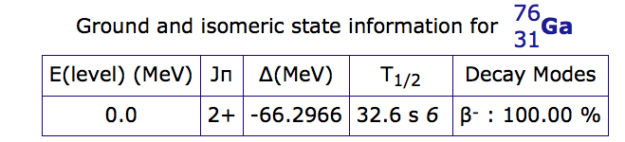
3. Case study: ⁷⁶Ga -> ⁷⁶Ge
-> Populating mainly 1+,2+,3+ levels in ⁷⁶Ge
Github…

Slide 11
4. ⁷⁶Ge – unfolding
Target not in the center of SuN
-> Two matrices, one for segment 2 and one for segment 3
-> Unfold each with the corresponding response matrix, add together in the end
In the github folder:
raw_76Ge_seg2, raw_76Ge_seg3

Slide 12
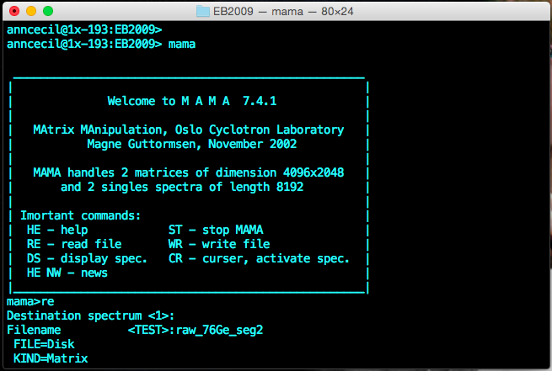
4. ⁷⁶Ge – unfolding
raw_76Ge_seg2

Slide 13
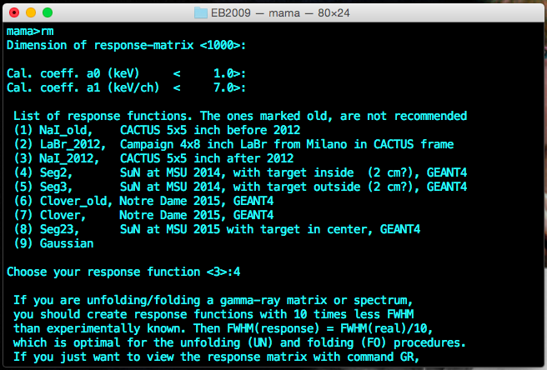
4. ⁷⁶Ge – unfolding
Get response matrix

Slide 14
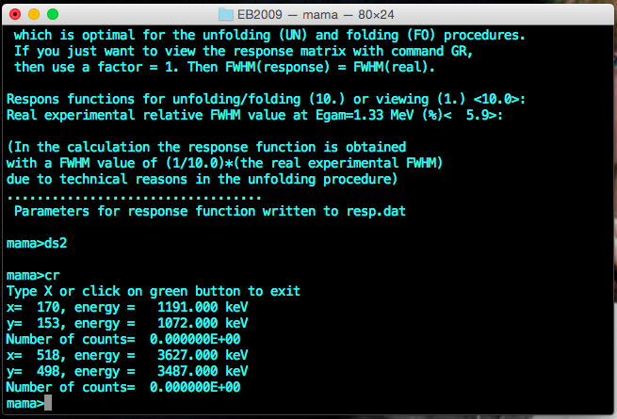
4. ⁷⁶Ge – unfolding
Choose limits for unfolding (E_{x} ≈ E_{γ})

Slide 15
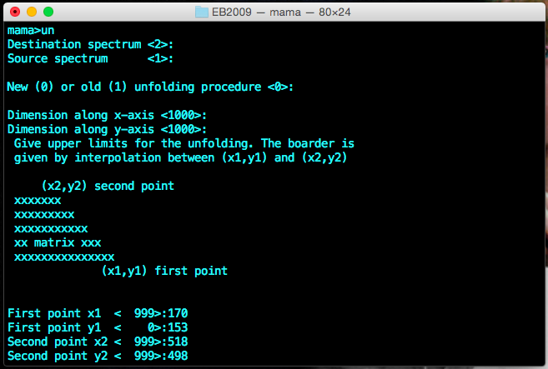
4. ⁷⁶Ge – unfolding
The unfolding routine (remember to remove negative counts)

Slide 16
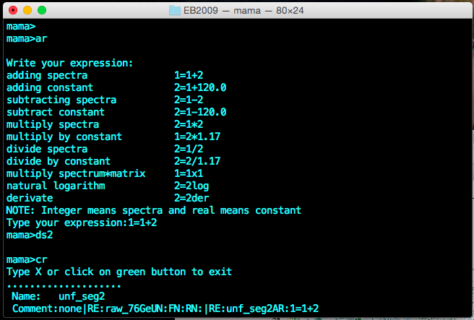
4. ⁷⁶Ge – unfolding
Save unfolded seg.2 matrix, repeat for seg.3, and add the two matrices to get the full dataset (≈4 million counts):

Slide 17
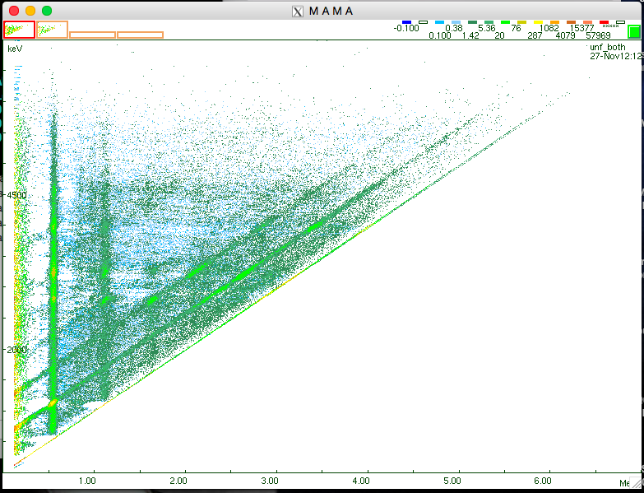
4. ⁷⁶Ge – unfolding

Slide 18
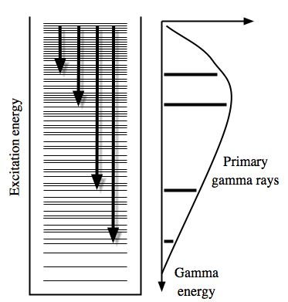
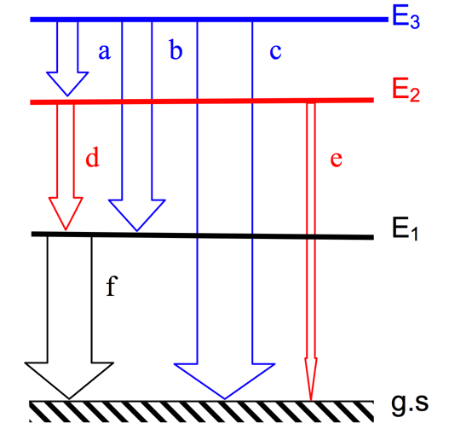
5. ⁷⁶Ge – first-generation spectra
First-generation γ ray = primary γ ray (1st in the cascade)
Principle: For a given E_{x}, subtract all γ spectra below (with a proper weighting function). The spectra below will contain all the γ rays in the E_{x} bin except the ones that are primaries in E_{x}!

Slide 19
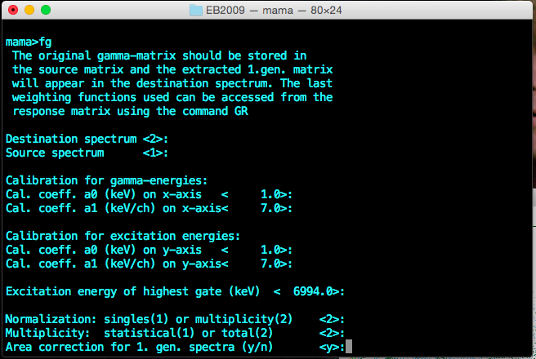
5. ⁷⁶Ge – first-generation spectra
First-generation method in MAMA, starting from the unfolded matrix

Slide 20
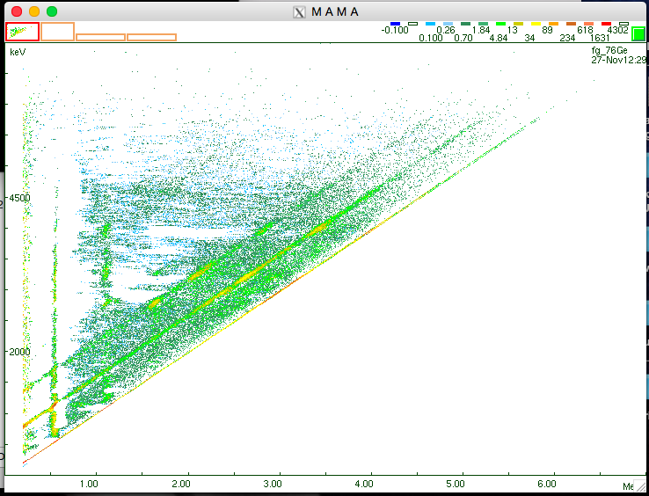
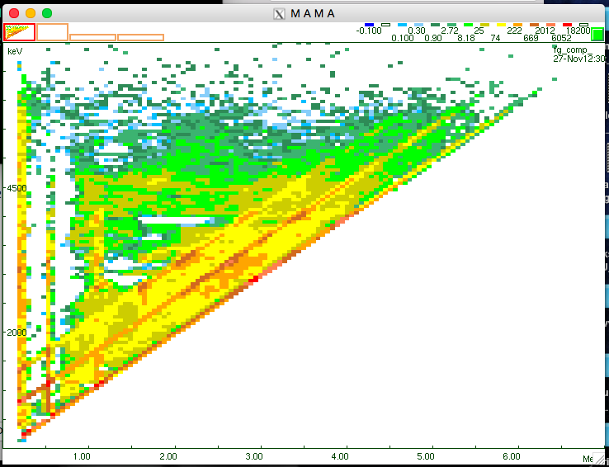
5. ⁷⁶Ge – first-generation spectra
First-generation method in MAMA, starting from the unfolded matrix
Notes:
Discuss how it looks, compared to 56Fe for example

Slide 21
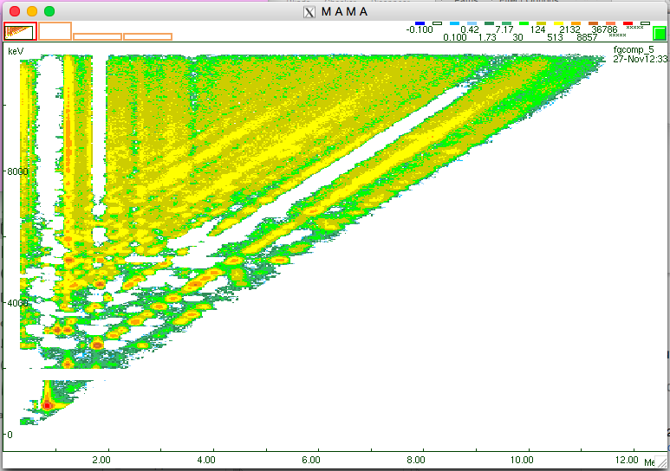
5. ⁷⁶Ge – first-generation spectra
Comparison with ⁵⁶Fe(p,p’)
⁷⁶Ge
⁵⁶Fe
Notes:
Discuss how it looks, compared to 56Fe for example

Slide 22
6. ⁷⁶Ge – level density & γ strength
Code ‘rhosigchi’ – determine “good” area for extraction
(check also ‘α’ from f.g. method in figegaout.dat!)
[A. Schiller et al., NIM A447, 498 (2000)]
Notes:
Discuss how it looks, compared to 56Fe for example

Slide 23
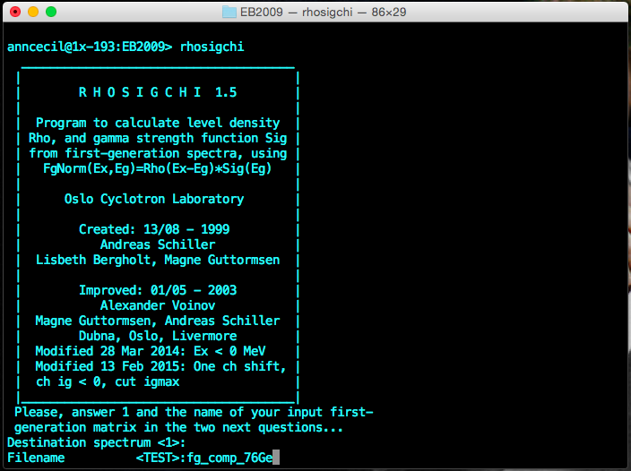
6. ⁷⁶Ge – level density & γ strength
Code ‘rhosigchi’ – determine “good” area for extraction
(check also ‘α’ from f.g. method in figegaout.dat)
Notes:
Discuss how it looks, compared to 56Fe for example

Slide 24
6. ⁷⁶Ge – level density & γ strength
Does it work? Yes!!! (I think 😛 )
Notes:
Discuss how it looks, compared to 56Fe for example

Slide 25
6. ⁷⁶Ge – first normalization
Codes: ‘robin’, ‘counting’, ‘normalization’
NB!!! Updated input.cnt in the Github
PROBLEM 0: No neutron-resonance data for normalization…
PROBLEM 1: The level density does not cover the full spin range!
-> The slope of the γ-transmission coefficient could be too steep…
PROBLEM 2: We don’t really know the full spin distribution!
Neutron-resonance data: RIPL-3 https://www-nds.iaea.org/RIPL-3/
Or Mughabghab’s atlas…

Slide 26
6. ⁷⁶Ge – first normalization
Systematics using phenomenological Fermi-gas parameters for the spin distribution – folder systematics_D0_Gg
@ S_{n} = 9.43 MeV
More about systematic errors tomorrow…

