Slide 1
The Oslo Method (Part II)
From a more detailed point
of view
Magne Guttormsen
Department of Physics
University of Oslo

Slide 2
The Oslo Method
A set of data analysis techniques and methods that allow us to extract NLD and γSF:
Unfolding of (continuum) γ spectra (MAMA folding.f)
Obtain distribution of first-generation (primary) γ rays (MAMA figega.f)
Simultaneous fit of primary matrix gives the functional form of the NLD and γSF (rhosigchi.f)
Normalization of level density from discrete levels (low Ex) and the neutron-resonance spacing (high Ex) (counting.c)
Normalization of the γSF from the average, total radiative width (assuming dominance of dipole radiation) (normalization.c)

Slide 3
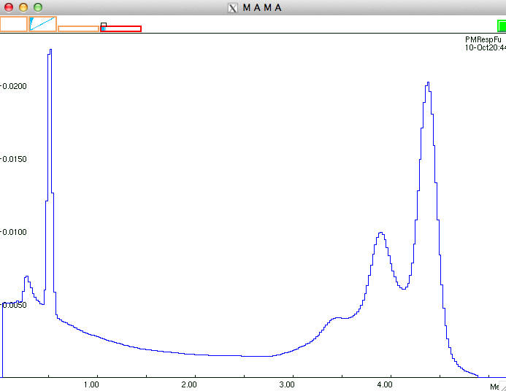
Unfolding (see other pptx)
The detector is not “perfect”:
Compton scattering
Single/double escape
Backscattering
Annihilation peak
Response function
4.4 MeV
3

Slide 4
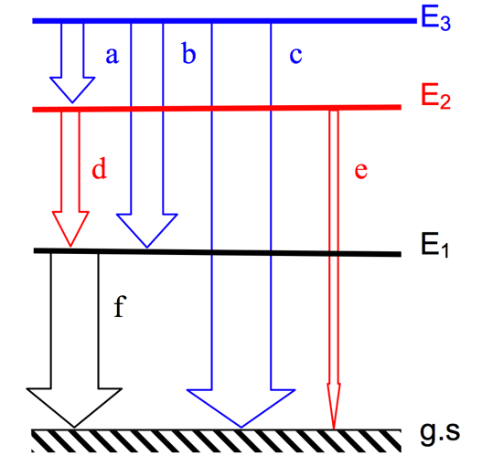
First-generation method
A.C. Larsen et al., PRC 83, 034315 (2011)
Simple test:

Slide 5
Artificial primary ⁵⁷Fe
More advanced test (DICEBOX):
A.C. Larsen et al., PRC 83, 034315 (2011)

Slide 6
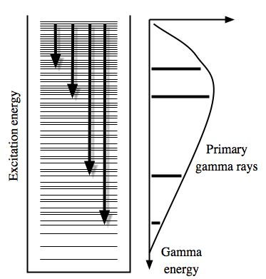
Multiplicative factors
Fermi’s golden rule (Dirac)
Brink-Axel hypothesis
A. Schiller et al., NIM A 447, 498 (2000)

Slide 7
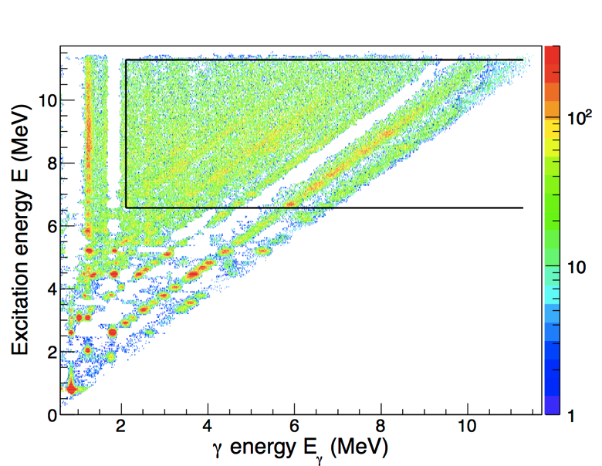
rhosigchi.f
Choose “good” region for extraction of level density and γ-transmission coefficient: similar shape of primary spectra, alpha-coefficient in f.g. procedure close to unity (indication of correct weighting functions)
⁵⁶Fe(p,p’)

Slide 8
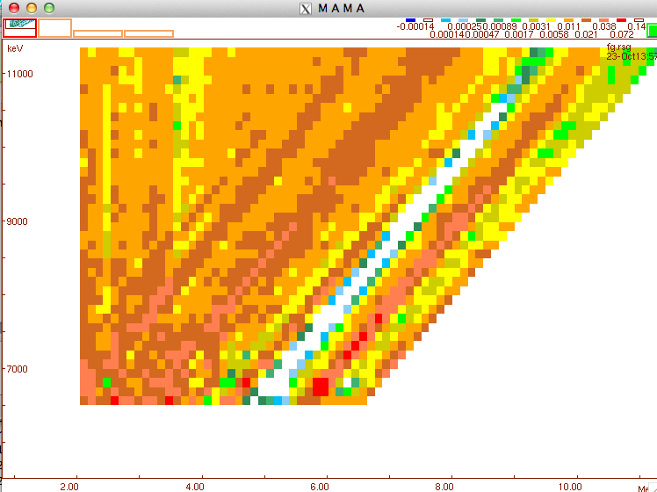
rhosigchi.f
Higher-order estimates through least chi-square minimization:
Each point in ρ(E-Eγ) and τ(Eγ) is
considered as a free parameter
⁵⁶Fe(p,p’) example:
Data points (“pixels”): 2052
Free parameters: 184
N_{free} << N_{data}
=> that’s why it works!

Slide 9
rhosigchi.f
Take all derivatives:
Minimum is normally reached within 10-20 iterations
_______________________________________________________
Convergence test using various indicators
Indicator Iteration = 0 10 20 30 40 50
Rho/Rho0 at U=2848. 1.00 0.93 0.95 0.95 0.93 0.93
Rho/Rho0 at U=5700. 1.00 0.73 0.70 0.70 0.69 0.69
Rho/Rho0 at U=8428. 1.00 0.48 0.48 0.49 0.48 0.48
Sig/Sig0 at Eg=2848. 1.00 1.06 1.05 1.05 1.03 1.03
Sig/Sig0 at Eg=5700. 1.00 0.59 0.58 0.58 0.58 0.58
Sig/Sig0 at Eg=8428. 1.00 1.24 1.24 1.25 1.27 1.27
Chi^2 for 1.gen.sp. 39.63 8.11 7.42 7.20 7.14 7.14
_______________________________________________________
¹⁰⁶Cd(³He,³He’)
_______________________________________________________
Convergence test using various indicators
Indicator Iteration = 0 10 20 30 40 50
Rho/Rho0 at U=2616. 1.00 1.56 1.56 1.56 1.56 1.56
Rho/Rho0 at U=5344. 1.00 0.64 0.61 0.60 0.60 0.59
Rho/Rho0 at U=8072. 1.00 0.28 0.28 0.28 0.27 0.26
Sig/Sig0 at Eg=2616. 1.00 0.89 0.89 0.89 0.90 0.90
Sig/Sig0 at Eg=5344. 1.00 1.23 1.19 1.18 1.17 1.16
Sig/Sig0 at Eg=8072. 1.00 1.43 1.33 1.31 1.29 1.27
Chi^2 for 1.gen.sp. 1.08 0.62 0.61 0.61 0.61 0.61
_______________________________________________________
⁵⁶Fe(p,p’)

Slide 10
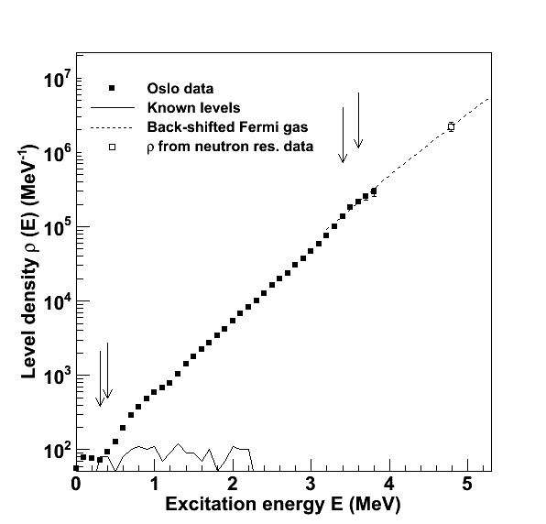
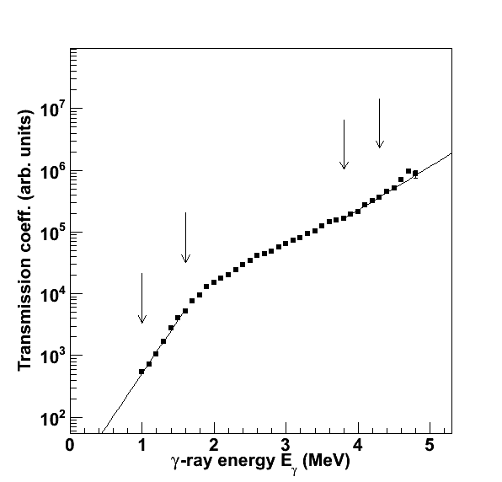
ρ(E_{f}) and T(E_{γ})

Slide 11
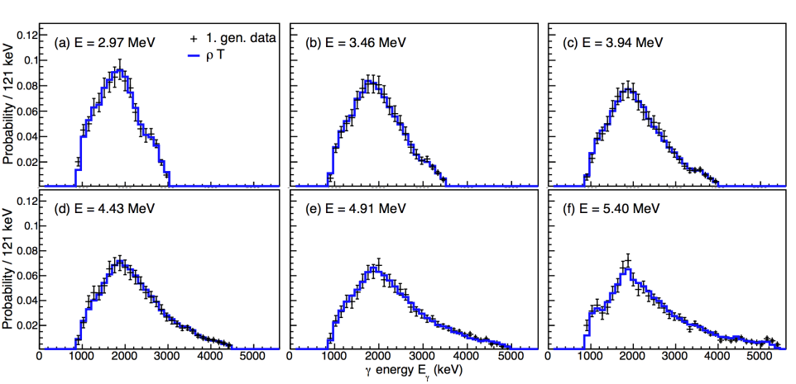
P(E,E_{γ}) = ρ(E_{f})T(E_{γ})?
Remember: ρ and τ are extracted from all primary spectra within the cuts in E and Ε_{γ}
Errors include statistical + f.g. method + unfolding

Slide 12
Normalization
The extracted ρ(E_{f}) and τ(Ε_{γ}) functions have a functional form that is uniquely determined by the ‘rhosigchi’ code (e.g. bumps, dips, …)
However, the absolute normalizations and slopes are not known. Equally good solutions are found with all functions of the form
The parameters A, B, and α must be determined from external data

Slide 13
Normalization, NLD
At low E, use discrete levels
At high E, use data on neutron or proton resonance spacings
Calculate ρ(S_{n}) from:
This step is sometimes tricky, because it requires good knowledge of the spin distribution at ≈S_{n} => NOT trivial!
D₀: neutron s-wave spacing; I_{t}: target spin in (n,γ) reaction; σ: spin cutoff parameter

Slide 14
Spin distributions
“Fermi-gas” spin distribution (Gilbert & Cameron, Can. J. Phys. 43, 1446 (1965))
⁴⁴Sc, E=8 MeV
⁵¹V, S_{n}=11.051 MeV

Slide 15
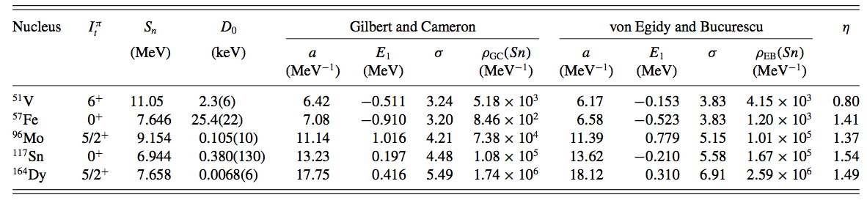
Uncertainties in ρ(S_{n})
A.C. Larsen et al., PRC 83, 034315 (2011)

Slide 16
Theoretical parity distributions

Slide 17
Parity distribution
Only a significant effect if the parity asymmetry is very large
A.C. Larsen et al., PRC 83, 034315 (2011)

Slide 18
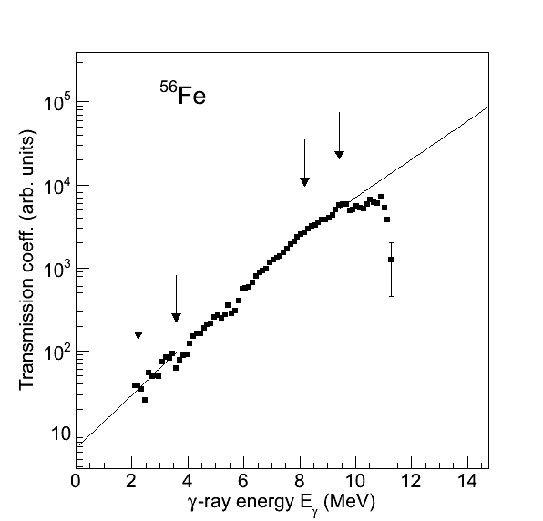
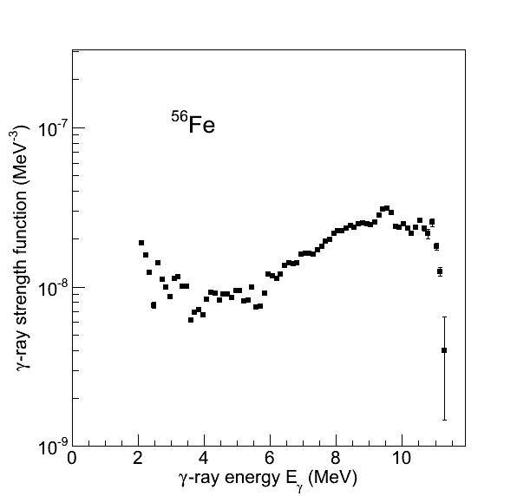
Normalization γSF
The slope α is already given by the level-density normalization
Find B through
Assuming L=1 transitions:

Slide 19
Excitation dependent γSF?
Blind tests with DICEBOX simulated spectra by Milan Krticka – compare with experimental data
A.C. Larsen et al., PRC 83, 034315 (2011)

Slide 20
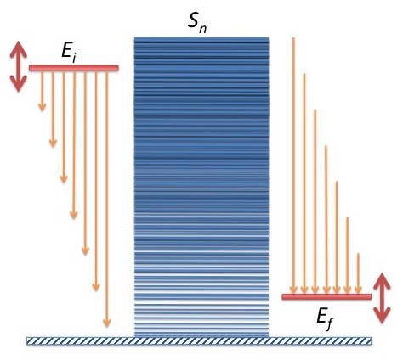
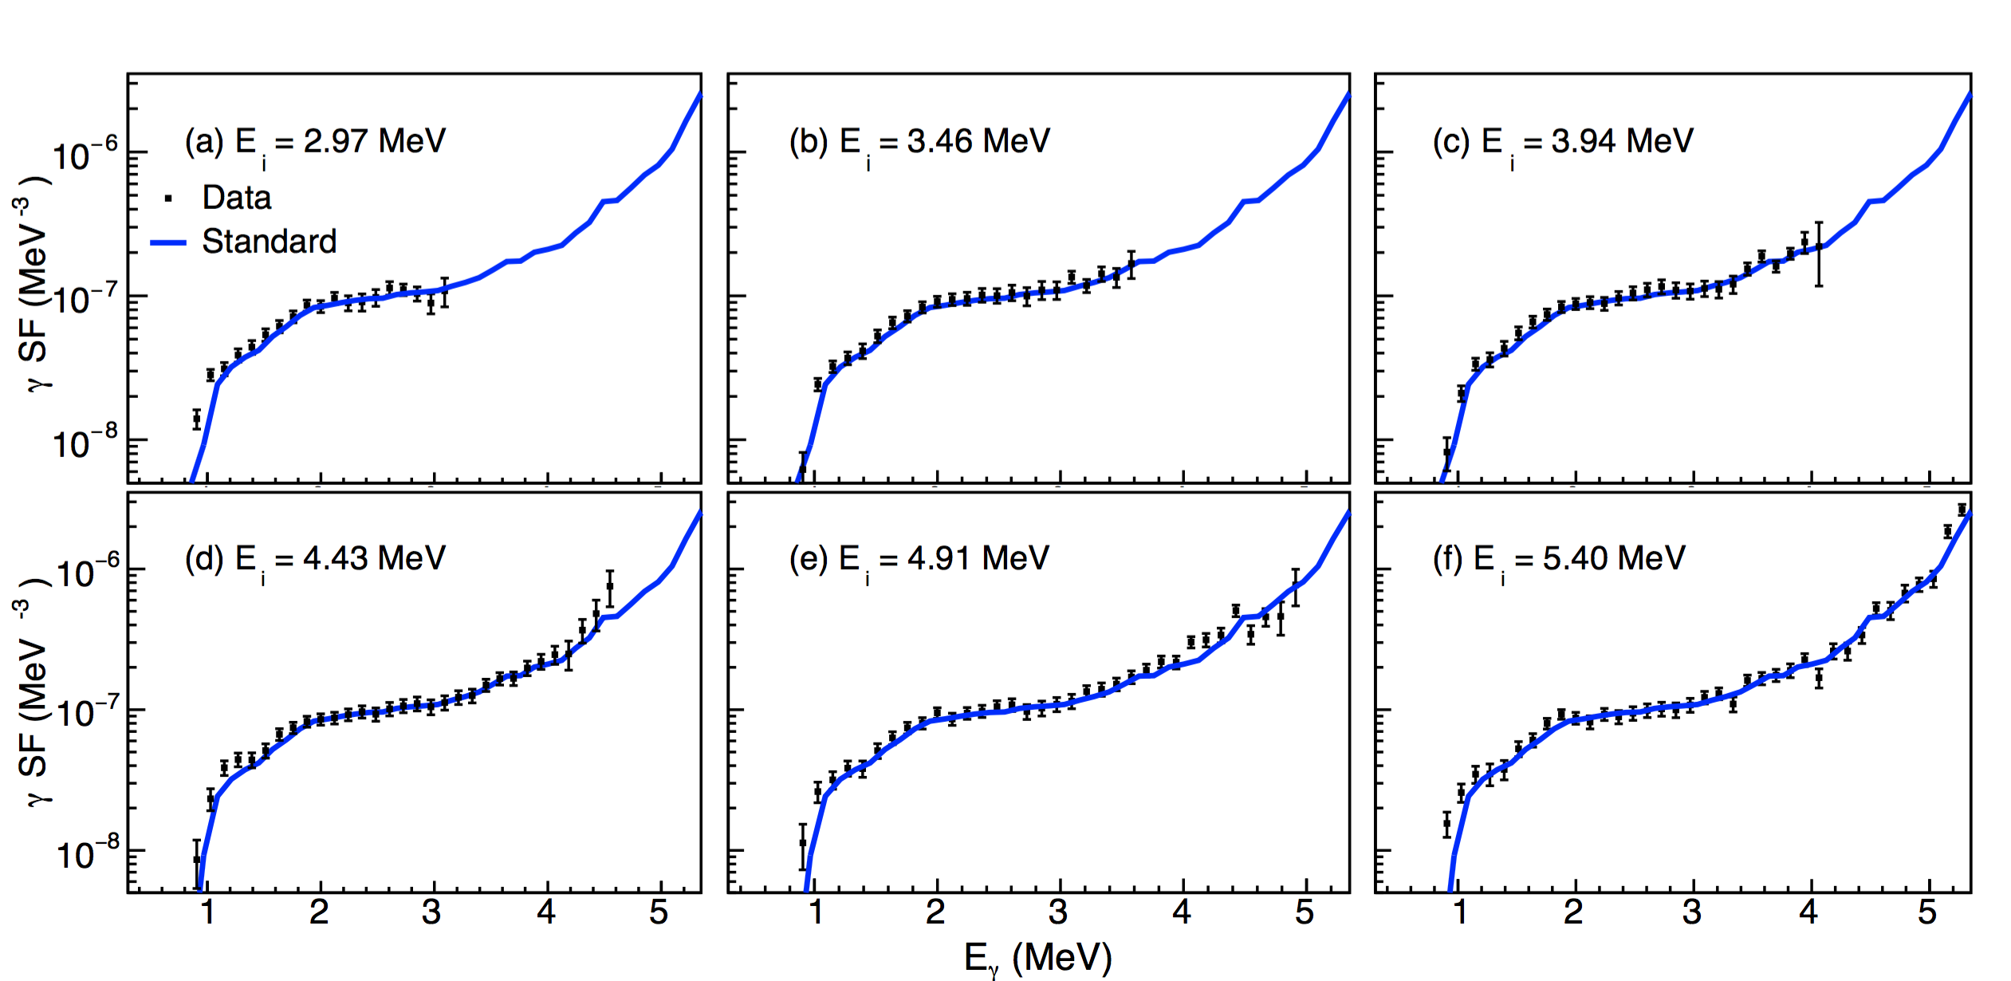
Brink-Axel works for ²³²Np
M. Guttormsen et al., subm. to PRL (2015)

Slide 21
Summary (Part II)
Fitting of primary γ-matrix by ρ(E_{f}) and τ(Ε_{γ}) functions
NLD normalized to known levels and ρ(S_{n}) from D₀
γSF normalized to < Γ_{γ} (S_{n}) >
Spin and parity distributions
Brink-Axel hypothesis

Slide 22

Thank you !

