Slide 1
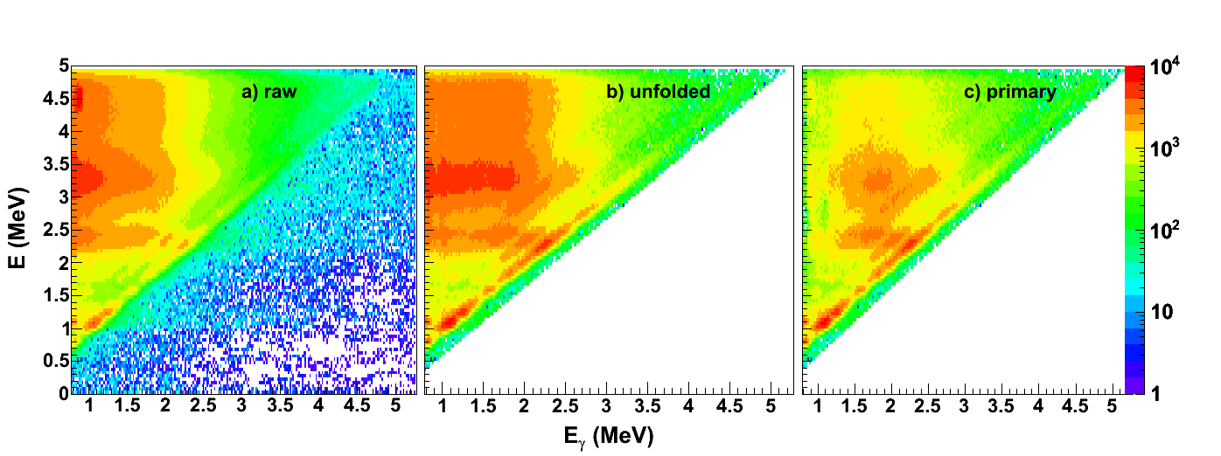
Folding and unfolding of γ-spectra

Slide 2
Unfolding of complex spectra
2

Slide 3
Not perfect γ-detectors
We measure electron energies, not γ-rays!
Back-scattering (Pb)
Photo-electric effect
Multi-Compton
Threshold
Compton
scattering
Pair
production

Slide 4
The problem (I)
N
incomming
Unfolded u
u₁
u₂
E
N
Raw r
measured
e
E
e

Slide 5
The problem (II)
Easy to fold
Difficult to unfold
known = r known unknown

Slide 6
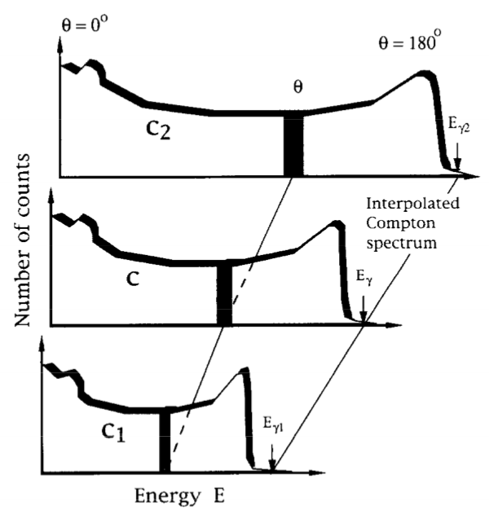
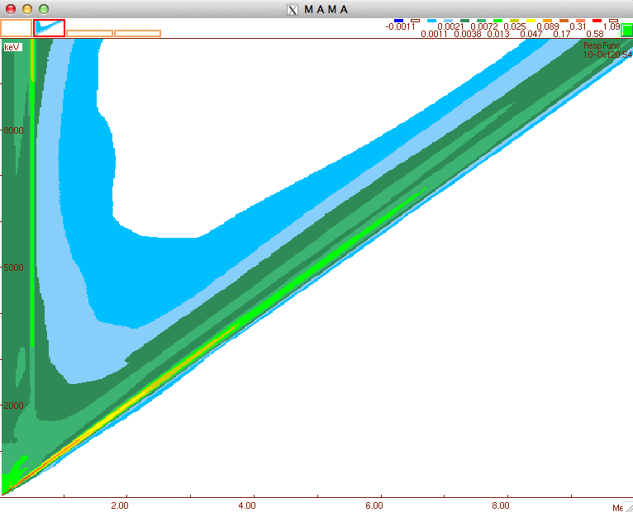
The response matrix
Detector response matrix R(E,Eγ)
Incident energy Eγ
Deposited Eγ in detector
M. Guttormsen et al., NIM A 374, 371 (1996)

Slide 7
The solution?
Channel by channel
Inverting response matrix R
But large fluctuations in u

Slide 8
Alternative solution
Exploit that we know how to fold:
Control by iteration:

Slide 9
Compton subtraction method
The basic principle is that the Compton background is a smoothly varying function, which can be heavily smoothed.
Start with the spectrum from the folding iteration method, u
This can now be used to create the full energy u_{f}, single escape u_{s}, double escape u_{d,} and annihilation u_{a} peaks
The Compton spectrum (with backscattering around Eγ=200-300 keV) is then u_{C} = r – u_{f} – u_{s} – u_{d} – u_{a}
Smooth u_{C} a lot: exp. FWHM
Now, get unfolded spectrum by u_{unf} = = r – u_{f} – u_{s} – u_{d} – u_{a} – u_{C}
Finally, correct for full-energy probability p_{f} and detection efficiency ε: U_{unf} = u_{unf} /(p_{f} ε)

Slide 10
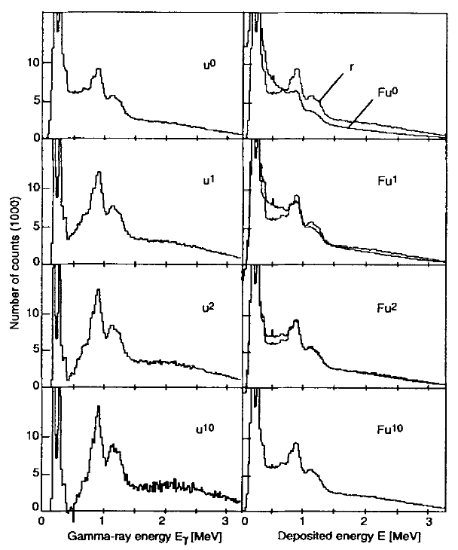
Iterations

Slide 11
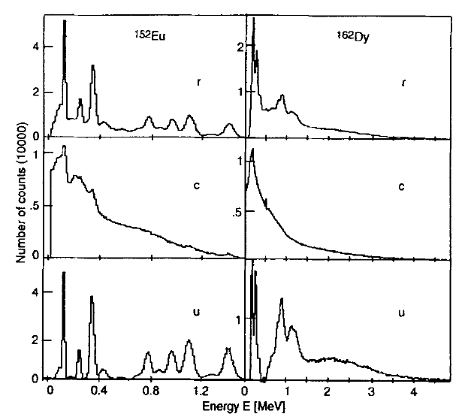
Examples of unfolding

Slide 12
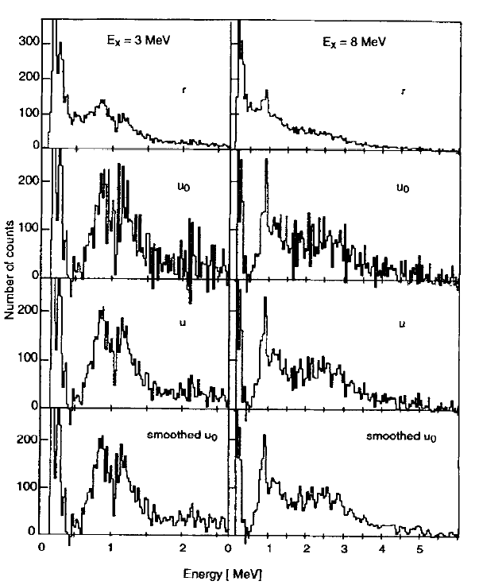
Comparison
Raw
Old
New
Old
smoothed

Slide 13
Summary
Consistent unfolding and folding
Reduced fluctuations with
Compton subtraction method
M. Guttormsen et al., NIM A 374, 371 (1996)

