Slide 1
2-D unfolding of SuN matrices A status report
Magne Guttormsen
Department of Physics
University of Oslo, Norway

Slide 2
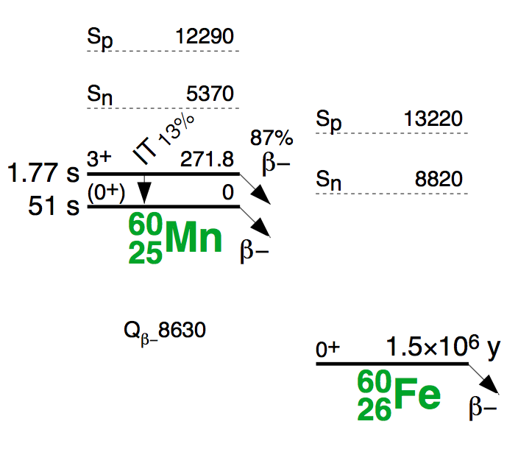
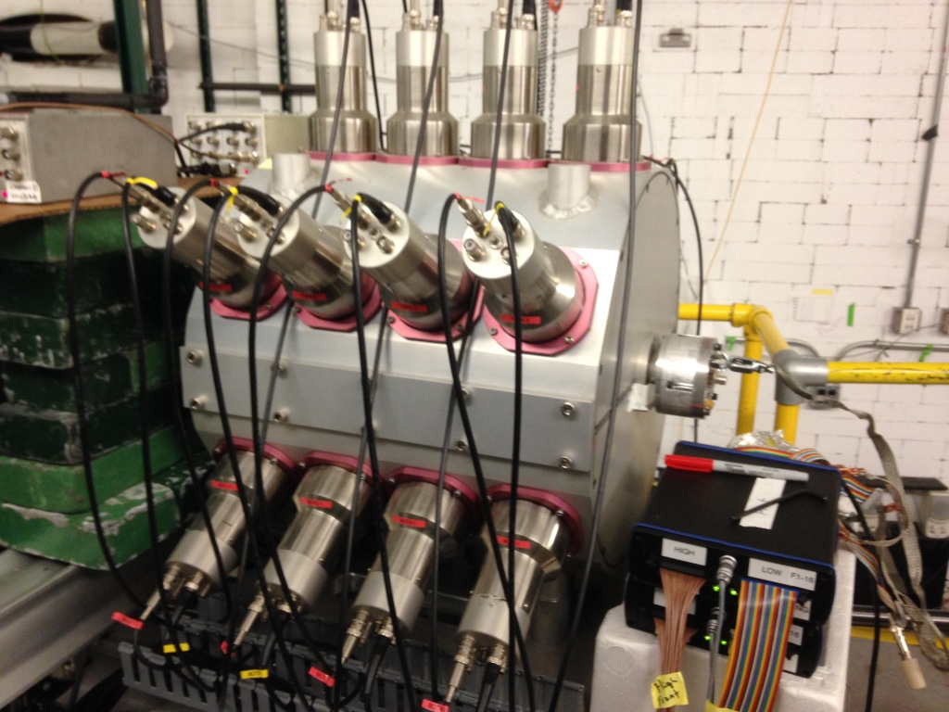
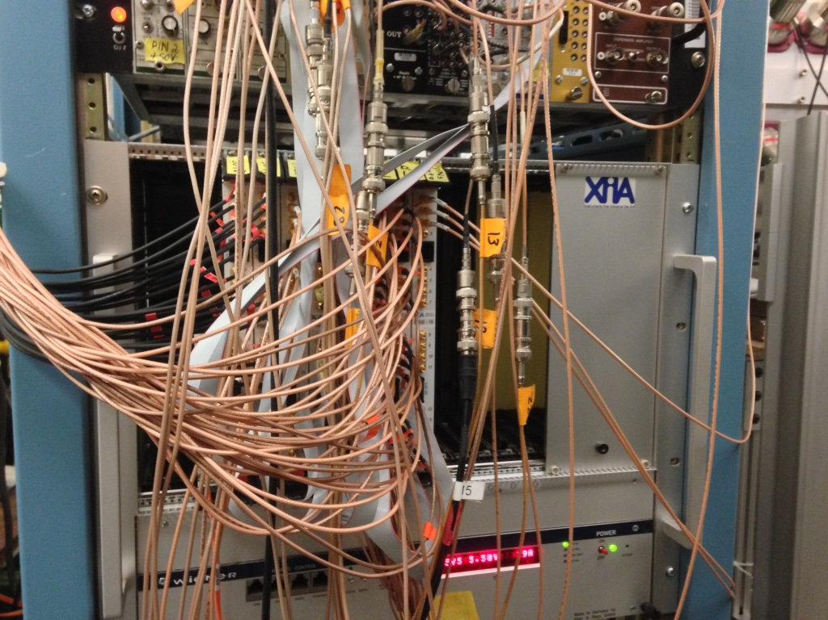
SuN
Total Absorption
Spectrometer (TAS)
@MSU
β-Oslo method

Slide 3
One crystal NaI response function
Back-scattering (Pb)
Photo-electric
effect
Threshold
Compton
scattering
Pair
production

Slide 4
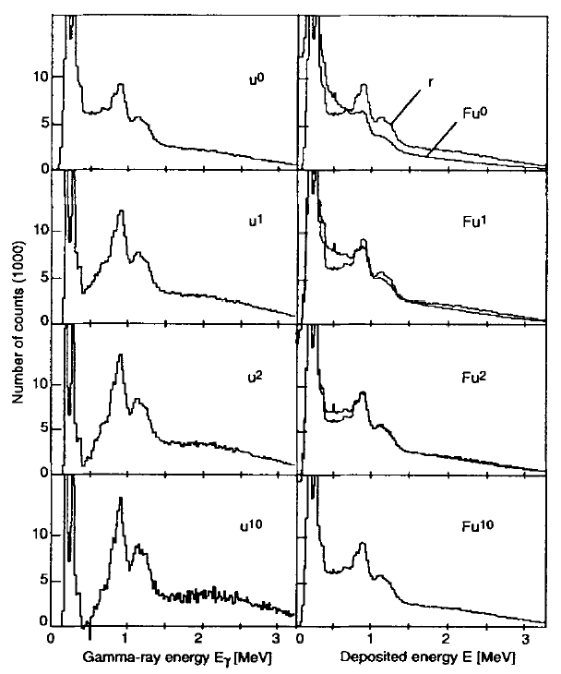
The unfolding algorithm
We know how to fold:

Slide 5
E_{x} = Σ E_{γ} NaI response function
Full-energy
peak
Compton, se, de,
511, back-sc. Etc.
Electrons from
β decay

Slide 6
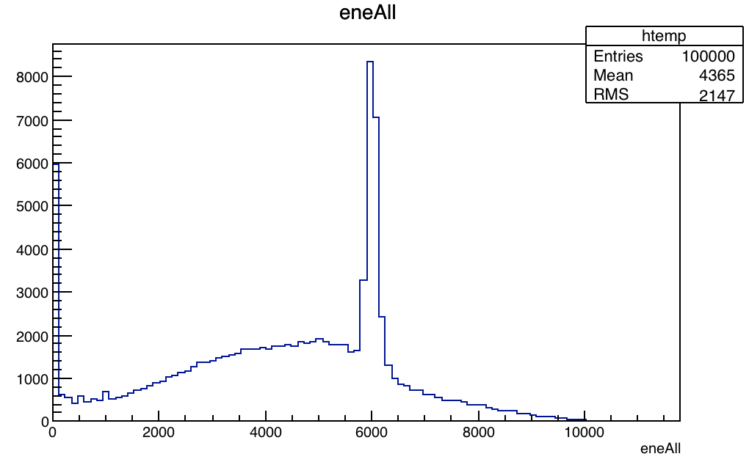
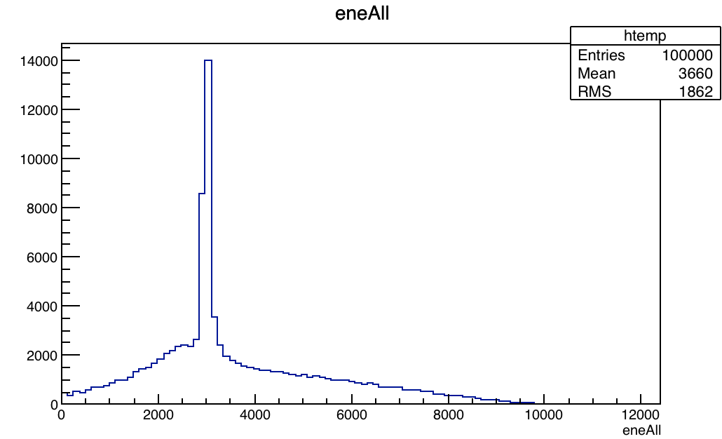
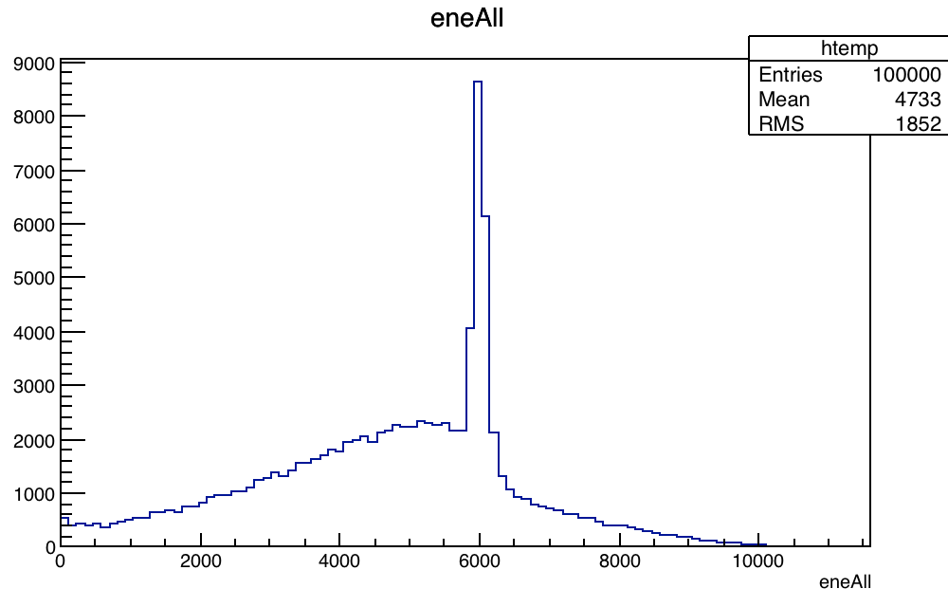
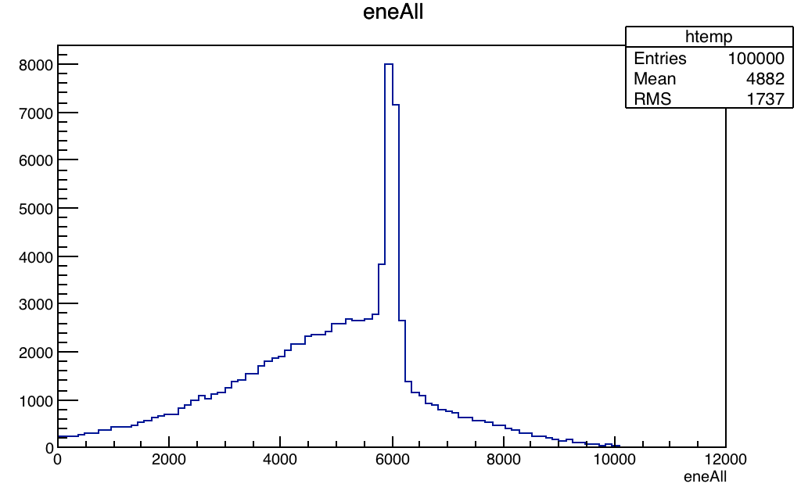
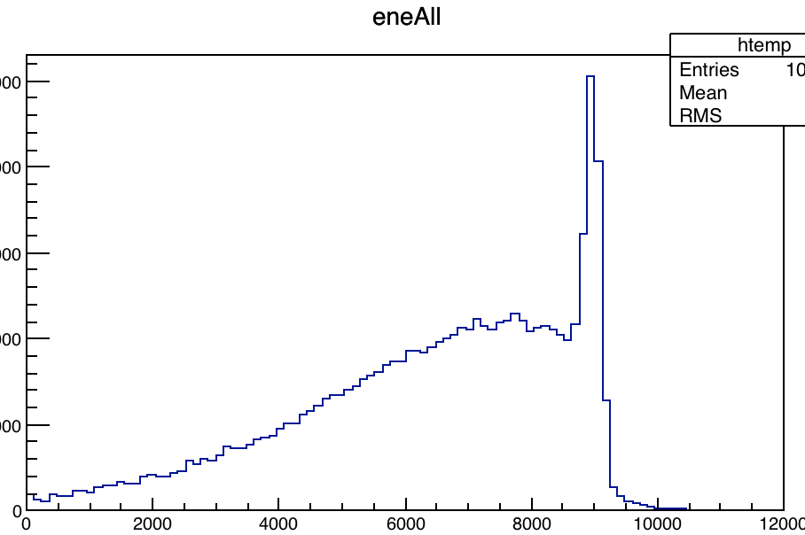
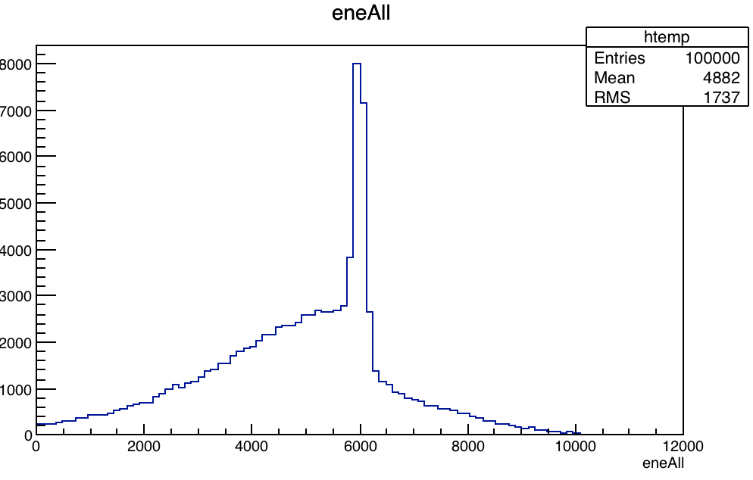
Dependence on E_{x} and M_{γ} ( GEANT4 simulations by Artemis Spyrou )
Ex = 6 MeV
Mγ = 2
Ex = 3 MeV
Mγ = 2
Mγ = 3
Ex = 6 MeV
Mγ = 3
Mγ = 4
Ex = 9 MeV
Mγ = 4

Slide 7
Multiplicity interpolation
Weigths:
wm₁ = (m₂ - m)/(m₂ - m₁)
wm₂ = 1 - wm₁
For all h’s at the same Ex:
h(e) = wm₁ h_{m1}(e) + wm₂ h_{m2} (e)

Slide 8
Ex interpolation below the full-energy peak
h₁
Channel energy:
e₁ = e (e_{max1} /e_{max})
e₂ = e (e_{max2} /e_{max})
Weigths:
we₁ = (e_{max2} - e)/(e_{max2} - e_{max1})
we₂ = 1 - w₁
h(e) = we₁ h₁(e₁) + we₂ h₂(e₂)
e₁
e_{max1}
h
e
e_{max}
h₂
e₂
e_{max2}

Slide 9
Ex interpolation above the full-energy peak
e_{max}
h₁
e_{min1}
e₁
e_{max} = 12 MeV
Channel energy:
e₁ = e_{min1}+(e-e_{min})(e_{max}- e_{min1})/(e_{max}- e_{min})
e₂ = e_{min2}+(e-e_{min})(e_{max}- e_{min2})/(e_{max}- e_{min})
h(e) = we₁ h₁(e₁) + we₂ h₂(e₂)
h
e_{min}
e
h₂
e_{min2}
e₂

Slide 10
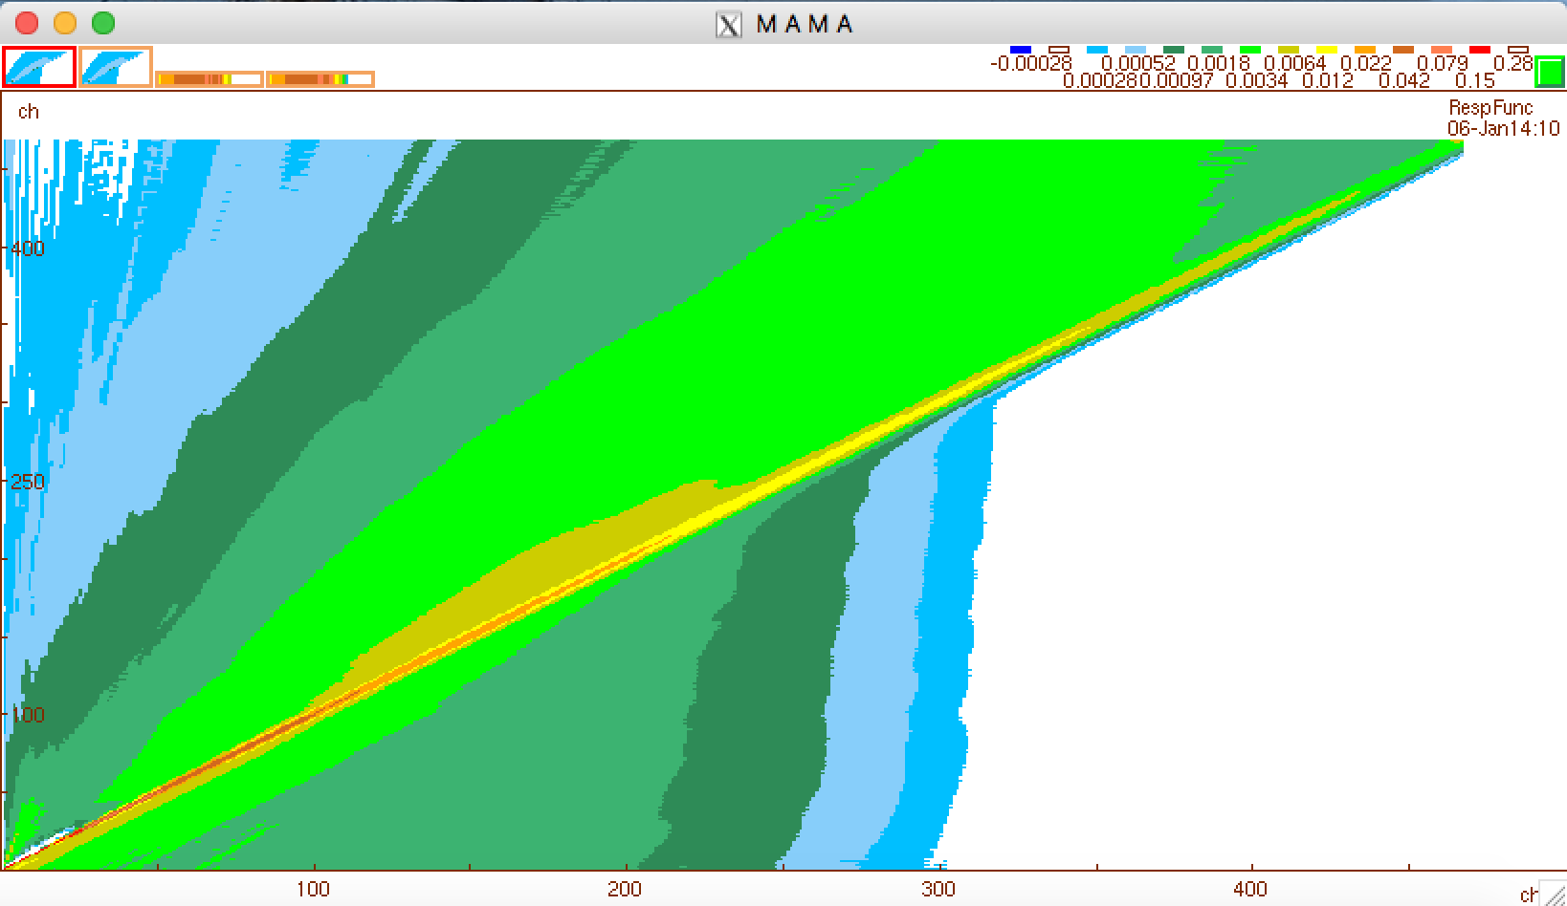
The Ex-response matrix

Slide 11
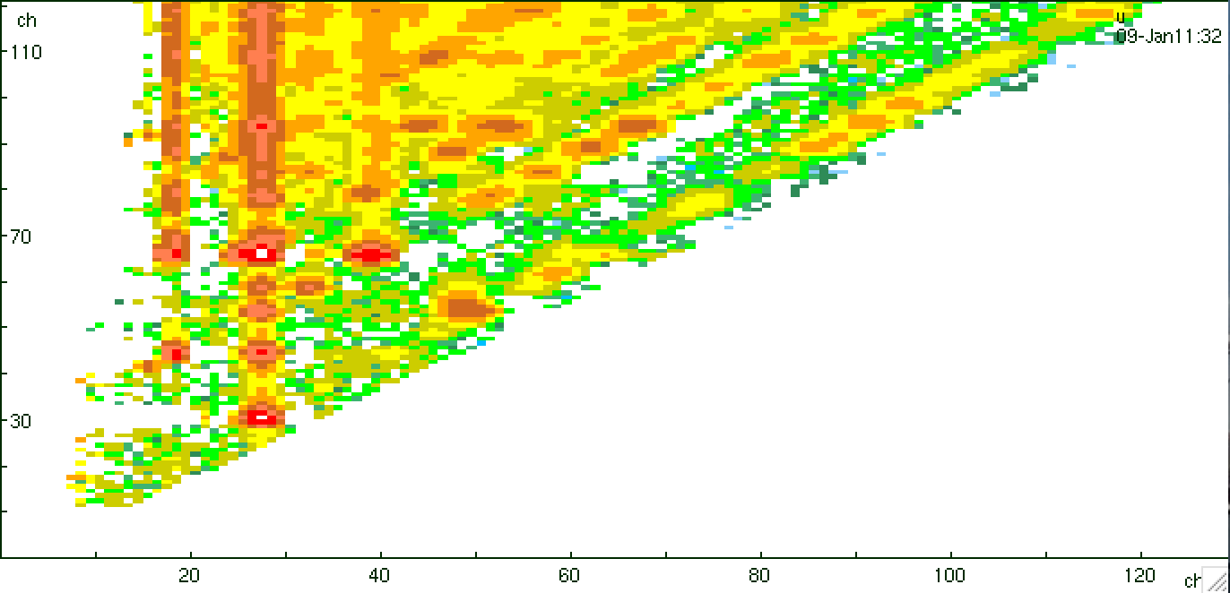
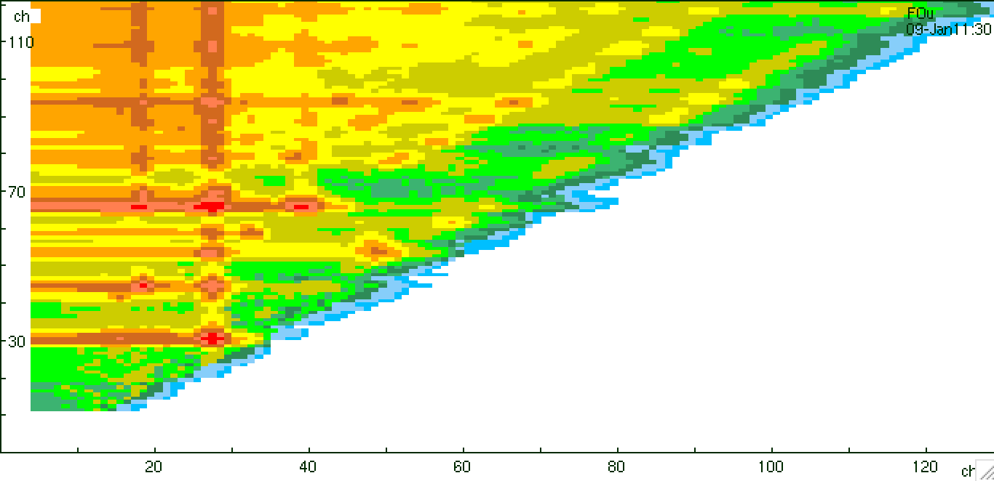
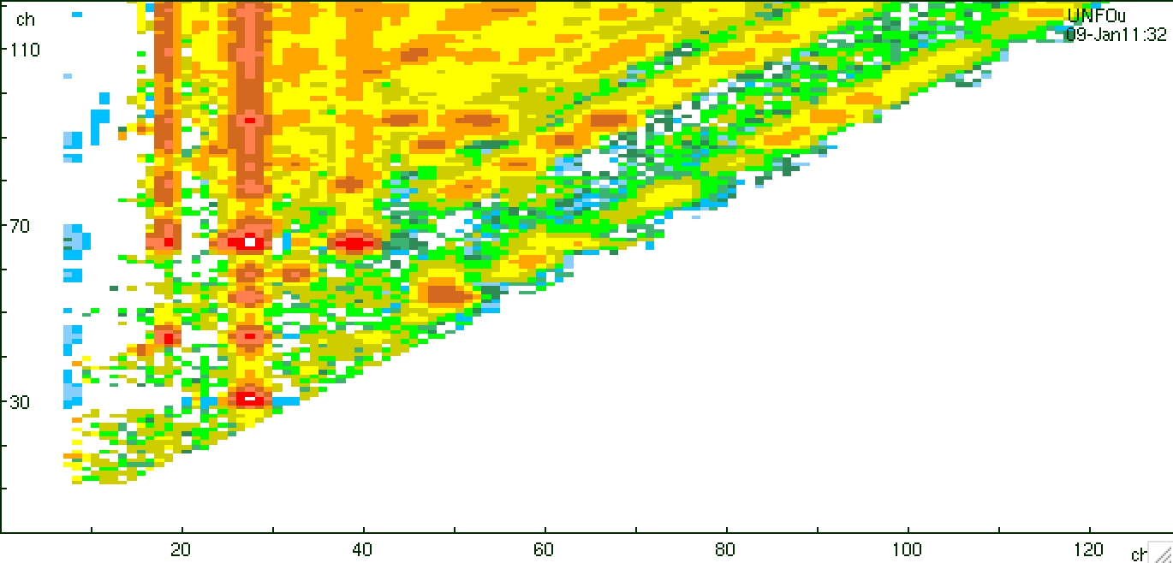
The x-axis (Eγ)
U₀ F_{x} (U₀) U_{x} (F_{x} (U₀))

Slide 12
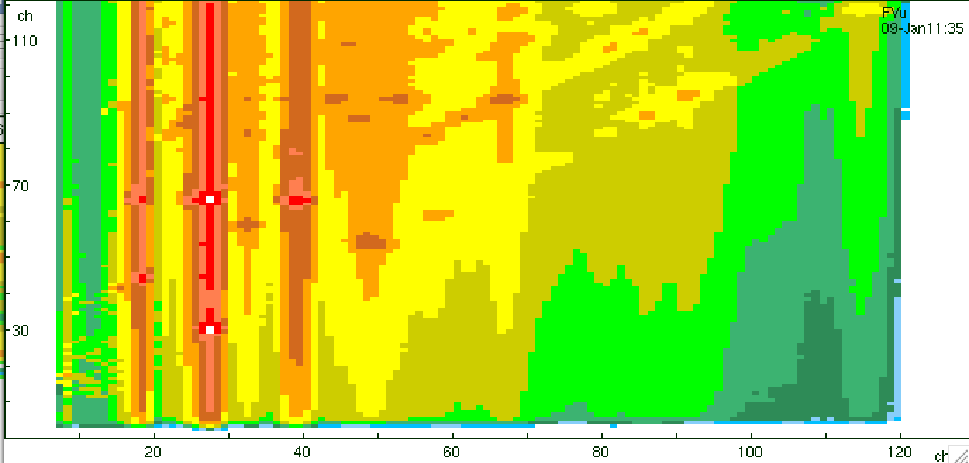
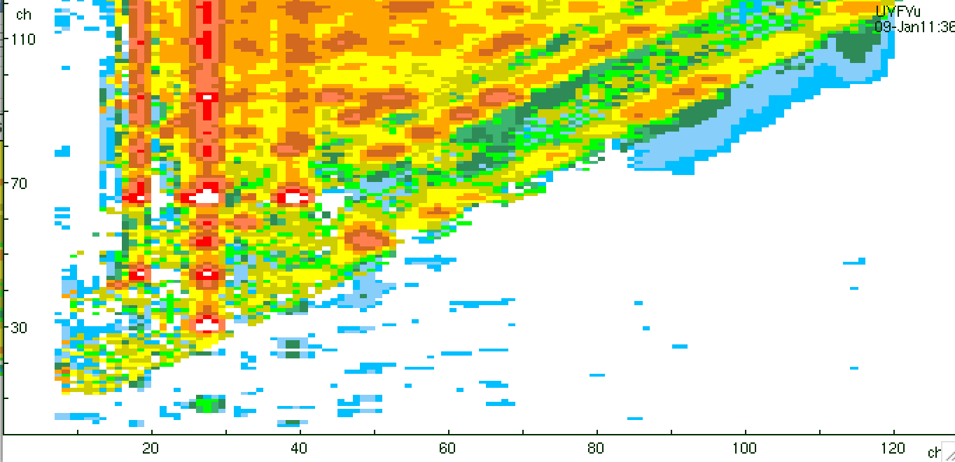
The y-axis (Ex)
U₀ F_{y} (U₀) U_{y} (F_{y} (U₀))

Slide 13
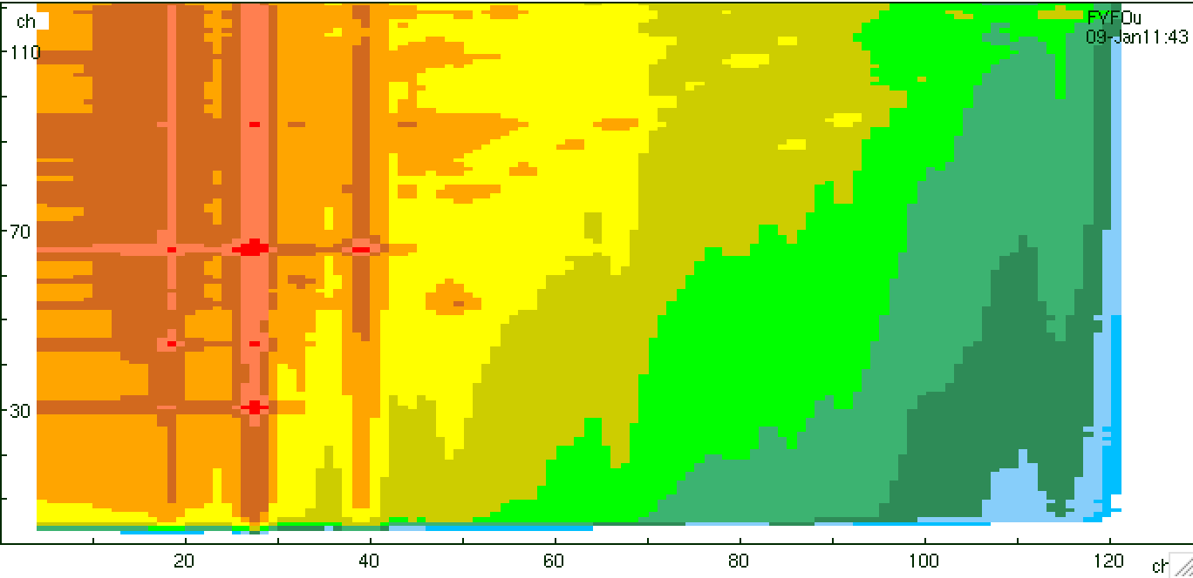
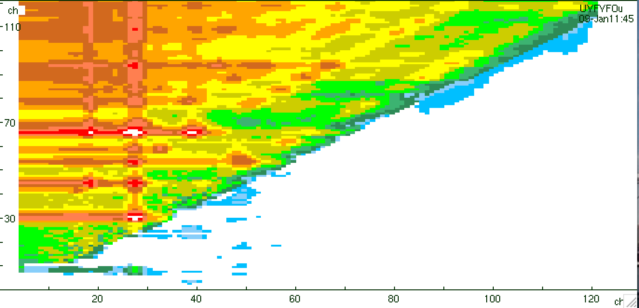
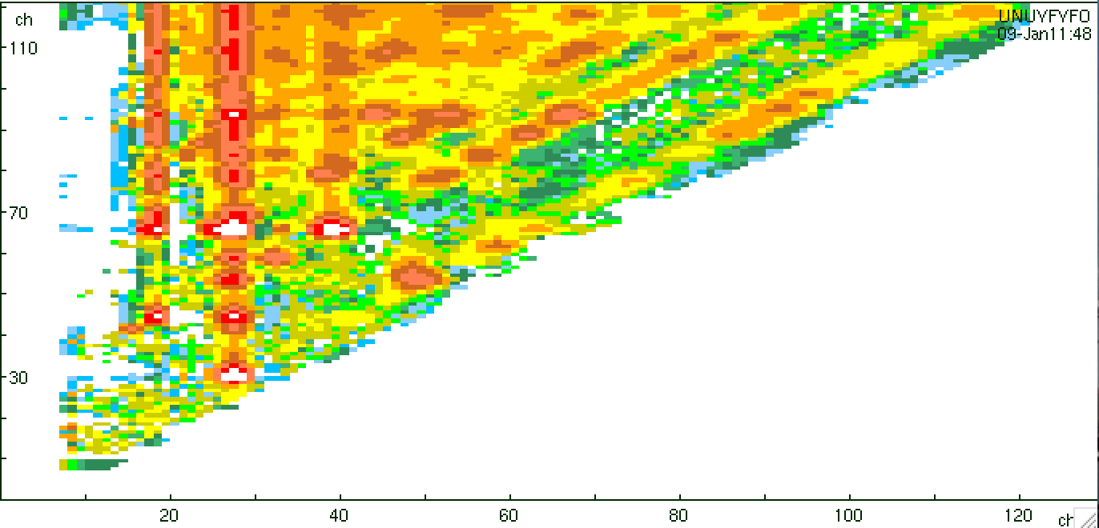
The xy-axis (Eγ,Ex)
F_{y} (F_{x} (U₀ )) U_{y} (F_{y} (F_{x} (U₀ ))) U_{x} (U_{y} (F_{y} (F_{x} (U₀ ))))
U₀

Slide 14
Was it that simple?
No!!!

Slide 15
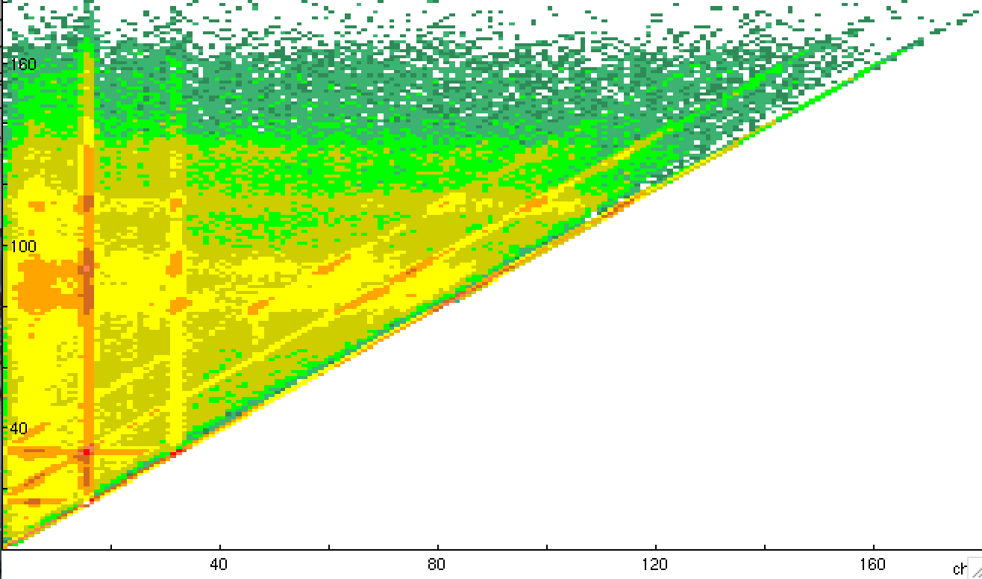
xy – dependence: Fxy is not = FxFy
76Ge
Ex
Eγ

Slide 16
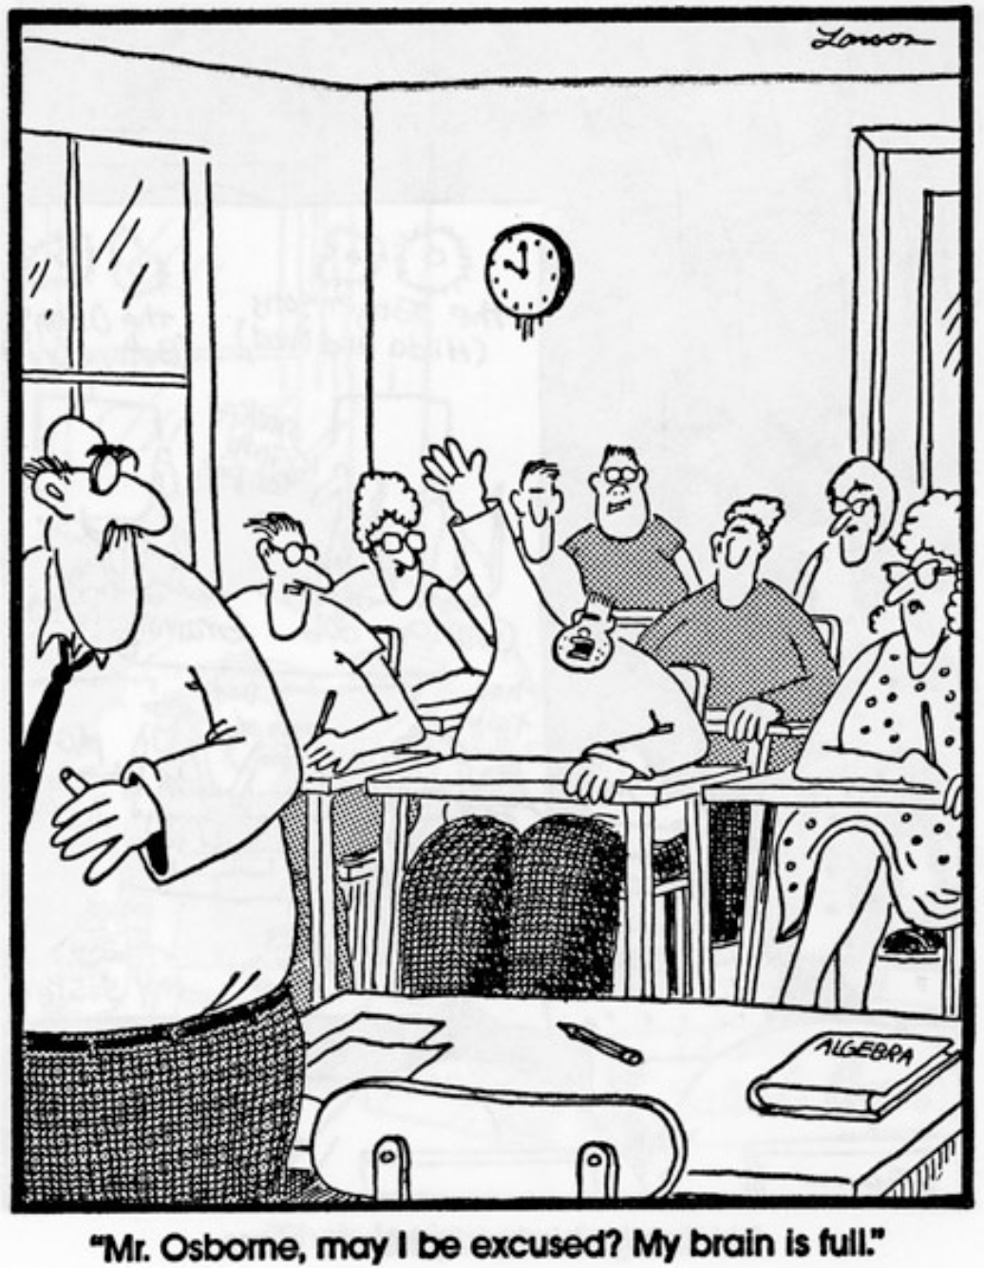
Thank you !
Mr. Osbome,
may I be excused?
My brain is full.

