Slide 1
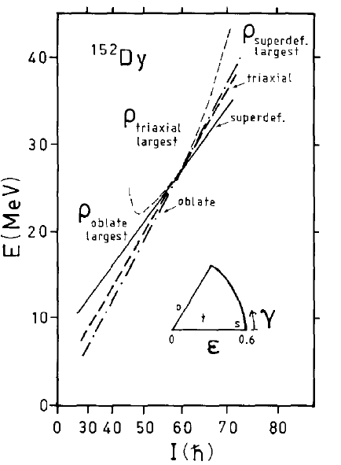
High-spin level densities
on three co-existing
deformations
S.Å. Nucl Phys 1988

Slide 2
Statistical assumptions
In reaction calculations it is often assumed a statistical mixing
also of the good quantum numbers parity and angular momentum
Parity
Equal participation of both parities:
Angular momentum
Statistical mixing of Ω (=j_{z}) states:
Spin-distribution function:
with spin cut-off factor:

Slide 3
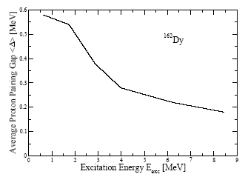
Pairing remains to high exc. energies
Average proton pair gap
vs excitation energy:
Eff. moment of inertia
reduced up to > 8 MeV
1
0.5
¹⁶²Dy
J_{eff.}/J_{rig.}
Δ_{p} (MeV)
0.5
¹⁶²Dy
0
0
2
4
6
0
8
2
4
6
8
E_{exc} (MeV)
E_{exc} (MeV)
- Average pairing remains non-zero at high excitation energies!
Blocking of qp states far away from Fermi energy region does not affect pairing
- No pairing phase transition!
Very different from canonical treatment!
Consequences?
Moment of inertia. Width of spin distribution.

Slide 4
I. Parity Enhancement

Slide 5
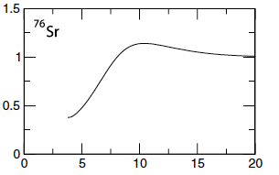

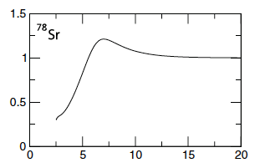
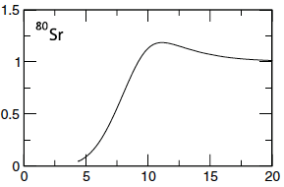

Parity distributions assuming Poisson distributed quasi-particles + BCS [1]
Suggests that parity ratio may
equilibrate at high Eexc
[1] D. Mocelj, T. Rauscher, G. Martínes-Pinedo, K. Langanke, L. Pacearescu,
A. Faessler, F.-K. Thielemann, Y. Alhassid, PRC 75, 045805 (2007)

Slide 6
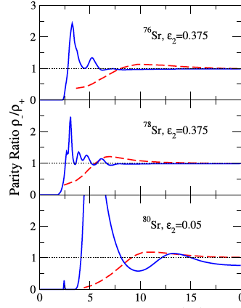

Red dashed line: [1]
Blue solid line:
Present calculation
20
[1] D. Mocelj, T. Rauscher, G. Martínes-Pinedo, K. Langanke, L. Pacearescu,
A. Faessler, F.-K. Thielemann, Y. Alhassid, PRC 75, 045805 (2007)

Slide 7
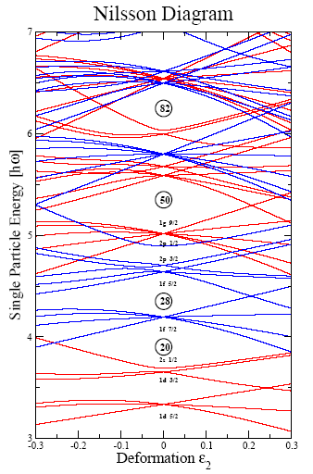
Simple understanding of parity enhancement
Role of particle number and deformation
N=48
N=52
Z=30
N=44
positive parity:
negative parity:
Huge parity enhancements!

Slide 8
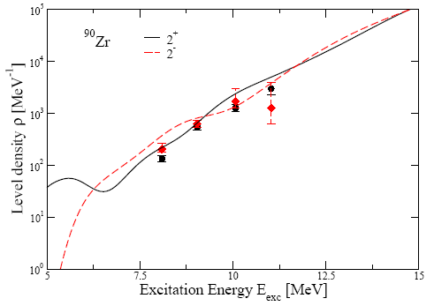
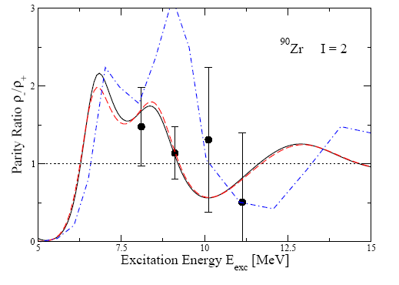
Measured parity enhancement in ⁹⁰Zr
Individual 2⁺ and 2⁻ level dens.
Parity ratio
Skyrme HF [2]
40
Present calc.
2⁺
2⁻
total
Exp. [1]
I=2
Present calc.
[1] High-res E2 (p-scatt.) and M2 (el. scatt.) giant res.
Y. Kalmykov et al Phys Rev Lett 99 (2007) 202502 (Richter exp.)
[2] Skyrme-Hartree-Fock calc.
S. Hilaire and G. Goriely, Nucl. Phys. A779 (2006) 63

Slide 9
Parity enhancement – role of spin distribution
Parity enhancement may quickly saturate:
What about individual spins?
Spin distributions for different parities
44
44
- Saturate at higher E_{exc}
- Different for different spins
even positive-parity spins favoured
Study spin distribution!

Slide 10
II. Structure in spin distribution

Slide 11
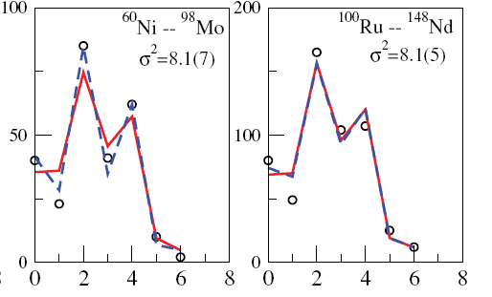
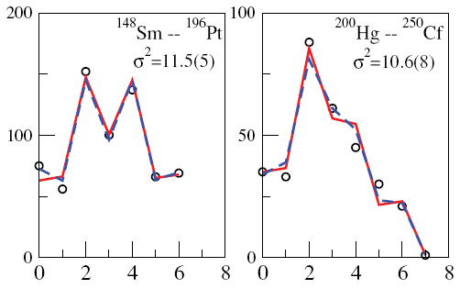
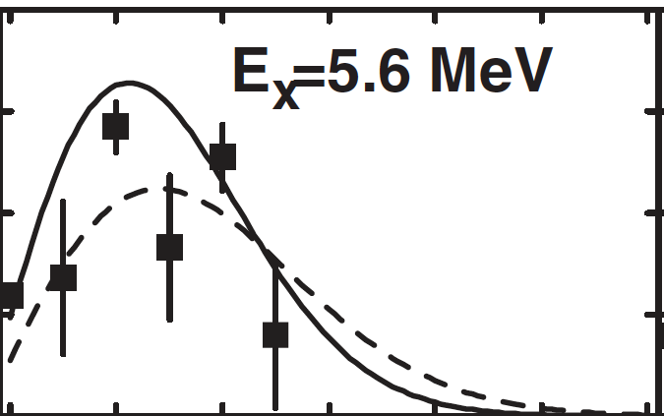
Observed structure effects in spin distributions [1]
From discrete levels in even-even nuclei; low E_{exc} < 3 MeV
Odd-even staggering! Favouring even I
No A-dependence
Shell-model Monte Carlo
calc for ⁵⁶Fe (spherical) [2]
[1] T. von Egidy and D. Bucurescu, PRC 78, 051301 (R) (2008)
[2] Y. Alhassid, S. Liu, H. Nakada, PRL99, 162504 (2007)

Slide 12
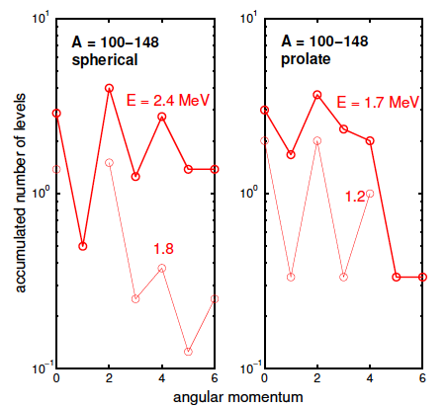
Spin distributions averaged over many nuclei
Exp. data
(open-shell)
Systematic odd-even spin staggering.
Even spins much more frequent.

Slide 13
Low-lying states – exp.data
Spherical
Deformed
K=0
K=2
K=0
Open-shell spherical j-shell:
seniority coupling e.g (j)² I=0,2,..(2j-1)
even spins positive-parity favoured
K=0 rotational bands (if r-symmetry):
even spins positive-parity favoured
⇧
⇧
Odd-even staggering in spin-distribution function
appears for deformed and open-shell spherical nuclei

Slide 14
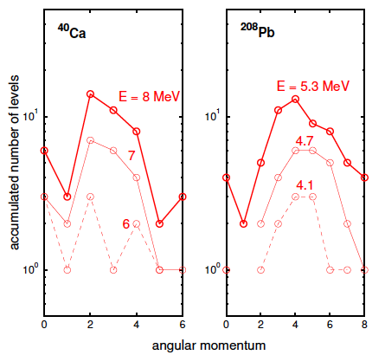
While for closed-shell spherical nuclei
Exp. data
No systematic behavior

Slide 15
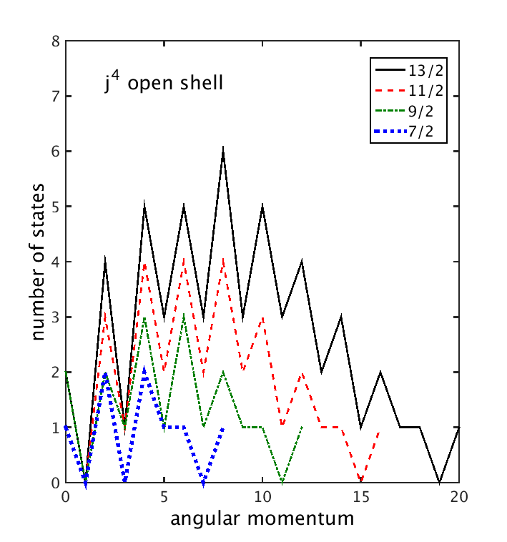
Open-shell spherical nuclei
Fermion exchange symmetry causes staggering

Slide 16
If r-symmetric nuclear shape
rotational bands on K=0 band head:
if v = 0: I = 0, 2, 4, ….
if v > 0: I = 0, 1, 2, ….
Consider in Fermi-gas model
K=0 excitations in deformed nuclei,
assuming r-symmetry.

Slide 17
Two kinds of K=0 excitations – Role of seniority
Ω₂=Ω₁
Ω₁
ground state
v=2 2pq exc.
v=0 pair exc.
I = 0^{π}, 1^{π}, 2^{π}, 3^{π}, …
I = 0⁺, 2⁺, 4⁺, 6⁺, …
Level density
(Fermi gas):

Slide 18
Two kinds of K=0 excitations
Accumulated level dens of K=0 band heads
Fermi-gas model, A=168, seniority = v
v>0
Acc. level dens
v>0
Acc. level dens
v=0
v=0
E_{exc} (MeV)
E_{exc} (MeV)
v=0 part ignored in traditional Fermi-gas model
v=0 states favour pair-vibrations
dis-favour β-vibrations

Slide 19
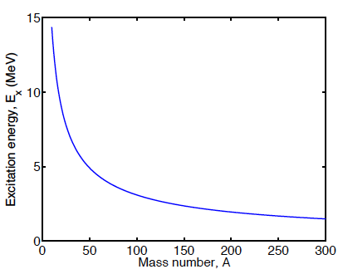
Two kinds of K=0 excitations
v=0, K=0 states dominate for
v>0 states dominate
v=0 states dominate

Slide 20
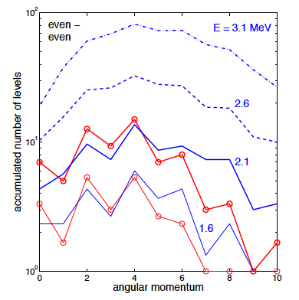
Observed and calculated spin-distribution – even-even nuclei
Exp. data
(^{156,158}Gd,¹⁶⁸Er)
- Seniority-zero, K=0 states cause staggering
- Dissapear with increasing exc. energy

Slide 21
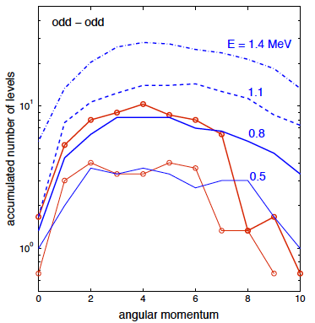
Observed and calculated spin-distributions – odd-odd nuclei
Exp. data
(¹⁶⁶Ho,¹⁷⁶Lu,¹⁸²Ta)
odd-odd nuclei ➔no zeniority-zero states ➔ no staggering

Slide 22
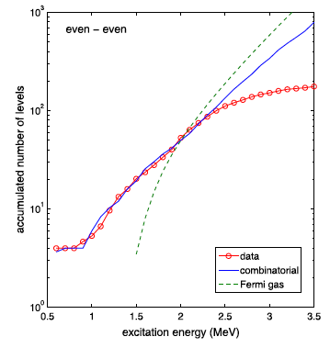
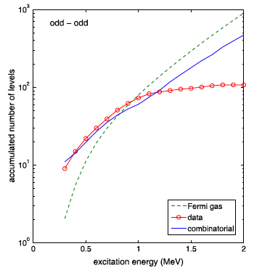
Accumulation of all levels in three nuclei
Excellent agreement

Slide 23
III. Summary
Parity and spin distributions from microscopic model may
deviate strongly from Fermi-gas model – also at high E_{exc}
Observed odd-even staggering in spin-distribution
- due to seniority-zero states

