Slide 1
Angular momentum dynamics
-- The difference between the total level density and
the actual level density accesible to the Oslo method

Slide 2
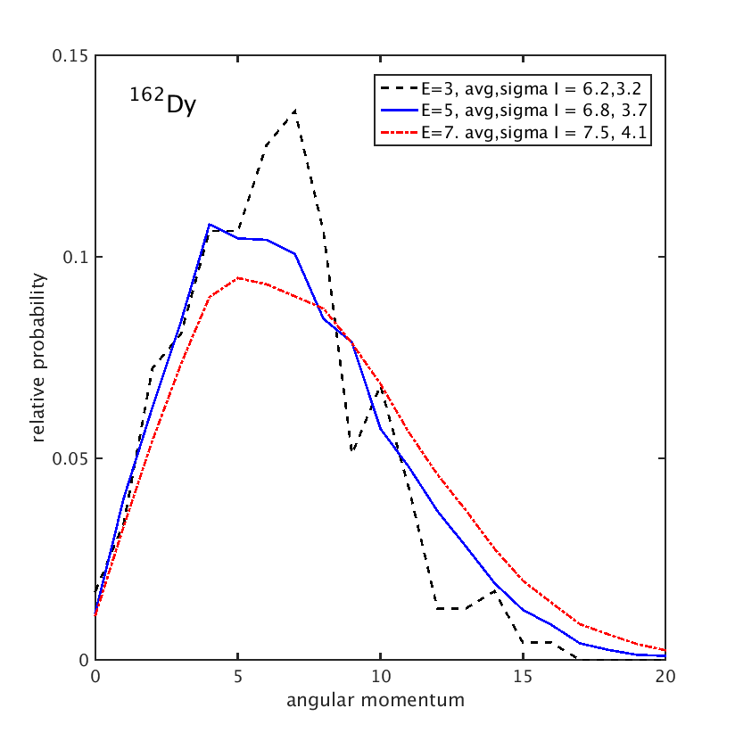
Distribution of angular momentum of the calculated total level density

Slide 3
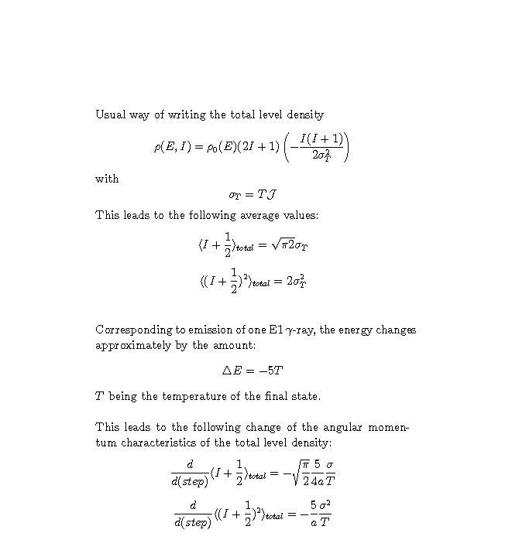
Shrinking of total distribution along decay cascade

Slide 4
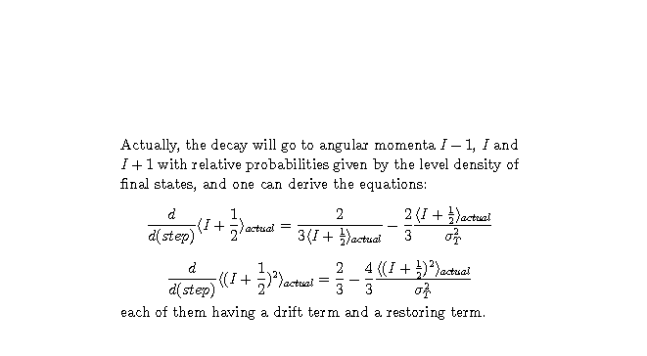
Shrinking of actual distribution along decay cascade

Slide 5
Views of gamma-cascades – total or actual level density
total actual
angular momentum
energy

Slide 6
Scaling to total level density
Problems:
only scaling at ends (small problem)
How to choose sigma
resolved at S
n
resolved at low E

