Slide 1
Combinatorial level density evaluation
-- Basis:
PM levels (folded Yukawa), gap parameter,
moment of inertia parameterisation. (no fit)
-- a) Program and basic results:
- how to generate levels
- comparison to resolved levels at low energy and at neutron
separation energy
- basic comparison to Oslo results
S Åberg
P. Møller
T. Døssing
H. Uhrenholt
G. Carlsson
Daniel
-- b) Applications and results sofar: (Sven)

Slide 2
Generating configurations
Single particle states sorted into 2 * 3 loops - base 3 numbers
Pairing
Interval
+- 8 MeV
particle state 100002
λ
λ
hole state 0000111
- no of p. = no. of h.
- unpaired E < E
-> go on to pairing
max

Slide 3
Particles => quasiparticles
Possible truncation of quasiparticles: “throw particles back into the BCS vacuum”:
-> one paired state for each unpaired
One qp. state:
not contributing to pairing
Two qp’s in time reversed
orbitals: counteracts pairing
λ
λ
λ
truncation 6 q.p. -> 4 q.p.
cannot be truncated: 6 q.p.

Slide 4
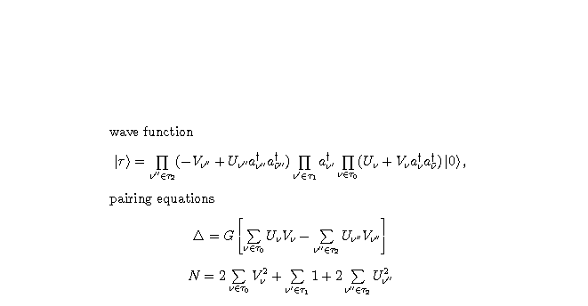
Blocking BCS equations
problem: non-orthogonality of states

Slide 5
Physical states: build rotational bands
Combine neutrons and protons to all possible intrinsic states,
characterized by angular momentum projection K.
Build rotational band on top of each K-state: each state combines with r-symmetric state of –K to form band head. Moment of inertia depends on and
Problem: keep track of K = +0 and -0 to form one band. Solution random numbers: K = + 0.00013 combines with K = - 0.00013
Δ
Δ
p
n
K = 2 band
energy
K = 0 band
angular momentum

Slide 6
Special case: seniority zero
pairwise excitations of particles in time-reversed orbitals :
r(state) = state: Only even angular momenta K = 0
Examples: ground state and lowest 2 q.p. excitation.
π
+
λ
λ
λ
λ
ground state. 4 q.p. → either 2.q.p (part.) or 2.q.p (hole)

Slide 7
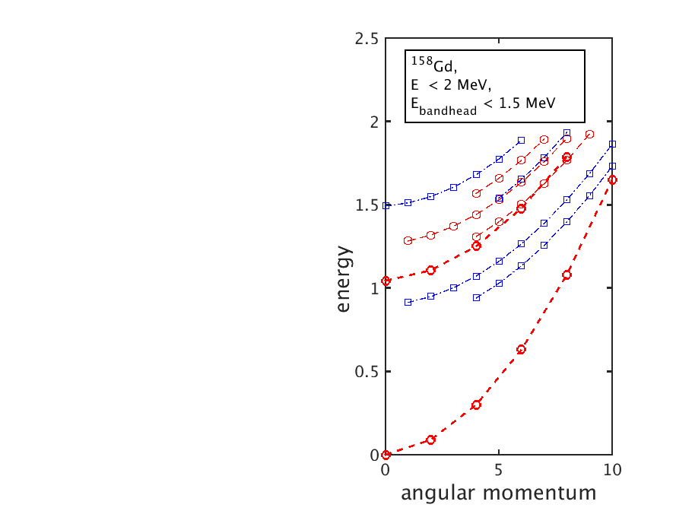
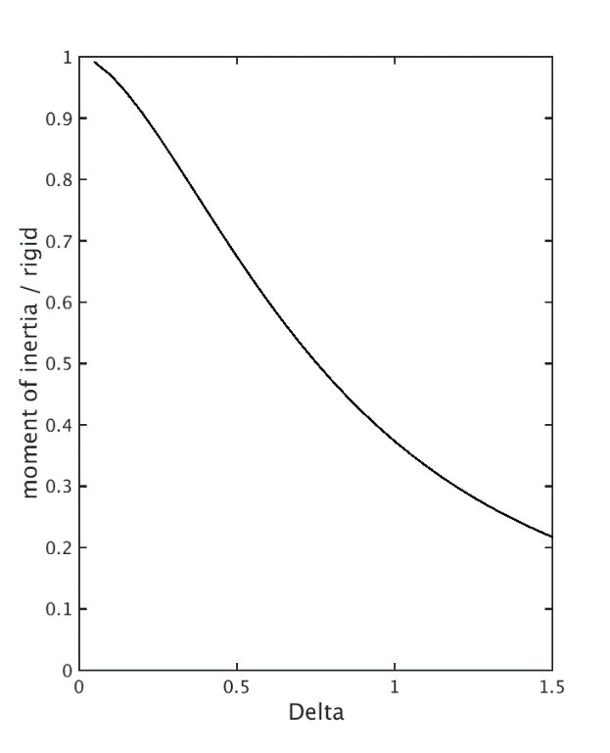
Moment of inertia – and one example
Scaling of moment of inertia (Belyaev):
Pairing gap Δ

Slide 8
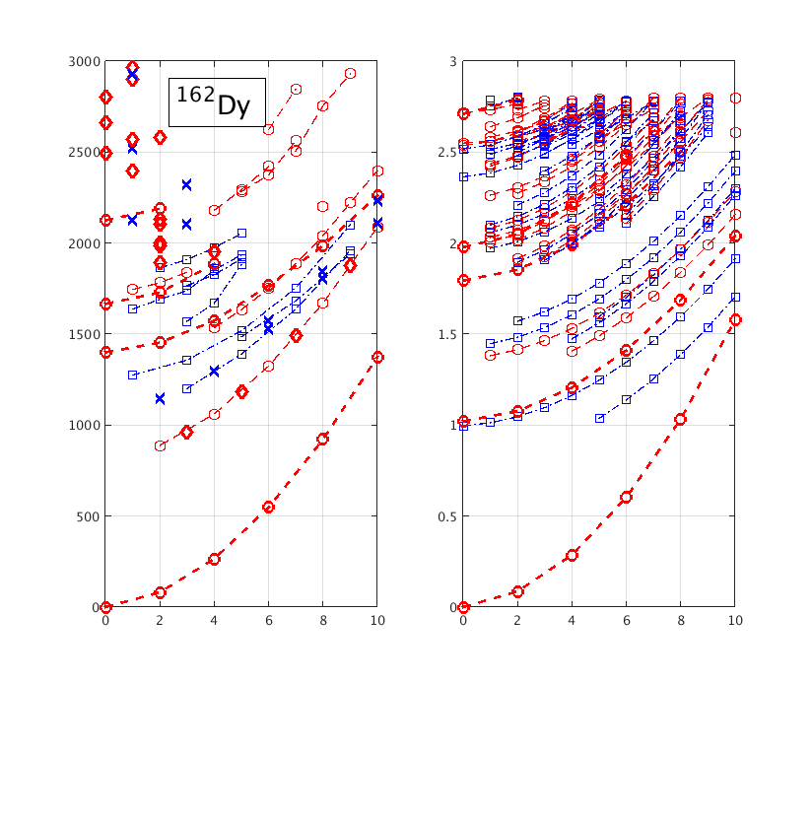
Move on to results – lowest energies in 162Dy
data calculation
energy
complete
angular momentum

Slide 9
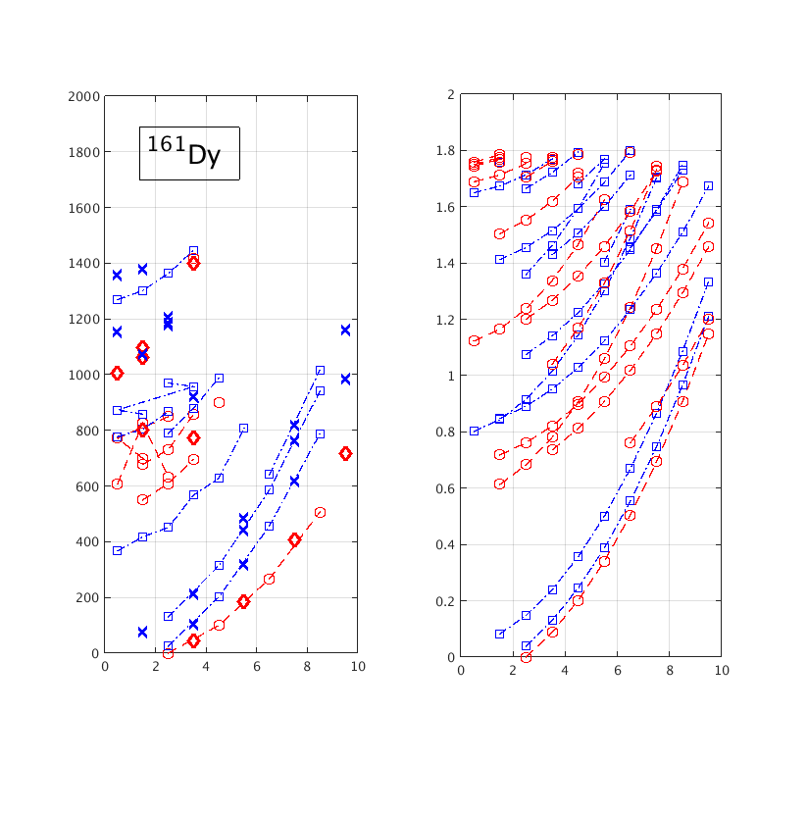
Lowest energies in 161Dy
data calculation
energy
angular momentum
complete

Slide 10
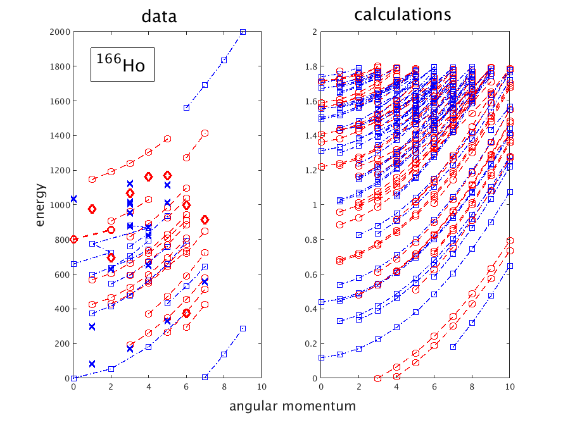
Lowest energies in 166Ho

Slide 11
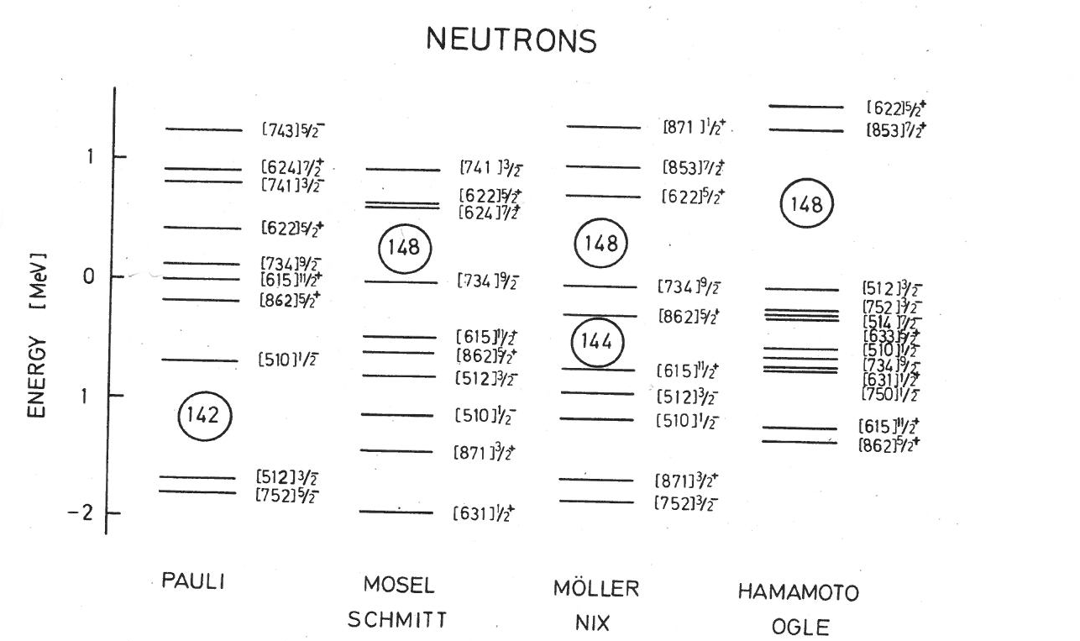
How much emphasis on single states and specific nuclei?
From the study of fission isomers -- V. Metag, in conference
“Physics and Chemistry of Fission”, Jülich, 1980
-
3
[512]
2
+
5
[862]
2

Slide 12
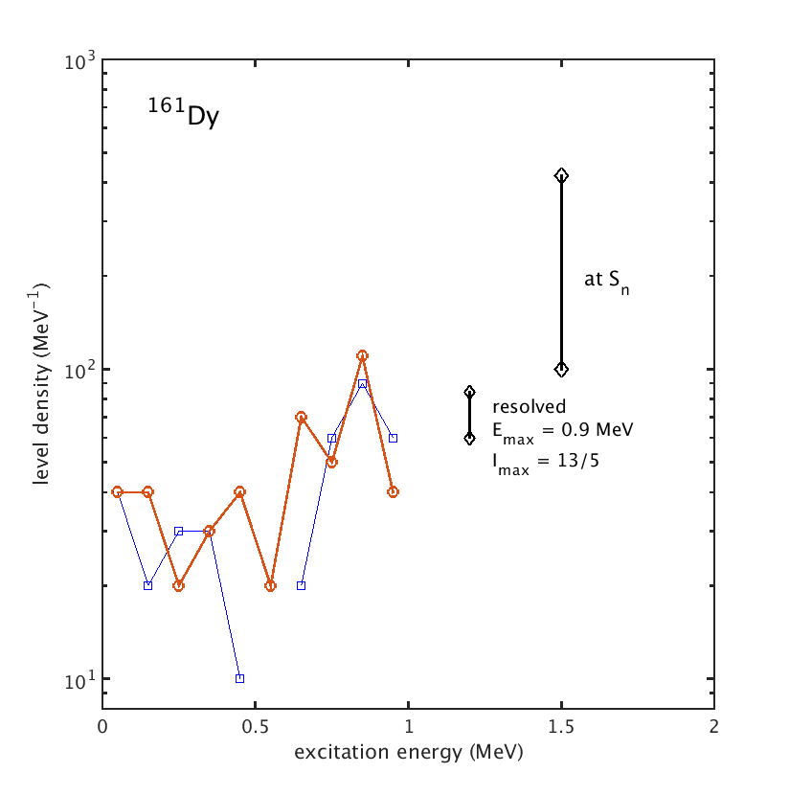
Level density from resolved states in 161Dy

Slide 13
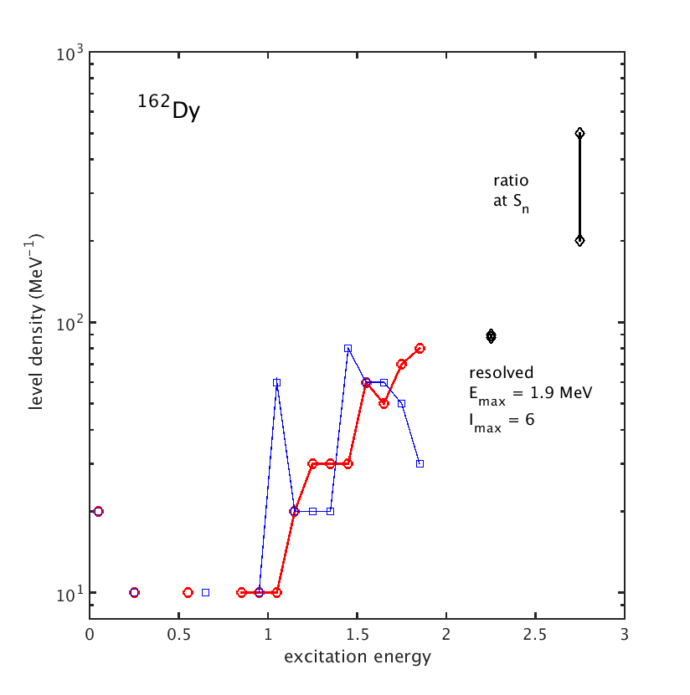
Level density from resolved states in 162Dy

Slide 14
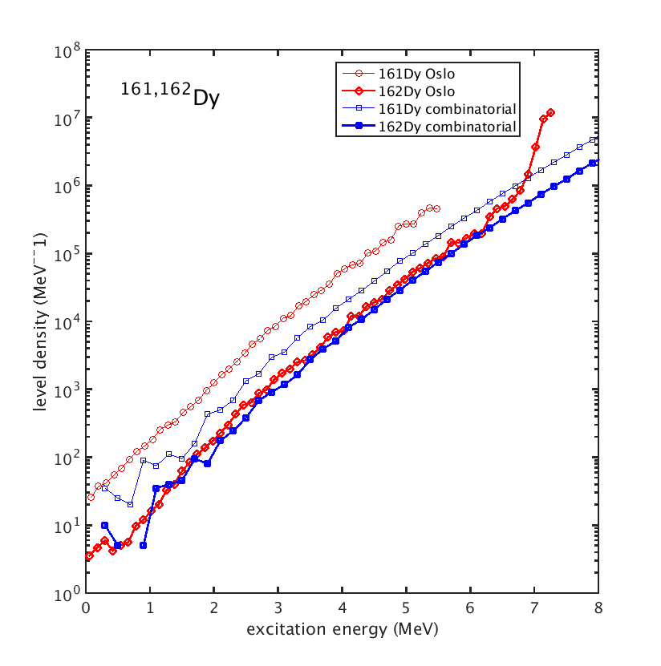
Total level density in 161,162Dy

Slide 15
Status
Combinatorial level density
- level density can be calculated up to
36 MeV for mass 160 nucleus (takes ~ 36 hours)
72 MeV for mass 80 nucleus
20 MeV for mass 250 nucleus
- realistic description of level density of resolved low lying
levels in mass 160 nuclei
individual levels within +- 500 keV (typical for single particle potentials)
at neutron separation energy (6-7 MeV)
calculated level density below experimental – factor of about 2-6
Comparison to Oslo data:
Discrepancy in regions of resolved levels – why?

