Slide 1
Thermal properties
Microcanonical temperature
Smoothing of logarithm of level density:
slope → microcanonical temperaure
Canonical ensemble:
nucleus out of thermal bath – Partition function etc.
-- Topics to discuss:
evidence for constant temperature
signatures of a phase transition

Slide 2
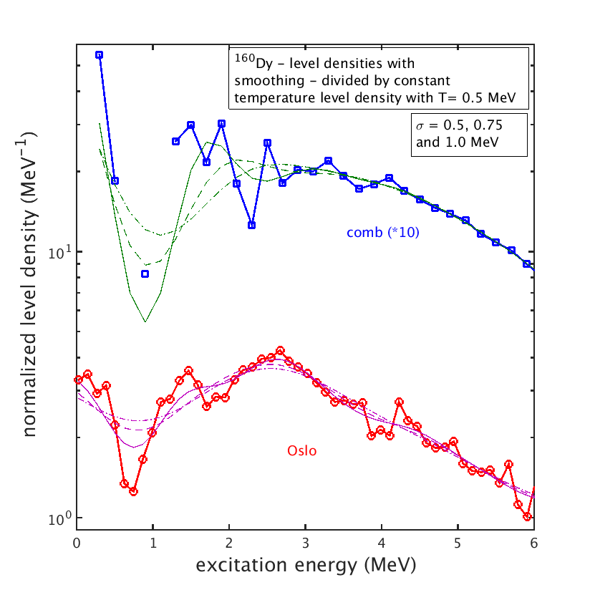
Smoothing of log(rho)

Slide 3
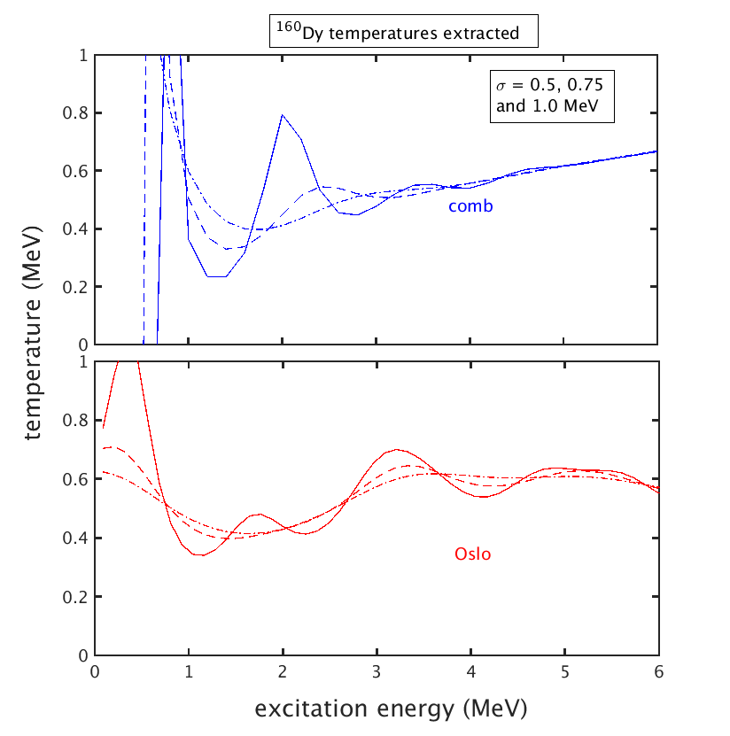
Resulting temperatures

Slide 4
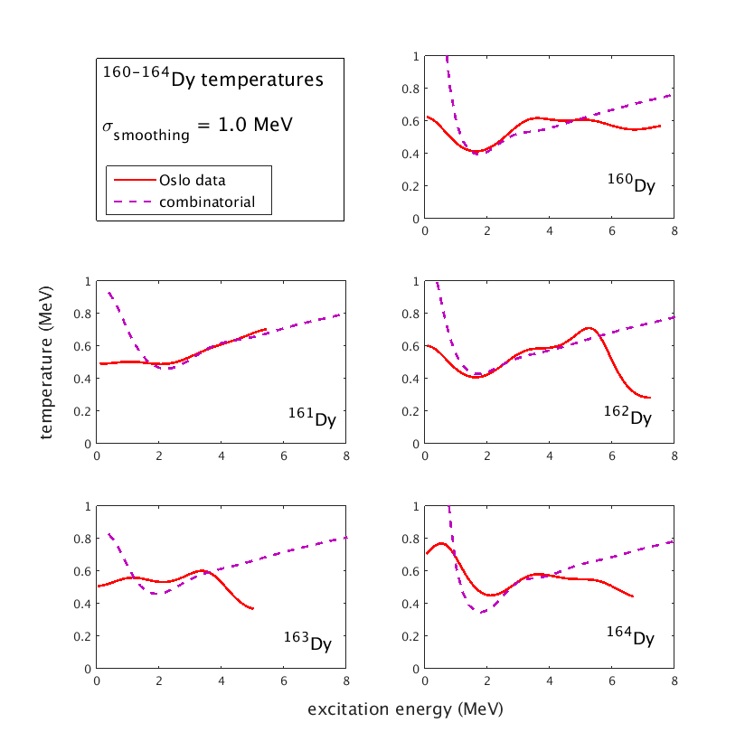
Dy nuclei – wide smoothing

Slide 5
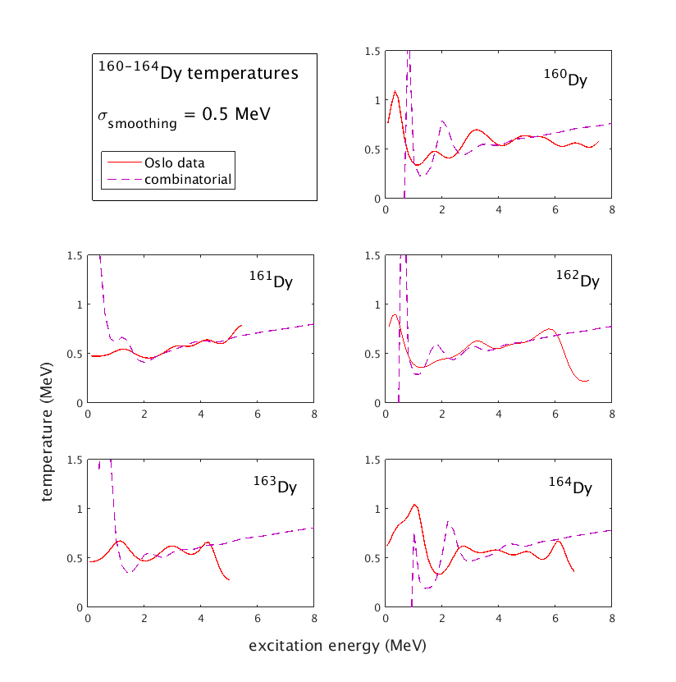
Dy nuclei – narrow smoothing
Const.T
Incr.T
Incr.T
Const.T
Const.T

Slide 6
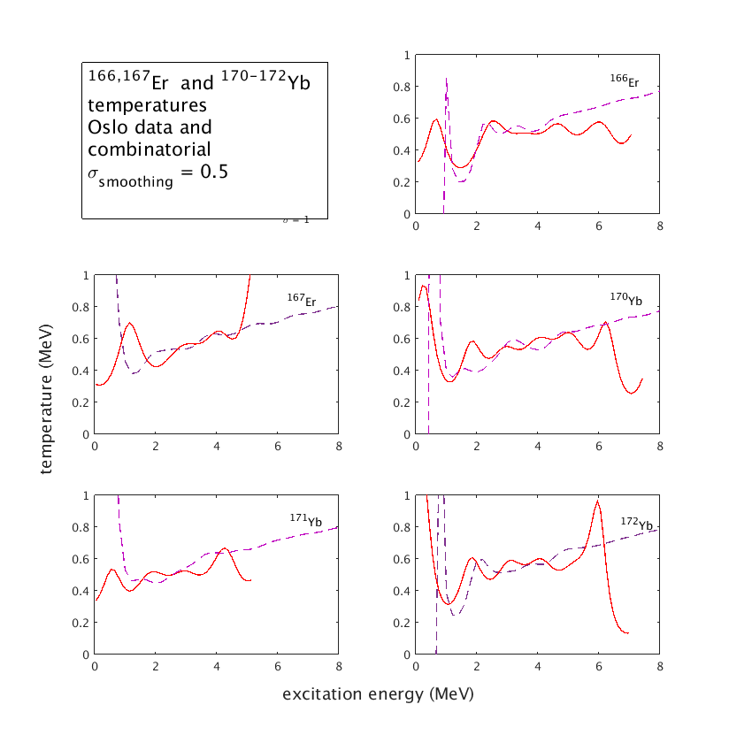
Er and Yb nuclei – narrow smoohting
Const.T
Incr.T
Incr.T
Incr.T
Const.T

Slide 7
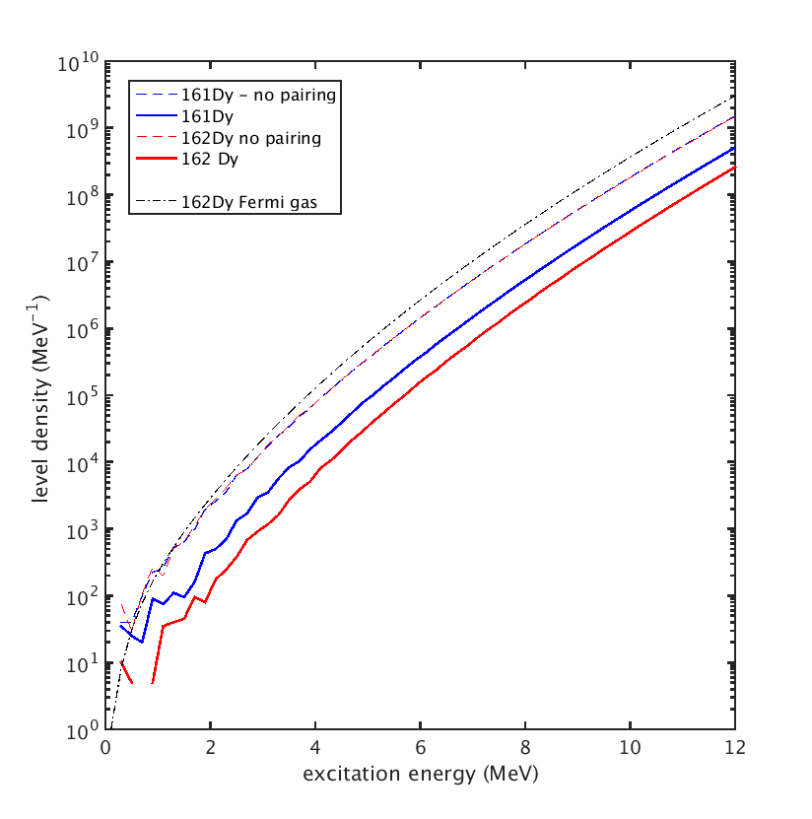
161,162Dy, pairing and no pairing

Slide 8
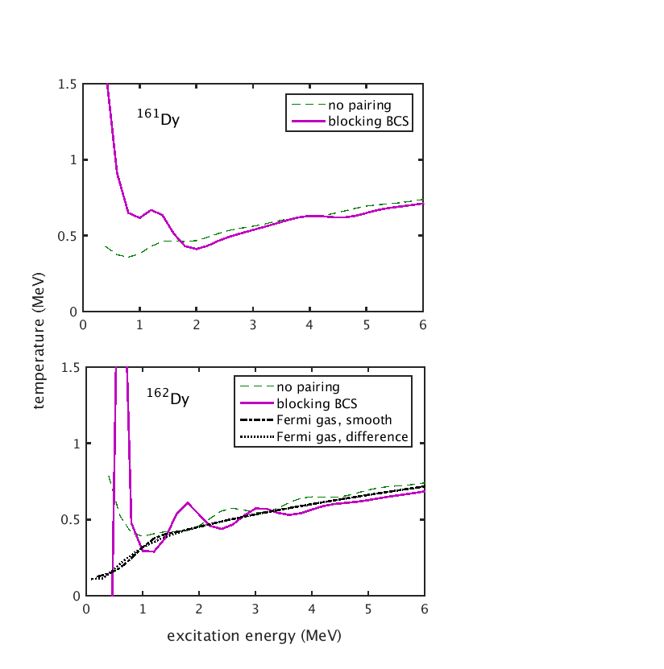
161,162Dy, pairing and no pairing

Slide 9
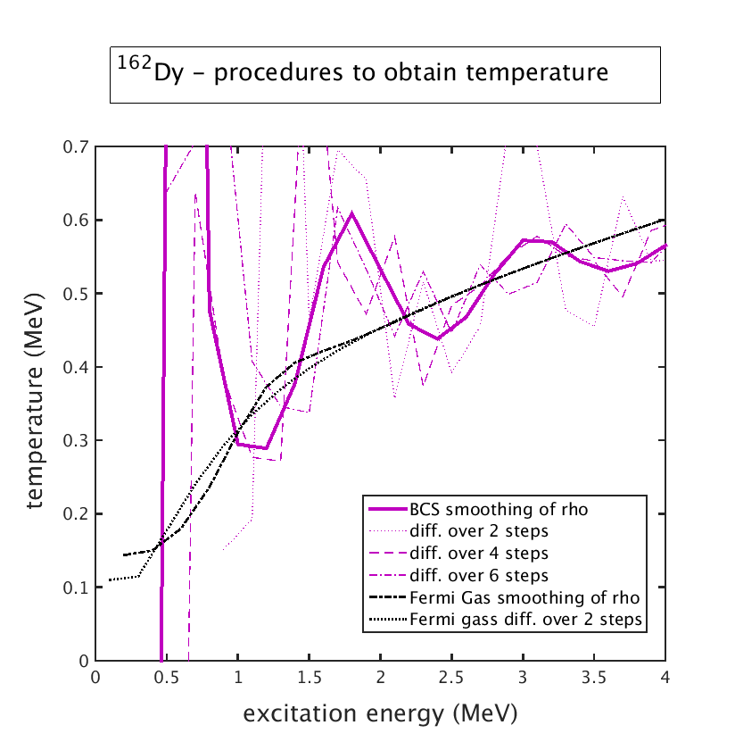
Digression: temperature by finite differences in stead of by smoothing

Slide 10
Canonical ensemble instead?
Heat reservoir of increasing
Temperature – how much
Energy is absorbed by nucleus with increasing temperature – heat capacity.
Calculate with partition
Function
Calculate with level density –
should be state density

Slide 11
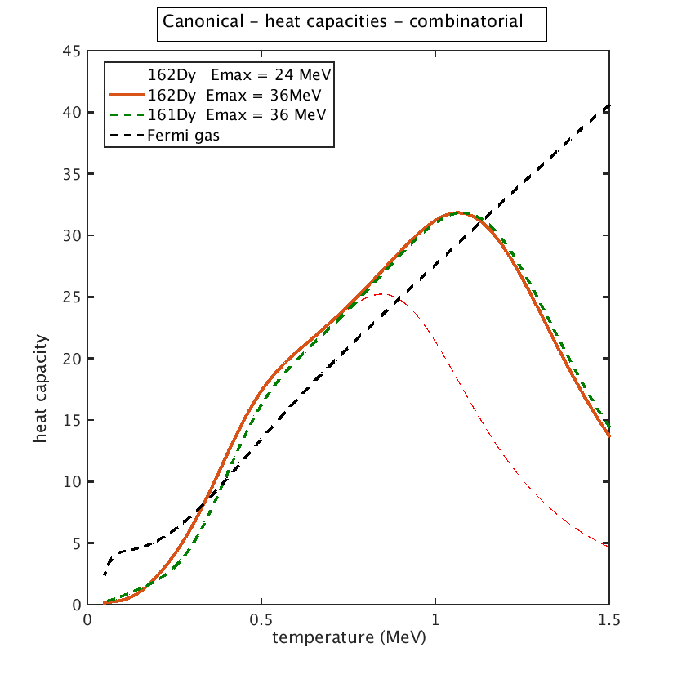
Canonical – combinatorial and Fermi gas

Slide 12
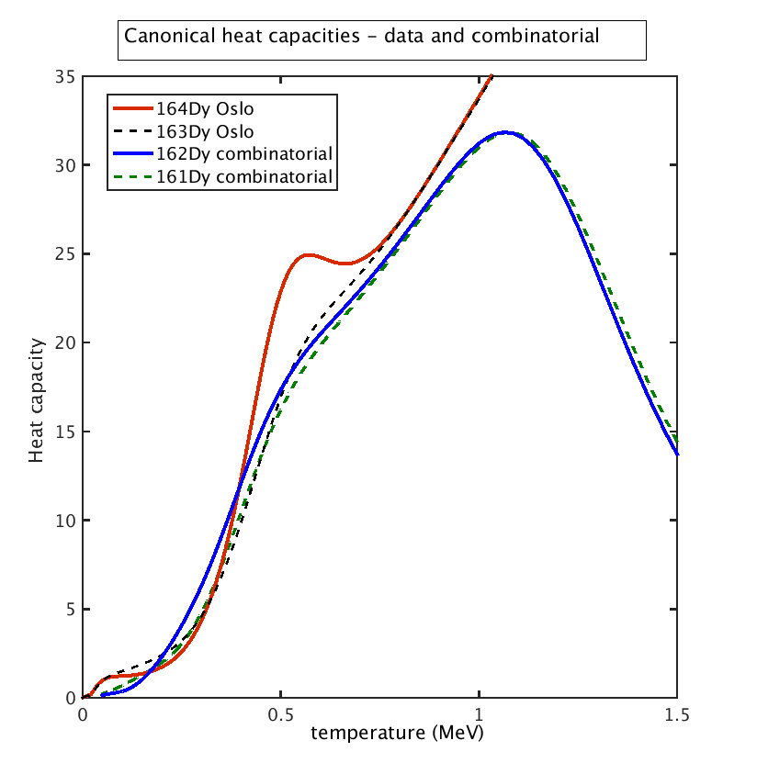
Canonical – comparison to Oslo analysis

Slide 13
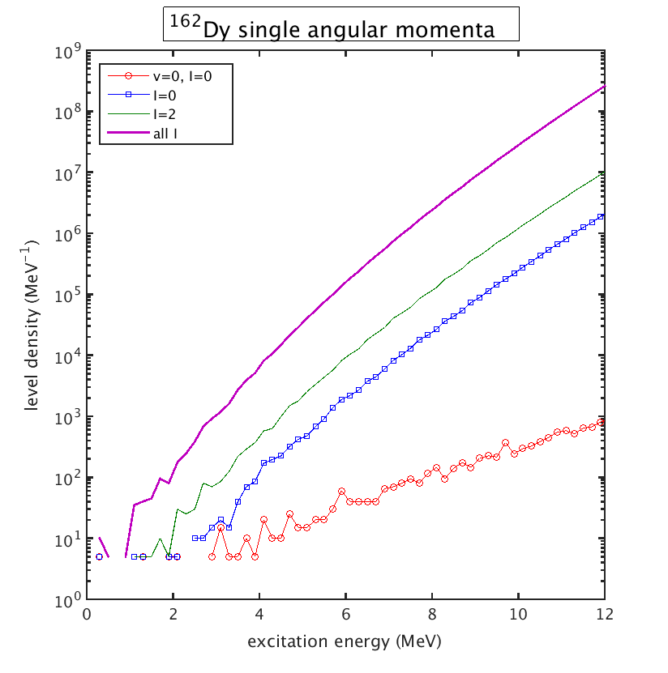
Selection of angular momentum

Slide 14
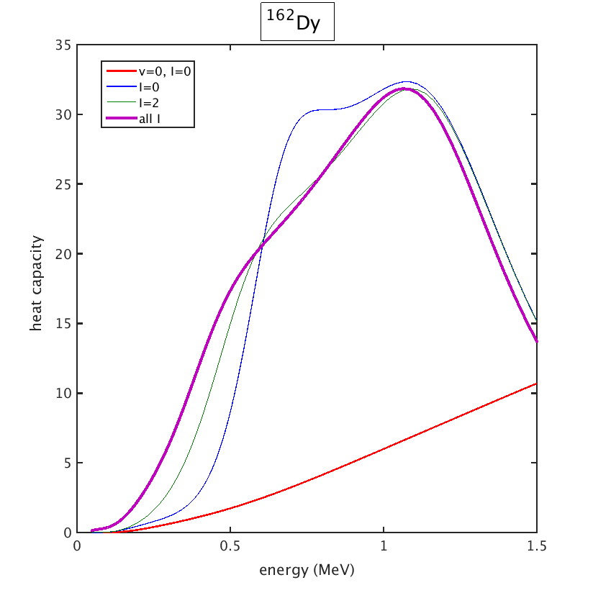
Selection of angular momentum

Slide 15
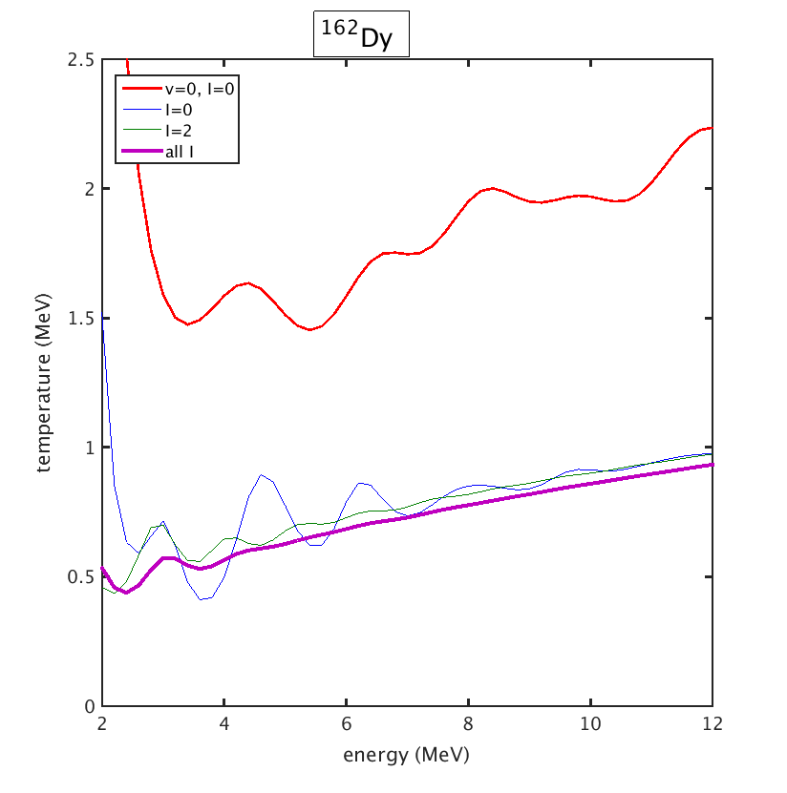
Selection of angular momentum

Slide 16
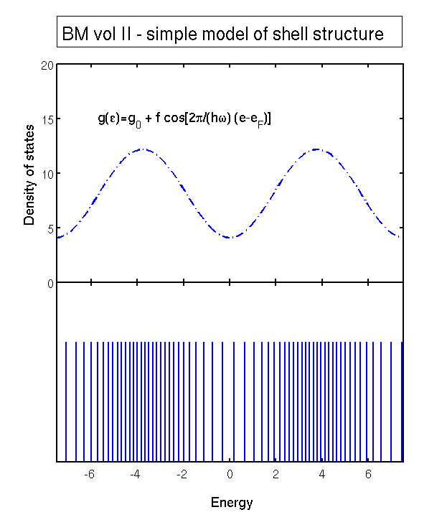
Schematic shell structure in single particle energies

Slide 17
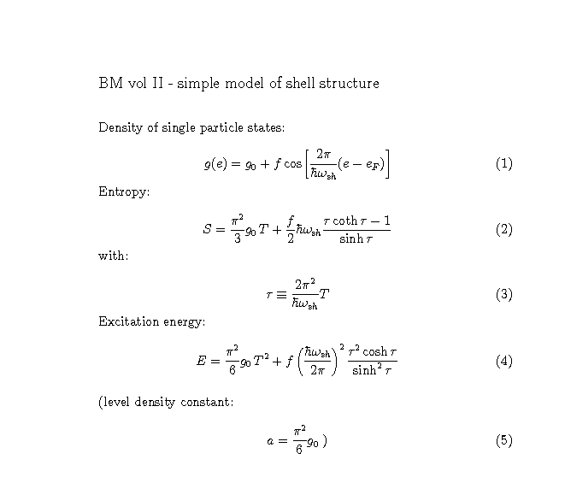
Thermal quantities with schematic shell structure

Slide 18
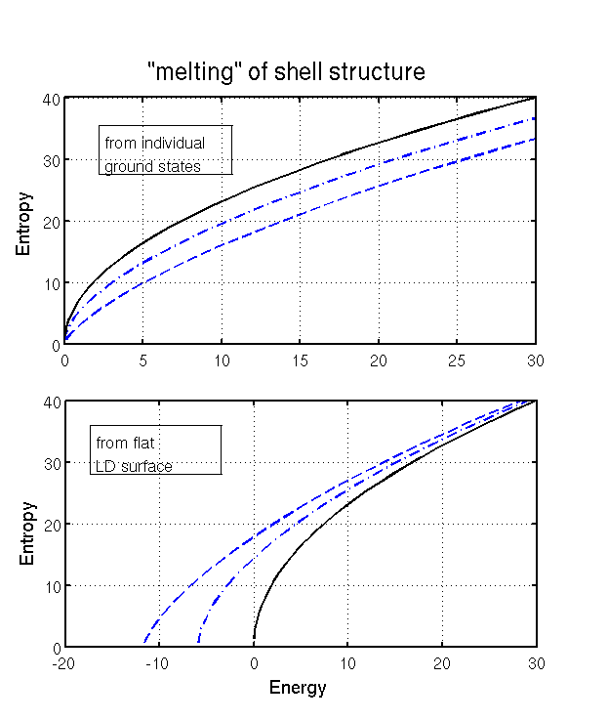
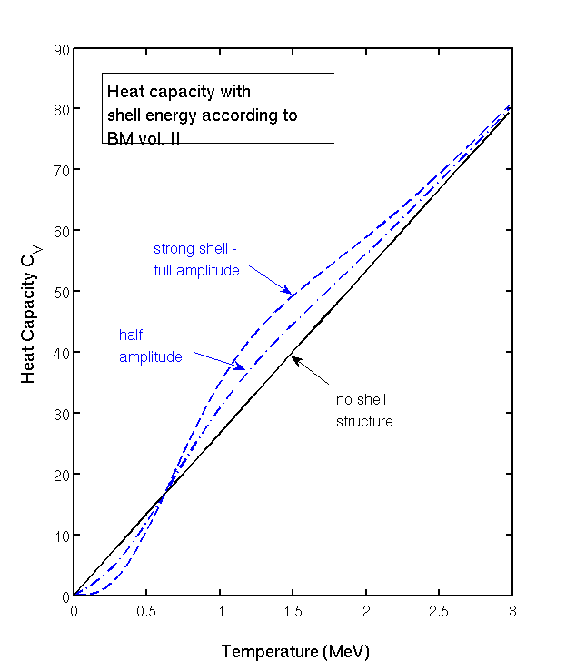
”Melting” of shell structure – shell structure in heat capacity

Slide 19
Topics
-- Topics to discuss:
evidence for constant temperature
signatures of a phase transition

Slide 20
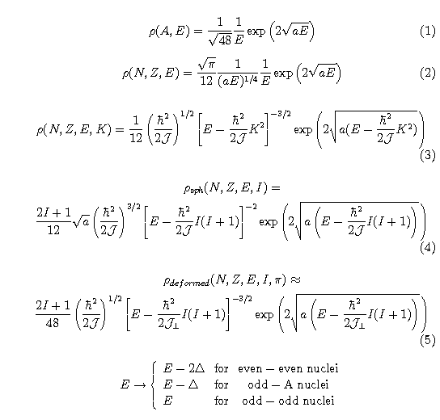
Smooth behavior of level density: Fermi Gas
level density
parameter a
Spherical nuclei:
Bethe formula
Deformed nuclei:
Ericsson formula

Slide 21
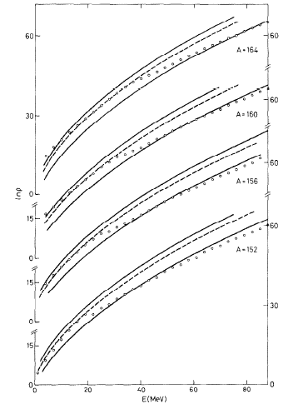
Higher up in excitation energy
G. Hansen and A.S. Jensen,
Nucl. Phys. A406 (1983)236:
Elliot model
1’st order phase transition
ln ρ
Ericsson
Bethe
E (MeV)

