Slide 1

TEAM MEMBERS
MAJOR PROJECT PHASE-1 | REVIEW-2
1
Mohammed Osman
Roll No: 160923748042
EnergyGen
2
Syed Amaan
Roll No: 160923748037
Generative AI-Powered Energy Optimization Platform
Syed Sadaam
Roll No: 160923748036
3
4
Shahid Mohammed Sajid
Roll No: 160923748053

Slide 2
Table of Contents
1
Abstract
5
Proposed System & Advantages
2
Introduction
6
System Architecture
3
Overview
7
Modules
4
Existing System & Disadvantages
8
Algorithms

Slide 3
Abstract
EnergyGen analyzes historical and real-time consumption, predicts future demand with machine learning, and uses Generative AI to turn analytics into clear recommendations and automated sustainability reports.
1
2
Analyze
Predict
Usage patterns, peak periods, wastage
ML-based demand forecasting
3
4
Advise
Optimize
GenAI energy advisor in plain language
Load scheduling and solar/wind use

Slide 4
Introduction
The Challenge
Energy use is tracked through meters, bills and manual reports, so wastage is noticed only after the fact.
1
The Gap
Basic dashboards show usage but cannot forecast demand, explain abnormal use or personalize savings advice.
2
Our Approach
One platform uniting monitoring, ML demand prediction, a GenAI advisor, renewable optimization and auto-generated reports.
3

Slide 5
Overview
1
2
3
4
5
6
7
Monitor & Analyze
Predict Demand
AI Advisor
Optimize Energy
Optimize Renewables
Generate Reports
Track & Improve
Consumption patterns, peaks, abnormal usage
ML forecasts from history and seasonality
Plain-language insights and explanations
Load scheduling and peak reduction
Match solar and wind to demand
AI-written sustainability reports
Dashboards, alerts, performance tracking
Outputs: Energy insights | Recommendations | Renewable utilization | Reports | Alerts

Slide 6
Existing System & its Disadvantages
Disadvantages
Existing System
1
Limited real-time usage analysis
6
Poor demand-renewable coordination
Conventional metering and periodic billing
Manually prepared consumption reports
Basic dashboards with no forecasting or contextual advice
2
Heavy reliance on manual reports
7
Weak peak-load management
3
No accurate AI demand forecasting
8
Hard for non-technical users to read
4
Hidden wastage and anomalies missed
9
Manual sustainability reporting
5
Little personalized saving advice
10
Limited support for cutting costs

Slide 7
Proposed System & its Advantages
Advantages
Proposed System
1
Centralized intelligent monitoring
6
Higher solar and wind utilization
Unified AI platform: monitoring, ML prediction, GenAI advisor, renewable optimization
Proactive forecasts, alerts and load scheduling
Admin control of users, data, AI operations and reports
2
AI-based demand prediction
7
Less manual analysis
3
Detects anomalies and peak periods
8
Auto-generated sustainability reports
4
Personalized saving recommendations
9
Dashboards, alerts and KPIs
5
Proactive load scheduling
10
Lower costs, long-term sustainability

Slide 8
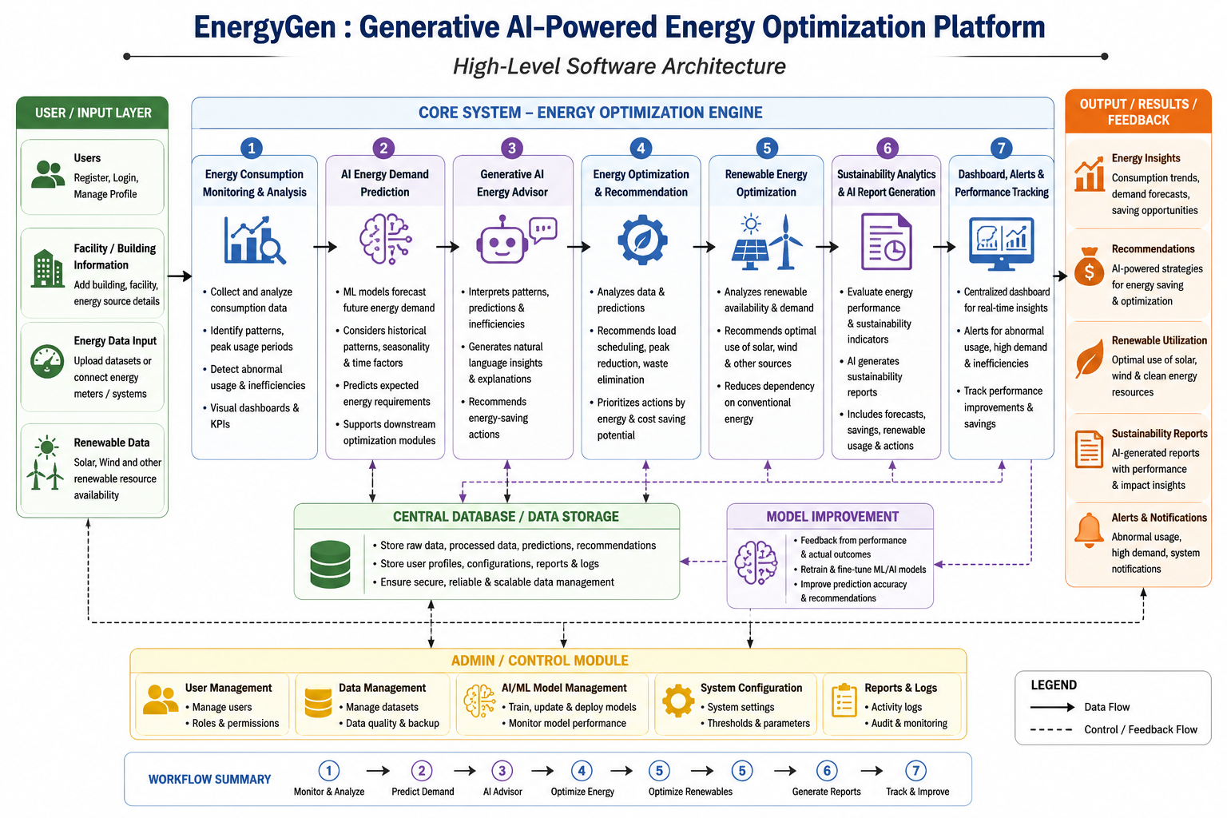
System Architecture
Input layer
Users, facility data, energy data and renewable data
Core engine
Seven modules, from monitoring to dashboards
Output layer
Insights, recommendations, reports and alerts
Support
Central database, model improvement, admin control

Slide 9
Modules
1
2
3
4
5
User Module
Admin Module
User & Energy Profile
Consumption Monitoring
Demand Prediction
Secure access, dashboards, recommendations
Manages users, data, AI and reports
Facility and energy source preferences
Patterns, peaks, wastage detection
ML forecasts of future demand
6
7
8
9
10
GenAI Energy Advisor
Optimization & Recommendation
Renewable Optimization
Sustainability & Reports
Dashboard & Alerts
Natural-language insights and tips
Load scheduling, peak reduction
Prioritizes solar and wind use
AI-generated performance reports
Charts, KPIs, abnormal-usage alerts

Slide 10
Algorithms
1
Data Preprocessing
2
Demand Forecasting
3
Anomaly Detection
Clean, normalize and aggregate consumption data into daily, weekly and monthly patterns.
ML model trained on historical usage, time and seasonal features to predict future demand.
Flags consumption that deviates from learned patterns to expose wastage and abnormal use.
4
Optimization & Ranking
5
Renewable Matching
6
Generative AI Advisor
Scores load-scheduling and peak-reduction actions by energy and cost savings.
Compares predicted demand with solar and wind availability to prioritize renewables.
Converts analytics into natural-language insights and structured sustainability reports.

