Slide 1

Census Project
Problème :
Covid-19 :
- plus de 1/3 de la pop Mondiale
- plus de 1/4 de la pop US

Slide 2


Solution

Slide 3
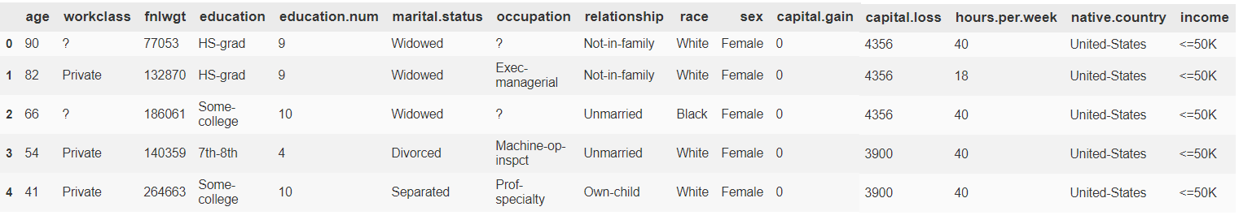
DataSet
DataSet
‘?’ = NaN
Transformer en classe la colonne Income

Slide 4
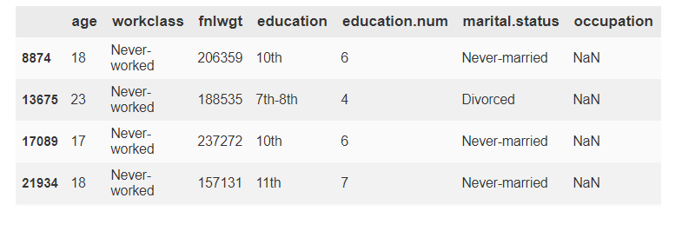
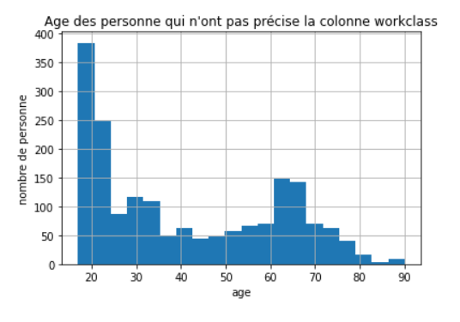
Cleaning
Workclass : 1836 NaN
Occupation : 18443 NaN
Native.country : 583 NaN

Slide 5
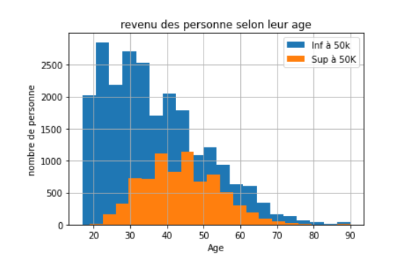
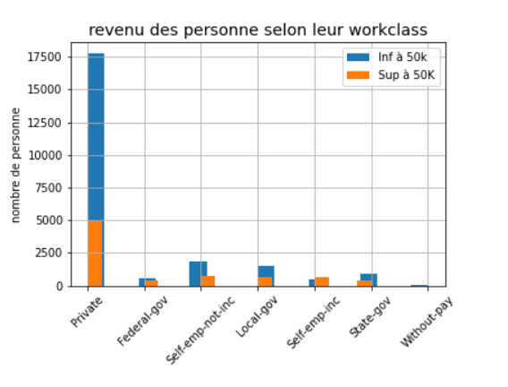
Exploratory data analysis

Slide 6
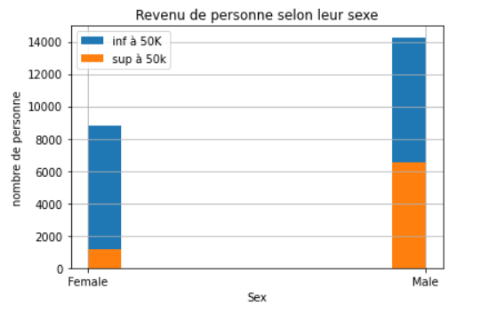
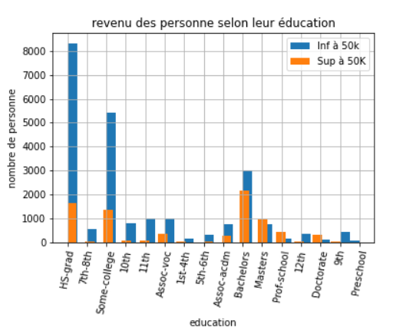
Exploratory data analysis

Slide 7
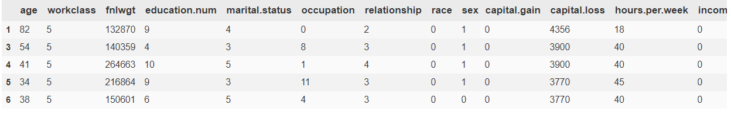
Préprocessing
Self-emp-inc (0) < … < Private(5) < Without-pay(6)
education : 1< 2 <...< 15 < 16
…

Slide 8
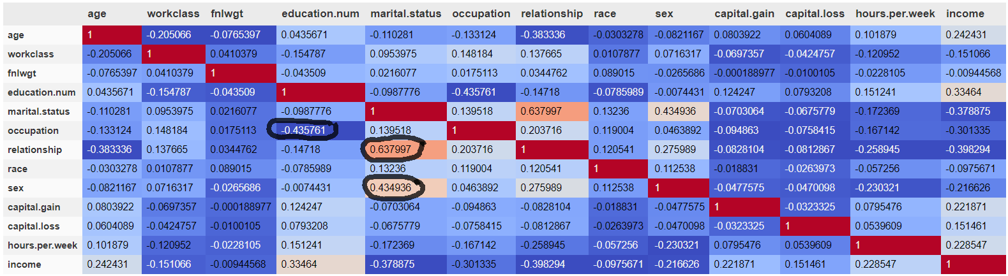
Préprocessing
Relationship & Marital Status
Occupation & education

Slide 9
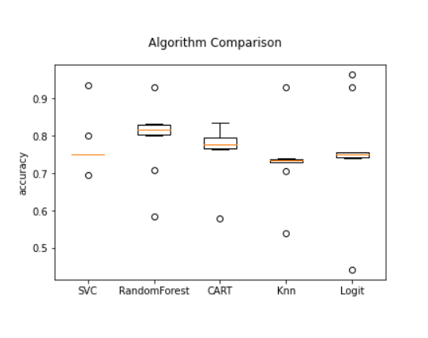
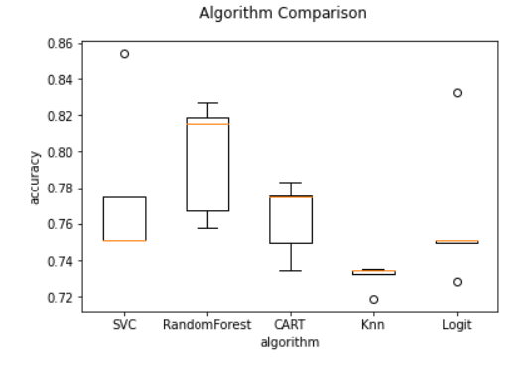
Model
Kfold = 10
Kfold = 5

