Slide 1
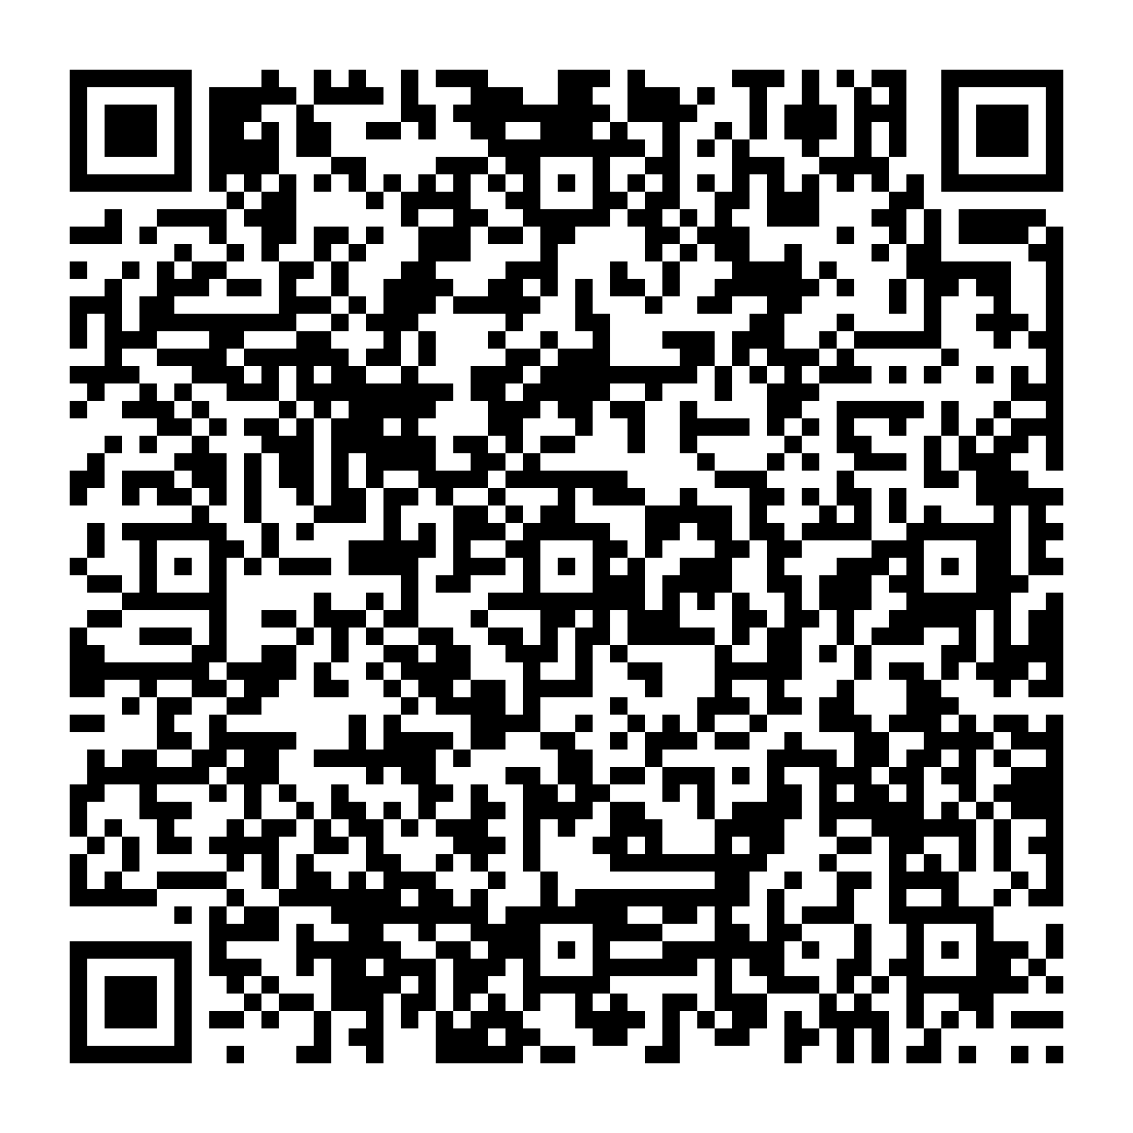
Hands-on workflow
Session 0 — Set up the paired and transcript-only datasets
Session 1 — Preprocess paired spatial RNA and protein data
Session 2 — Understand how DGAT learns RNA-to-protein relationships
Session 3 — Infer and interpret protein landscapes in human lymph node
Tutorial materials:
https://github.com/osmanbeyoglulab/ECCB-2026-Tutorial/
Zeyuan Meng, MS — Intelligent Systems Program
Notes:
Session 0 — Set up the paired and transcript-only datasets Session 1 — Preprocess paired spatial RNA and protein data Session 2 — Understand how DGAT learns RNA-to-protein relationships Session 3 — Infer and interpret protein landscapes in human lymph node
Presenter script:
The fundamental data contract is row identity. Row i must refer to the same physical tissue spot in the RNA matrix, protein matrix, coordinate table, annotations, and every graph. Quality-control filters therefore have to be propagated to all objects together. RNA and ADT counts have different distributions and should not receive an identical transformation by default. After normalization, the workflow creates one spatial graph and one similarity graph per modality. The same nodes are reused, but their edges answer different biological questions.
[Sources]
- hands-on_tutorial/notebooks/01_data_and_spatial.ipynb

Slide 2
Session 1 — Prepare Paired Spatial RNA and Protein Data
Ensure that RNA, ADT, spatial coordinates, and annotations refer to the same spots in the same order.
Apply quality control without disrupting the correspondence across modalities.
Normalize RNA and protein measurements using modality-appropriate methods.
Construct spatial and molecular graphs to capture complementary neighborhood relationships.
Core requirement: RNA, ADT, spatial coordinates, and annotations must describe the same spots in the same order.
Zeyuan Meng, MS — Intelligent Systems Program
Notes:
Ensure that RNA, ADT, spatial coordinates, and annotations refer to the same spots in the same order. Apply quality control without disrupting the correspondence across modalities. Normalize RNA and protein measurements using modality-appropriate methods. Construct spatial and molecular graphs to capture complementary neighborhood relationships.
Presenter script:
The fundamental data contract is row identity. Row i must refer to the same physical tissue spot in the RNA matrix, protein matrix, coordinate table, annotations, and every graph. Quality-control filters therefore have to be propagated to all objects together. RNA and ADT counts have different distributions and should not receive an identical transformation by default. After normalization, the workflow creates one spatial graph and one similarity graph per modality. The same nodes are reused, but their edges answer different biological questions.
[Sources]
- hands-on_tutorial/notebooks/01_data_and_spatial.ipynb

Slide 3
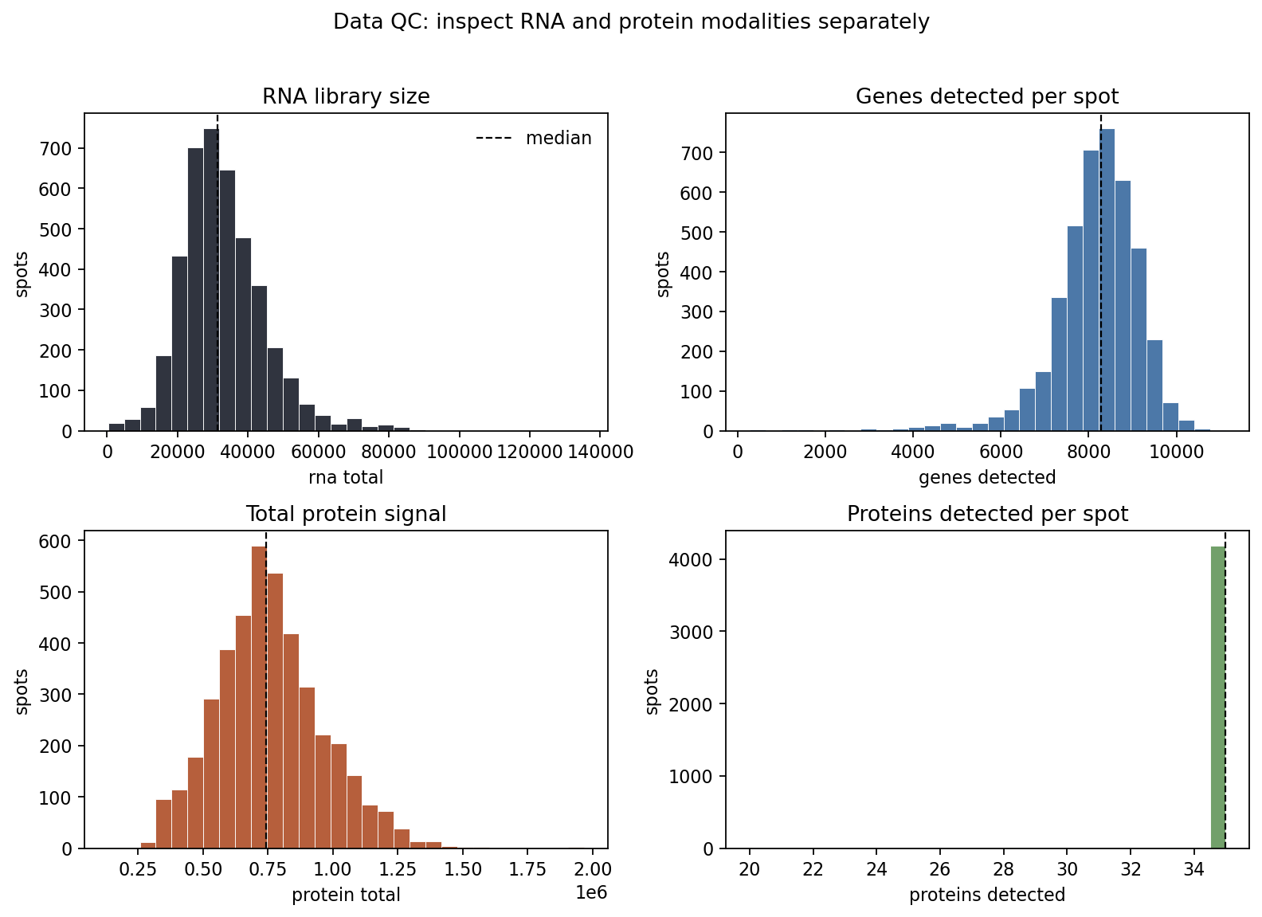
Quality Control
Spot filtering: Remove spots with fewer than 700 detected genes or more than 30% mitochondrial UMIs to exclude low-complexity or potentially damaged spots.
Gene filtering: Retain genes detected in at least 2.5% of spots to reduce sparsity and technical noise.
Protein-panel cleanup: Remove four isotype controls because they measure nonspecific antibody background rather than biological protein abundance.
Alignment check: Confirm that RNA, ADT, spatial coordinates, and annotations contain the same spots in the same order.
Zeyuan Meng, MS — Intelligent Systems Program
Notes:
Detected genes: Retain spots with at least 700 genes with nonzero counts. Spots with very few detected genes generally contain limited biological information. Mitochondrial fraction: Remove spots with an excessive proportion of RNA counts from mitochondrial genes, which can indicate damaged or low-quality tissue. RNA molecules are counted using unique molecular identifiers (UMIs), which reduce amplification-related duplication. Gene prevalence: Retain genes detected in at least 2.5% of spots while preserving genes corresponding to the protein panel. This reduces extremely sparse features. Isotype controls: Remove the four antibody controls used to assess nonspecific binding because they are not biological protein targets.
[Sources]
- Local tutorial output: /Users/zmengaf/Documents/ECCB tuto/hands-on_tutorial/results/figures/session01_qc_rna_and_protein.png
- Local tutorial output: /Users/zmengaf/Documents/ECCB tuto/hands-on_tutorial/results/figures/session01_rna_raw_vs_normalized.png
[/Sources]
[Sources]
- https://github.com/osmanbeyoglulab/ECCB-2026-Tutorial/tree/main/hands-on_tutorial
[/Sources]
[Sources]
- https://github.com/osmanbeyoglulab/ECCB-2026-Tutorial/tree/main/hands-on_tutorial
[/Sources]
[Sources]
- hands-on_tutorial/notebooks/01_data_and_spatial.ipynb

Slide 4
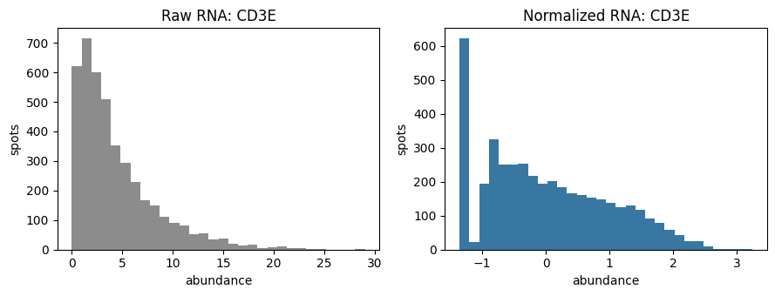
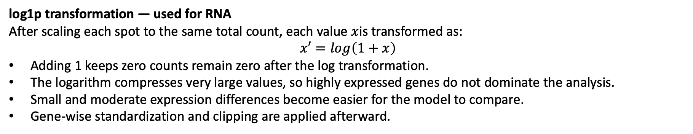
RNA normalization
log1p transformation — used for RNA
After scaling each spot to the same total count, each value $x$is transformed as:
$$x′=\log\left(1+x\right)$$
Adding 1 keeps zero counts remain zero after the log transformation.
The logarithm compresses very large values, so highly expressed genes do not dominate the analysis.
Small and moderate expression differences become easier for the model to compare.
Gene-wise standardization and clipping are applied afterward.
Zeyuan Meng, MS — Intelligent Systems Program
Notes:
Presenter script:
Centered log-ratio transformation treats a p-protein profile as compositional. For spot i, calculate the geometric mean across proteins after adding a small pseudocount c to avoid log zero. Each protein is then expressed as a log ratio to that geometric mean. Positive and negative values mean above or below the within-spot reference, not presence and absence. CLR improves comparability and compresses skew, but it does not recover absolute protein molecules. Interpretation always depends on which proteins were included in the panel.
[Sources]
- Aitchison J. 1982. The statistical analysis of compositional data. Journal of the Royal Statistical Society B 44:139–177.
[Sources]
- hands-on_tutorial/src/dgat_tutorial/processing.py; muon.prot.pp.clr axis=0 implementation
[Sources]
- hands-on_tutorial/notebooks/01_data_and_spatial.ipynb
- hands-on_tutorial/src/dgat_tutorial/processing.py

Slide 5
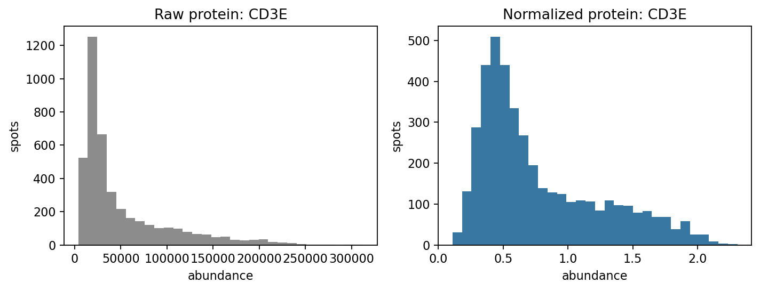
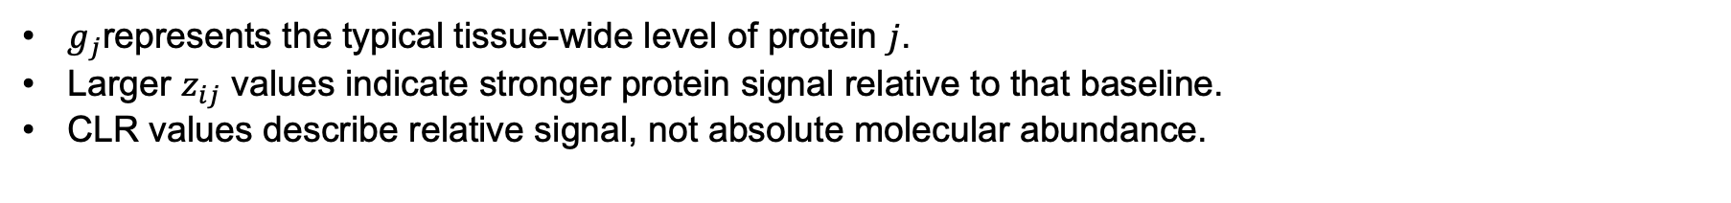
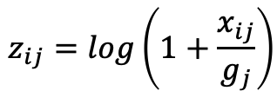
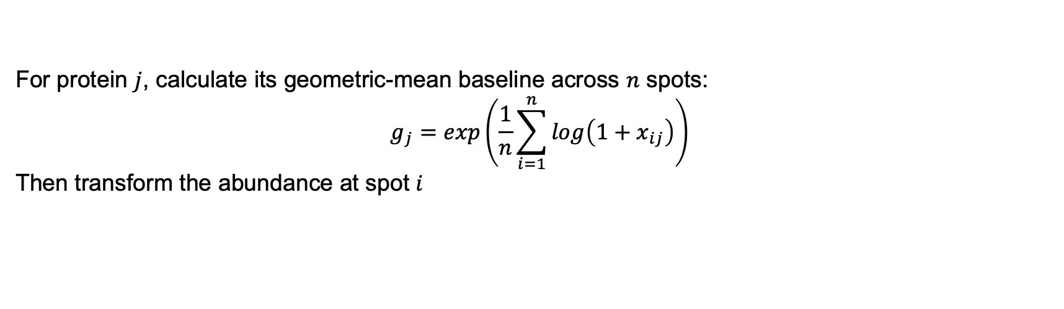
Protein normalization (CLR)
For protein $j$, calculate its geometric-mean baseline across $n$ spots:
$$g_{j}=\exp\left(\frac{1}{n}\sum_{i=1}^{n}{\log\left(1+x_{ij}\right)}\right)$$
Then transform the abundance at spot $i$
$$z_{ij}=\log\left(1+\frac{x_{ij}}{g_{j}}\right)$$
$g_{j}$represents the typical tissue-wide level of protein $j$.
Larger $z_{ij}$ values indicate stronger protein signal relative to that baseline.
CLR values describe relative signal, not absolute molecular abundance.
Zeyuan Meng, MS — Intelligent Systems Program
Notes:
Presenter script:
Centered log-ratio transformation treats a p-protein profile as compositional. For spot i, calculate the geometric mean across proteins after adding a small pseudocount c to avoid log zero. Each protein is then expressed as a log ratio to that geometric mean. Positive and negative values mean above or below the within-spot reference, not presence and absence. CLR improves comparability and compresses skew, but it does not recover absolute protein molecules. Interpretation always depends on which proteins were included in the panel.
[Sources]
- Aitchison J. 1982. The statistical analysis of compositional data. Journal of the Royal Statistical Society B 44:139–177.
[Sources]
- hands-on_tutorial/src/dgat_tutorial/processing.py; muon.prot.pp.clr axis=0 implementation
[Sources]
- hands-on_tutorial/notebooks/01_data_and_spatial.ipynb
- hands-on_tutorial/src/dgat_tutorial/processing.py

Slide 6
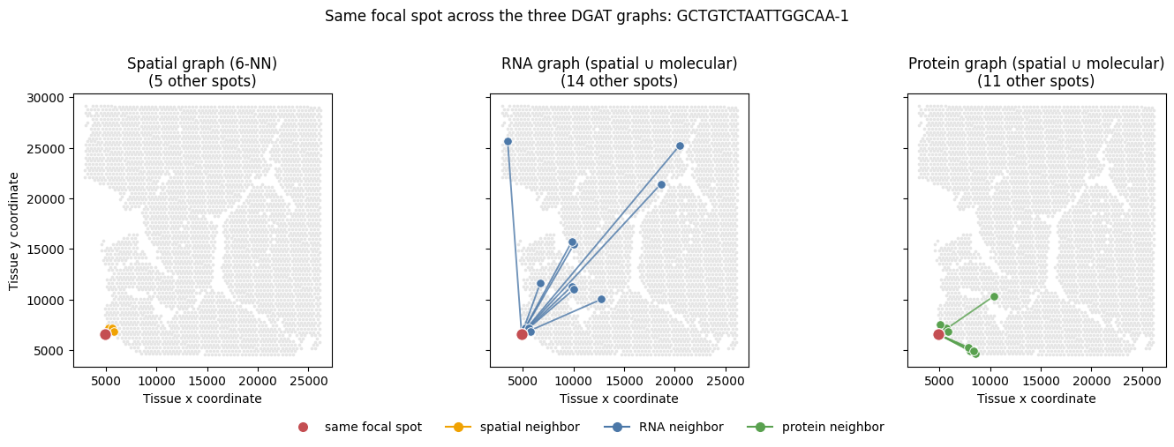
Three graphs encode three definitions of neighborhood
Spatial 6-NN: nearby coordinates encode local tissue adjacency.
RNA 10-NN: proximity in PCA space encodes transcriptional similarity; PCs retain 85% variance when >1,500 genes are available.
Protein 10-NN: proximity among 31 normalized ADTs encodes phenotypic similarity.
Shared nodes: the spot set is identical; only the edge definitions change.
Zeyuan Meng, MS — Intelligent Systems Program
Notes:
RNA and protein embeddings should reveal related but non-identical structure; the spatial 6-NN graph should follow tissue geometry and local adjacency.
[Sources]
- Local tutorial output: /Users/zmengaf/Documents/ECCB tuto/hands-on_tutorial/results/figures/session01_modality_pca_and_spatial_clusters.png
- Local tutorial output: /Users/zmengaf/Documents/ECCB tuto/hands-on_tutorial/results/figures/session01_spatial_knn_graph.png
[/Sources]
[Sources]
- https://github.com/osmanbeyoglulab/ECCB-2026-Tutorial/tree/main/hands-on_tutorial
[/Sources]
[Sources]
- https://github.com/osmanbeyoglulab/ECCB-2026-Tutorial/tree/main/hands-on_tutorial
[/Sources]
[Sources]
- hands-on_tutorial/notebooks/01_data_and_spatial.ipynb

Slide 7
Session 2 — DGAT architecture and training objective
Two graph-attention encoders summarize paired RNA and protein neighborhoods.
Two modality-specific decoders reconstruct or translate those representations.
A shared latent coordinate system connects measurements from the same spot.
Five losses preserve information, align modalities, and train both translations.
Deployment retains only the RNA encoder and protein decoder.
Zeyuan Meng, MS — Intelligent Systems Program
Notes:
Presenter script:
The model section moves from components to data flow, latent representation, loss functions, and gradient updates. During paired training, RNA and measured protein graphs pass through separate graph-attention encoders. Their representations are decoded both within modality and across modality. The training objective balances reconstruction, alignment, and translation. At deployment, measured protein is unavailable, so the retained pathway is RNA graph to RNA encoder to protein decoder.
[Sources]
- hands-on_tutorial/external/DGAT/Model/Train_and_Predict.py
- hands-on_tutorial/external/DGAT/utils/Preprocessing.py

Slide 8
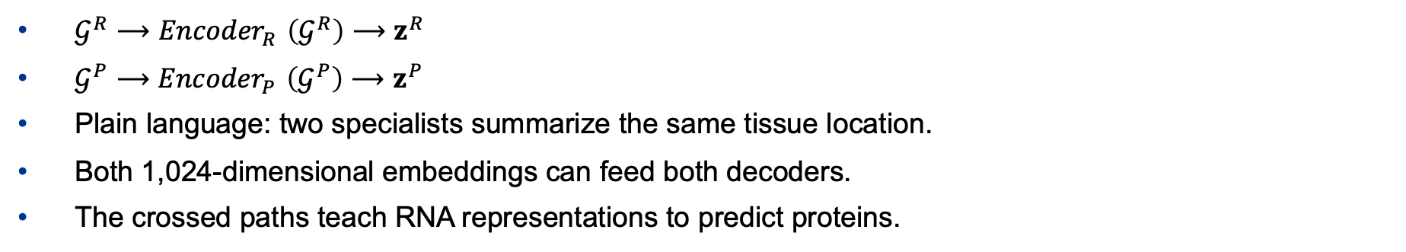
DGAT learns two views of the same spatial spot
$𝒢^{R}⟶{Encoder}_{R}{​}\left(𝒢^{R}\right)⟶z^{R}$
$𝒢^{P}⟶{Encoder}_{P}{​}\left(𝒢^{P}\right)⟶z^{P}$
Plain language: two specialists summarize the same tissue location.
Both 1,024-dimensional embeddings can feed both decoders.
The crossed paths teach RNA representations to predict proteins.
Haoyu Wang, Department of Biomedical Informatics
Notes:
Presenter script:
Read the diagram from left to right. During training, one graph represents gene expression and another represents protein measurements for the same spatial spots. Separate graph-attention encoders turn each view into a 1,024-dimensional latent vector per spot, written z superscript R and z superscript P. Think of the encoders as two specialists writing compact summaries of the same tissue location. Each summary can be sent to either decoder. A same-modality path reconstructs its own input; a crossed path translates one modality into the other. Because deployment starts with RNA only, the RNA-to-protein crossed path is the one DGAT ultimately needs to make useful.
[Sources]
- hands-on_tutorial/src/dgat_tutorial/teaching.py
- hands-on_tutorial/external/DGAT/Model/Train_and_Predict.py

Slide 9
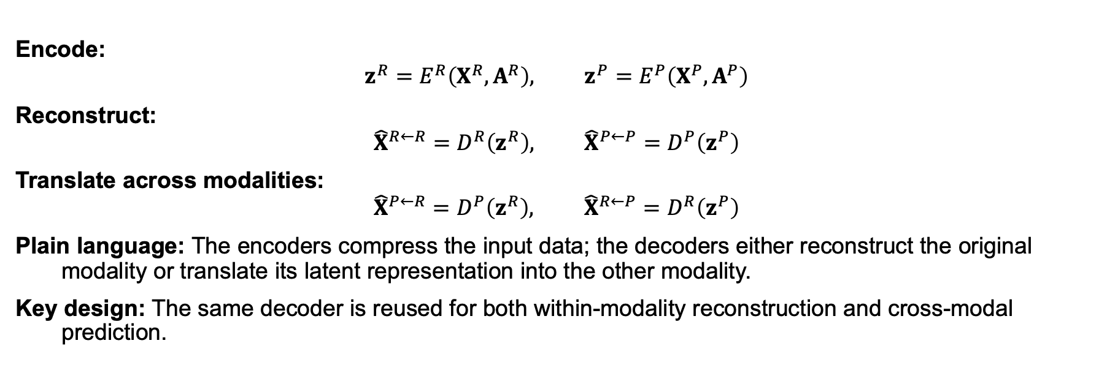
Two encoders and two decoders support five complementary loss terms
Encode:
$$z^{R}=E^{R}​\left(X^{R},A^{R}\right), z^{P}=E^{P}​\left(X^{P},A^{P}\right)$$
Reconstruct:
$${\hat{X}}^{R←R}=D^{R}​\left(z^{R}\right), {\hat{X}}^{P←P}=D^{P}​\left(z^{P}\right)$$
Translate across modalities:
$${\hat{X}}^{P←R}=D^{P}​\left(z^{R}\right), {\hat{X}}^{R←P}=D^{R}​\left(z^{P}\right)$$
Plain language: The encoders compress the input data; the decoders either reconstruct the original modality or translate its latent representation into the other modality.
Key design: The same decoder is reused for both within-modality reconstruction and cross-modal prediction.
Zeyuan Meng, MS — Intelligent Systems Program
Notes:
Presenter script:
Here is the architecture in symbols. X is the feature matrix, A is the spatial graph, E is an encoder, D is a decoder, R denotes RNA, and P denotes protein. Encoding produces one latent matrix per modality. Decoding the RNA latent with the RNA decoder and the protein latent with the protein decoder produces two reconstructions. Swapping which latent enters each decoder produces two cross-modal predictions. These four outputs give four error terms. Comparing the two latent matrices gives the fifth. Reusing the same decoder matters: it requires a latent code from the other modality to be meaningful in the coordinate system that decoder has learned.
[Sources]
- hands-on_tutorial/src/dgat_tutorial/teaching.py
- hands-on_tutorial/external/DGAT/Model/Train_and_Predict.py

Slide 10
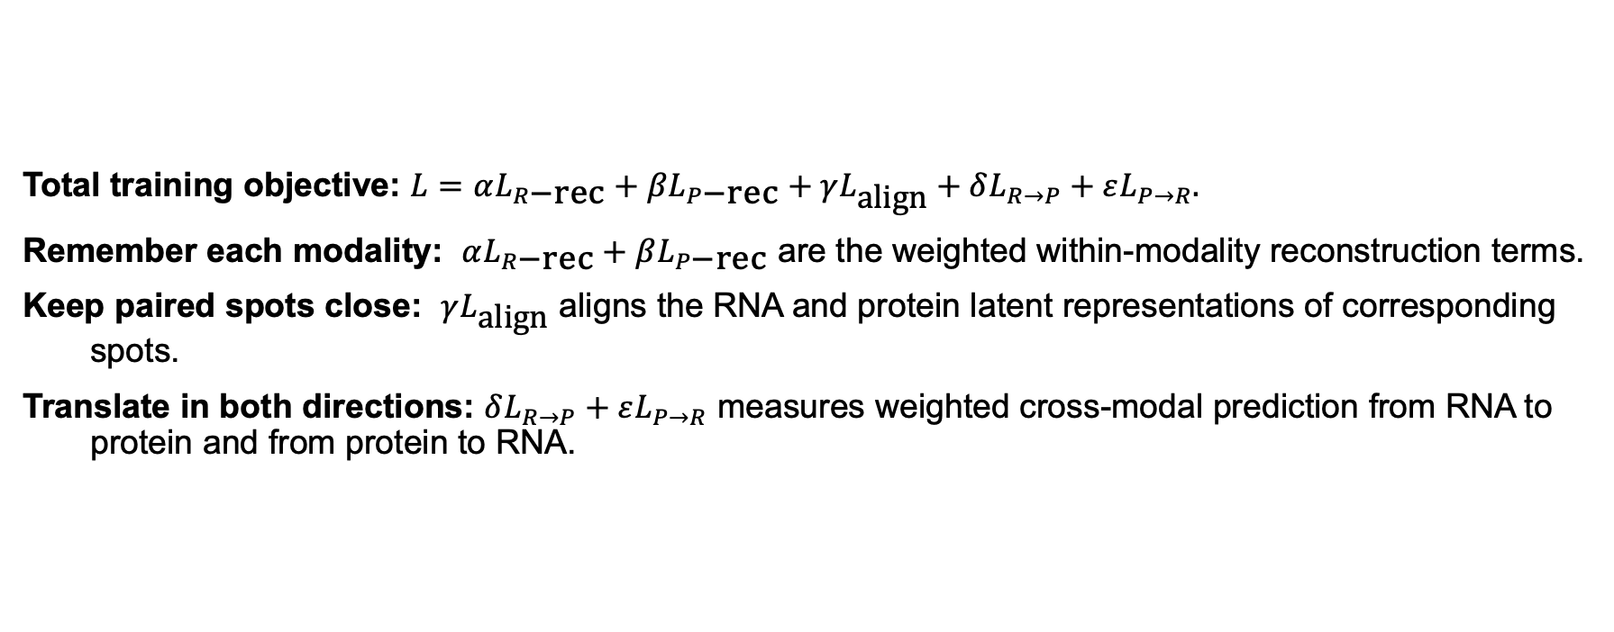
One objective asks DGAT to remember, align, and translate
Total training objective: $L=αL_{R\text{−rec}}+βL_{P\text{−rec}}+γL_{\text{align}}+δL_{R→P}+εL_{P→R}.$
Remember each modality: $αL_{R\text{−rec}}+βL_{P\text{−rec}}$ are the weighted within-modality reconstruction terms.
Keep paired spots close: $γL_{\text{align}}$ aligns the RNA and protein latent representations of corresponding spots.
Translate in both directions: $δL_{R→P}+εL_{P→R}$ measures weighted cross-modal prediction from RNA to protein and from protein to RNA.
Zeyuan Meng, MS — Intelligent Systems Program
Notes:
Presenter script:
DGAT minimizes a weighted sum of five losses. The first two ask each autoencoder to remember its own modality. The middle term asks paired RNA and protein representations for the same spot to occupy nearby positions in latent space. The final two ask the model to translate across modalities. The coefficients are not probabilities; they rescale how strongly each error contributes to the gradient. RNA reconstruction is multiplied by five, and RNA-to-protein prediction by three. The latter emphasizes the exact path used during deployment. A lower total is better, but the total must be interpreted together with all five components because a heavily weighted term can hide a stalled smaller one.
[Sources]
- hands-on_tutorial/src/dgat_tutorial/teaching.py
- hands-on_tutorial/external/DGAT/Model/Train_and_Predict.py

Slide 11
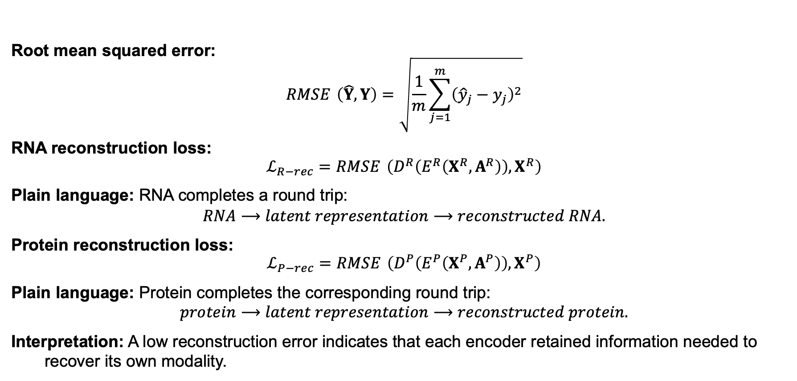
Reconstruction losses: can each latent code rebuild its input?
Root mean squared error:
$$\operatorname{RMSE}{​}\left(\hat{Y},Y\right)=\sqrt{\frac{1}{m}\sum_{j=1}^{m}{{\left({\hat{y}}_{j}−y_{j}\right)}^{2}}}$$
RNA reconstruction loss:
$$ℒ_{R−rec}=\operatorname{RMSE}{​}\left(D^{R}​\left(E^{R}​\left(X^{R},A^{R}\right)\right),X^{R}\right)$$
Plain language: RNA completes a round trip:
$$RNA⟶latent representation⟶reconstructed RNA.$$
Protein reconstruction loss:
$$ℒ_{P−rec}=\operatorname{RMSE}{​}\left(D^{P}​\left(E^{P}​\left(X^{P},A^{P}\right)\right),X^{P}\right)$$
Plain language: Protein completes the corresponding round trip:
$$protein⟶latent representation⟶reconstructed protein.$$
Interpretation: A low reconstruction error indicates that each encoder retained information needed to recover its own modality.
Zeyuan Meng, MS — Intelligent Systems Program
Notes:
Presenter script:
RMSE is the square root of the average squared difference between a prediction and its target over m entries. Squaring prevents positive and negative errors from cancelling and emphasizes larger misses; the square root returns the result to the target's original scale. RNA reconstruction first encodes the RNA graph and then asks the RNA decoder to reproduce the original RNA features. Protein reconstruction does the analogous round trip. These terms prevent the latent spaces from collapsing into representations that are aligned but no longer informative. In the full objective, RNA reconstruction receives weight five and protein reconstruction receives weight one.
[Sources]
- hands-on_tutorial/src/dgat_tutorial/teaching.py
- hands-on_tutorial/external/DGAT/Model/Train_and_Predict.py

Slide 12
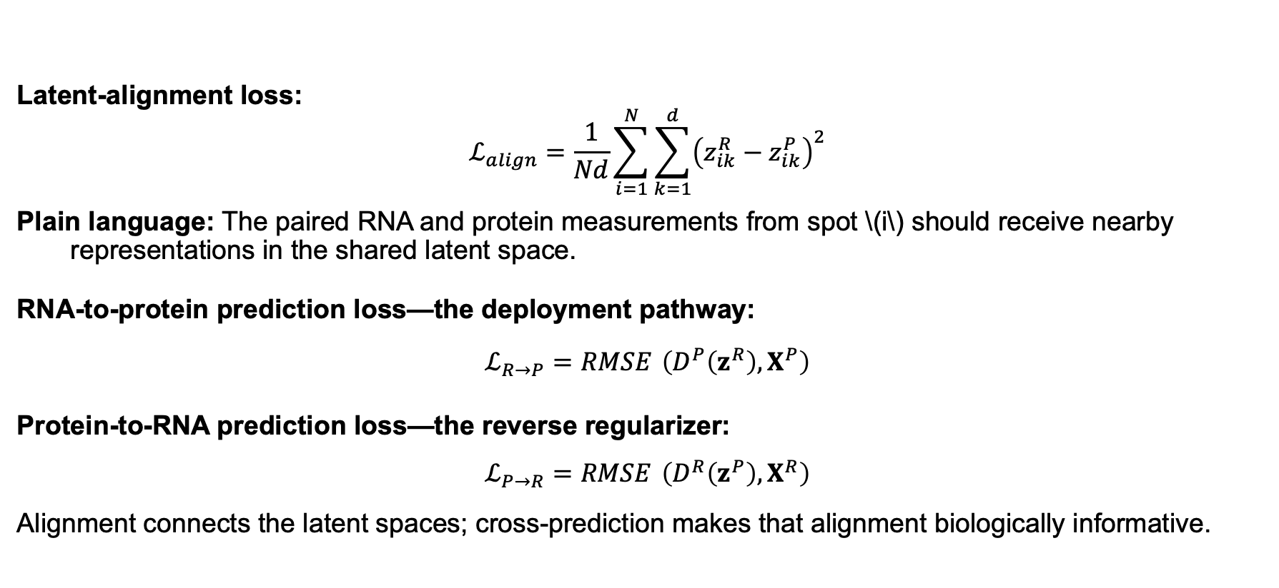
Alignment and cross-prediction connect the modalities
Latent-alignment loss:
$$ℒ_{align}=\frac{1}{Nd}\sum_{i=1}^{N}{\sum_{k=1}^{d}{{\left(z_{ik}^{R}−z_{ik}^{P}\right)}^{2}}}$$
Plain language: The paired RNA and protein measurements from spot \(i\) should receive nearby representations in the shared latent space.
RNA-to-protein prediction loss—the deployment pathway:
$$ℒ_{R→P}=\operatorname{RMSE}{​}\left(D^{P}​\left(z^{R}\right),X^{P}\right)$$
Protein-to-RNA prediction loss—the reverse regularizer:
$$ℒ_{P→R}=\operatorname{RMSE}{​}\left(D^{R}​\left(z^{P}\right),X^{R}\right)$$
Alignment connects the latent spaces; cross-prediction makes that alignment biologically informative.
Zeyuan Meng, MS — Intelligent Systems Program
Notes:
Presenter script:
The alignment loss is a mean squared distance across N paired spots and d latent coordinates. It compares z superscript R and z superscript P row by row, so spot order must match between modalities. Minimizing it pulls paired summaries together. Alignment alone is not enough: all points could collapse to the same vector. The reconstruction and cross-prediction terms prevent that. RNA-to-protein prediction sends the RNA latent through the protein decoder and compares the result with measured proteins; this is the deployed pathway and receives weight three. Protein-to-RNA prediction supplies the reverse constraint, making the shared coordinate system useful in both directions.
[Sources]
- hands-on_tutorial/src/dgat_tutorial/teaching.py
- hands-on_tutorial/external/DGAT/Model/Train_and_Predict.py

Slide 13
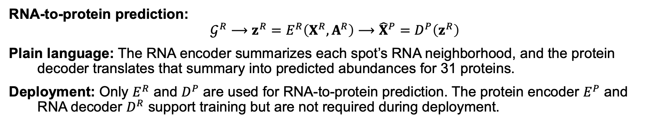
Inference requires only transcriptomics, spatial coordinates, and the trained RNA-to-protein model weights
Inference Mode
RNA-to-protein prediction:
$$𝒢^{R}⟶z^{R}=E^{R}​\left(X^{R},A^{R}\right)⟶{\hat{X}}^{P}=D^{P}​\left(z^{R}\right)$$
Plain language: The RNA encoder summarizes each spot’s RNA neighborhood, and the protein decoder translates that summary into predicted abundances for 31 proteins.
Deployment: Only $E^{R}$ and $D^{P}$ are used for RNA-to-protein prediction. The protein encoder $E^{P}$ and RNA decoder $D^{R}$ support training but are not required during deployment.
Haoyu Wang, Department of Biomedical Informatics
Notes:
Presenter script:
At inference, only the path that begins with RNA is available. The RNA encoder combines each spot's expression profile with its spatial neighbors and produces z superscript R. The protein decoder then converts that latent vector into 31 protein predictions. The protein encoder cannot be used because no measured protein graph exists at prediction time, and the RNA decoder is unnecessary because the goal is not to reconstruct RNA. This is why the RNA-to-protein loss receives extra weight during training. The exact input gene vocabulary is a Session 3 preprocessing contract and is introduced there, immediately before pretrained inference.
[Sources]
- hands-on_tutorial/src/dgat_tutorial/teaching.py
- hands-on_tutorial/external/DGAT/Model/Train_and_Predict.py

Slide 14
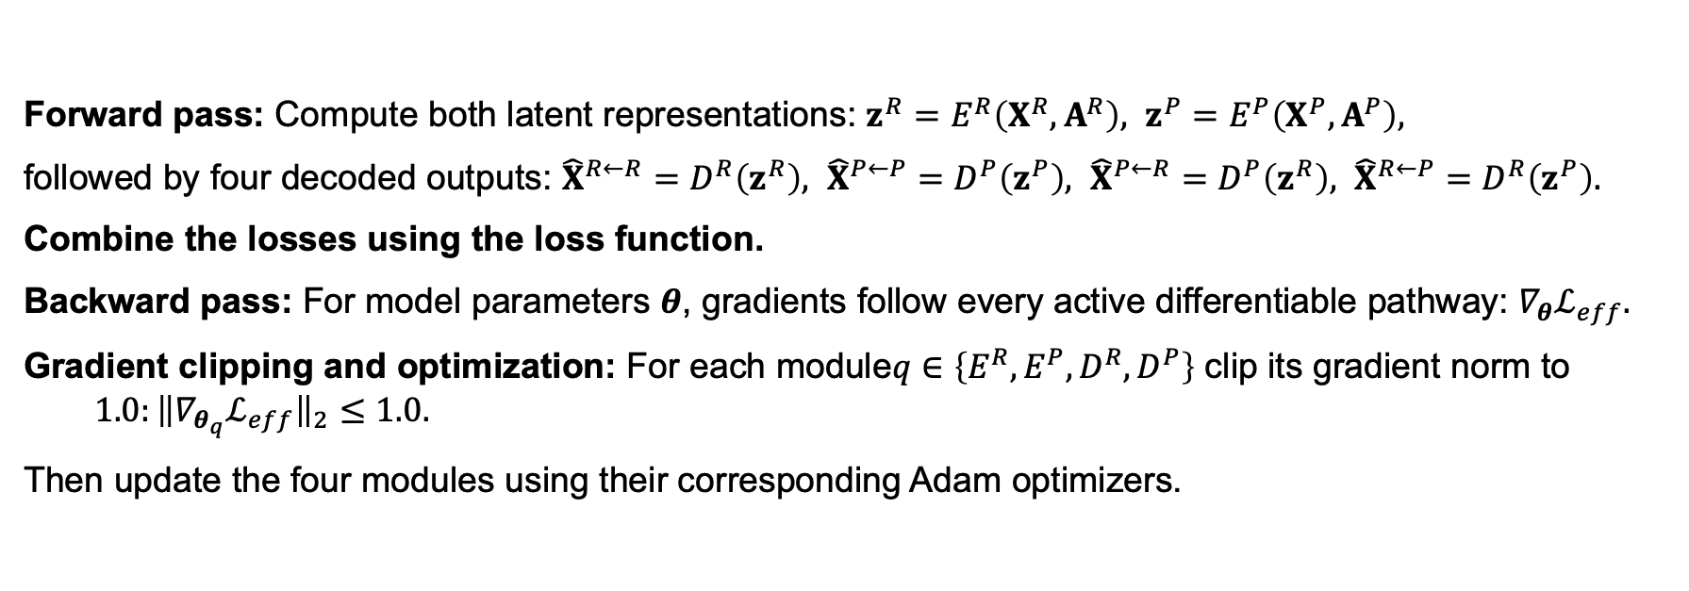
Backpropagation turns the weighted sum into four updates
Forward pass: Compute both latent representations: $z^{R}=E^{R}​\left(X^{R},A^{R}\right), z^{P}=E^{P}​\left(X^{P},A^{P}\right),$
followed by four decoded outputs: ${\hat{X}}^{R←R}=D^{R}\left(z^{R}\right), {\hat{X}}^{P←P}=D^{P}\left(z^{P}\right), {\hat{X}}^{P←R}=D^{P}\left(z^{R}\right), {\hat{X}}^{R←P}=D^{R}\left(z^{P}\right).$
Combine the losses using the loss function.
Backward pass: For model parameters $θ$, gradients follow every active differentiable pathway: $∇_{θ}ℒ_{eff}.$
Gradient clipping and optimization: For each module$q∈\left\{E^{R},E^{P},D^{R},D^{P}\right\}$ clip its gradient norm to $1.0:{\left\|∇_{θ_{q}}ℒ_{eff}\right\|}_{2}≤1.0.$
Then update the four modules using their corresponding Adam optimizers.
Zeyuan Meng, MS — Intelligent Systems Program
Notes:
Presenter script:
A single training step runs all paths forward, combines the five losses, and calls backward once. The chain rule sends gradients only through modules that influenced an active differentiable term. RNA reconstruction updates the RNA encoder and RNA decoder. Protein reconstruction updates the protein encoder and protein decoder. RNA-to-protein prediction updates the RNA encoder and protein decoder. In the current two-device implementation, the transferred protein latent is created inside torch.no_grad, so it is a detached target: alignment updates the RNA encoder but does not send gradient into the protein encoder through that branch, and protein-to-RNA prediction updates the RNA decoder but not the protein encoder through that branch. The code clips each module's gradient norm at one before stepping four Adam optimizers. Monitor each loss separately because a falling total can hide a stalled deployment-critical RNA-to-protein term.
[Sources]
- hands-on_tutorial/src/dgat_tutorial/teaching.py
- hands-on_tutorial/external/DGAT/Model/Train_and_Predict.py

Slide 15
Session3 — Explore DGAT-Predicted Protein Landscapes in Human Lymph Node
Zeyuan Meng, MS — Intelligent Systems Program
Notes:
Presenter script:
Evaluation begins before calculating a metric: the input matrix and output labels must match the checkpoint contract. Numerical agreement, spatial organization, anatomical concordance, and independent measurements answer different questions. Moran statistics quantify spatial pattern but do not establish predictive accuracy. Cluster overlap describes anatomical concordance but can be optimistic when regions are selected and scored on the same tissue. Pairwise spatial associations are best used to prioritize experiments rather than claim mechanism.
[Sources]
- hands-on_tutorial/notebooks/03_evaluation_and_interpretation.ipynb

Slide 16
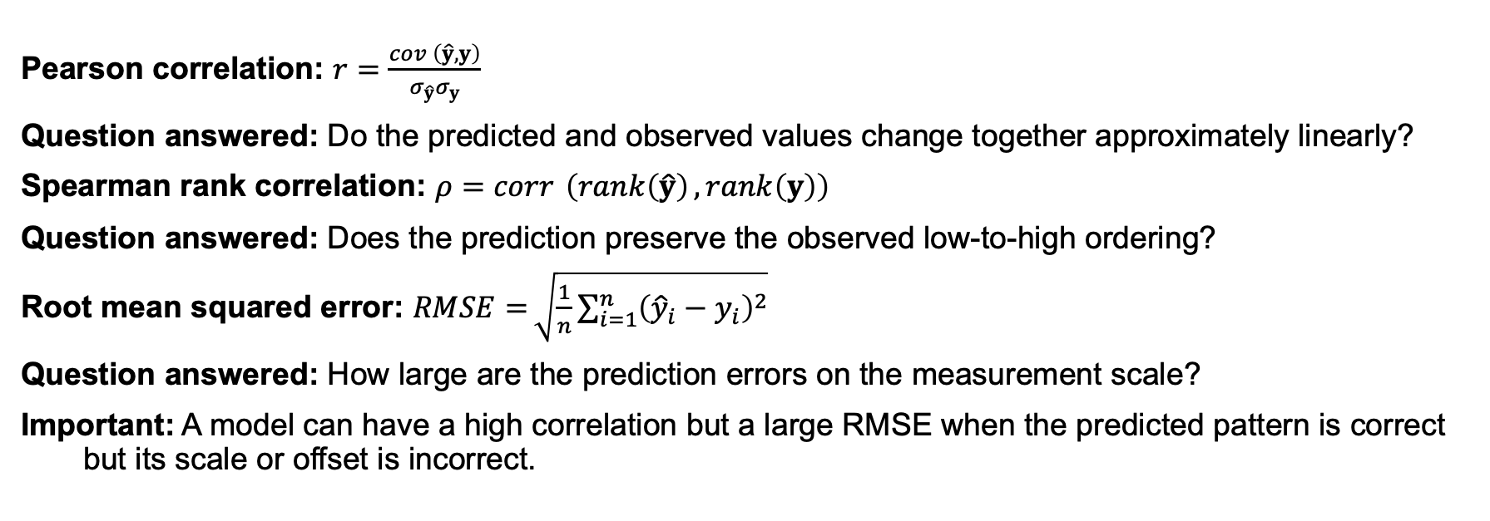
Pearson, Spearman, and RMSE answer different questions
Pearson correlation: $r=\frac{\operatorname{cov}{​}\left(\hat{y},y\right)}{σ_{\hat{y}}σ_{y}}$
Question answered: Do the predicted and observed values change together approximately linearly?
Spearman rank correlation: $ρ=\operatorname{corr}{​}\left(\operatorname{rank}\left(\hat{y}\right),\operatorname{rank}\left(y\right)\right)$
Question answered: Does the prediction preserve the observed low-to-high ordering?
Root mean squared error: $\operatorname{RMSE}{=}\sqrt{\frac{1}{n}\sum_{i=1}^{n}{{\left({\hat{y}}_{i}−y_{i}\right)}^{2}}}$
Question answered: How large are the prediction errors on the measurement scale?
Important: A model can have a high correlation but a large RMSE when the predicted pattern is correct but its scale or offset is incorrect.
Zeyuan Meng, MS — Intelligent Systems Program
Notes:
Presenter script:
Correlation and error are complementary. Pearson correlation detects linear co-variation and is sensitive to extreme values. Spearman correlation first converts values to ranks, so it asks whether the ordering of spots is preserved even when the relationship is nonlinear. RMSE retains the prediction scale and penalizes large errors more strongly because errors are squared. A prediction can reproduce the spatial pattern and therefore have high correlation while systematically overestimating abundance and therefore have poor RMSE. Protein-wise evaluation asks which targets are predictable across tissue; spot-wise evaluation asks which tissue locations are reconstructed well across the panel.
[Sources]
- Pearson K. 1895. Proceedings of the Royal Society of London 58:240–242.
- Spearman C. 1904. American Journal of Psychology 15:72–101.

Slide 17
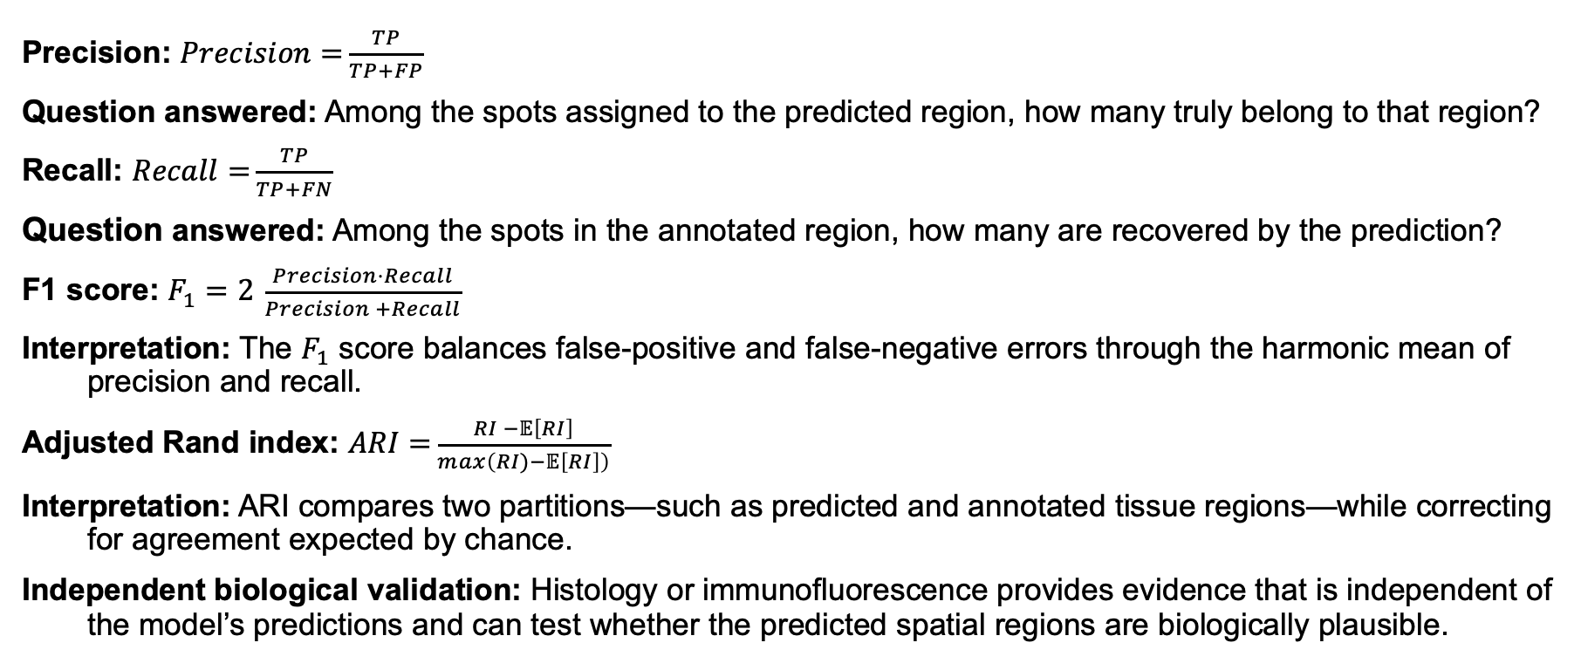
Anatomical recovery requires chance-aware and class-aware metrics
Precision: $\operatorname{Precision}{=}\frac{TP}{TP+FP}$
Question answered: Among the spots assigned to the predicted region, how many truly belong to that region?
Recall: $\operatorname{Recall}{=}\frac{TP}{TP+FN}$
Question answered: Among the spots in the annotated region, how many are recovered by the prediction?
F1 score: $F_{1}=2 \frac{\operatorname{Precision}{⋅}Recall}{\operatorname{Precision}{+}Recall}$
Interpretation: The $F_{1}$ score balances false-positive and false-negative errors through the harmonic mean of precision and recall.
Adjusted Rand index: $\operatorname{ARI}{=}\frac{\operatorname{RI}{−}𝔼\left[RI\right]}{\max\left(\operatorname{RI}{)}−𝔼\left[RI\right]\right)}$
Interpretation: ARI compares two partitions—such as predicted and annotated tissue regions—while correcting for agreement expected by chance.
Independent biological validation: Histology or immunofluorescence provides evidence that is independent of the model’s predictions and can test whether the predicted spatial regions are biologically plausible.
Zeyuan Meng, MS — Intelligent Systems Program
Notes:
Presenter script:
Precision and recall depend on which region is treated as positive. Precision penalizes contamination outside the annotated structure; recall penalizes missed spots inside it. F1 is their harmonic mean, so it becomes low when either component is low. The adjusted Rand index evaluates whole partitions rather than one selected region and corrects for matches expected by chance. None of these proves protein abundance is numerically accurate. Histology provides anatomical context, while independently measured protein staining provides a stronger orthogonal check of the predicted protein pattern.
[Sources]
- Hubert L, Arabie P. 1985. Comparing partitions. Journal of Classification 2:193–218.

Slide 18
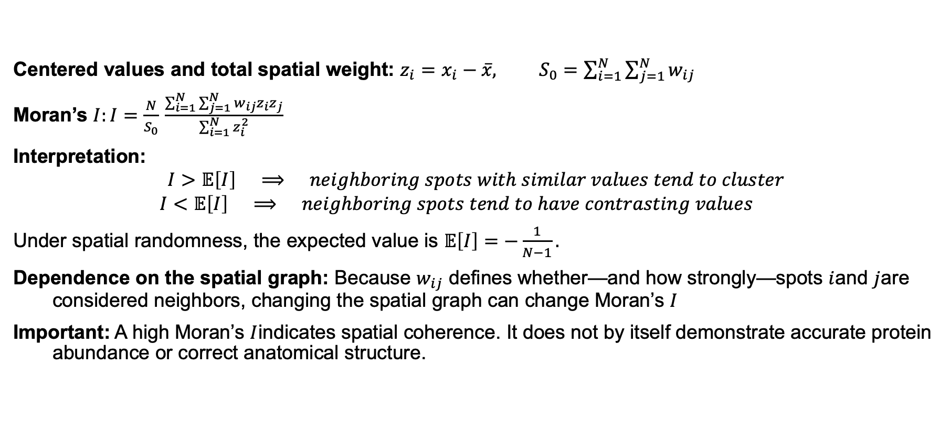
Moran’s I measures spatial coherence—not prediction accuracy
Centered values and total spatial weight: $z_{i}=x_{i}−\overline{x}, S_{0}=\sum_{i=1}^{N}{\sum_{j=1}^{N}{w_{ij}}}$
Moran’s $I:I=\frac{N}{S_{0}} \frac{\sum_{i=1}^{N}{\sum_{j=1}^{N}{w_{ij}}}z_{i}z_{j}}{\sum_{i=1}^{N}{z_{i}^{2}}}$
Interpretation:
$$I>𝔼\left[I\right] ⟹ neighboring spots with similar values tend to cluster$$
$$I<𝔼\left[I\right] ⟹ neighboring spots tend to have contrasting values$$
Under spatial randomness, the expected value is $𝔼\left[I\right]=−\frac{1}{N−1}.$
Dependence on the spatial graph: Because $w_{ij}$ defines whether—and how strongly—spots $i$and $j$are considered neighbors, changing the spatial graph can change Moran’s $I$
Important: A high Moran’s $I$indicates spatial coherence. It does not by itself demonstrate accurate protein abundance or correct anatomical structure.
Zeyuan Meng, MS — Intelligent Systems Program
Notes:
Presenter script:
Moran's I compares a value at each spot with values at its graph-defined neighbors. The centered value z is positive above the tissue mean and negative below it. The numerator becomes positive when neighboring deviations share a sign. S zero is the sum of all spatial weights and normalizes the graph. Under randomization the expectation is minus one over N minus one, which is close to zero for a large tissue. Positive autocorrelation indicates clustering; negative autocorrelation indicates neighboring contrasts. The magnitude depends on the weight matrix, so comparisons require the same graph definition. Statistical significance is commonly assessed by permutation.
[Sources]
- Moran PAP. 1950. Notes on continuous stochastic phenomena. Biometrika 37:17–23.

Slide 19
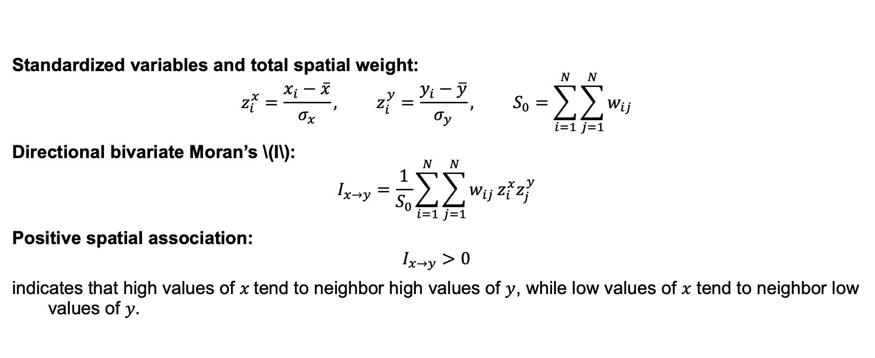
Bivariate Moran's I links one feature to its neighbor's feature
Standardized variables and total spatial weight:
$$z_{i}^{x}=\frac{x_{i}−\overline{x}}{σ_{x}}, z_{i}^{y}=\frac{y_{i}−\overline{y}}{σ_{y}}, S_{0}=\sum_{i=1}^{N}{\sum_{j=1}^{N}{w_{ij}}}$$
Directional bivariate Moran’s \(I\):
$$I_{x→y}=\frac{1}{S_{0}}\sum_{i=1}^{N}{\sum_{j=1}^{N}{w_{ij}}}z_{i}^{x}z_{j}^{y}$$
Positive spatial association:
$$I_{x→y}>0$$
indicates that high values of $x$tend to neighbor high values of $y$, while low values of $x$ tend to neighbor low values of $y.$
Zeyuan Meng, MS — Intelligent Systems Program
Notes:
Presenter script:
Bivariate Moran's I replaces one side of the univariate cross-product with a different feature. It asks whether x at focal spot i is associated with y in neighboring spot j. Standardization makes the two feature scales comparable. The statistic can be directional because the focal and lagged variables have different roles, especially with asymmetric weights. A permutation test evaluates whether the observed association is stronger than expected after breaking the spatial correspondence. Even a strong value is an ecological co-location pattern and cannot establish direct molecular interaction.
[Sources]
- Wartenberg D. 1985. Multivariate spatial correlation: a method for exploratory geographical analysis. Geographical Analysis 17:263–283.

Slide 20
Reproducible inference preserves preprocessing and label order
Construct AnnData with counts, barcode-indexed metadata, and spatial coordinates.
Apply fill_genes → preprocess_ST → protein_predict in the recorded order.
Use evaluation mode and no-gradient inference with the matching checkpoint.
Reindex outputs to the expected spot and 31-protein label order.
Record software versions, device, checkpoint hash, and preprocessing parameters.
Zeyuan Meng, MS — Intelligent Systems Program
Notes:
Presenter script:
Reproducibility depends on more than the model weights. AnnData rows must follow barcode order, and spatial coordinates must refer to those same rows. The recorded pipeline first fills and reorders the model gene vocabulary, then applies the checkpoint-compatible preprocessing, then predicts proteins. The model should be placed in evaluation mode and run without gradient tracking. Reindexing the result by explicit labels prevents a plausible-looking but mislabeled comparison. Environment versions, checkpoint identity, device, and preprocessing settings belong in the provenance record.
[Sources]
- hands-on_tutorial/external/DGAT/Model/Train_and_Predict.py
- hands-on_tutorial/external/DGAT/utils/Preprocessing.py

Slide 21
Appendix

