Slide 1
Automated Translation of CD Into Alloy Models
Osman Bugra DAGLI

Slide 2
System
Class Diagram
XMI Export
XMI Parser
CD.wsd
XMI File
Alloy Model
Alloy Code Generation
IR
Alloy.als
Structured model

Slide 3
Rule
Usage
abstract sig Obj { get: Fname → {Obj + Val + EnumVal}}
sig CandidateInfo extends Obj {}
abstract sig FName {}
private one sig hasRace extends FName {}
abstract sig Val {}
abstract sig FName {}
abstract sig EnumVal {}
private one sig enum_Validity_valid extends EnumVal {}
fun getInv[target: Obj, field: FName]: set Obj { { o: Obj | target in o.get[field] }}
fun getInv[target: Obj, field: FName]: set Obj { { o: Obj | target in o.get[field] }}

Slide 4
Rule
Usage
pred ObjAttrib[objs: set Obj,
fName: one FName,
fType: set {Obj + Val +EnumVal}] {
objs.get[fName] in fType all o: objs| one o.get[fName] }
ObjAttrib[Candidate, info,
CandidateInfoSubsCD]
pred ObjFNames[objs: set Obj,
fNames:set FName] {
no objs.get[FName - fNames]}
ObjFNames[FilledPreference, votes + validity + post + inBallot]

Slide 5
Rule
Usage
pred Composition[compos: Obj→Obj,
right: set Obj] {
all r: right | lone compos.r}
Composition[RaceCompFieldsCD, RaceSubsCD]
fun rel[wholes: set Obj, fn: FName] :
Obj->Obj {
{o1:Obj,o2:Obj|o1->fn->o2
in wholes <: get} }
fun RaceCompFieldsCD:Obj->Obj {
rel[ElectionSubsCD,
hasRaces]}

Slide 6
Rule
Usage
pred ObjUAttrib[objs: set Obj,
fName:one FName, fType:set Obj, up: Int] {
objs.get[fName] in fType
all o: objs| (#o.get[fName] =< up)}
ObjLAttrib[ElectionSubsCD, hasRaces, RaceSubsCD, 5]
pred ObjLAttrib[objs: set Obj,
fName: one FName, fType:set Obj,low:Int]{
objs.get[fName] in fType
all o: objs | (#o.get[fName] >= low)}
ObjLAttrib[ElectionSubsCD, hasRaces, RaceSubsCD, 1]

Slide 7
Rule
Usage
pred ObjL[objs: set Obj, fName:one FName, fType: set Obj, low: Int] {
all r: objs | # { l: fType |
r in l.get[fName]} >= low}
ObjL[PartySubsCD, affiliated, CandidateSubsCD, 1]
pred ObjU[objs: set Obj, fName:one FName, fType: set Obj, up: Int] {
all r: objs | # { l: fType |
r in l.get[fName]} =< up}
ObjL[PartySubsCD, affiliated, CandidateSubsCD, 10]

Slide 8
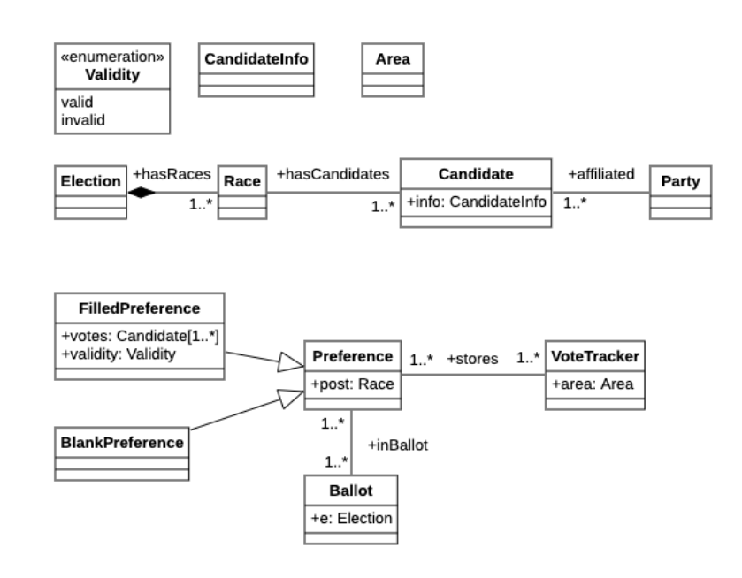
Real World Example
Class Diagram Used in SE2 Exam 14/07/2023

