Slide 1
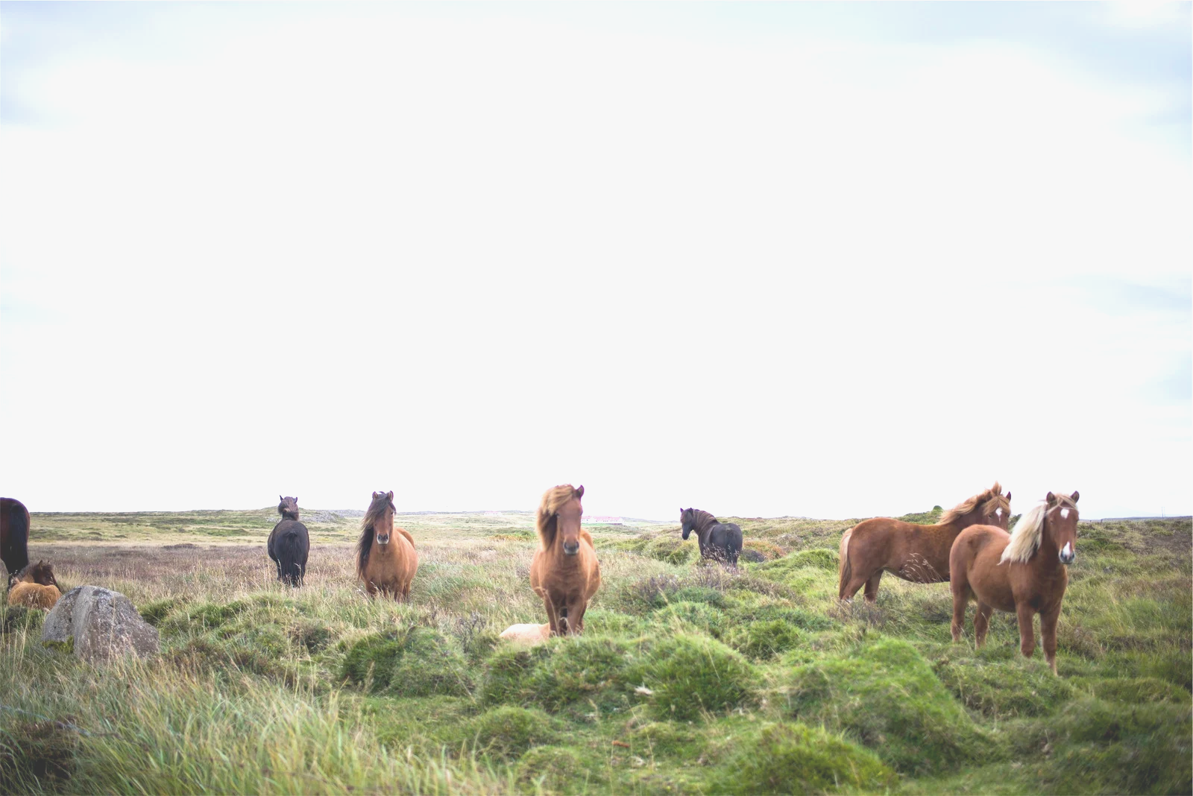
PREDICT HEALTH OUTCOMES OF HORSES

Slide 2
TODAY'S DISCUSSION
Explore the dataset
Pre-processing data
Classification methods
Conclusion
2

Slide 3


EXPLORE THE DATASET

Slide 4
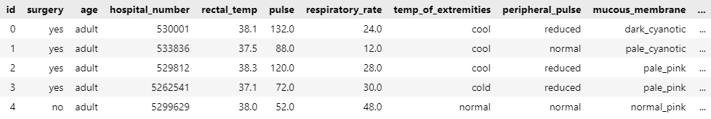
EXPLORE THE DATASET
DATASET SHAPE : 1235 ROWS X 29 COLUMNS
4

Slide 5
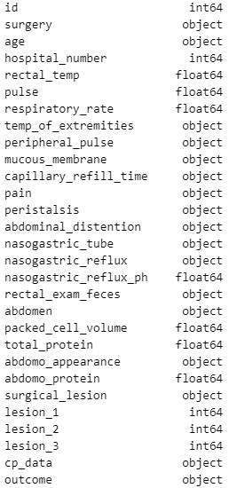
EXPLORE THE DATASET
COLUMN TYPES :
INT : 5
FLOAT : 7
OBJECT : 17
5

Slide 6
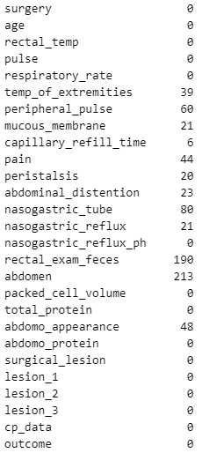
EXPLORE THE DATASET
MISSING VALUES :
6

Slide 7
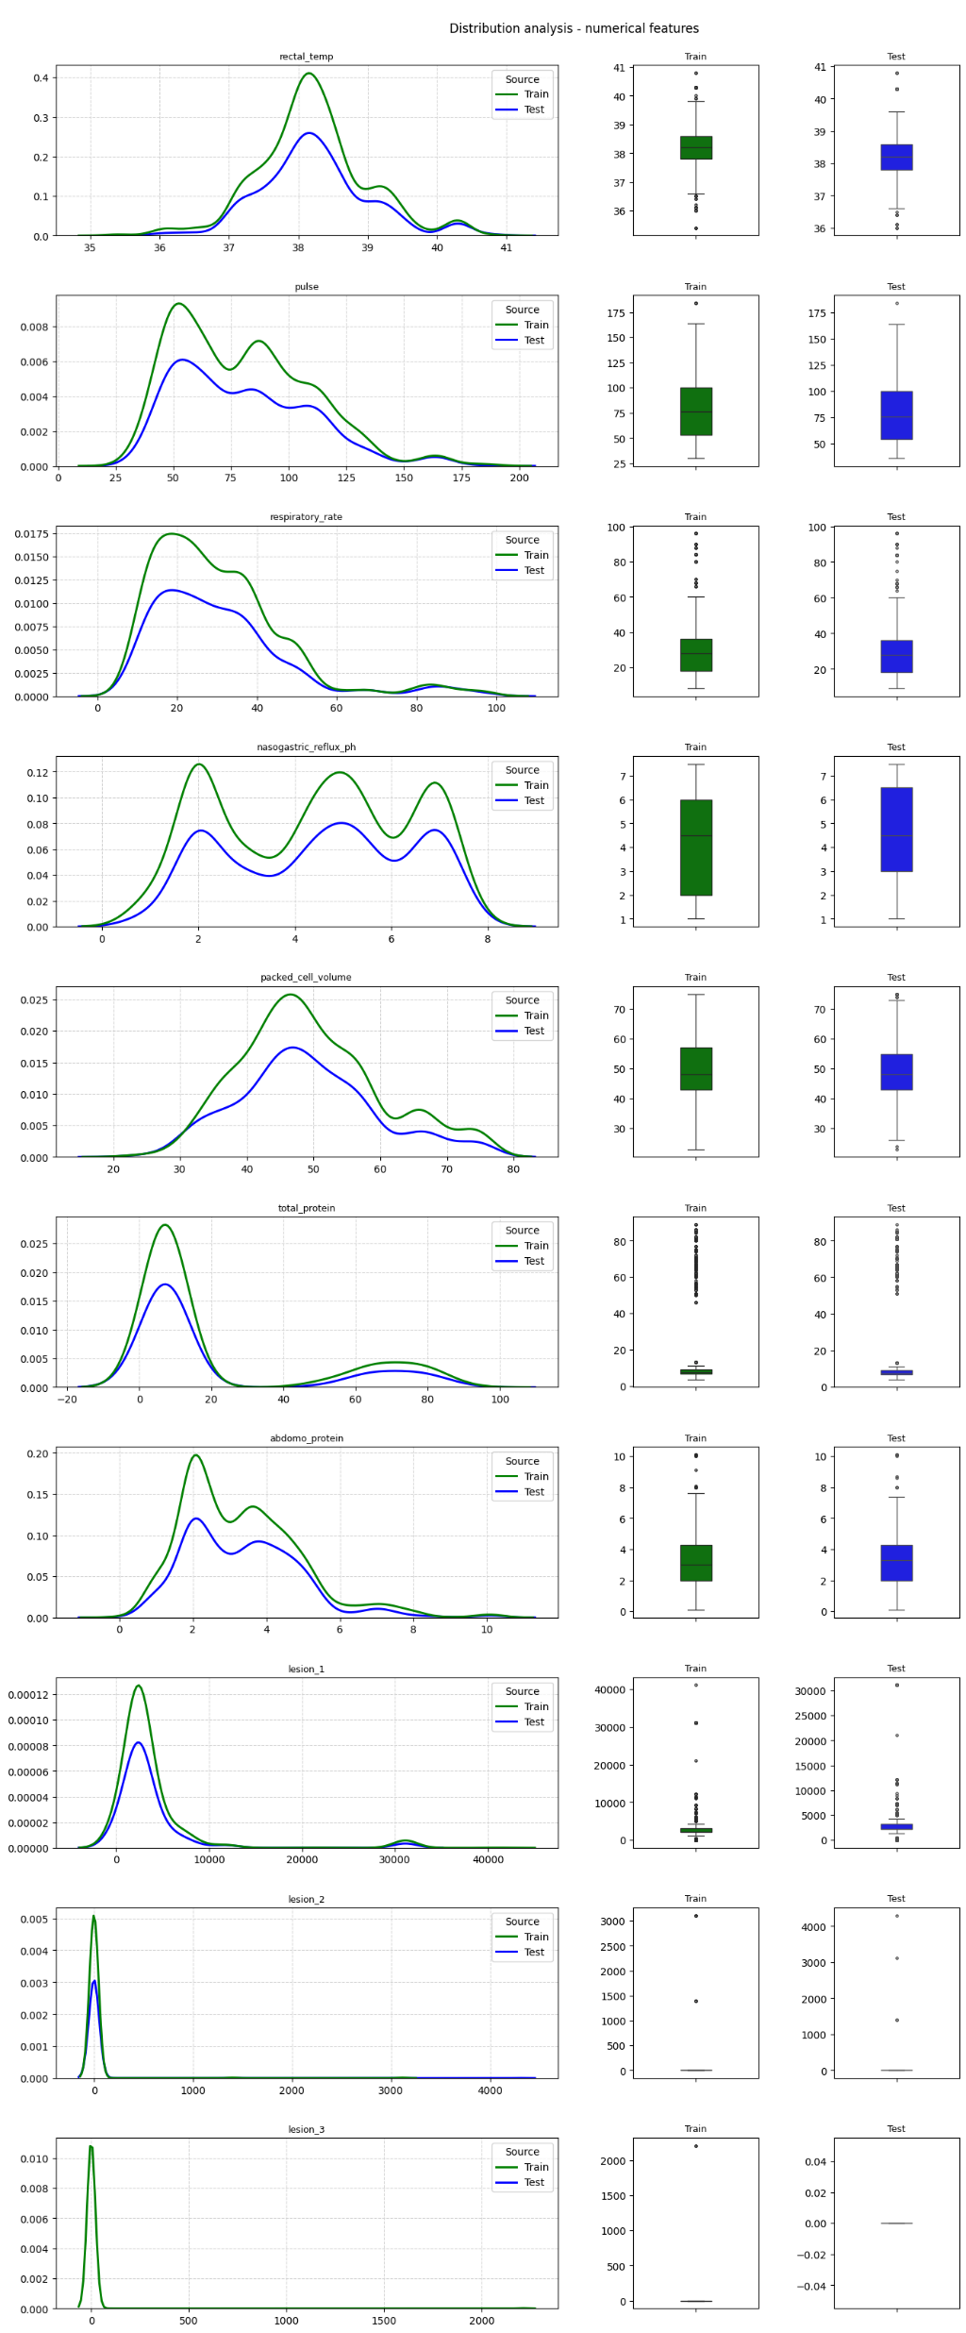
Distribution
Analysis
Numerical Variables
7

Slide 8
8

Slide 9
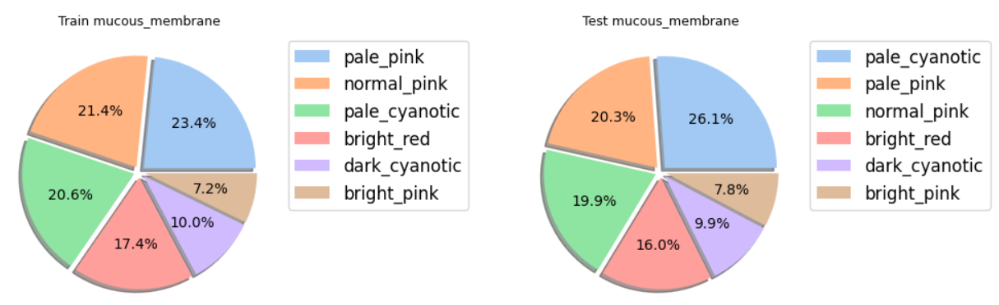
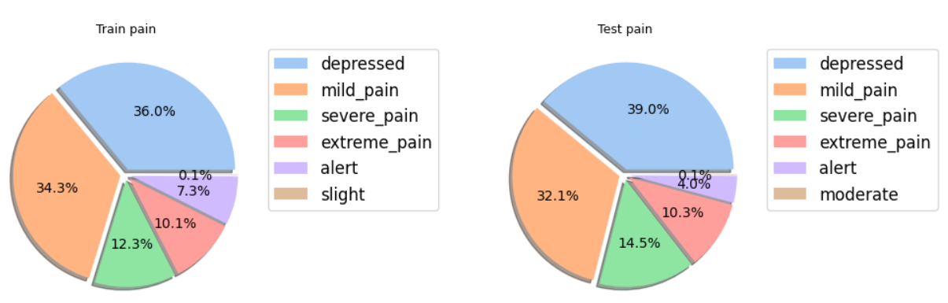
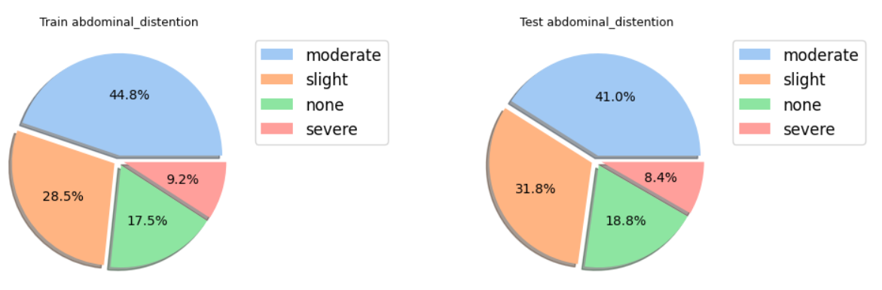
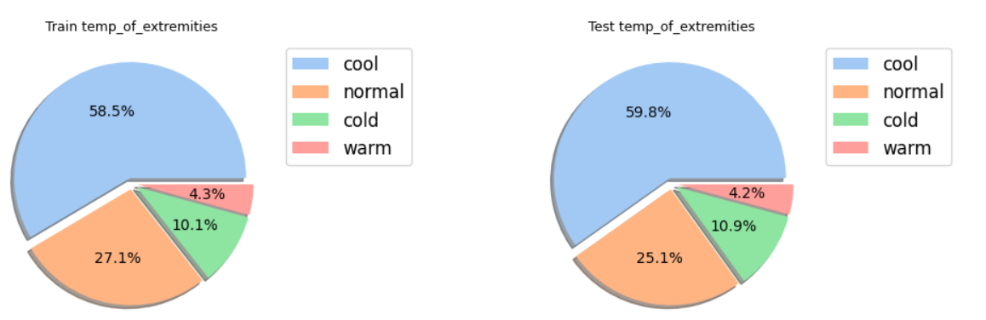
Distribution
Analysis
Categorical Variables
9

Slide 10
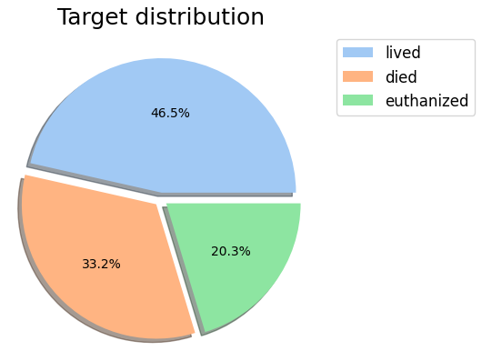
EXPLORE THE DATASET
10

Slide 11
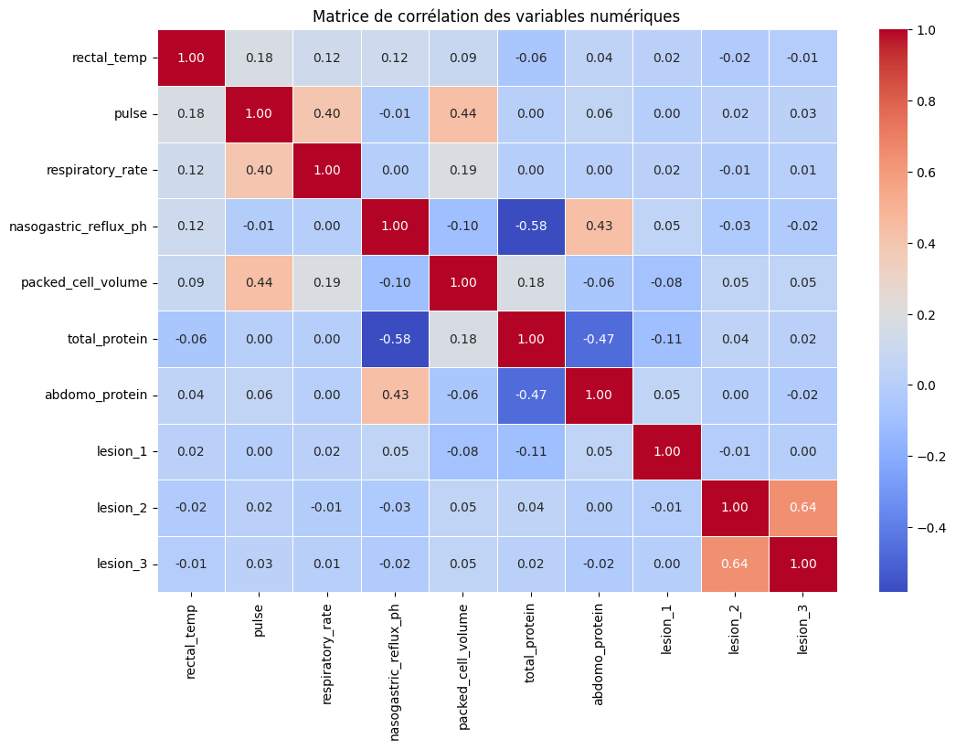
EXPLORE THE DATASET
11

Slide 12
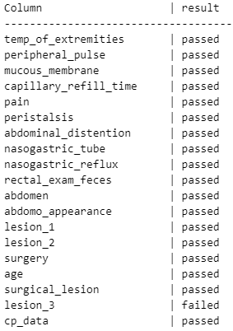
EXPLORE THE DATASET
CHI-SQUARED TEST
THE FEATURE LESION_3 FAILED THE TEST
12

Slide 13

PRE-PROCESSING DATA

Slide 14
PRE-PROCESSING DATA
CHI-SQUARED TEST
AS LESION_3 FAILED THE TEST, WE DELETE IT
14

Slide 15

PRE-PROCESSING DATA
DELETE USELESS COLUMNS :
ID COLUMN
HOSPITAL_NUMBER COLUMN
15

Slide 16


PRE-PROCESSING DATA
ORDER CATEGORICAL COLUMNS
ORDINAL ENCODER
LABEL ENCODER
FOR EXAMPLE WITH THE ABDOMEN_DISTENSION FEATURE :
SEVERE: 0
NONE : 1
SLIGHT: 2
MODERATE : 3
NONE : 0
SLIGHT : 1
MODERATE : 2
SEVERE : 3
16

Slide 17
PRE-PROCESSING DATA
IMPUTE DATA :
FOR CATEGORICAL VALUES : MOST FREQUENT STRATEGY
FOR NUMERICAL VALUES : MEDIAN STRATEGY
17

Slide 18
PRE-PROCESSING DATA
QUANTILE TRANSFORMER
STANDARD SCALER
18

Slide 19




CLASSIFICATION METHODS

Slide 20
CLASSIFICATION METHODS
CLASSIFICATION METHODS USED :
RANDOM FOREST
LOGISTIC REGRESSION
K NEIGHBORS
DECISION TREE
GRADIENT BOOSTING
ADABOOST
EXTRA TREES
BAGGING
20

Slide 21
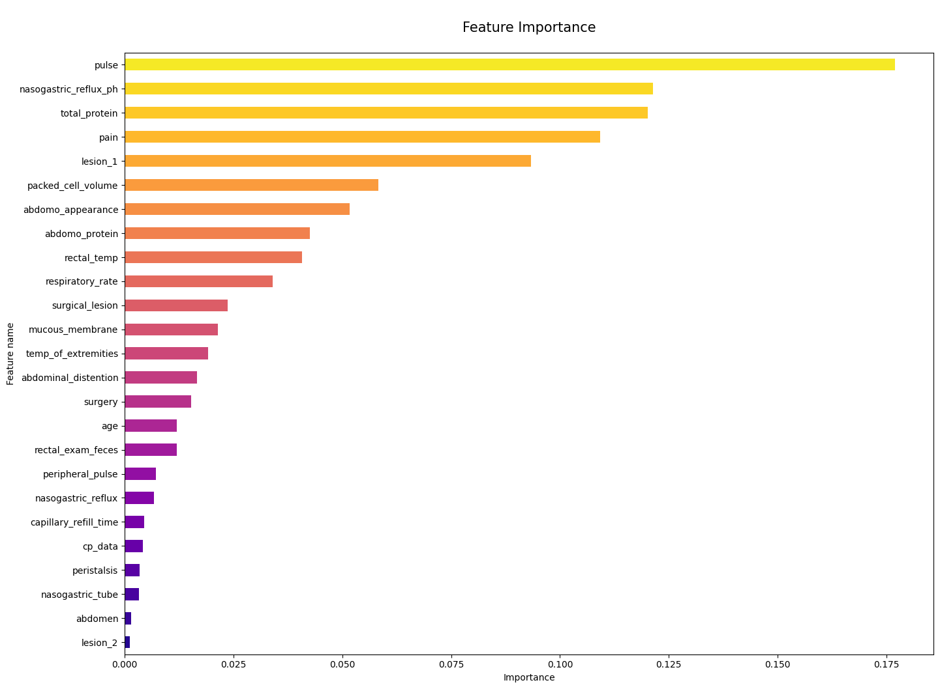
CLASSIFICATION METHODS
VERY IMPORTANT
21

Slide 22
CONCLUSION

Slide 23
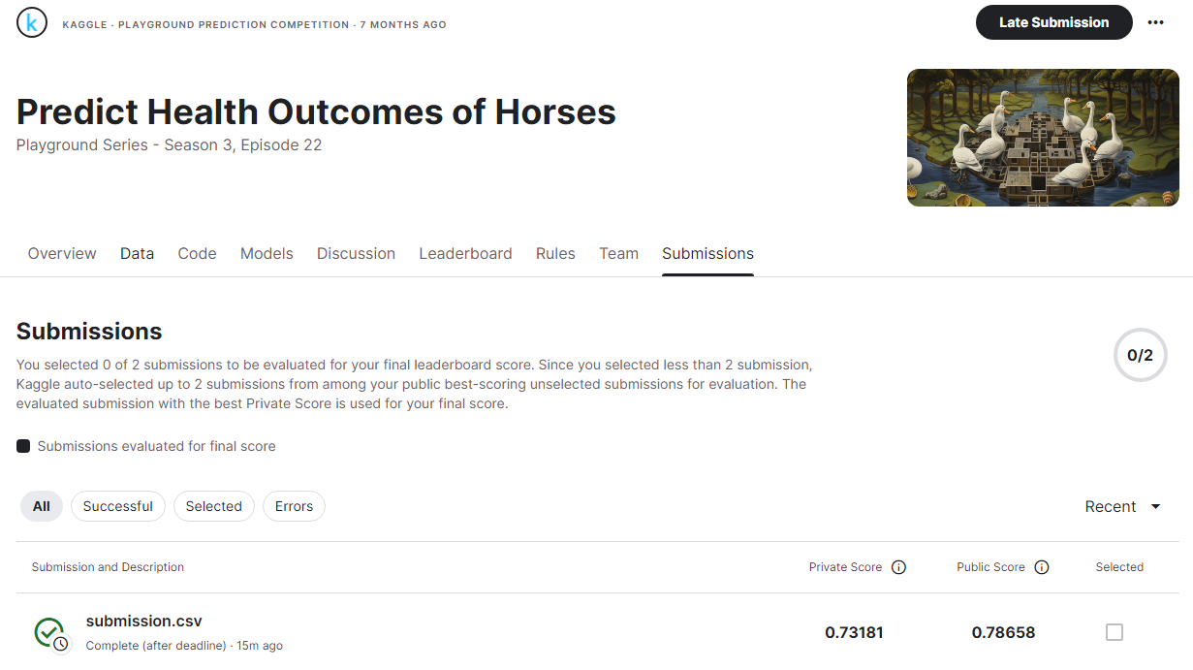
CONCLUSION
23

