Slide 1

Egypt Agricultural
Spatial Analysis Project
Mapping crop suitability, agricultural regions & land use patterns
across Egypt's 27 governorates using spatial data science.
Student: Osman Osama
Institution: Egyptian Chinese University — Faculty of Computer Science
Tools: R · sf · ggplot2 · leaflet · GADM Shapefiles · CAPMAS Data

Slide 2




Project Overview
Data Sources
Methods
GADM boundary shapefiles (level 1)
CAPMAS agricultural statistics
Custom crop suitability scores
Coordinates for 27 governorates
Spatial joins & geometry handling (sf)
Choropleth mapping (ggplot2)
Interactive overlays (leaflet)
Agriculture region classification
Outputs
Goal
Static choropleth: suitability score
Interactive dot map: agricultural regions
Interactive map: top crops per governorate
Full spatial analysis report
Understand which governorates are most suitable for agriculture and what crops they grow, using open spatial data.

Slide 3
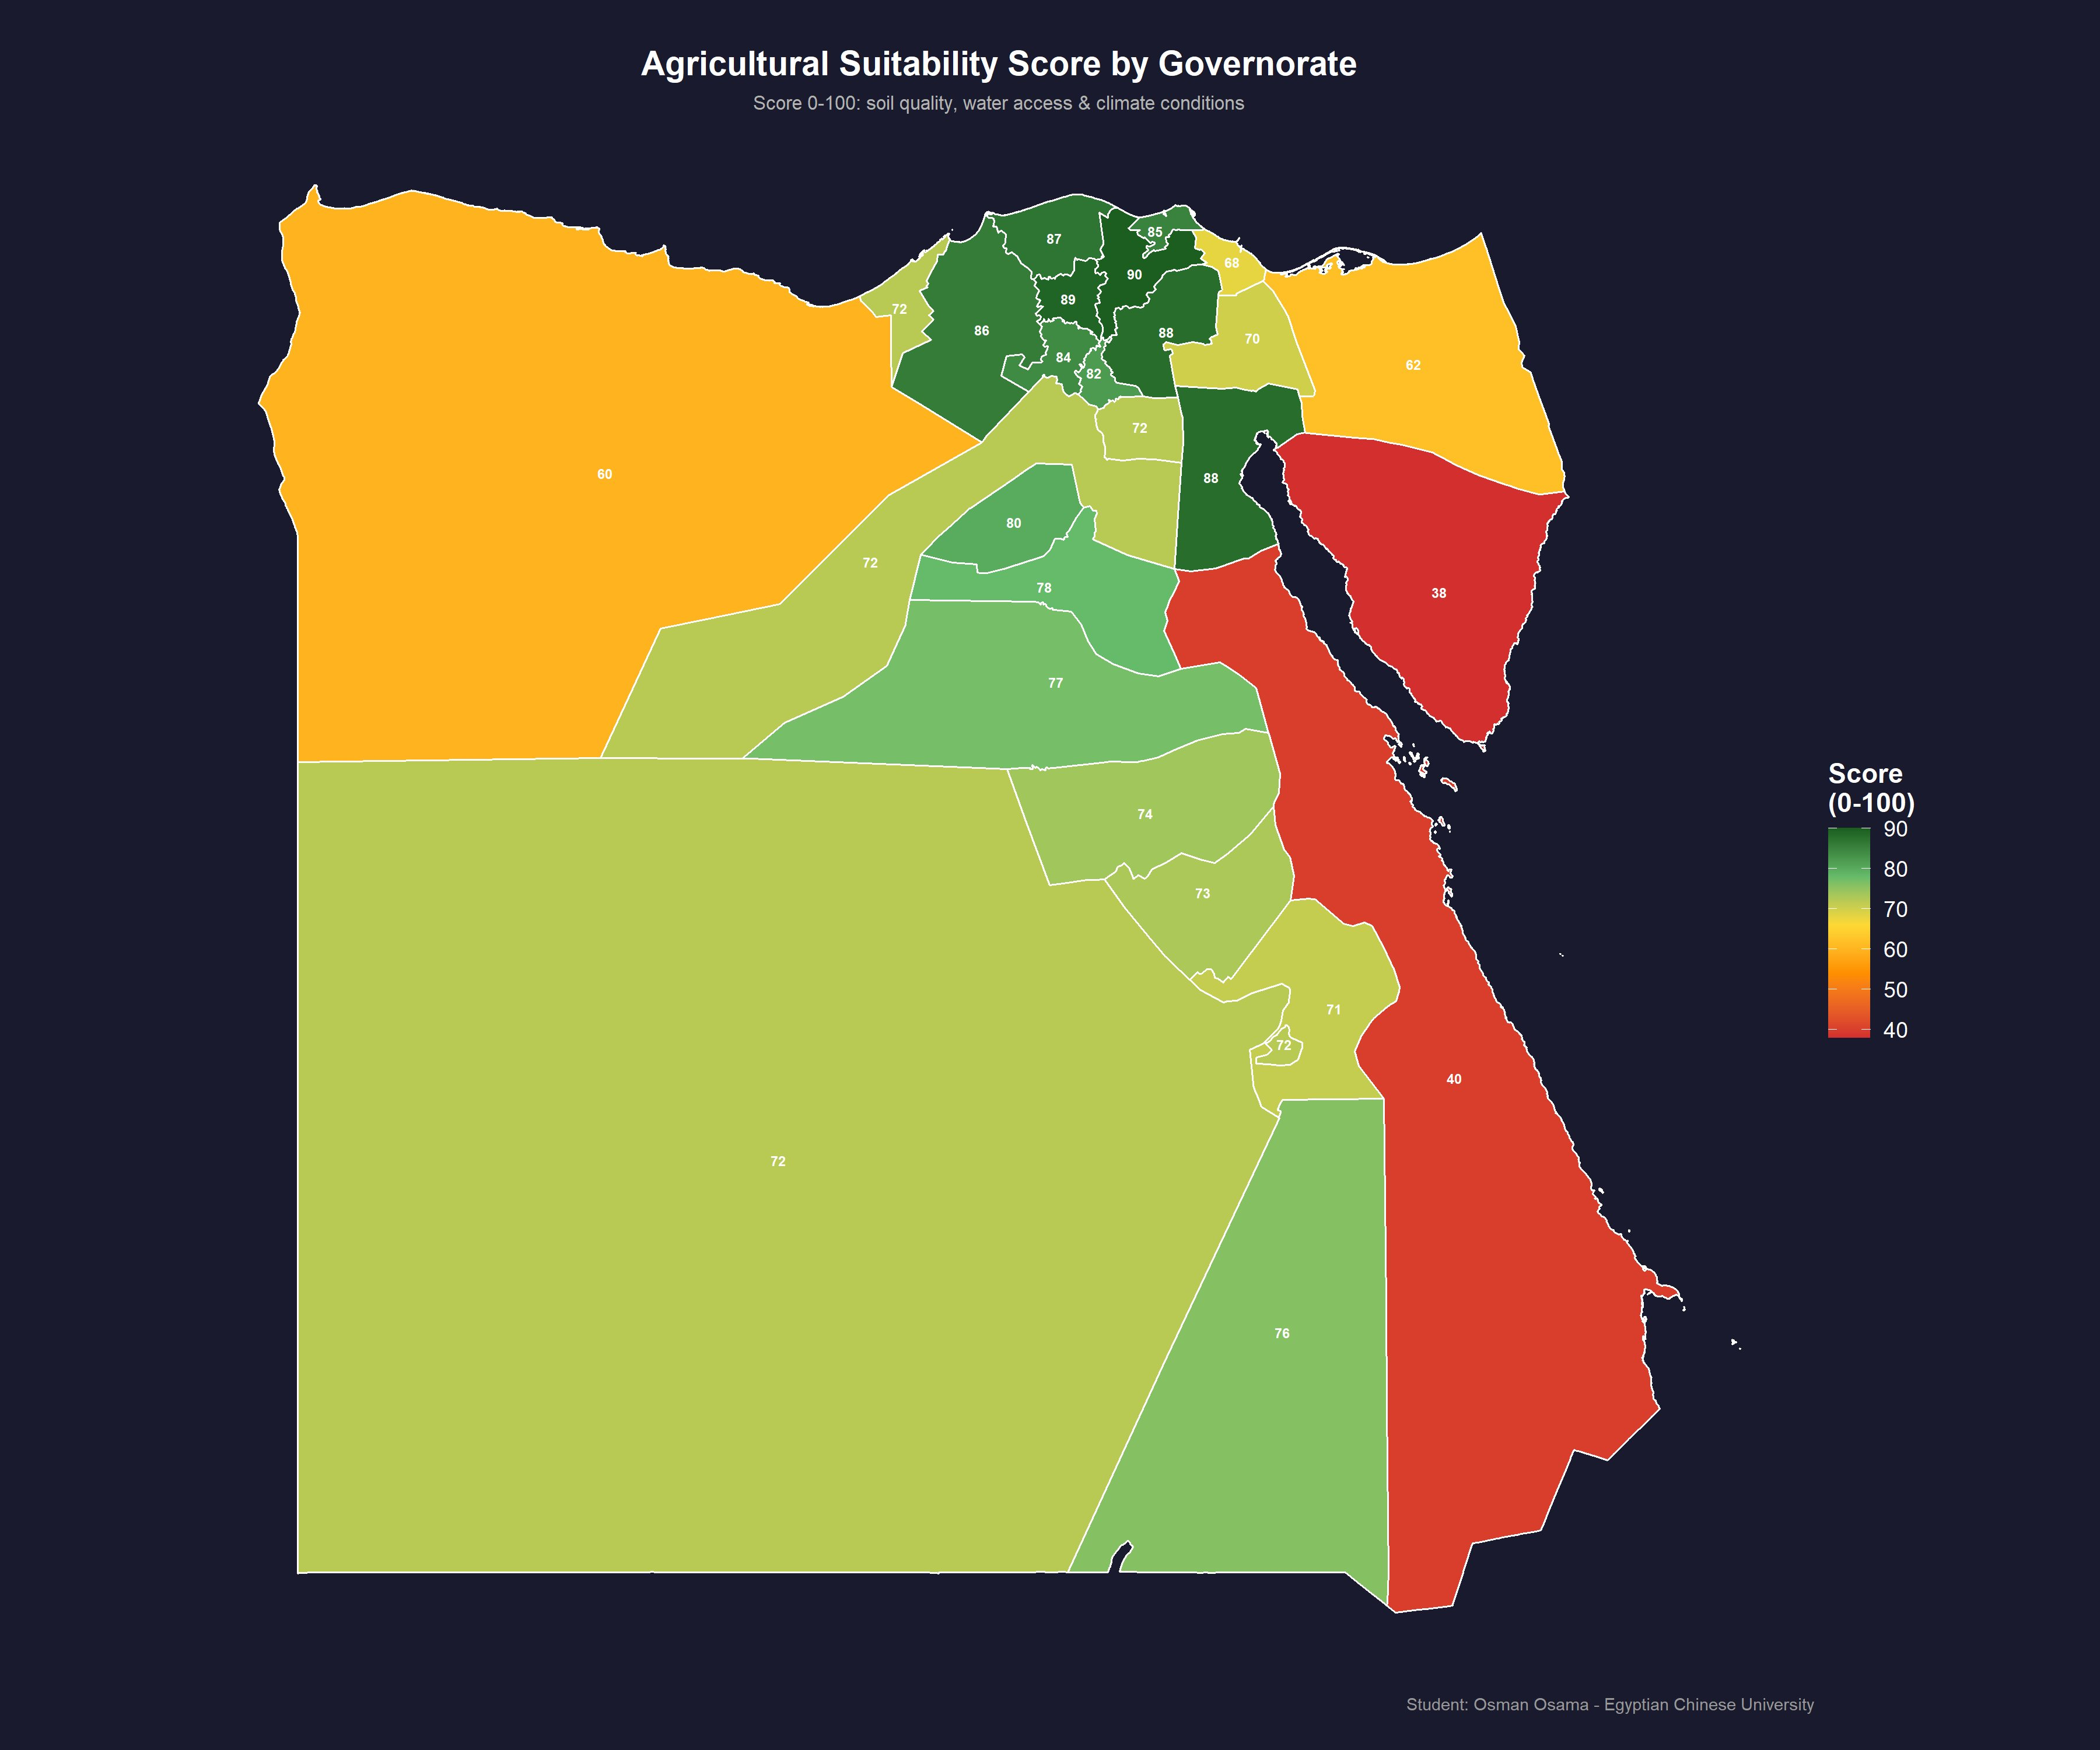
Agricultural Suitability Score Map
Score 0–100 based on soil quality, water access & climate conditions across all 27 Egyptian governorates
90
Highest Score
Ad Daqahliyah (Rich Delta Soil)
38
Lowest Score
Janub Sina' (Arid Desert)
87
Delta Avg
Nile Delta Governorates
49
Desert Avg
Desert / Red Sea Govs.
🟢 Green = High suitability 🔴 Red = Low

Slide 4
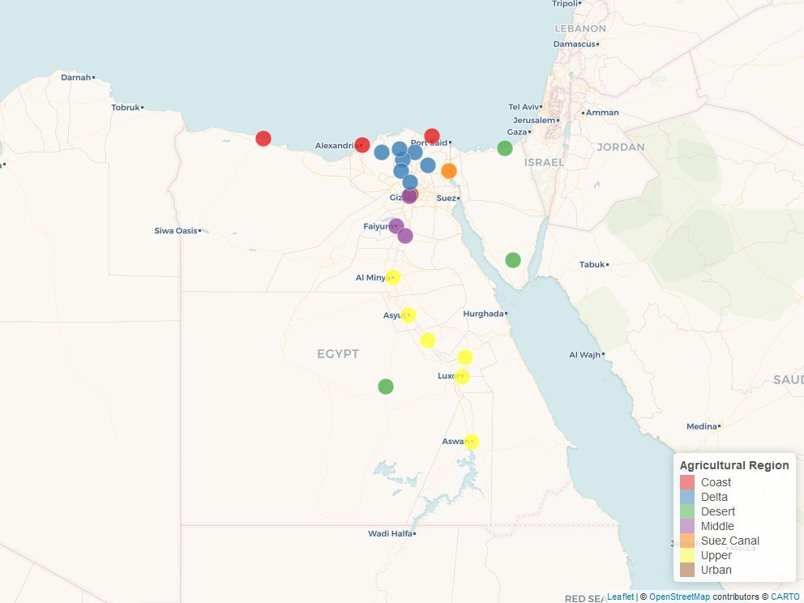
Agricultural Regions — Interactive Map
Each governorate classified into one of 7 agricultural regions, displayed with color-coded dot markers (Leaflet / OpenStreetMap)
Agricultural Regions
Delta
Upper Egypt
Coast
Middle
Desert
Suez Canal
Urban

Slide 5
Top Crops by Agricultural Region
Primary crops grown in each region based on soil type, water availability, and climate
Region | Primary Crops | Avg Score
Delta | Rice · Cotton · Maize · Wheat | 88
Upper Egypt | Sugarcane · Wheat · Dates · Maize | 74
Coast | Cotton · Olives · Citrus · Barley | 66
Middle | Vegetables · Grapes · Olives · Cotton | 77
Desert | Dates · Medicinal Herbs · Drought Crops | 50
Suez Canal | Citrus · Vegetables · Grapes | 64
Urban | Vegetables · Herbs · Flowers | 45
Scores reflect composite index: soil fertility + water access + climate suitability (0–100)

Slide 6
Suitability Score Distribution
Top 10 and Bottom 5 governorates by agricultural suitability score

Slide 7




Key Findings & Insights
Nile Delta Dominates
Water Access = Key Driver
Delta governorates score 82–90, making them the most productive agricultural zone. Rich alluvial soil + dense irrigation networks explain this advantage.
Water availability is the single strongest predictor of suitability. Governorates near the Nile or Delta canals consistently outperform desert regions by 30–50 points.
Crop Diversity by Region
Desert Zones Need Attention
Upper Egypt specializes in sugarcane & dates; the Delta in rice & cotton; the coast in olives & citrus. Each region has a distinct crop identity driven by climate.
Red Sea, South Sinai & parts of New Valley score 38–60. These regions need investment in drip irrigation, desert agriculture & oasis farming technologies.

Slide 8
Tools & Methodology
01
Data Collection
GADM shapefiles for Egypt administrative boundaries (level 1 — governorates). CAPMAS crop & agriculture data used to build suitability scores.
02
Data Processing
Loaded shapefiles using the sf package in R. Merged agricultural data by governorate name. Validated CRS and geometry integrity.
03
Static Mapping
Built choropleth map with ggplot2 + geom_sf(). Applied a green-red gradient palette scaled to suitability scores. Added labels and theme customization.
04
Interactive Mapping
Built two Leaflet maps: (1) agricultural region dot map with color-coded circles, (2) crop overlay map with popups showing top 3 crops per governorate.

Slide 9
R Libraries Used
sf
CRAN
dplyr
CRAN
Simple features — load, transform, and manipulate spatial data & shapefiles
Data wrangling — filter, mutate, merge agricultural data with spatial layers
ggplot2
CRAN
stringr
CRAN
Static choropleth maps using geom_sf() with custom color scales and themes
String cleaning for smart fuzzy matching of governorate names
geodata
CRAN
scales
CRAN
Download GADM administrative boundary shapefiles directly in R
Rescale suitability scores for gradient color mapping
leaflet
CRAN
tidyr
CRAN
Interactive web maps — circle markers with color-coded agricultural regions
Tidy data transformations — tribble() for inline data creation
htmlwidgets
CRAN
mapview
CRAN
Export Leaflet and Plotly maps as self-contained HTML files
Export Leaflet map screenshots to PNG via mapshot()
plotly
CRAN
RColorBrewer
CRAN
Convert ggplot2 to interactive hover maps via ggplotly()
Color palettes — Set1 palette for 7 agricultural region categories
All packages installed via: install.packages() from CRAN | R version ≥ 4.2

Slide 10
Project Data Sources
GADM — Global Administrative Areas
FAO Egypt — Food & Agriculture Organization
gadm.org / R: geodata::gadm()
fao.org/egypt
• Egypt Level-1 shapefile (27 governorates)
• Crop suitability benchmarks per agro-climatic zone
• Downloaded via geodata::gadm('EGY', level = 1)
• Water access and soil quality reference data
• Coordinate Reference System: WGS84 (EPSG:4326)
• Validated suitability score ranges (0–100 index)
• Provides geometry boundaries for all choropleth maps
• Referenced for Upper Egypt & Delta region benchmarks
CAPMAS — Central Agency for Statistics
OpenStreetMap / CartoDB Voyager
capmas.gov.eg
leaflet addProviderTiles(providers$CartoDB.Voyager)
• Egypt agricultural census & land use statistics
• Base tile layer for interactive Leaflet maps
• Primary, secondary & tertiary crop data per governorate
• CartoDB.Voyager used for clean, neutral background
• Used as reference to build the crop_data tribble in R
• OpenStreetMap data — open license (ODbL)
• Source for agricultural region classification logic
• Loaded automatically via R leaflet package
Course: Spatial Statistics | Supervisor: Dr. Mahmoud Eissa | Egyptian Chinese University

Slide 11
Conclusion & Future Work
This project successfully applied spatial data science techniques to analyze Egypt's agricultural landscape. Using R's sf and ggplot2 libraries alongside interactive Leaflet mapping, we produced both static and interactive visualizations that reveal meaningful patterns in crop suitability, regional specialization, and geographic constraints.
✅ Delivered
Static choropleth (suitability score) + 2 interactive Leaflet maps with full popups
✅ Insight
Nile Delta remains Egypt's most productive zone; desert regions require targeted agricultural investment
🔭 Future
Integrate satellite NDVI data for real-time vegetation monitoring per governorate
🔭 Future
Add time-series layer showing crop yield changes (2010–2024) for trend analysis
Student: Osman Osama | Egyptian Chinese University | Data Science Track

