Slide 1

SPATIAL STATISTICS
Egypt Births by
Governorate (2016)
Interactive Choropleth & Point Visualization | CAPMAS Official Data
STUDENT
UNIVERSITY
COURSE
Osman Osama
Egyptian Chinese University
Spatial Statistics
2016

Slide 2




PROJECT OVERVIEW
Data Source
Spatial Focus
CAPMAS Official Egypt Statistical Yearbook 2016/2017 — Egypt's primary national statistics authority
27 Egyptian Governorates mapped using official shapefiles in WGS84 coordinate reference system (EPSG 4326)
Variable
Output Types
Registered births per governorate in 2016 — total ~2.3 million births across all regions of Egypt
Static choropleth map, proportional point map, interactive HTML maps, and a top-10 bar chart
Spatial Statistics Assignment | Egyptian Chinese University

Slide 3

METHODOLOGY
8-Part R Workflow — From Raw Data to Published Maps
1
Part 1 — Libraries
2
Part 2 — Shapefile Load
sf, ggplot2, plotly, dplyr, viridis, scales
Egypt governorate boundaries (EPSG 4326)
3
Part 3 — Extract Names
4
Part 4 — Births Data
27 governorate names exported to CSV
CAPMAS 2016 official birth counts per governorate
5
Part 5 — Spatial Merge
6
Part 6 — Static Map
left_join by name + centroid & category computation
ggplot2 choropleth with labels & color classification
7
Part 7 — Interactive
8
Part 8 — Point Map
ggplotly HTML map with hover tooltips
Proportional circles at centroids — size ∝ births

Slide 4
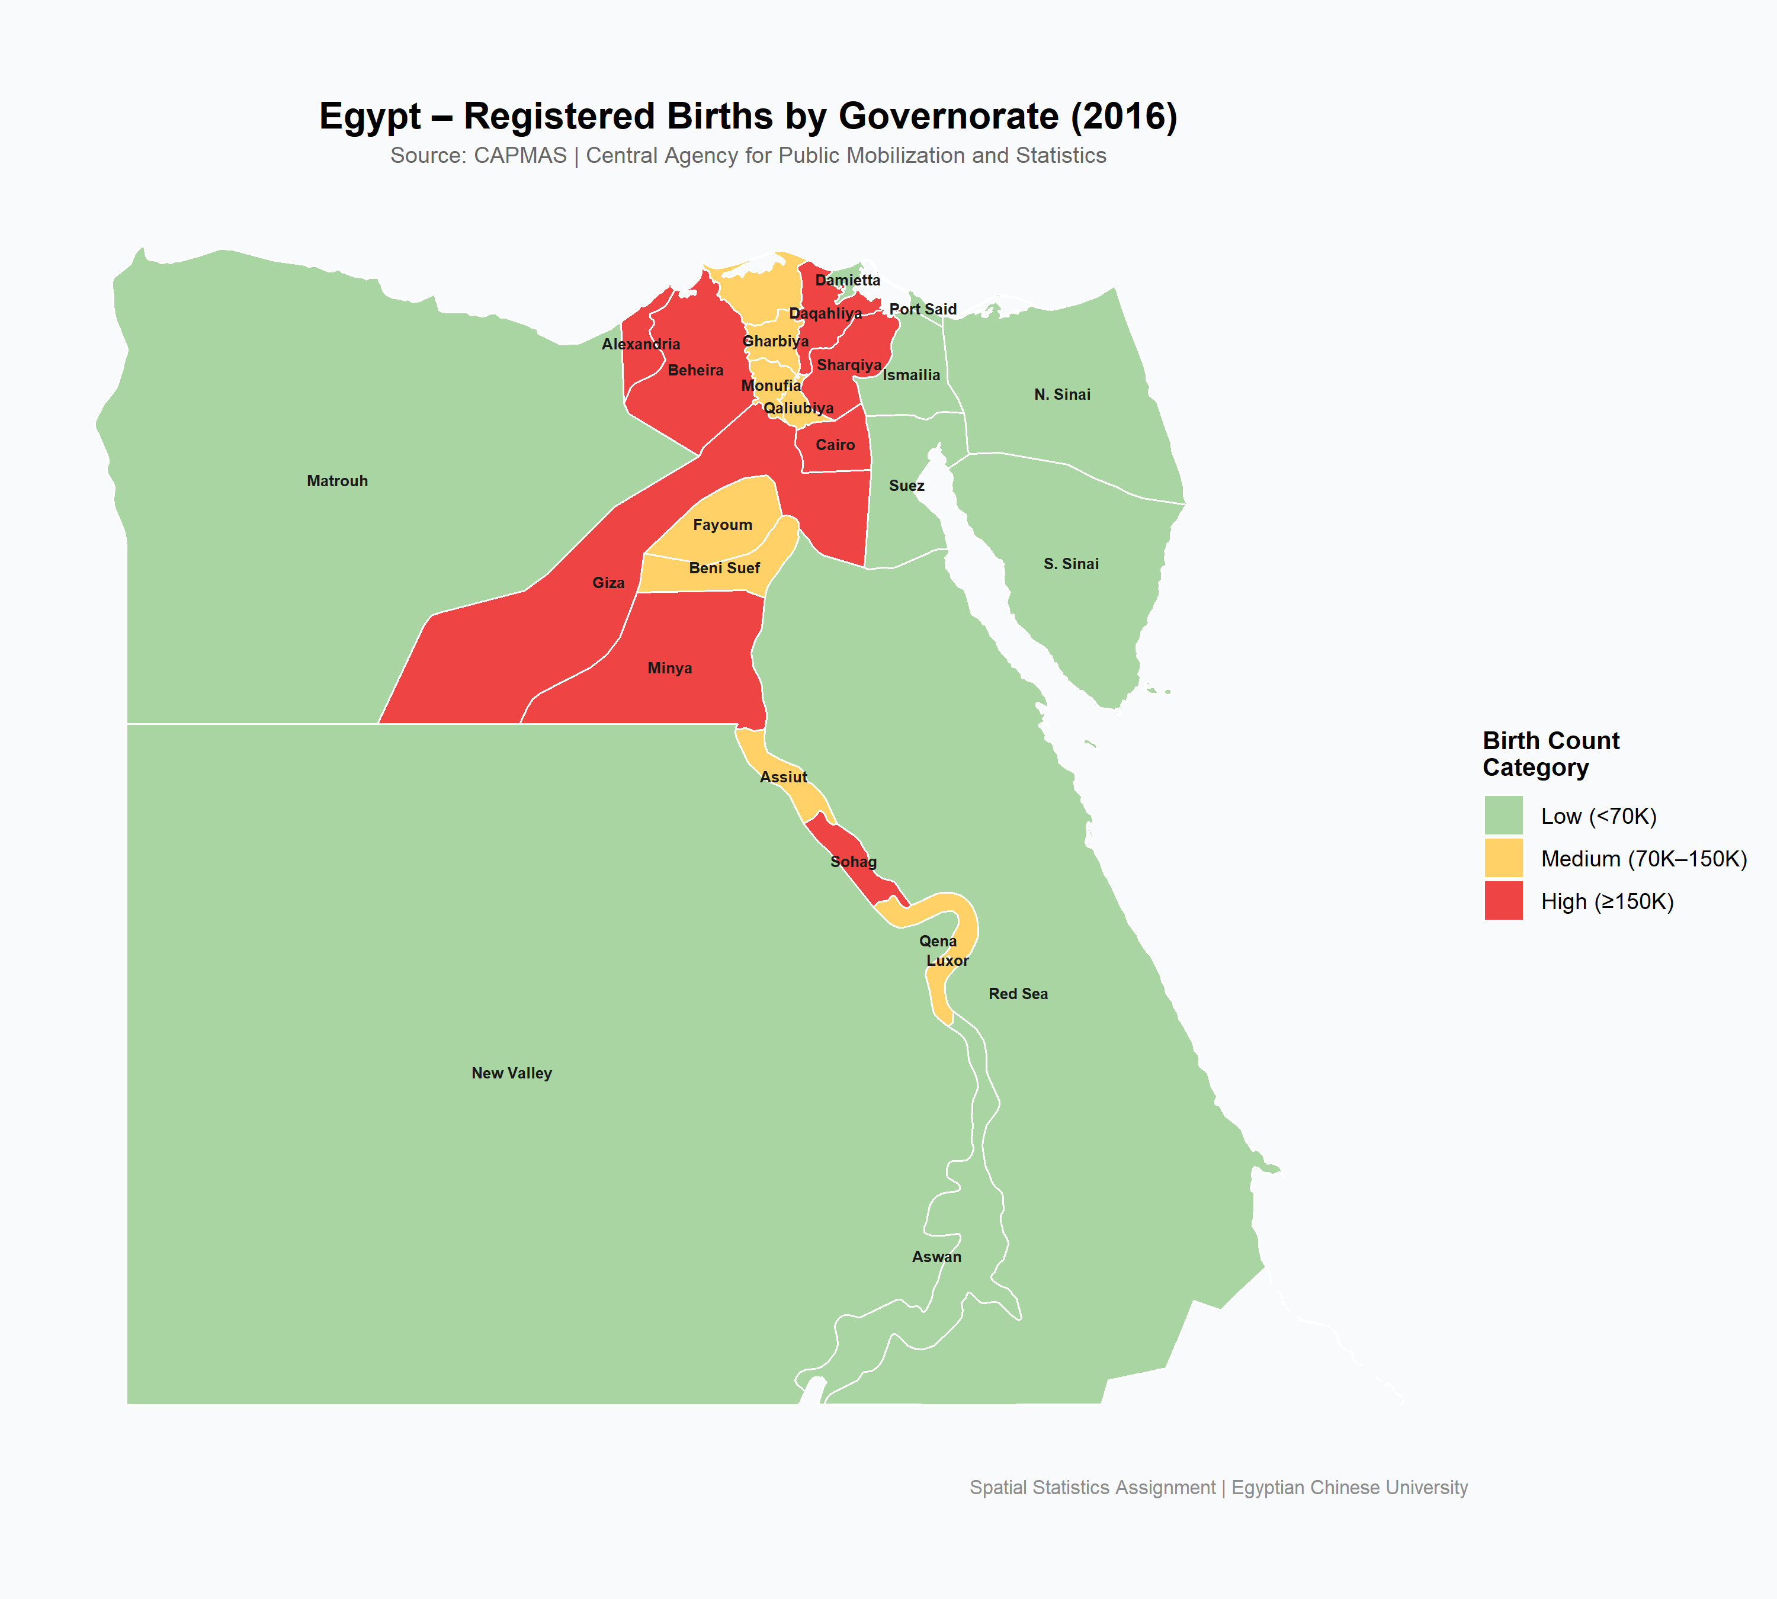
CHOROPLETH MAP — Births by Category
BIRTH CATEGORIES
High ≥150K
Cairo, Giza, Alexandria,
Sharqiya, Beheira, Minya,
Daqahliya, Sohag, Beheira
Medium 70K–150K
Gharbiya, Monufia,
Qaliubiya, Assiut, Fayoum,
Beni Suef, Qena, KFR el-Shaykh
Low <70K
Damietta, Ismailia,
Suez, Port Said, Aswan,
Luxor, Red Sea, S. Sinai…
Source: CAPMAS 2016/2017 Statistical Yearbook

Slide 5
POINT VISUALIZATION — Proportional Circles
What is a Proportional Circle Map?
CIRCLE SIZE LEGEND
Each governorate is represented by a circle placed at its centroid. The circle's area is directly proportional to the number of registered births — the bigger the circle, the more births recorded in that governorate.
≥150K births
High
70–150K births
Medium
Choropleth vs. Point Map
Choropleth fills entire polygon — large desert governorates dominate visually even with few births.
<70K births
Low
Proportional circles show true magnitude — South Sinai's tiny circle vs. Cairo's large one tells the real story.
R Code: geom_point(aes(size = Births_2016)) + scale_size_area(max_size = 18)

Slide 6
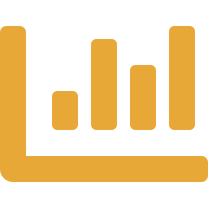
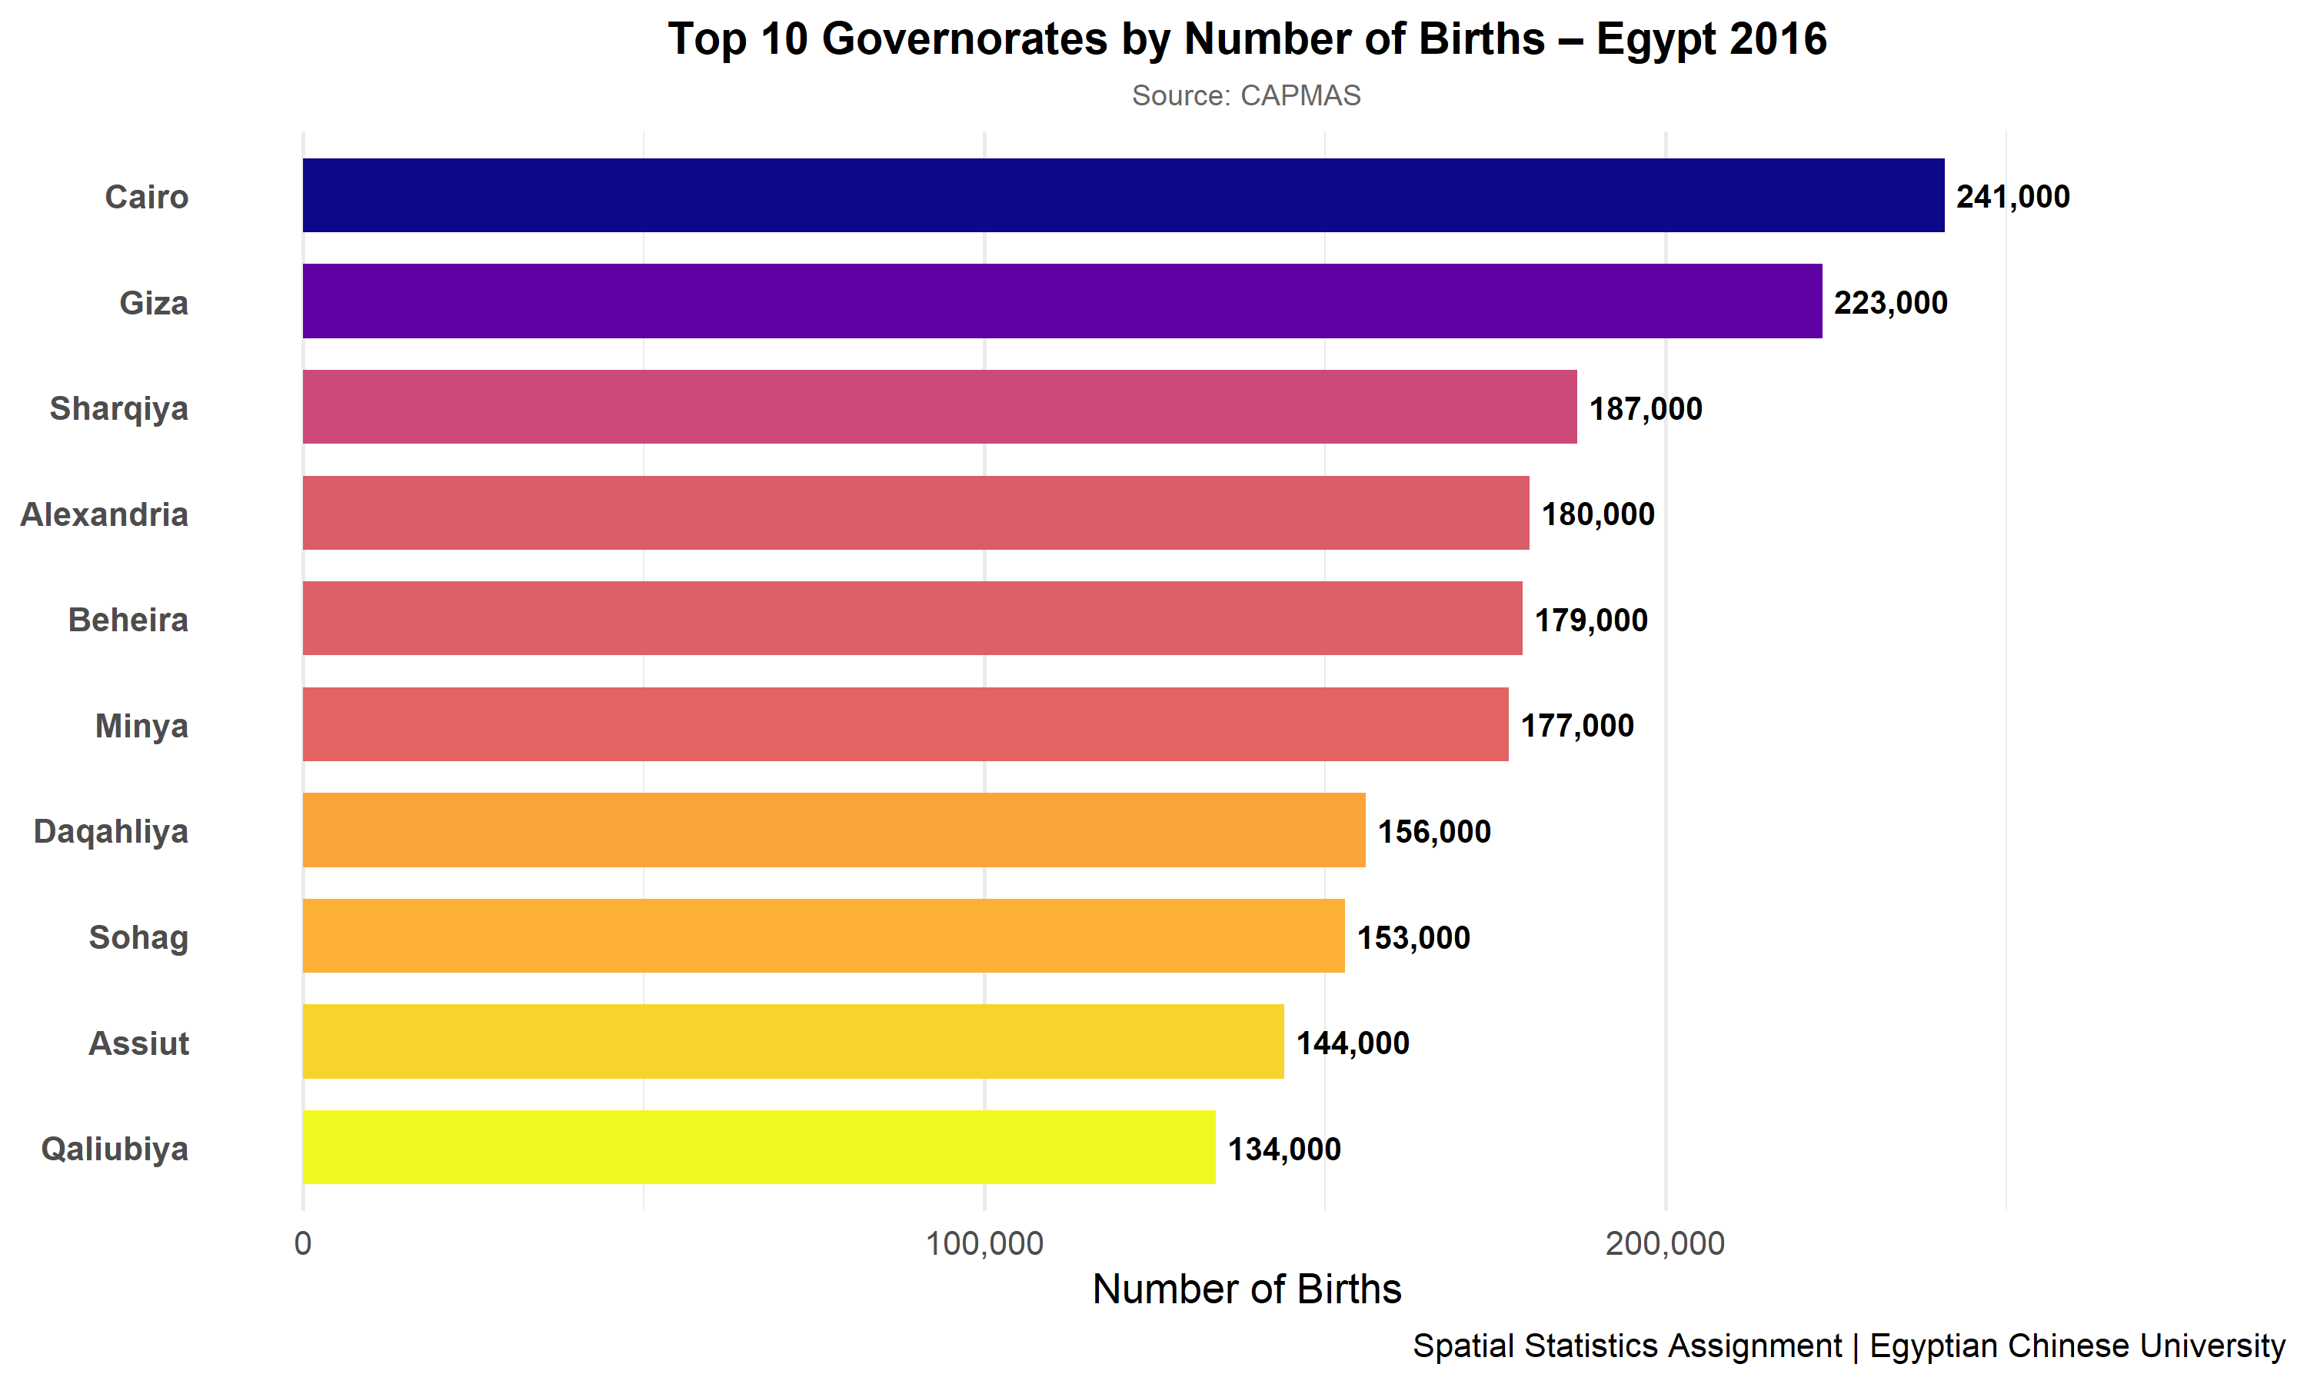
TOP 10 GOVERNORATES BY BIRTHS
241K
Cairo
(Highest)
2.3M
Total
Egypt
3,372
S. Sinai
(Lowest)
Source: CAPMAS 2016/2017 Statistical Yearbook

Slide 7
KEY FINDINGS
01
Geographic Concentration
02
Desert Governorates — Sparse Population
The Nile Delta and Valley concentrate over 80% of Egypt's births. Cairo, Giza, Sharqiya, Beheira, Alexandria, and Minya alone account for more than 1.2 million births.
New Valley, South Sinai, and Red Sea governorates cover vast desert territories but recorded fewer than 30,000 births combined — a stark contrast to their geographic size.
03
Point Map vs. Choropleth
04
Interactive Output
The proportional circle map corrects the visual bias of the choropleth: large desert governorates shrink to small dots, while densely populated Delta governorates become the visual focus.
The ggplotly HTML maps enable drill-down exploration — hover tooltips reveal exact birth counts and categories for each governorate without cluttering the static view.

Slide 8

TOOLS & OUTPUT FILES
R Packages Used
Output Files (9 total)
sf
ggplot2
governorate_names.csv
governorates_births.csv
plotly
dplyr
egypt_births_map.png
htmlwidgets
viridis
egypt_map.html
scales
RColorBrewer
egypt_births_updated.shp
governorates_births_final.csv
egypt_births_top10.png
egypt_births_point_map.png
egypt_point_map.html

Slide 9
Thank You
Egypt Births by Governorate — Spatial Statistics Assignment
Student: Osman Osama | University: Egyptian Chinese University | Data: CAPMAS 2016

