Slide 1
When Cross-Dataset Battery RUL Transfer Fails — and How to Repair It with Valid Uncertainty
A capacity-only, four-dataset benchmark with rank-signal regime taxonomy and split conformal prediction
Durukan Demir · Dicle Çoban · Salih Sarp · Osman Safa Çifçi | 2026
Notes:
Welcome. This work proposes a sistematic cross-dataset transfer protocol for early-cycle battery RUL prediction with valid uncertainty intervals.

Slide 2
Motivation — why cross-dataset transfer matters
Battery management systems are trained on lab data and deployed on field data with different chemistry, protocol, format.
Within-dataset accuracy is now a solved problem (Severson 2019, BatLiNet 2024).
But cross-dataset transfer is treated as a black-box engineering problem: train and pray.
Reviewers and practitioners ask: when will my pre-trained model work on a new dataset? How can I trust the answer?
We need a diagnostic framework + a deployment protocol + valid uncertainty intervals.
4
public datasets
12
transfer directions
3 deterministic regimes
2 / 26
Notes:
Within-dataset accuracy is largely a solved problem. The frontier is cross-dataset reliability and uncertainty quantification for deployment. We span 4 public datasets and 12 transfer directions.

Slide 3
Brief literature snapshot — what others do
Within-dataset accuracy SOTA
Cross-dataset / UQ approaches
Severson 2019 (Nature Energy) — voltage curves + elastic net; ~10% MAPE on MATR.
BatLiNet 2024 (Nat. MI) — joint training across 401 cells; 6% MAPE on MATR-1.
EES 2025 — surface temperature features; 12% MAPE on TRI.
DCIR 2024 — internal impedance pulses; 150-cycle MAE across manufacturers.
Domain-Adaptive Transformer 2025 — V/Q+fine-tune; RMSE 178 cycles.
HybridoNet-Adapt 2025 — MMD as training loss for UDA.
Geng et al. 2025 — LSTM+attention+SSA; UQ via 50-seed MC (no coverage guarantee).
Ge et al. 2025 — Deep Koopman with embedded operating conditions.
GAP — no one first diagnoses what kind of shift exists, decides whether transfer is salvageable, and provides valid prediction intervals for the deployment.
3 / 26
Notes:
Two themes: within-dataset accuracy SOTA (left) and cross-dataset / UQ (right). None of them first diagnoses the type of shift, decides whether transfer can be repaired, and provides valid (coverage-guaranteed) prediction intervals — that is our gap.

Slide 4
Research questions and contributions
Three research questions
RQ1 — Can cross-dataset RUL transfer failure modes be predicted before training, from source/target diagnostics alone?
RQ2 — Does a small target labelled set (k=20 cells) repair the failure with valid uncertainty intervals?
RQ3 — Is the answer architecture-dependent, or does it survive a deep-learning backbone?
Five contributions
Four-dataset benchmark (MATR / HUST / Sandia / Luh-KIT) under a capacity-only feature contract.
Covariate-vs-concept shift decomposition framework with falsifier (importance-weighted CP).
Rank-signal regime taxonomy of 12 transfer directions (strong-rank / offset-dominant / rank-collapsed).
k-shot target calibration protocol with MAPIE split conformal prediction (valid 90% / 95% coverage).
Backbone-agnostic validation via PyTorch 1D-CNN baseline.
4 / 26
Notes:
Three questions, five contributions. The regime taxonomy and valid CP intervals are the two paper-defining novelties.

Slide 5
Datasets — four public archives under one feature contract
Dataset | Cells (modeled / censored) | Chemistry / format | Lifetime range (cycles) | Source
MATR (Severson/TRI) | 129 / 6 | LFP 18650, fast-charge | 133 – 2066 | Nature Energy 2019
HUST | 77 / 0 | LFP, multi-stage discharge | 829 – 2024 | EES 2022
Sandia 0-100 SOC | 50 / 11 | NCA / NMC / LFP 18650 | varies (mixed temp) | JES 2020
Luh / KIT RADAR | 106 / 2 | NMC, standard cycling | Sandia/Luh narrow | KITopen 10.35097/1947
362 modeled cells total (19 censored at 0.85·Q0 EOL threshold; retained for survival audit).
Same Q0/EOL definition across datasets: Q0 = median(Q_dis at cycles 2–5); EOL when Q_dis ≤ 0.85·Q0.
Capacity-only feature contract — 34 features derived from Q_dis(c) trajectory only (no voltage, current, temperature).
Universal contract enables apples-to-apples transfer across batteries with different chemistries and protocols.
5 / 26
Notes:
Four public datasets, all using the same minimal feature contract (capacity-only). 362 modeled cells, ~19 censored cells handled in the survival audit.

Slide 6
Methodology — pipeline overview
Raw cell data
Audit + features
Splits (70/15/15)
Outputs: paper-facing tables and figures (within / cross / shift / CP / SHAP / regime).
MATR / HUST / Sandia / Luh raw .pkl + .csv
Q0 = median(QD₂…QD₅); EOL = first c where Q_dis ≤ 0.85·Q0; 34 features
5 seeds × cell-level lifetime-stratified
All hyperparameters tuned by inner 5-fold CV (matching protocol across classical models and CNN).
Per-cell cluster bootstrap CIs avoid double-counting target cells across seeds (cross-dataset).
Median R² aggregation guards against catastrophic linear-adapter draws on small k_adapter.
Open code + committed feature CSVs (FAIR + Zenodo deposit, MIT license).
Models
Shift + regime
k-shot + CP
7 classical (EN, PLS, RF, XGB, CB, GP, Stacking) + PyTorch 1D-CNN
MMD, Mahalanobis, conditional-shift slopes, rank-signal classifier
Adapter (residual / linear) → MAPIE split CP at 90% / 95%
6 / 26
Notes:
Pipeline: audit → features → splits → models → diagnostics → calibration + CP. Same CV protocol on classical and CNN; cluster bootstrap; median R² for outlier-robust aggregation.

Slide 7
Within-dataset — capacity-only feature contract performance
Dataset | Best model | MAE | sMAPE | R² | R² 95% CI (pooled cluster bootstrap)
MATR | CatBoost | 171.7 | 23.7% | 0.575 | [0.458, 0.646]
HUST | Random Forest | 178.0 | 12.2% | 0.340 | [0.072, 0.512]
Sandia 0-100 SOC | XGBoost | 120.8 | 23.4% | 0.940 | [0.804, 0.987]
Luh / KIT | Gaussian Process | 115.8 | 18.4% | 0.769 | [0.675, 0.843]
Sandia and Luh — fitted reasonably well by capacity-only features (R² ≥ 0.77).
MATR — within the capacity-only literature ceiling (0.6 – 0.7); HUST narrow lifetime range caps R².
Reference: BatLiNet (voltage curves, joint training across 401 cells) hits 6% MAPE on MATR — we trade off accuracy for data-minimality, transferability and valid CP.
Bootstrap CIs from cluster-bootstrap by cell_id across pooled out-of-split predictions.
7 / 26
Notes:
Within-dataset accuracy is reasonable for Sandia/Luh, capped by lifetime spread for HUST, and in the capacity-only literature ceiling for MATR. We do not chase deep-learning SOTA — we trade accuracy for valid CP.

Slide 8
Cross-dataset transfer fails — but not uniformly
Direction | Best model | MAE | R²
Sandia → Luh | PLS | 185.0 | +0.477
Luh → Sandia | XGBoost | 415.3 | +0.492
HUST → Luh | PLS | 352.8 | −0.373
MATR → Sandia | CatBoost | 715.0 | +0.041
MATR → HUST | Gaussian Process | 763.0 | −7.94
HUST → MATR | Gaussian Process | 720.4 | −3.60
Three failure regimes emerge
Strong rank signal
Offset / weak signal
Rank-collapsed
Sandia ↔ Luh stay positive — salvageable.
MATR ↔ HUST catastrophic — no architecture helps.
Worst case: Sandia → MATR with PyTorch CNN reaches R² = −47.8.
Failure structure is not noise — it is predictable.
8 / 26
Notes:
Cross-dataset transfer fails on every direction, but the failure mode varies. Sandia↔Luh remain positive; MATR↔HUST collapse. This is the first sign of a regime structure.

Slide 9
Geometric shift — capacity normalization closes 71% of the gap
Setting | Feature set | MMD | Mahalanobis
Raw features (MATR vs HUST) | 12 | 0.71 | 13.10
Raw features | 34 | 0.57 | 16.00
Q0-normalized | 12 | 0.51 | 3.75
Q0-normalized | 34 | 0.43 | 6.71
71%
of geometric shift closed by Q0 normalization
Largest single contributor: Qdis_cycle10 — 10.84 σ pooled-z mean shift (MATR Q0 ≈ 1.07 Ah, HUST Q0 ≈ 1.20 Ah).
Capacity normalization (SOP §2.3) divides Q-scale features by per-cell Q0, putting heterogeneous datasets on the same scale.
Mahalanobis 13.10 → 3.75 with 12-feature set; MMD 0.71 → 0.51.
But R² doesn't improve — sometimes degrades (next slide).
9 / 26
Notes:
Capacity normalization closes 71% of the geometric gap. The natural next step is to check whether prediction improves — it doesn't (next slide).

Slide 10
Key finding — covariate alignment ≠ concept alignment
Direction | Feature set | Raw R² | Capnorm R² | Δ R²
MATR → HUST | 12 | −8.13 | −8.11 | +0.02
HUST → MATR | 12 | −1.53 | −3.82 | −2.29
HUST → MATR | 34 | −2.05 | −3.60 | −1.55
MMD ↓ 28%
Mahalanobis ↓ 71%
R² unchanged or worse
Concept shift in P(Y|X) remains
Classical covariate-vs-concept shift distinction shows up cleanly in battery data.
Removing the dataset-identity signal (Q0 gap) breaks the implicit predictor without fixing the y-distribution mismatch.
HUST → MATR even degrades after capnorm (−1.53 → −3.82 for 12-feat) — the Q0 gap was load-bearing.
Motivation for the conditional-shift decomposition framework (next slide).
10 / 26
Notes:
The headline finding: closing the geometric shift does not fix prediction. This motivates the next layer of diagnostics.

Slide 11
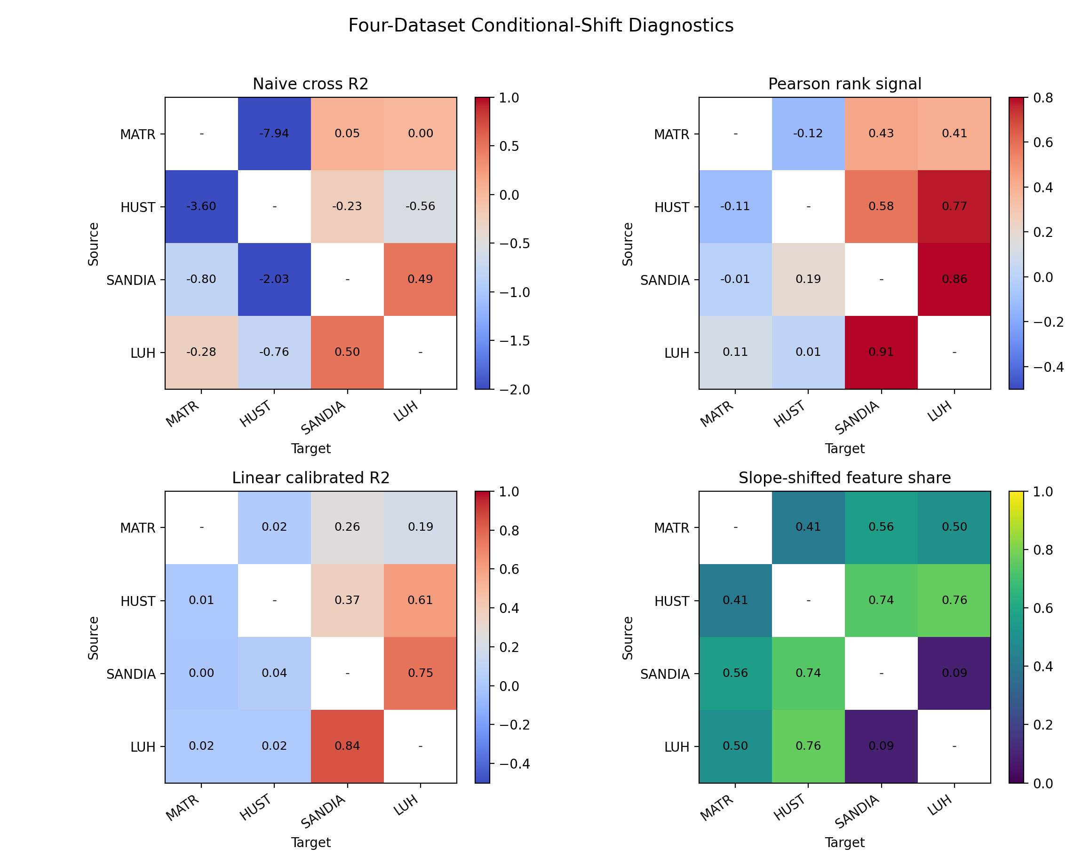
Conditional shift — slope tests across four-dataset pairs
Z-score each feature within dataset; centre log(cycle_life) within dataset.
Compare HUST−MATR slope differences with bootstrap CIs + BH FDR correction.
Universal log-life offset reported separately (e.g. HUST/MATR = 0.735, ≈ 2.09×).
Slope-shifted feature counts per pair: HUST↔Luh 26/34; HUST↔Sandia 25/34; MATR↔Sandia 19/34; MATR↔HUST 14/34; Sandia↔Luh 3/34 (the cleanest pair).
Decision rule: BH-q < 0.05 AND bootstrap CI excludes zero.
11 / 26
Notes:
Per-feature slope test removes the universal log-life offset and asks whether the within-dataset feature/y relationship changes between datasets.

Slide 12
Rank-signal regime taxonomy — predict success before training
Direction | Naive R² | Pearson r | Linear-cal R² | Regime
Luh → Sandia | 0.492 | 0.912 | 0.840 | STRONG_RANK
Sandia → Luh | 0.477 | 0.859 | 0.744 | STRONG_RANK
HUST → Luh | −0.373 | 0.766 | 0.600 | OFFSET_DOM
MATR → Sandia | +0.041 | 0.522 | 0.343 | OFFSET_DOM
MATR → HUST | −7.94 | −0.12 | 0.025 | RANK_COLLAPSED
HUST → MATR | −3.60 | −0.13 | 0.015 | RANK_COLLAPSED
STRONG_RANK — naive R² > 0.4, high Pearson r; salvageable.
OFFSET_DOMINANT — rank signal preserved (r > 0.5), but absolute scale wrong → calibratable.
RANK_COLLAPSED — r near zero or negative; no architecture or k-shot fix is sufficient.
Regime label can be predicted from source/target diagnostics without training the predictor (regime classifier).
12 / 26
Notes:
The regime taxonomy is the paper-defining table. Pearson r between source predictions and target ground truth is the deciding diagnostic.

Slide 13
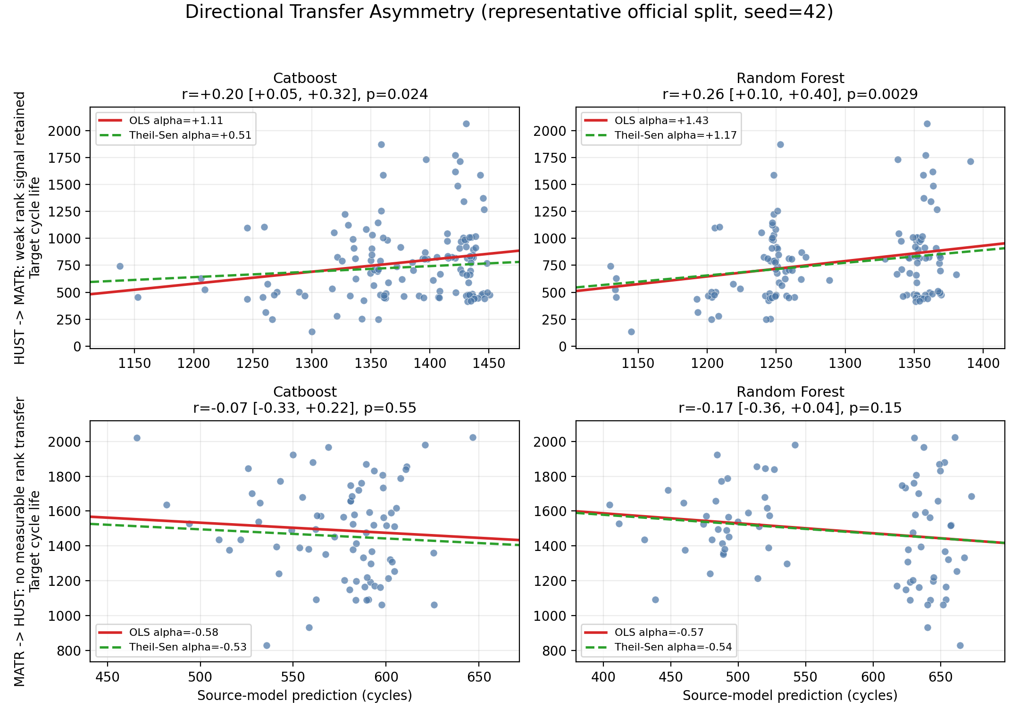
Directional asymmetry — MATR ↔ HUST exemplar
Source predictions vs target ground truth — paper-facing scatter, seed=42.
HUST → MATR keeps weak positive rank signal (r ≈ 0.22 – 0.27).
MATR → HUST is essentially uncorrelated with target lifetime (r ≈ −0.12 to −0.14).
Negative alpha in OLS is fitting noise — not a real mechanistic inversion.
Theil-Sen and Huber estimators confirm the same picture.
Constant share of squared error: 72 – 90% across configs → dominant component is a directional offset.
13 / 26
Notes:
Two pairwise scatter panels per direction × model. The take-away is that MATR↔HUST is rank-collapsed but with a large offset that a constant adapter can shrink.

Slide 14
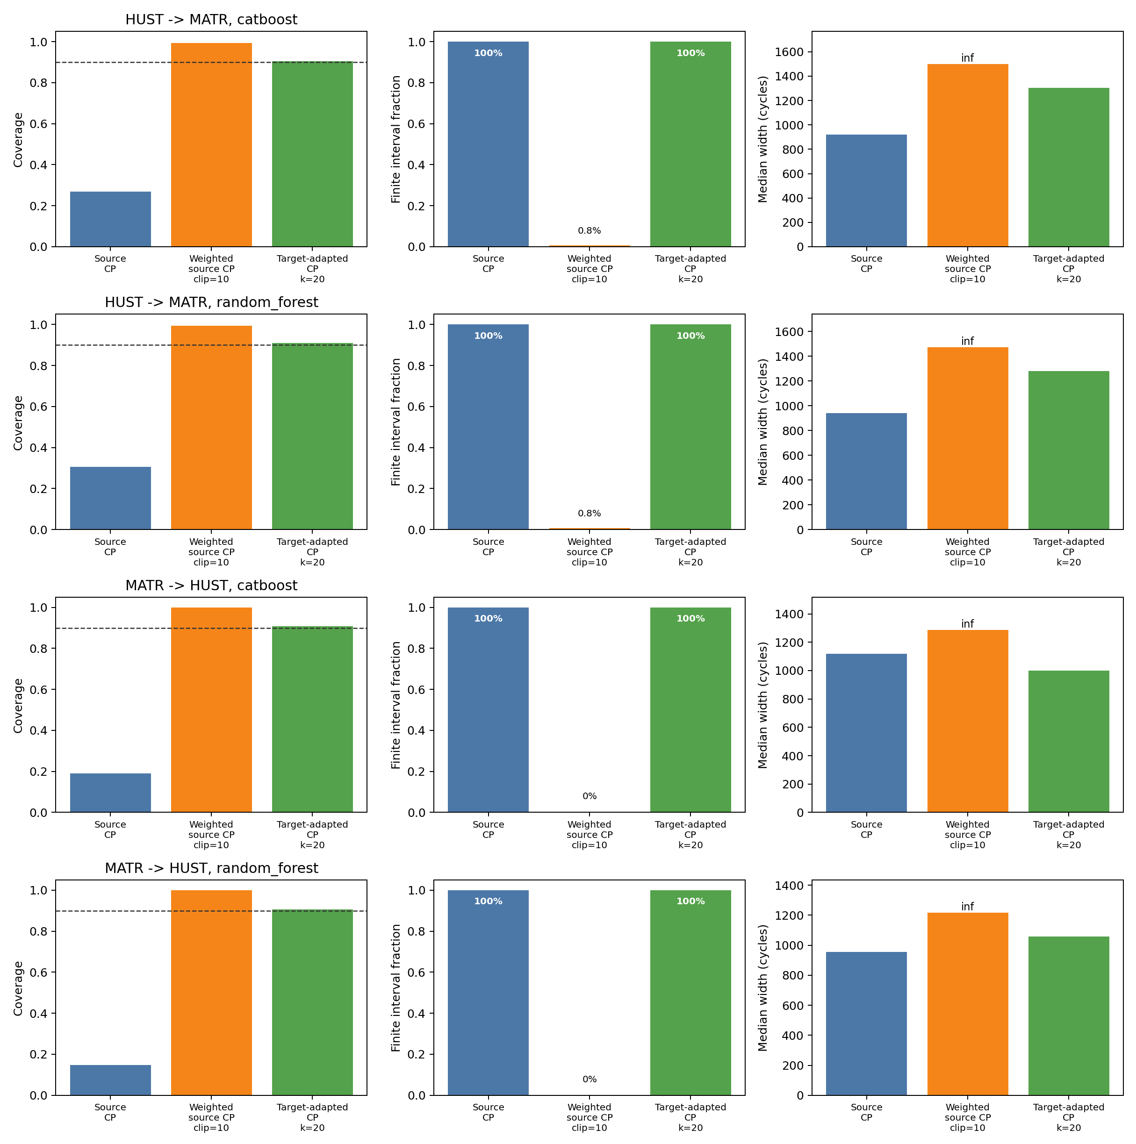
Importance-weighted CP — the falsifier
Can a pure covariate-shift fix recover coverage?
Cross-fitted logistic discriminator AUC = 0.994 – 0.996 → near-perfect dataset separability.
Raw calibration-weight ESS/n ≈ 0.55 – 0.59.
Importance-weighted CP at 90% nominal: coverage reaches 99% only by returning infinite intervals 99% of the time (finite-interval fraction ≤ 0.9%).
Re-weighting alone cannot deliver useful target intervals — covariate shift is not the binding constraint.
Target-adapted residual-mean CP at k=20 recovers 90% coverage with finite intervals (0.905 – 0.909).
14 / 26
Notes:
This is the falsifier. We rule out the obvious covariate-shift fix before introducing the target-adapter solution.

Slide 15
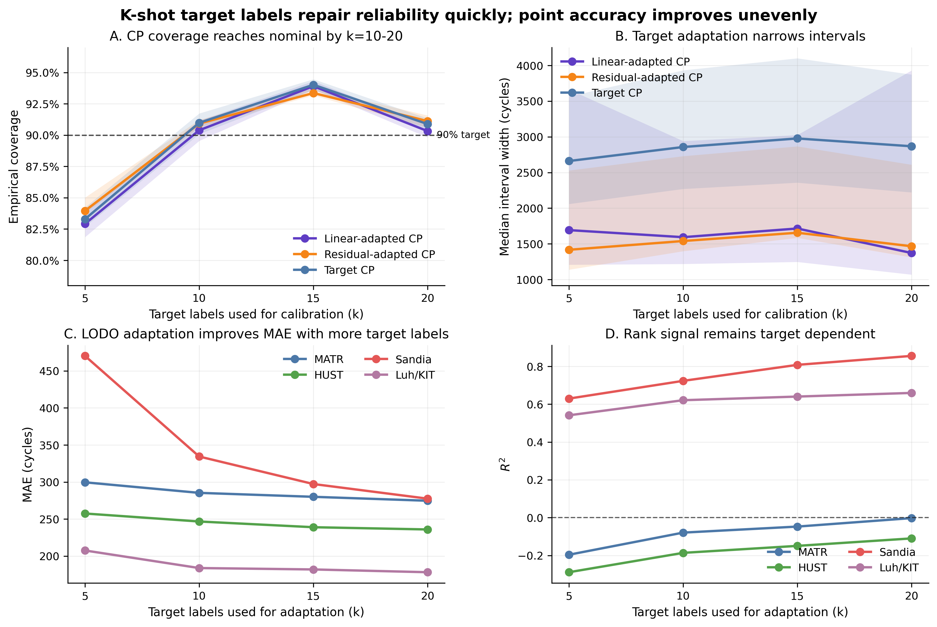
k-shot target calibration — scaling with target labels
Two-parameter linear adapter fit on k random target cells, scored on the rest.
MATR → HUST CatBoost: R² −10.0 → −0.13 with k=20 (≈10× MSE reduction).
HUST → MATR Stacking: R² −2.66 → −0.05 with k=20.
Linear adapter outperforms residual-mean on heterogeneous Sandia targets.
Repaired R² near 0 = matches target marginal mean — calibration ceiling for rank-collapsed pairs.
k=5 is too few; k=20 is the sweet spot for budget and recovery.
15 / 26
Notes:
Calibration curve: R² climbs from catastrophic to ~0 across k = 5 → 20, with the linear adapter dominating in heterogeneous-target directions.

Slide 16
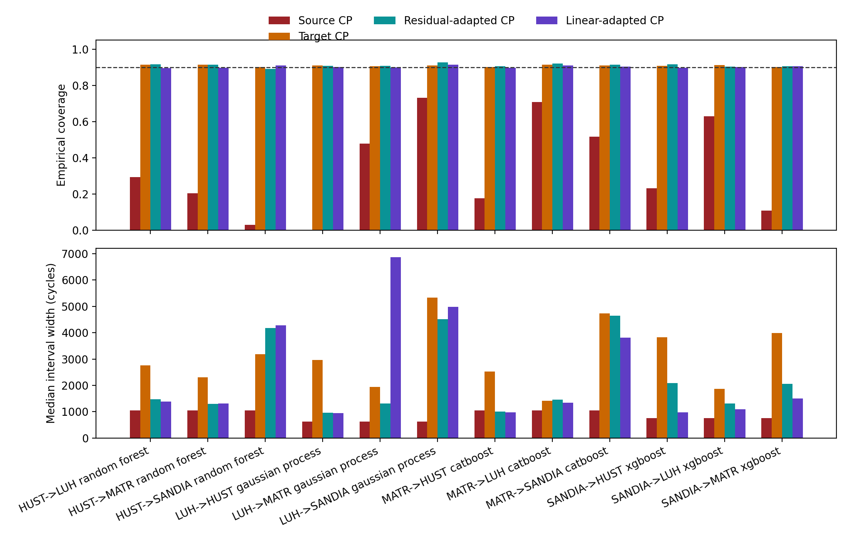
Conformal prediction — coverage and interval width
MAPIE split CP at 90% / 95%, absolute-residual conformity score, prefit estimator.
Within-dataset CP: coverage 0.89 – 0.97 — coverage-valid by exchangeability.
Naive source-calibrated cross CP: 0.00 – 0.73 — under-covers under shift.
Target-domain CP (k=20): 0.89 – 0.92 — coverage restored at cost of width.
Residual-mean adapted CP (k=20 + 20): 0.89 – 0.93 — best width/coverage trade-off.
Median R² used in tables (linear adapter occasionally produces extreme draws — see CP outlier note).
16 / 26
Notes:
Three CP modes compared. Target-adapted residual-mean is the deployment policy.

Slide 17
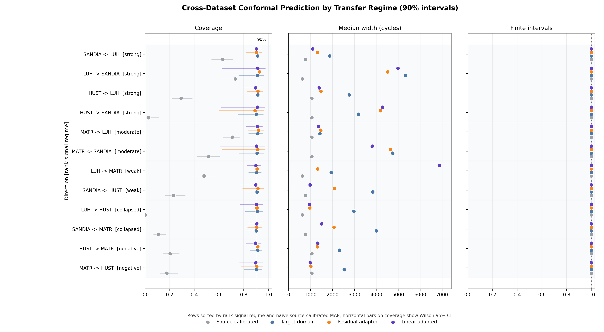
Regime-stratified CP — coverage and width organized by regime
12 transfer directions sorted by rank-signal regime; four CP scenarios per row.
STRONG_RANK pair (Sandia ↔ Luh) — narrow intervals after adapter.
RANK_COLLAPSED pair (MATR ↔ HUST) — coverage restored but width remains large.
Source-calibrated CP collapses in every regime — under-coverage is universal, not regime-specific.
Median R² reporting suppresses the LUH→MATR linear-adapter outlier (was R²_mean ≈ −3.5 × 10⁵).
17 / 26
Notes:
Regime-stratified CP table — paper-facing figure that joins the CP results with the conditional-shift regime labels.

Slide 18
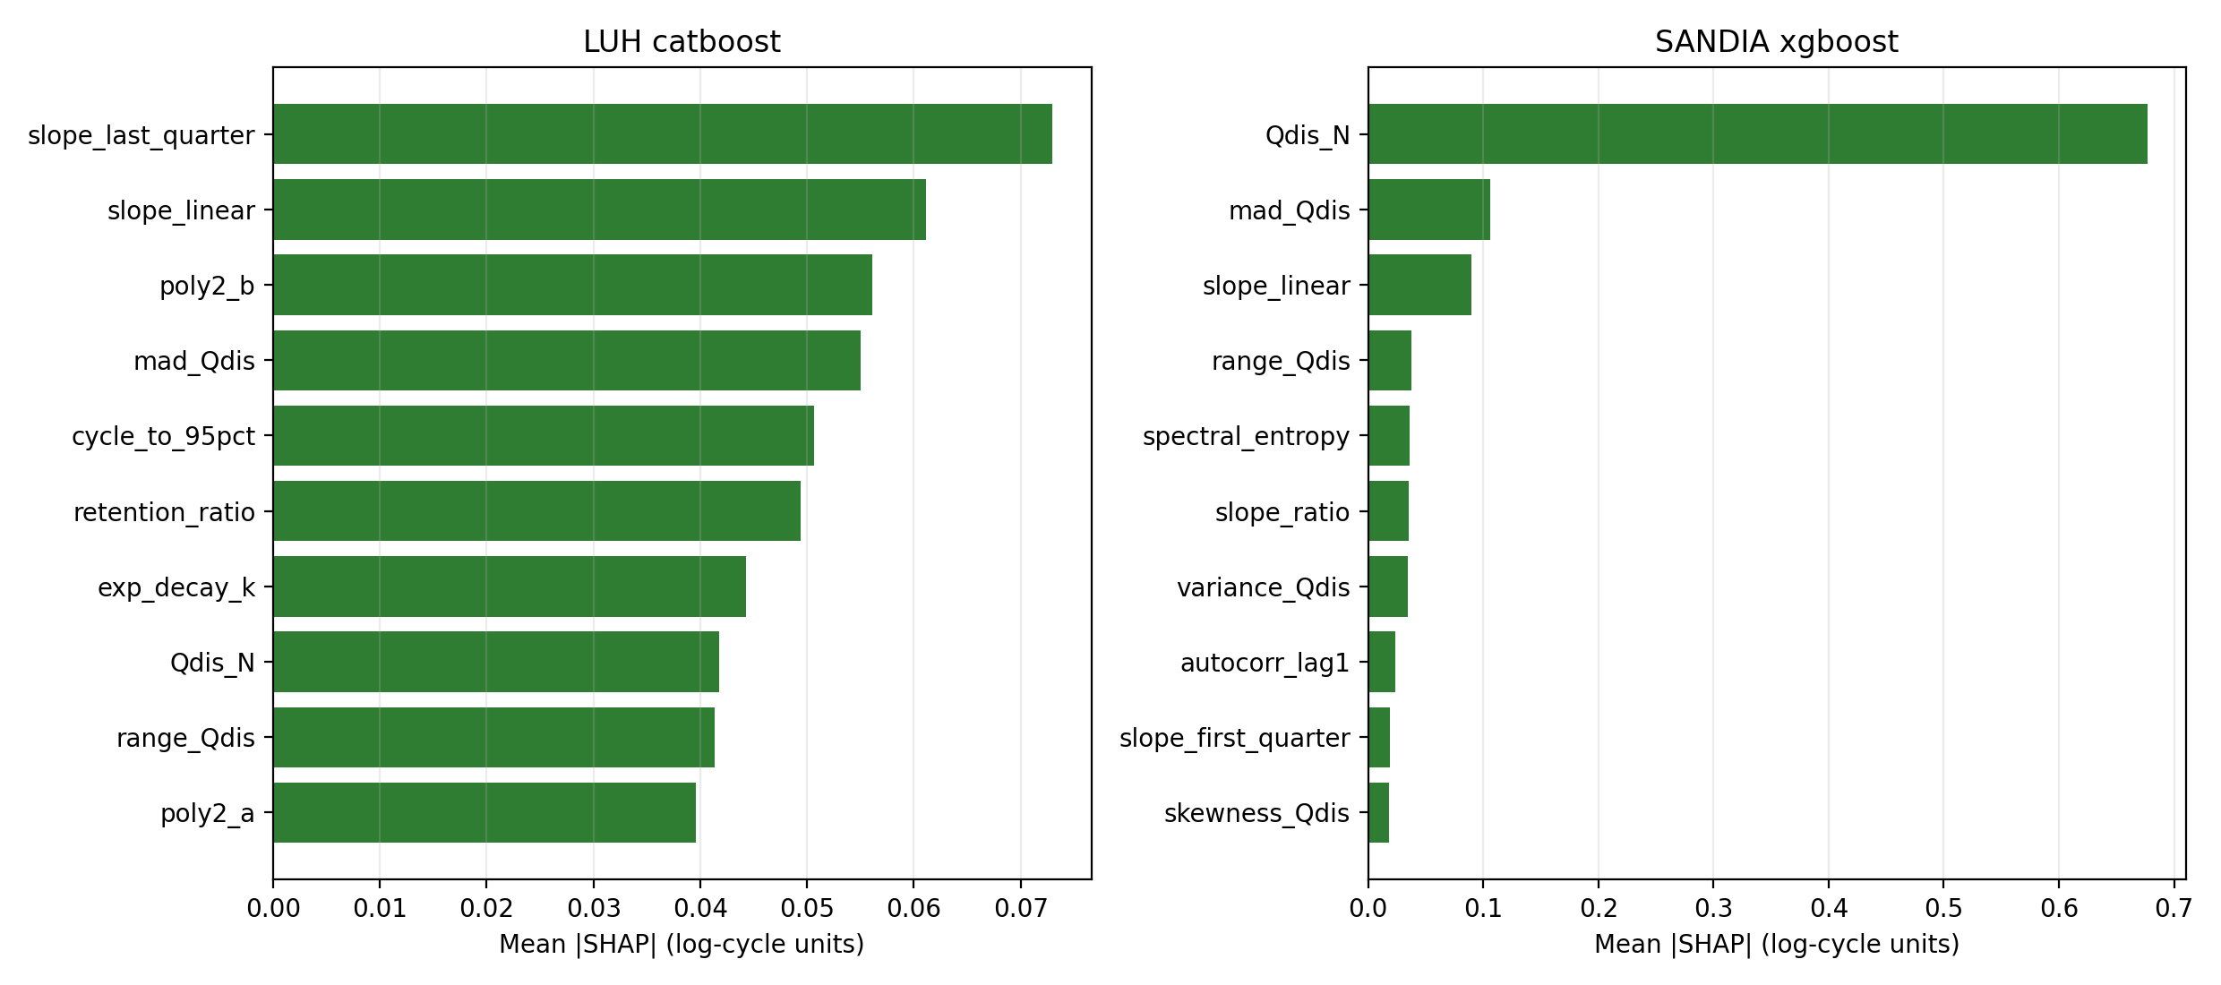
SHAP × regime — important within-domain, fragile across
TreeSHAP attribution on the per-dataset primary model (CatBoost / RF / XGBoost / GP).
MATR top: accel_mean, poly2_c, slope_last_quarter, range_Qdis — most are slope-shifted across MATR↔HUST.
HUST top: Qdis_N, linearity_r2, Qdis_cycle10, poly2_a — scale-shift fragile (Qdis_cycle10 has 10.84σ shift).
Sandia top: Qdis_N (55% rel. importance), mad_Qdis, slope_linear — slope-stable across Sandia↔Luh.
Sandia↔Luh transferable directions have stable top SHAP features; MATR↔HUST collapsed pairs have unstable ones.
18 / 26
Notes:
Closing the loop: the within-domain importance of a feature is not the same as its cross-dataset reliability.

Slide 19
Backbone-agnostic check — PyTorch 1D-CNN + Pareto positioning
Dataset | Classical best | PyTorch CNN | Δ R²
MATR | CatBoost 0.575 | 0.305 | −0.270
HUST | RF 0.340 | −0.174 | −0.514
Sandia | XGBoost 0.940 | 0.881 | −0.059
Luh / KIT | GP 0.769 | 0.761 | −0.008
Pareto positioning vs literature
Severson 2019 (V(Q))
~10% MAPE · no CP
BatLiNet 2024 (V/Q + joint)
6% MAPE MATR-1 · no CP
EES 2025 (T features)
12% MAPE TRI · no CP
This work — capacity-only + CP
24% sMAPE MATR · valid CP · CPU seconds
CNN is competitive on Sandia/Luh, falls below classical on MATR/HUST.
Cross-dataset regime taxonomy preserved with CNN — same STRONG_RANK / RANK_COLLAPSED pairs.
But CNN over-extrapolates on Sandia source: Sandia → MATR R² = −47.8, Sandia → HUST = −36.8 — deep architecture amplifies source-specific signal under shift.
Take-away: regime taxonomy is backbone-agnostic; deep architecture does not buy cross-dataset robustness on the capacity-only contract.
19 / 26
Notes:
CNN serves as backbone-agnostic check. It confirms the regime taxonomy without changing the qualitative conclusion.

Slide 20
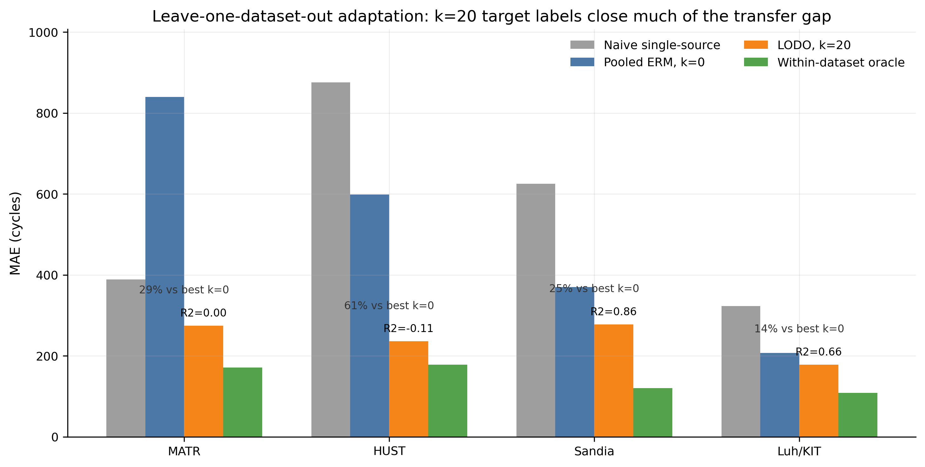
LODO source-expert — multi-source deployment
Hold out each target dataset; train on the other three.
Compare pooled ERM, source-expert selection, convex source-expert weighting, and pooled ERM + k-shot adapters.
Best k=20 results: HUST R² = −0.115, Luh R² = +0.667, MATR R² = −0.018, Sandia R² = +0.862.
Improves over naive single-source for every target, with clear k-shot scaling.
Does not uniformly beat an oracle that picks the best source post-hoc — practical protocol, not a silver bullet.
20 / 26
Notes:
LODO source-expert is a practical multi-source deployment protocol. Improves over naive single-source for every held-out target.

Slide 21
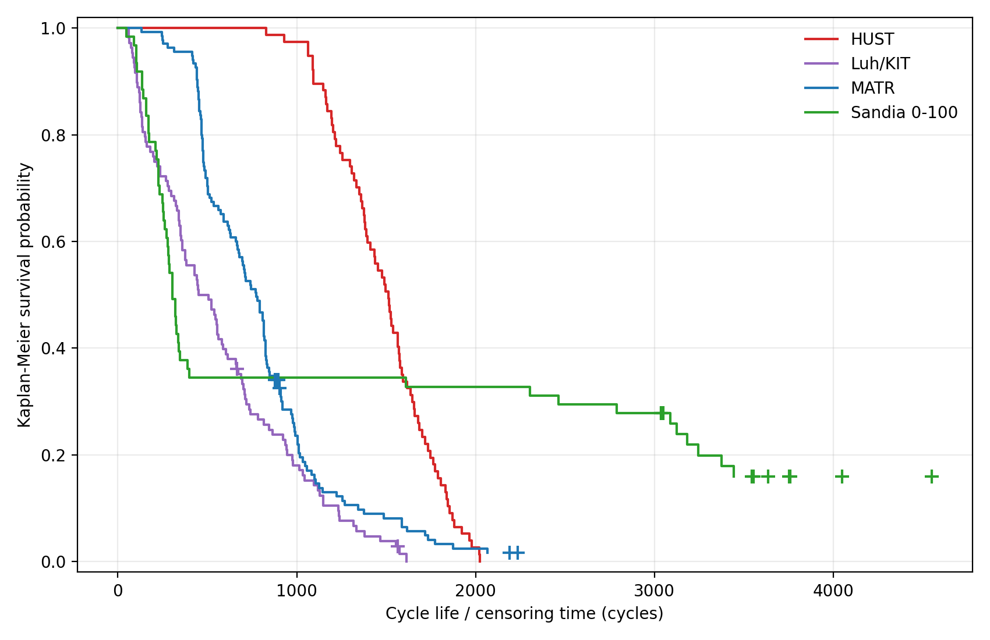
Survival audit — censoring is not the explanation
MATR 6/135 cells censored at 0.85·Q0; HUST 0/77; Sandia 11/61; Luh 2/108.
Kaplan-Meier medians: MATR 773, HUST 1513, Sandia 305, Luh 508 cycles.
Log-rank χ² = 61.2, p = 5.2 × 10⁻¹⁵ between MATR and HUST — separation is decisive.
Imputing censored MATR cells at their censoring times moves MATR mean only 778 → 802 cycles.
Censoring is not the reason HUST appears longer-lived than MATR.
Supplementary diagnostic — paper-facing claim unchanged.
21 / 26
Notes:
Supplementary survival audit. Confirms that the lifetime gap between datasets is not driven by right-censoring of some MATR cells.

Slide 22
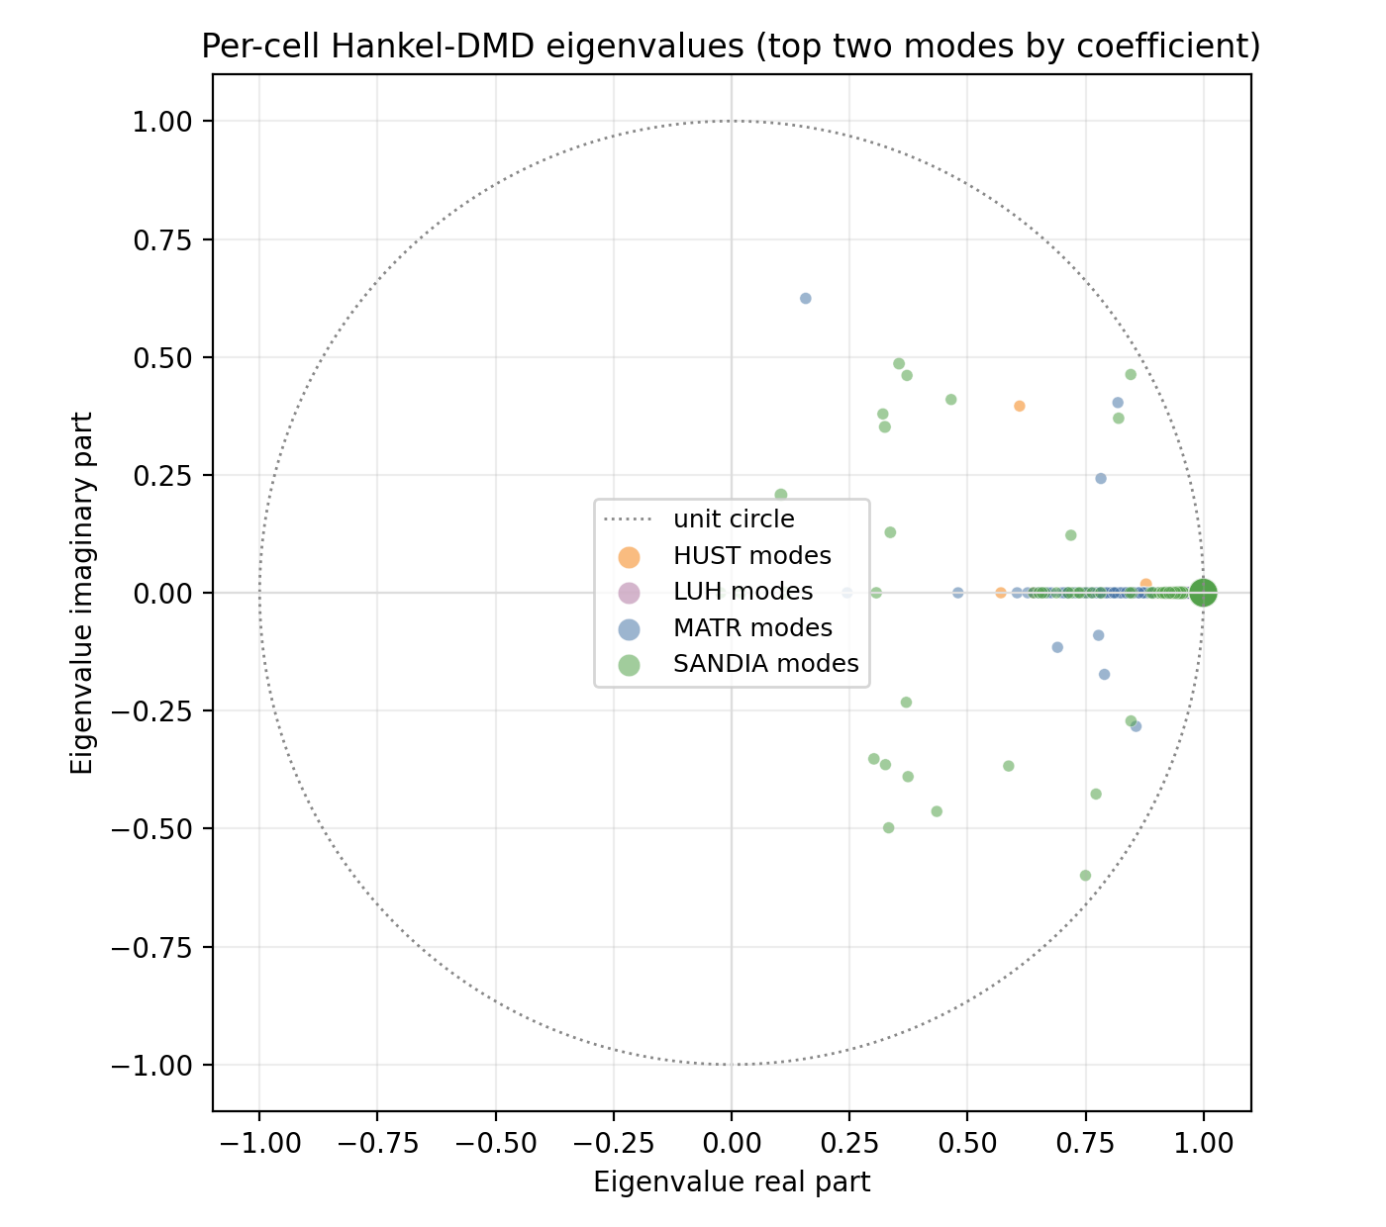
Dynamics-level evidence — Hankel-DMD pilot
Hankel-DMD on early Q/Q0 trajectories (cycles 2 – 100).
Four-class discriminator on DMD summaries reaches AUC 0.915 ± 0.019.
Sandia vs Luh dominant |λ| Pearson r with log-life: 0.80 (Sandia), 0.58 (Luh).
Sandia → Luh operator transfer: 1.07× Luh self-RMSE.
Sandia → MATR / Luh: operator extrapolation fails (consistent with regime collapse).
Supporting mechanistic evidence — not a headline predictor.
22 / 26
Notes:
Dynamics-level evidence supporting the regime story. Sandia/Luh dynamics are coherent; MATR/HUST are not.

Slide 23
Limitations
Capacity-only feature contract has a within-dataset accuracy ceiling. BatLiNet and BatteryLife clearly outperform on accuracy alone; we trade accuracy for transferability and valid CP.
Rank-collapsed regimes (MATR ↔ HUST) cannot be repaired by k-shot or by deeper architecture. The framework predicts this failure but does not solve it.
Linear adapter occasionally produces degenerate fits on small k_adapter — reported via median R² rather than mean to suppress outliers in paper-facing tables.
Five seeds × 70/15/15 splits give relatively wide bootstrap CIs on HUST (12-cell test set); we use pooled cluster-bootstrap to mitigate but cannot eliminate this.
We do not address streaming / online cell calibration — the protocol assumes a one-time k=20 collection per deployment.
23 / 26
Notes:
Honest limitations. The accuracy ceiling and rank-collapsed regimes are the two biggest constraints.

Slide 24
Conclusion — four findings
1. Cross-dataset RUL transfer separates into three deterministic regimes
(strong-rank · offset-dominant · rank-collapsed). The regime is predictable from source/target diagnostics before training.
2. Covariate alignment ≠ concept alignment.
Capacity normalization closes 71% of the geometric gap, but cross-dataset R² is unchanged or worse.
3. Small target labelled set (k=20) + MAPIE split CP repairs the salvageable regimes with valid 90% / 95% coverage.
Rank-preserving directions recover to R² ≈ 0 with finite intervals; rank-collapsed pairs remain hard.
4. The regime taxonomy is backbone-agnostic.
PyTorch 1D-CNN preserves it — and over-extrapolates on Sandia source, reinforcing the Pareto positioning argument.
Notes:
Four key findings; each tied to a specific table or figure in the paper.

Slide 25
Future work
Voltage / temperature / impedance feature contracts under the same regime-taxonomy framework. Does richer data shift the regime boundaries or simply add a constant to within-dataset accuracy?
Streaming / online k-shot calibration. Current protocol assumes a single batch of k=20 target cells; a real deployment might add cells incrementally.
Fifth-dataset held-out validation of the regime classifier. Currently the classifier is fit on 12 directions × 4 datasets; an unseen dataset would falsify or confirm the taxonomy.
Physics-informed adapter families. Replace the linear adapter with a small electrochemistry-aware correction that uses Q0 + chemistry prior — might break the rank-collapsed regime.
Cross-protocol transfer at fixed chemistry. Sandia includes mixed temperatures and discharge rates within one chemistry — natural follow-up benchmark.
25 / 26
Notes:
Future work along five axes — feature contract, online calibration, fifth-dataset validation, physics-informed adapters, cross-protocol benchmarks.

Slide 26
Thank you
Questions and discussion
Code, data, and reproduction recipe — github.com/osmansafacifci/Graduation-Project-Dicle
Companion paper: MIT-licensed, Zenodo DOI on release
Durukan Demir · Dicle Çoban · Salih Sarp · Osman Safa Çifçi
Notes:
Open floor. Repository and Zenodo deposit point.

