Slide 1

Welcome – Bienvenue – Welkom !!!
Thanks for attending our third National Mapathon :-)
PC Access @ULB :
user: pds2018 & password: Printemps
While you are waiting for others to arrive, complete the steps below:
Sign up for an account at www.openstreetmap.org
Check your email and confirm your account by clicking the link provided!
Read through the steps on the guide on your table, to get familiar with how to map
or you can also access the walk-through by clicking on the ‘Help’ button on the right hand side, then on ‘Start the Walkthrough’.
National Mapathon – 24 March 2018
@ ULB/VUB/UCL/KUL/UMons/UNamur/UGent/ULG

Slide 2

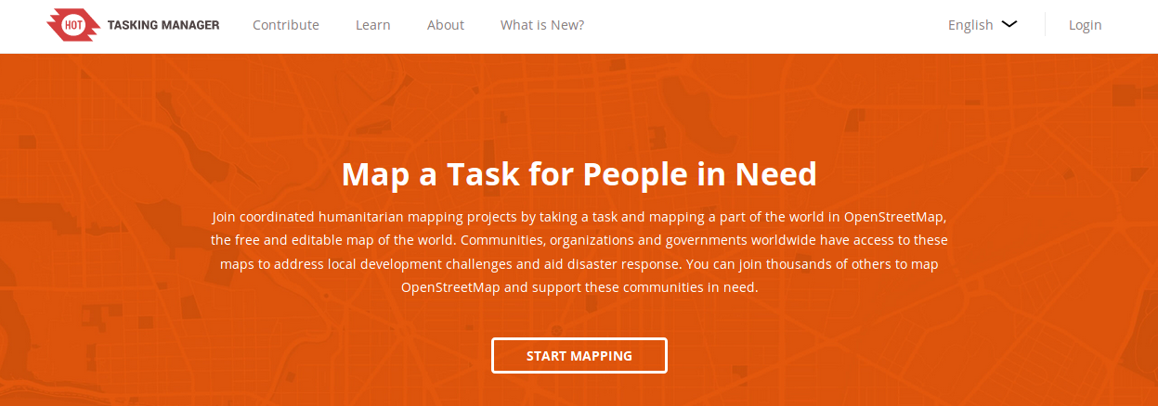
How to pick a task in
?
https://tasks.hotosm.org/learn
https://github.com/osmbe/presentations/tree/master/mapathons
National Mapathon – 24 March 2018
@ ULB/VUB/UCL/KUL/UMons/UNamur/UGent/ULG

Slide 3
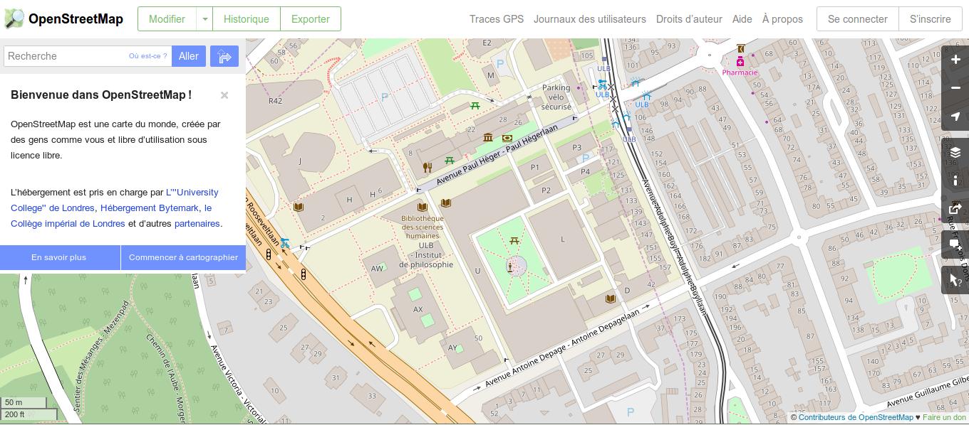
In your web browser, go on the OpenStreetMap website
Click on sign-up and fill in the form
Open your e-mail account and open the welcome message to confirm your account. You will be taken to the OpenStreetMap welcome page.
www.openstreetmap.org

Slide 4

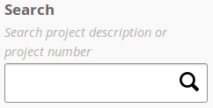
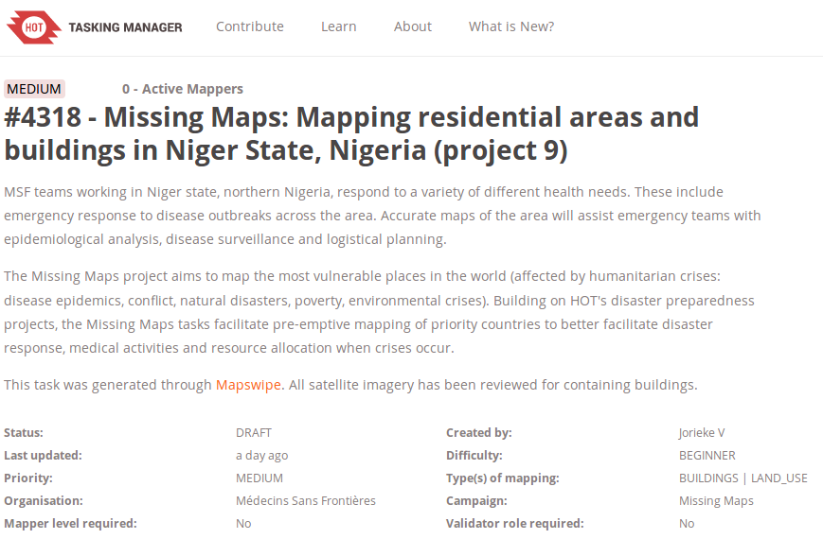
In your web browser, go on the HOT Tasking Manager website
Authenticate you with your OSM username and password (if not already logged on)
Click on start mapping
Search for a project on which you want to contribute. You can use the search bar to filter projects.
http://tasks.hotosm.org/
Today project
1) # 4318
2) # 3904
3) # 1970
Click on the project title to select it.

Slide 5
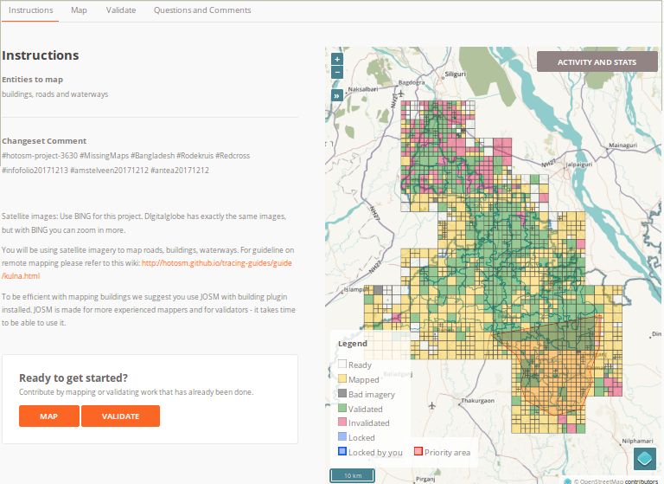
Organization of a project page
0. Please read the instructions carefully to have a clear idea of what is expected from your contributions.

Slide 6
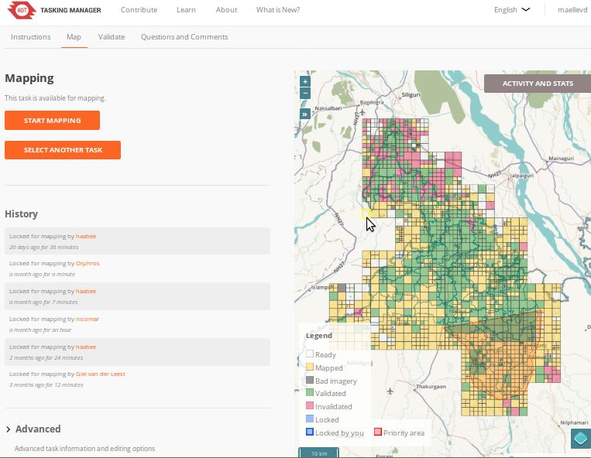
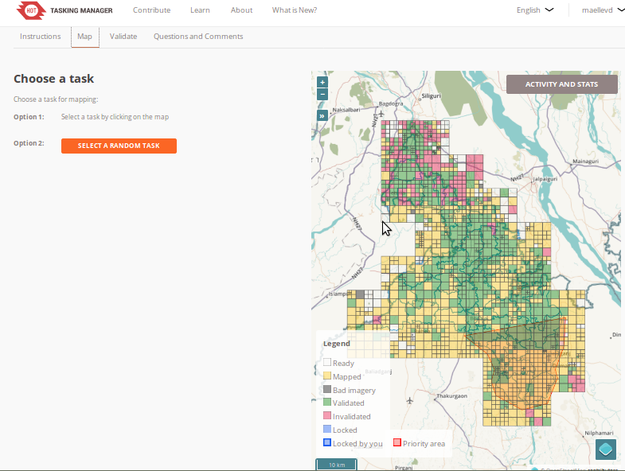
Organization of a project page
The selected task
1. Selecting
a white square

Slide 7
Organization of a project page
The selected task

Slide 8
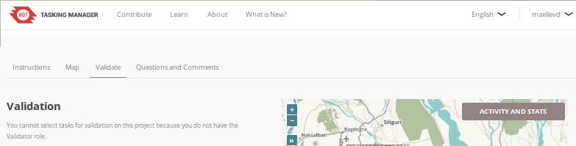
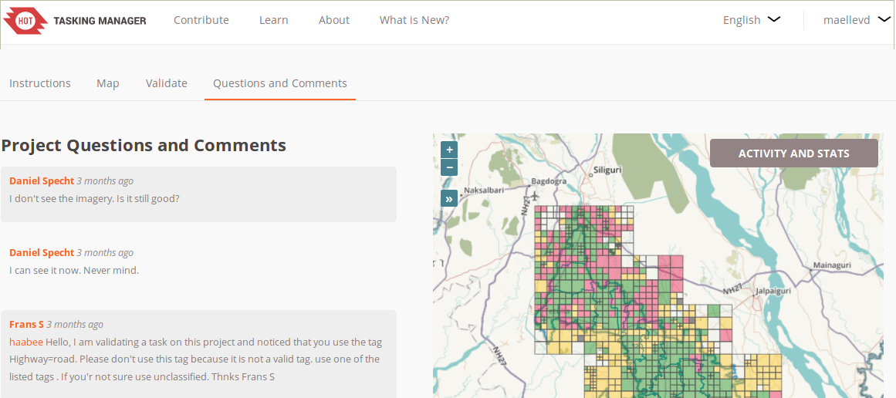
Organization of a project page
3.

Slide 9
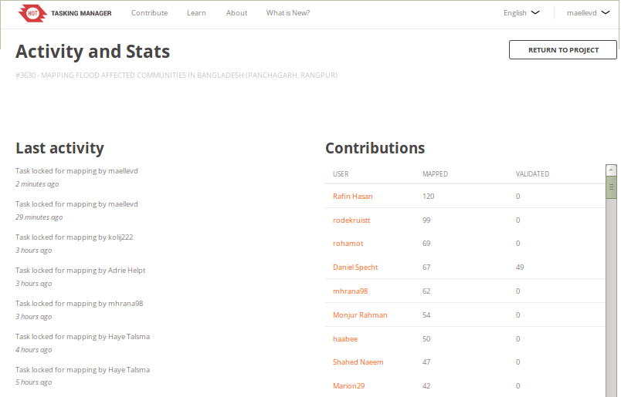
Organization of a project page
5.

Slide 10
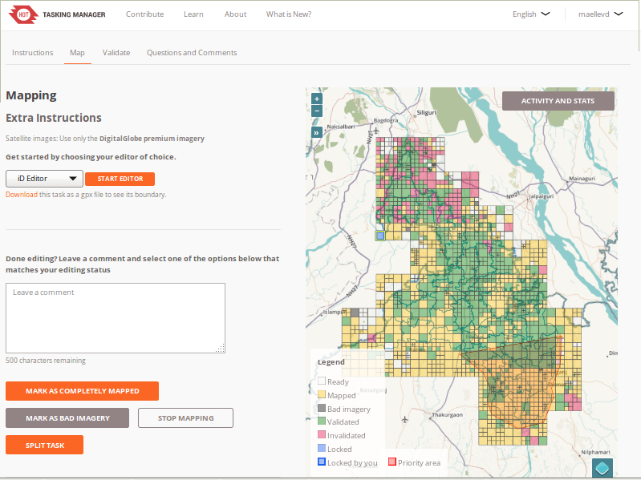
Lock a task and begin to contribute to the map
The selected task is too big ?

Slide 11
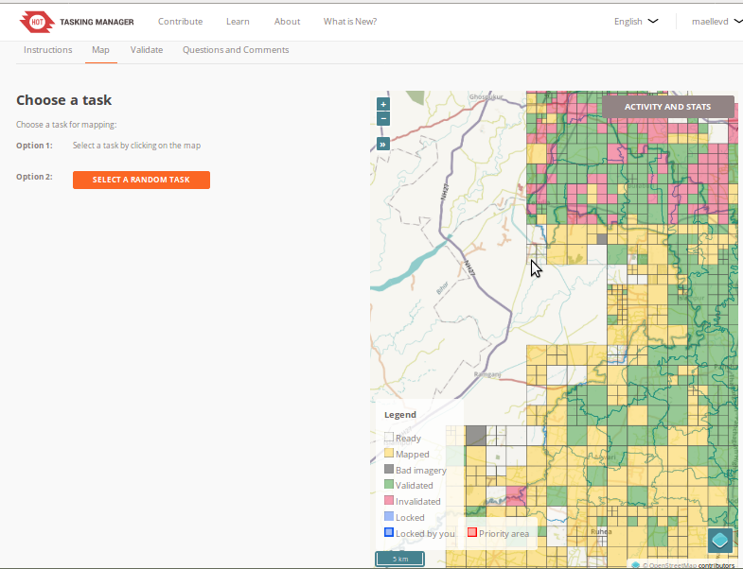
Lock a task and begin to contribute to the map
The selected task is split

Slide 12
Lock a task and begin to contribute to the map
Task locked. You can start mapping!

Slide 13
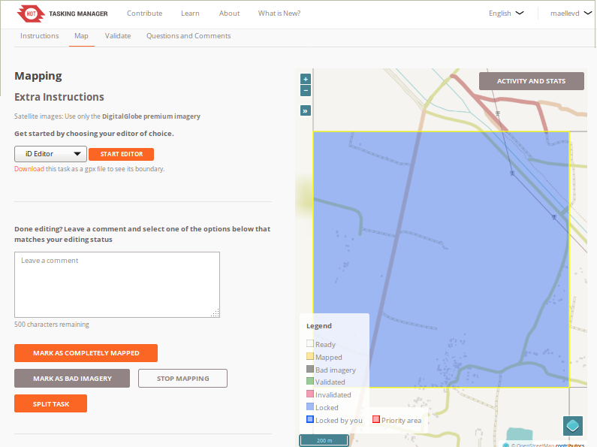
Lock a task and begin to contribute to the map

Slide 14
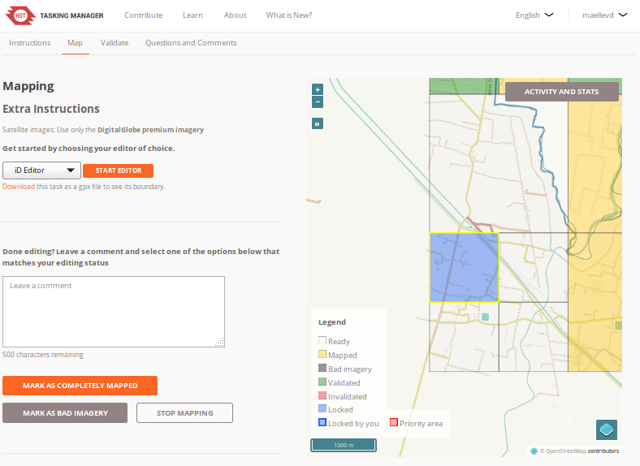
Lock a task and begin to contribute to the map

Slide 15
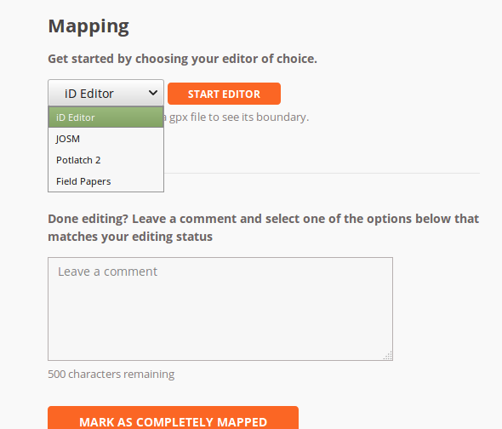
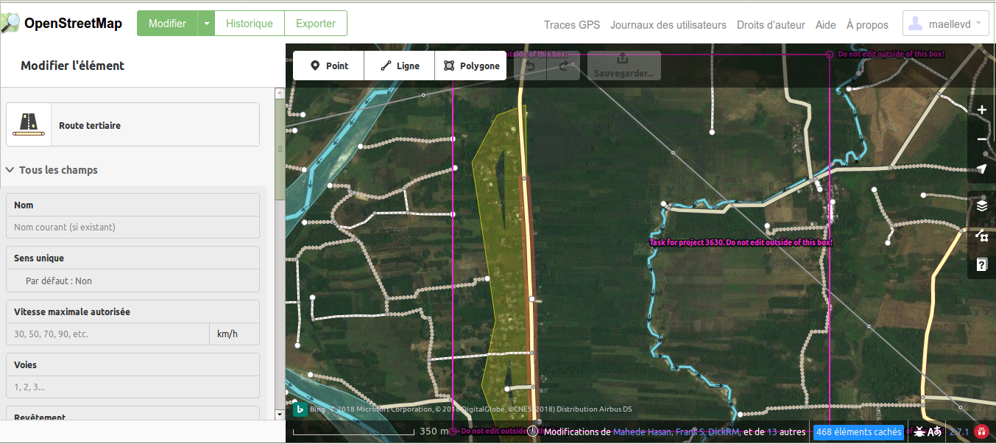
Lock a task and begin to contribute to the map
Open the OSM iD editor in a new tab and begin to map
Other tools can be used for mapping in OSM
As new-mappers, we will use the iD editor

Slide 16
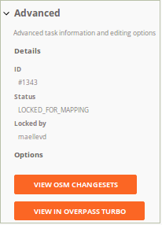
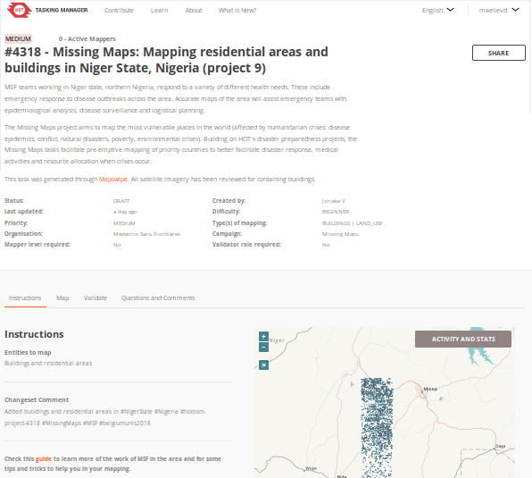
Please take note about the project AND task number !!
…in case you quit your TaskingManager webpage…
URL :
https://tasks.hotosm.org/project/4318?task=1343
Task number
HOT project number
& Save often !!!

Slide 17
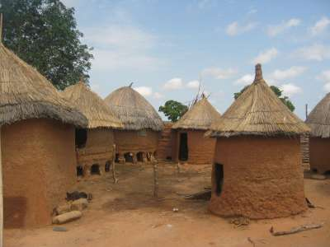
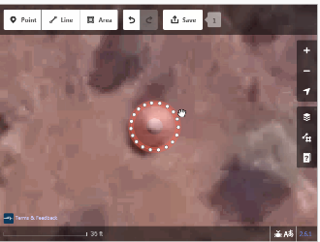
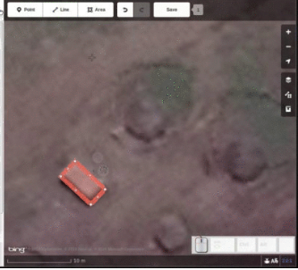
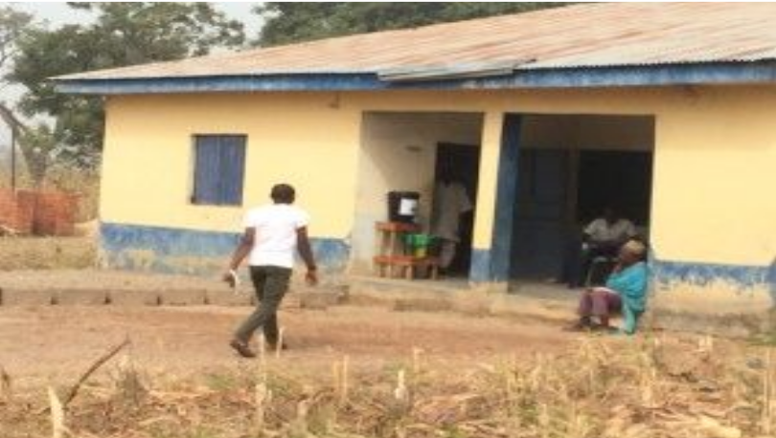
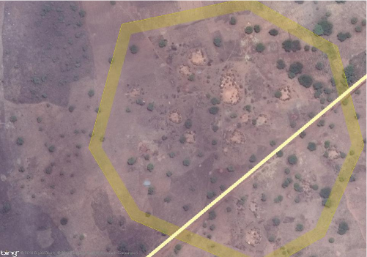
Overall Goals of our task today
Find all buildings, draw an area around them and tag each as Building Features=Building in iD or building=yes in JOSM.
Find all of the villages in the area, draw an area around them, tagging each as Land Use Features=Residential Area in iD or landuse=residential in JOSM.

Slide 18
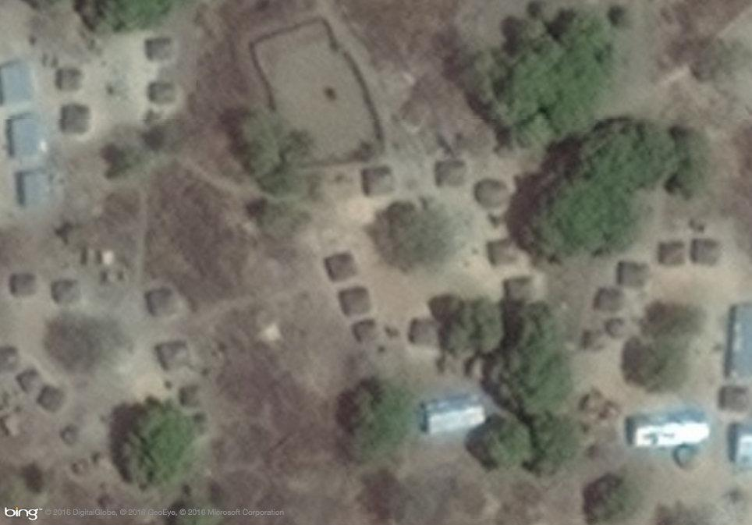
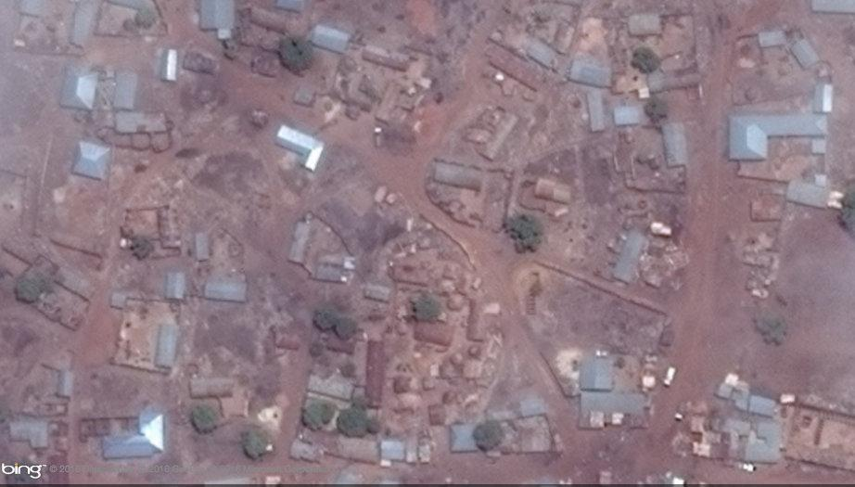
In larger villages you will find brick houses and circular or squared mud huts, with either straw roofs and tin roofs.
Mapping buildings
Compound
Square mud huts
Rectangular house
with tinned roof
Building Features=Building
building=yes

Slide 19
Mapping buildings
Some more advice:
Don’t forget to square or circle your building!
Pay attention that your building does not share points with or overlap roads and other buildings. Zooming in very close will help, and in the iD web editor, holding down the Alt key will keep nodes from "snapping" to each other and accidentally connecting.
Draw the footprint of your building, not the roof.
When a building is partly covered by trees, try to outline the complete building as best as you can.
Only if you have personal knowledge of a building, add that information to the building, like the name or type of building (hospital, school, gas station, etc).

Slide 20
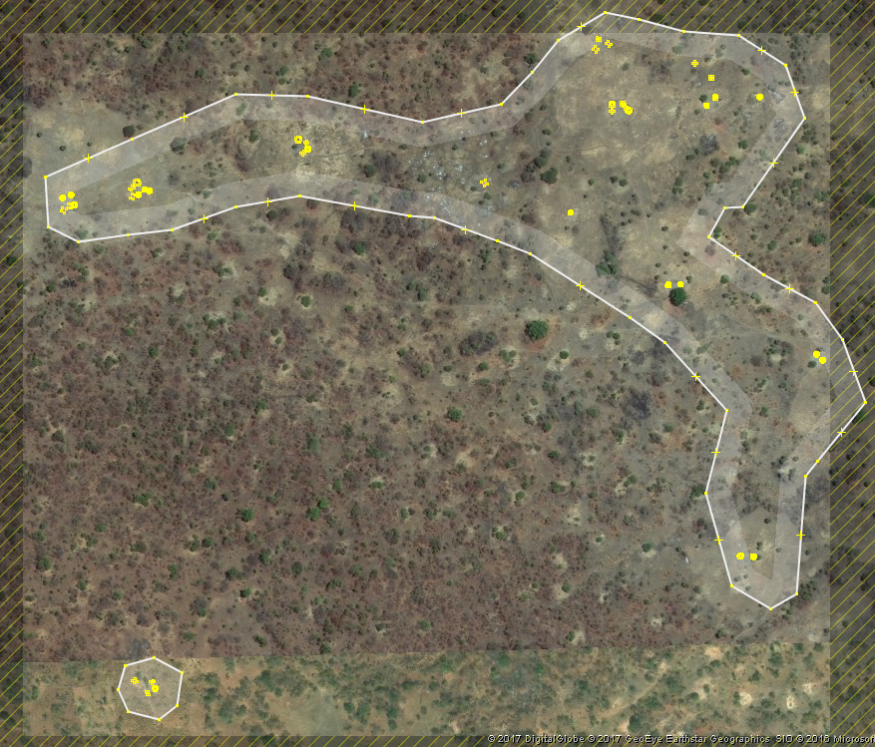
Mapping residential areas
Settlements in this part of the world are generally organised into extended family compounds, each containing a number of small shelters and often a few crops.
A residential area is an area with more than two buildings.
But, do not draw a residential area around every two buildings you map. Sometimes, it makes sense to draw one huge residential area instead of plenty of small ones. Please, do zoom out and consider the right size of the residential area you are mapping.
Land Use Features=Residential Area
landuse=residential

Slide 21
Mapping residential areas
Some more advice:
The boundary of the residential area needs to be closed. Make sure that the start point of the line, joins to the end point.
The lines and points of the boundary you draw can cross highways, buildings, streams,... but should not share any points or lines.
The boundary should be fairly close to the buildings and any compounds that form part of the grouping.
If your residential area is bigger than your ‘pink square’, draw a closed area as good as you can, and ‘hand it over’ by placing the boundary of the area just outside your square so the next mapper can take it on from there.

Slide 22
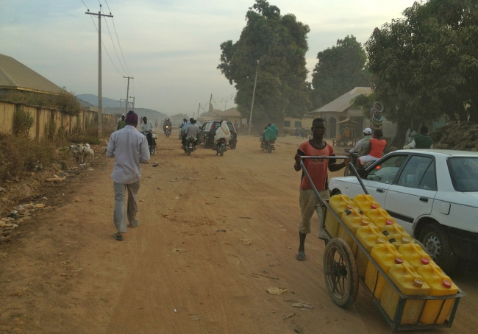
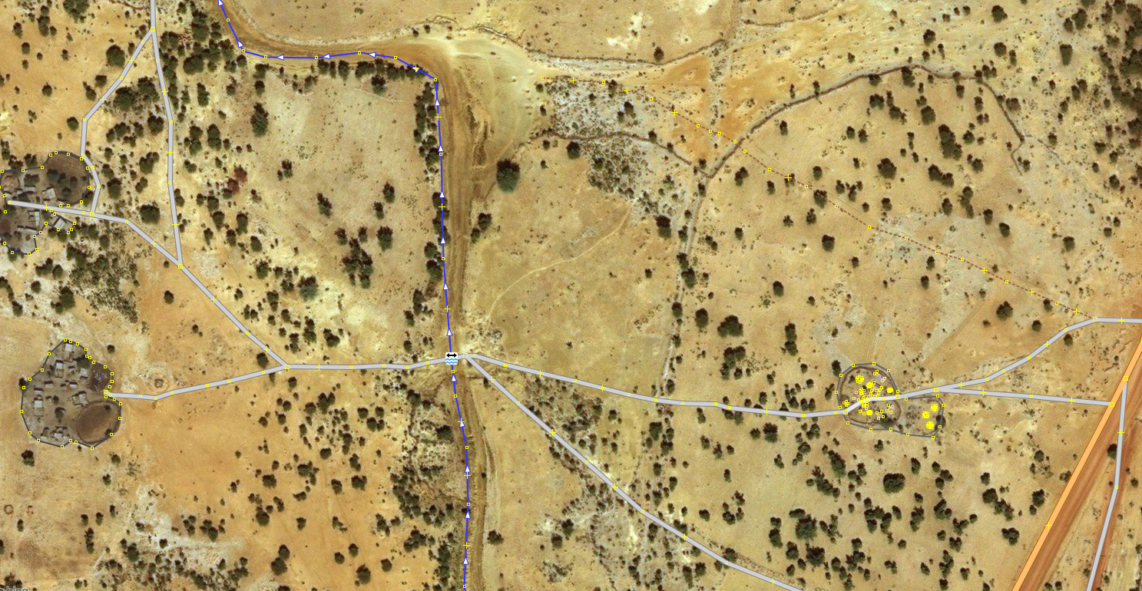
Most of the roads are unpaved. This does not mean that we will map all roads as track. The road typology is rather based on the road importance and not on the surface or visual appearance.
Mapping roads
Residential road within a village
Track leading to fields and a river
Secondary road - like primary roads
are mostly already mapped
Minor / Unclassified road connecting villages

Slide 23
Mapping roads
Some more advice:
Zooming out the imagery helps to get a better understanding of the context, which is of help with the classification of the road.
In most of the cases you will start mapping new roads from already existing ones. Make sure that the first point of your line starts on the other road. Don’t leave a gap between the two roads. Also if two roads are intersecting, make sure they are connected.
Split your road on each bigger intersection and if you need to change the road classification. Do this in iD by a right click of your mouse on the line and in JOSM look in the tools tab.
If your road is longer than your ‘pink square’, draw the road as good as you can and ‘hand it over’ by placing the last point of the road just outside your square so the next mapper can take it on from there.
Don’t confuse roads with dry rivers and streams!

Slide 24
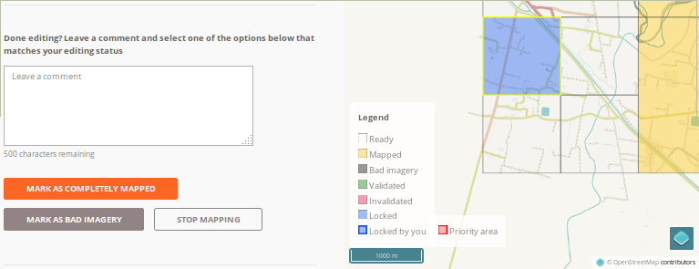
Unlock the task and leave a comment
WHEN YOU WANT TO STOP MAPPING:
Make sure you have saved the changes you made in the iD editor.
Close the iD editor tab in your web-browser
Return on the HOT tasking manager tab
Leave a explicit comment about what you have done
5. If you want to stop mapping, use the « stop mapping » button
If the task is done, use the « Mark task as completely mapped» button
Make sure your task is unlocked !

Slide 25
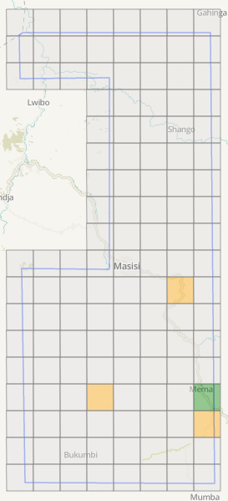
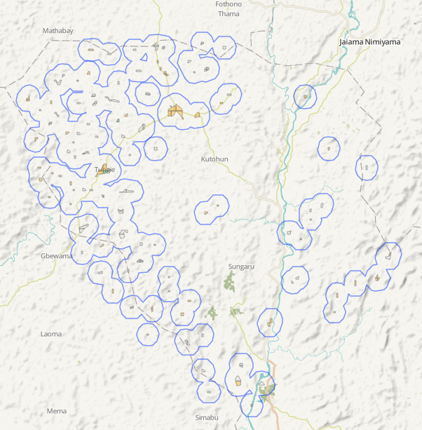
Additional information about MAPSWIPE
Classic tasks grid
Tasks preselected thanks to Mapswipe

Slide 26
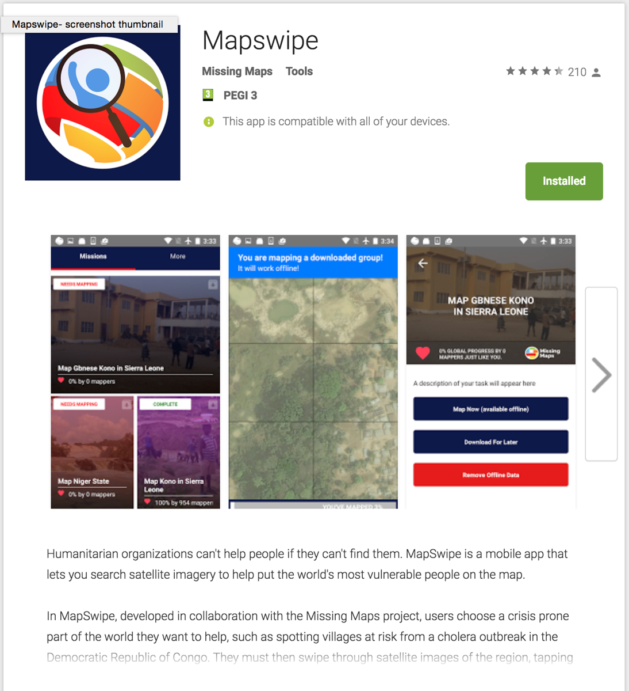
What is MAPSWIPE
https://mapswipe.org

Slide 27
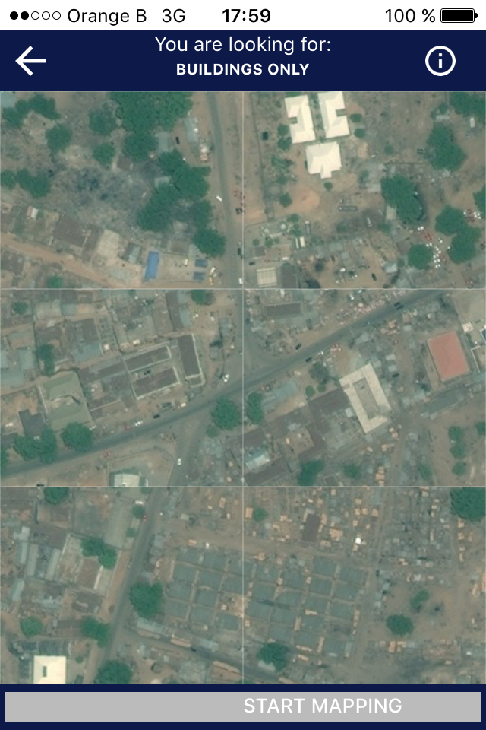
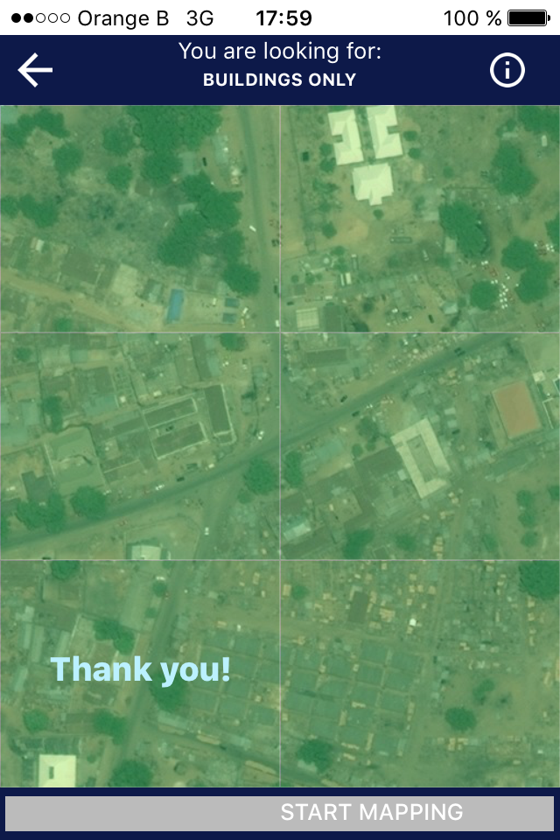
What is MAPSWIPE

Slide 28
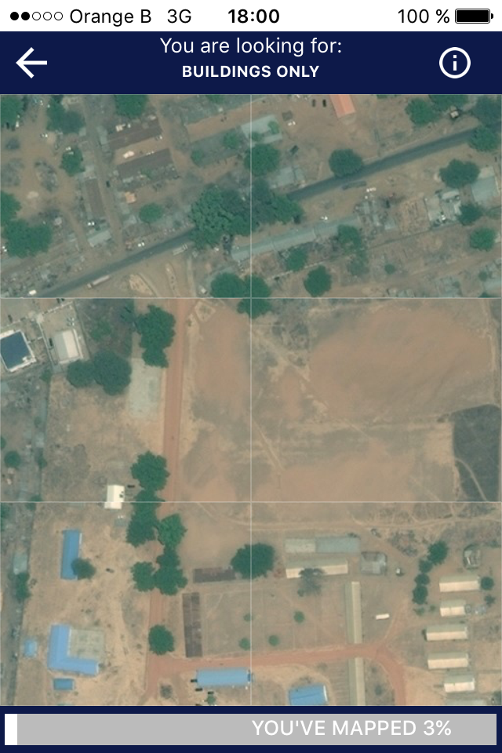
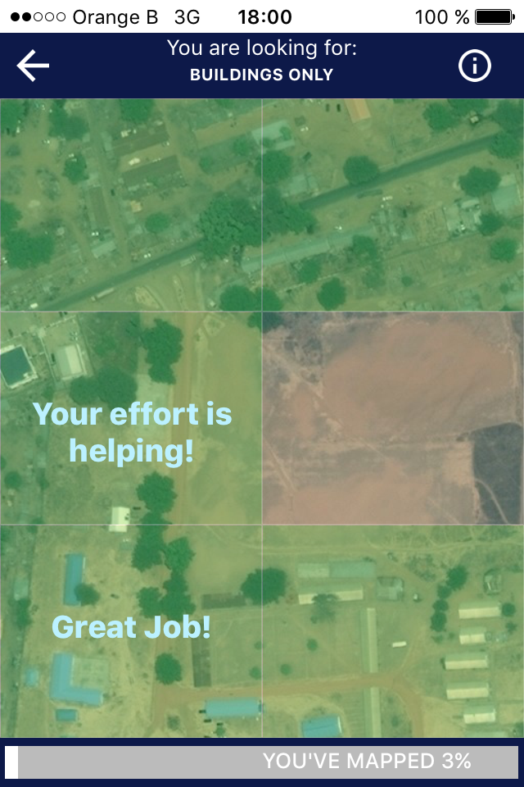
What is MAPSWIPE

