Slide 1
Dischord
Christopher Harmon & Olivier Midy
21M.385
December 12, 2016

Slide 2
Game Description
Premise: You have been stationed at the Wall of Resolution, the last stronghold of the Tonal Kingdom of Concordancia. Sadly, you are its only competent defender. Wielding El Fuego Cadencial, it is up to you to fend off the Dischordians, creatures of the Distant Dissonance.
Goals of the Game:
Strengthen musical concepts
Accommodate different difficulty levels
Reward, encourage tonal music knowledge

Slide 3
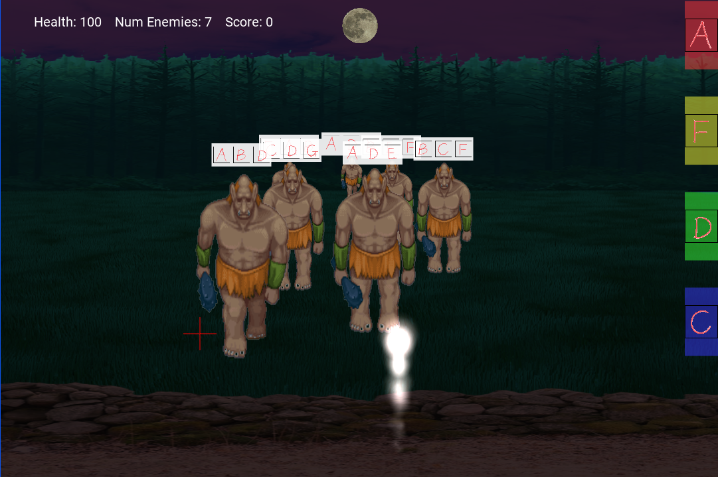
Game Elements & Mechanics
Enemies have dissonant chords to resolve
Control via Leap Motion
Left hand: horizontal aiming
Right hand: Note/weapon selection
HUD Tracks Player Stats
Score Multipliers for Chord Progressions

Slide 4

Lessons Learned
Motion control is hard
Needs careful calibration
Still has limitations
Working with sound is powerful, but nuanced
Feedback is half the game
Spec beforehand

Slide 5
Next Steps
Refined Leap Motion experience
Custom graphics & sound
Additional chord types, keys, etc.
More levels & gameplay aspects

