Slide 1
Group 3 Capstone Project Presentation 1
Fred Arandi
Charles Hafslund
Terry McCarthy
Othman Smihi
Mike Utenkov

Slide 2


Slide 3
Vision
A restaurant management application used to:
Enter, track, and delegate food and drink orders
Enter and track table statuses and reservations
Prioritize orders in the kitchen according to arrival of orders and required prep times
Handle billing
We envision this as a web application which may be adapted to Android if time allows.

Slide 4
Business Case
Restaurants are busy environments and inefficiencies can result in business failure even if the food is great.
Effective coordination of personnel and resources is key to timely service and customer satisfaction.

Slide 5
Business Case
Boost business by
Making waiting times smaller and more predictable
Maximizing customer throughput
Maximizing employee efficiency
Increasing customer satisfaction

Slide 6
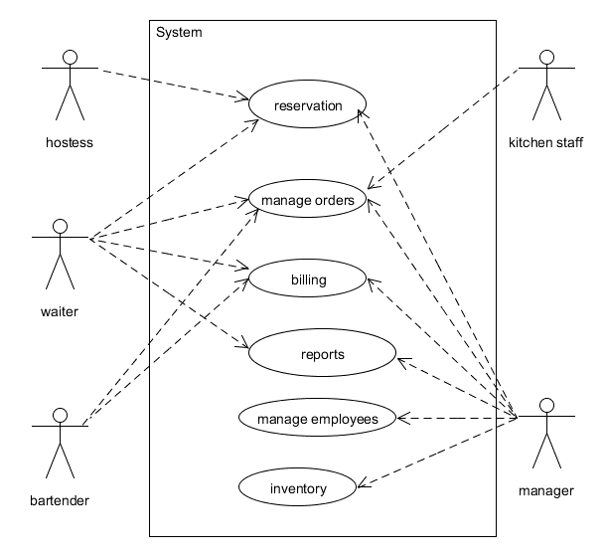
Actors
Waiter
Kitchen Staff
Hostess
Customer
Busboy
Bartender
Manager

Slide 7
Goals: Waiter
Enter customers' orders quickly and easily
Enter customers' orders without errors
Communicate customer orders to the kitchen
Access menu information on demand, as needed
Adjust bill splitting/sharing as needed
Mark what is from each person (seat number)
Take customer payment quickly and easily
See specials
Use coupons / codes
Receive tips
Take complaints

Slide 8
Goals: Kitchen Staff
View clear and accurate report of queued orders
View upcoming orders in terms of priority
Take ownership of orders
Mark items as completed

Slide 9
Goals: Customer
Have order recorded accurately
Receive an accurate bill,
including any splitting/sharing arrangements
Pay with a credit card easily and securely
Use coupons / codes
Make a reservation
Lodge a complaint

Slide 10
Goals: Hostess
View which tables are open and which are not
View waiting times for tables
via check in and check out, average duration
View which tables may be open soon
See table capacities
View table server assignments
by zone

Slide 11
Goals: Busboy
Indicate that tables are ready for seating, easily and without error
See which tables need to be cleaned (indicated by bill paid)

Slide 12
Goals: Manager
View aggregated information about sales
View aggregated information about inventory consumption
View aggregated information about employee work
Make adjustments to bill amounts
View complaints
Perform all other roles

Slide 13
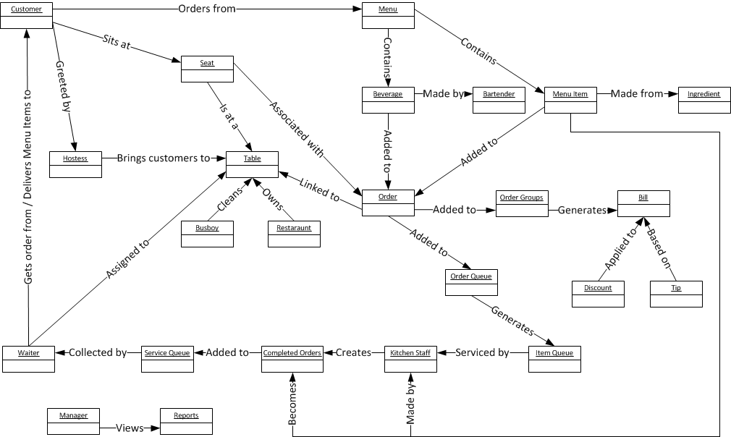
Domain Model

Slide 14
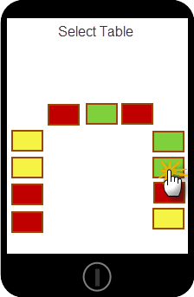
Basic Idea- Table Mgmt
Hostess, Waiters, and Bus Boys interact with a listing of tables.
Each role interacts with tables differently.

Slide 15
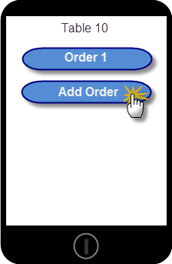
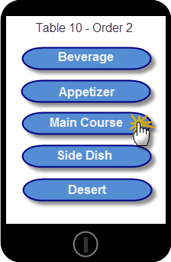
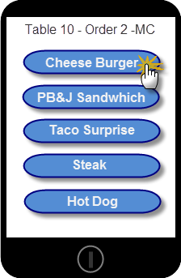
Basic Idea – Taking Orders
Waiters will be able to quickly add an order to a table using a categorized menu system.

Slide 16
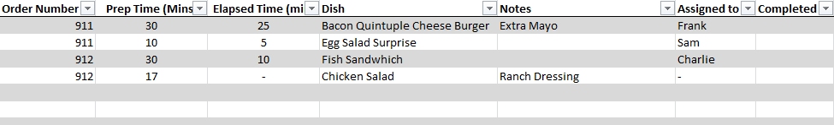
Basic Idea – Kitchen Staff
Kitchen Staff use a touch display that sorts order items in the following manner:
Table Orders queued in FIFO
Order Items queued within Table Group by longest prep-time first (LPTF) to synchronize their completion

Slide 17
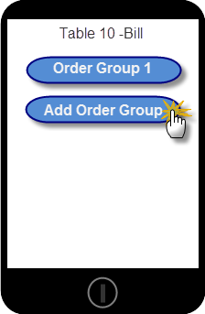
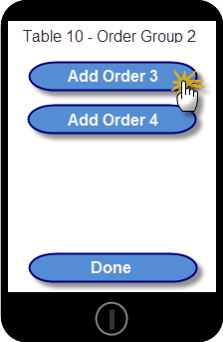
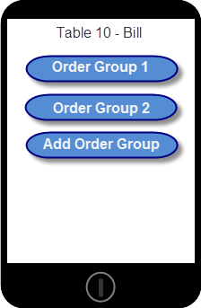
Basic Idea – Billing
Waiters will be able to quickly group orders into Order Groups for split billing.

Slide 18
Preliminary Use Cases
ID | Name | Scope | Primary Actor | Compelxity | Priority
1 | Menu view | In | Anyone | Low | 1
2 | Place Order | In | Customer | Low | 1
3 | Deliver Order | In | Waiter | Low | 1
4 | Order review | In | Waiter/customer | Low | 1
5 | Manage Table | In | Waiter | High | 2
6 | Order check off | In | Kitchen staff | Med | 1
7 | Reservation | In | Customer | Med | 2
8 | Item's metadata | In | Anyone | Med | 2
9 | Inventory | In | Manager | Low | 1
10 | Complaint | In | Manager/waiter | Med | 2

Slide 19
Risks
Fast application speed: Do not try customers’ patience.
High reliability: Downtime must be avoided
Credit card PCI information handling
Billing accuracy
Logins securely connect users with their correct role
Effective prioritization algorithm for orders and dishes

Slide 20
In Scope
Queue customers waiting to be seated
Table management:
Table capacity
Server assignments
Ready to clean / cleaned status
Menu
Send orders to kitchen
Payment API (stub)
Employee names and roles
Consumption report of ingredients
Sales numbers
Mobile site
Bill splitting
Tips
Prioritize orders in the kitchen
Customer time in/out
Busboy role
Drinks as items
Dish categories (app, main, dessert, drink, etc.)
Basic account authorization & security
Kitchen UI (queue display)

Slide 21
Out of Scope
Specifics of payment
PCI compliance
Payroll, time clocks
Inventory management
Complaints
Bar management
Splitting bill for a single item
Custom table setups
Recipes
Customer directly using the application

Slide 22
Scope Undecided
Reservations
Basic employee stats
Mobile app
Discounts / adjustments (comping)
Parties spanning > 1 table

Slide 23
Planning: Time
12 weeks
5 people
9 hours / person•week
540 hours total

Slide 24
Planning: Estimated Man-hours
App Design | 140
Mobile App | 120
Web app | 120
Server code | 60
Testing | 50
Database | 25
Graphics/Design | 25

Slide 25
Glossary of Terms
Bill: All Dishes belonging to an Order Group. Includes the price of each Dish and the total price
Bus queue: List of tables ready to be cleaned and prepared for new customers
Discount: Any action that reduces prices below those listed in the menu. Includes coupons, complimentary items, manager adjustments
Item Type: An attribute of a menu item; values include the basic categories found within the menu: Appetizer, Main, Dessert, Drink (non-alcoholic), Drink (alcoholic), etc.
Menu Item: A dish or drink on the menu that a customer can order
Item Queue: List of Items, used in the kitchen to plan for Items of the same Type to be ready for each seat at a table at the same time

Slide 26
Glossary of Terms
Order Group: Orders to be paid by the same payee
Order Queue: List of Orders, used in the kitchen to plan for orders to be prepared on a first-come first-served basis (grouped by Party and Dish Type)
Order: A set of items ordered by a customer at a seat
Party: A set of customers sitting together and ordering for the same meal
Seat: A single spot at a Table, identified by number. A Customer in a Party occupies a Seat.
Service Queue: Collection of Items of the same type ready to be delivered to a table
Table status: Attribute of Tables determining next action that can be taken. Values include: occupied, bus-queue, available
Table: The physical location at which Customers sit while dining

