Slide 1
Restaurant Booking Agent – using Dialog Intent Detection
Ankit Phaterpekar
Nanditha Sundararajan
Notes:
Hi! Ankit and I are here to give a status update on our project Restaurant Booking Agent- using Dialog Intent Detection

Slide 2
Agenda
Problem Definition
Use Cases
Methodology / Workflow / Iterations
Integrations
Deployment / Release
Packaging and Documentation
Roadblocks/Limitations
Pricing
Learnings
Future Work

Slide 3
Problem Statement
Motivation was to build a task-oriented conversational agent similar to those built by Amazon for handling specific customer related queries.
Simplify and automate the tasks involved during a Yelp Business search, Placing an Order and Reservation using a Dialog Agent.
End user could be a client like Yelp that could integrate such a service into its website or into Facebook / Slack.

Slide 4
Project Design
Build custom queries to identify/manage intents and control conversational flow in Google DialogFlow.
Integrating entity data such as location information, restaurant names etc.

Slide 5
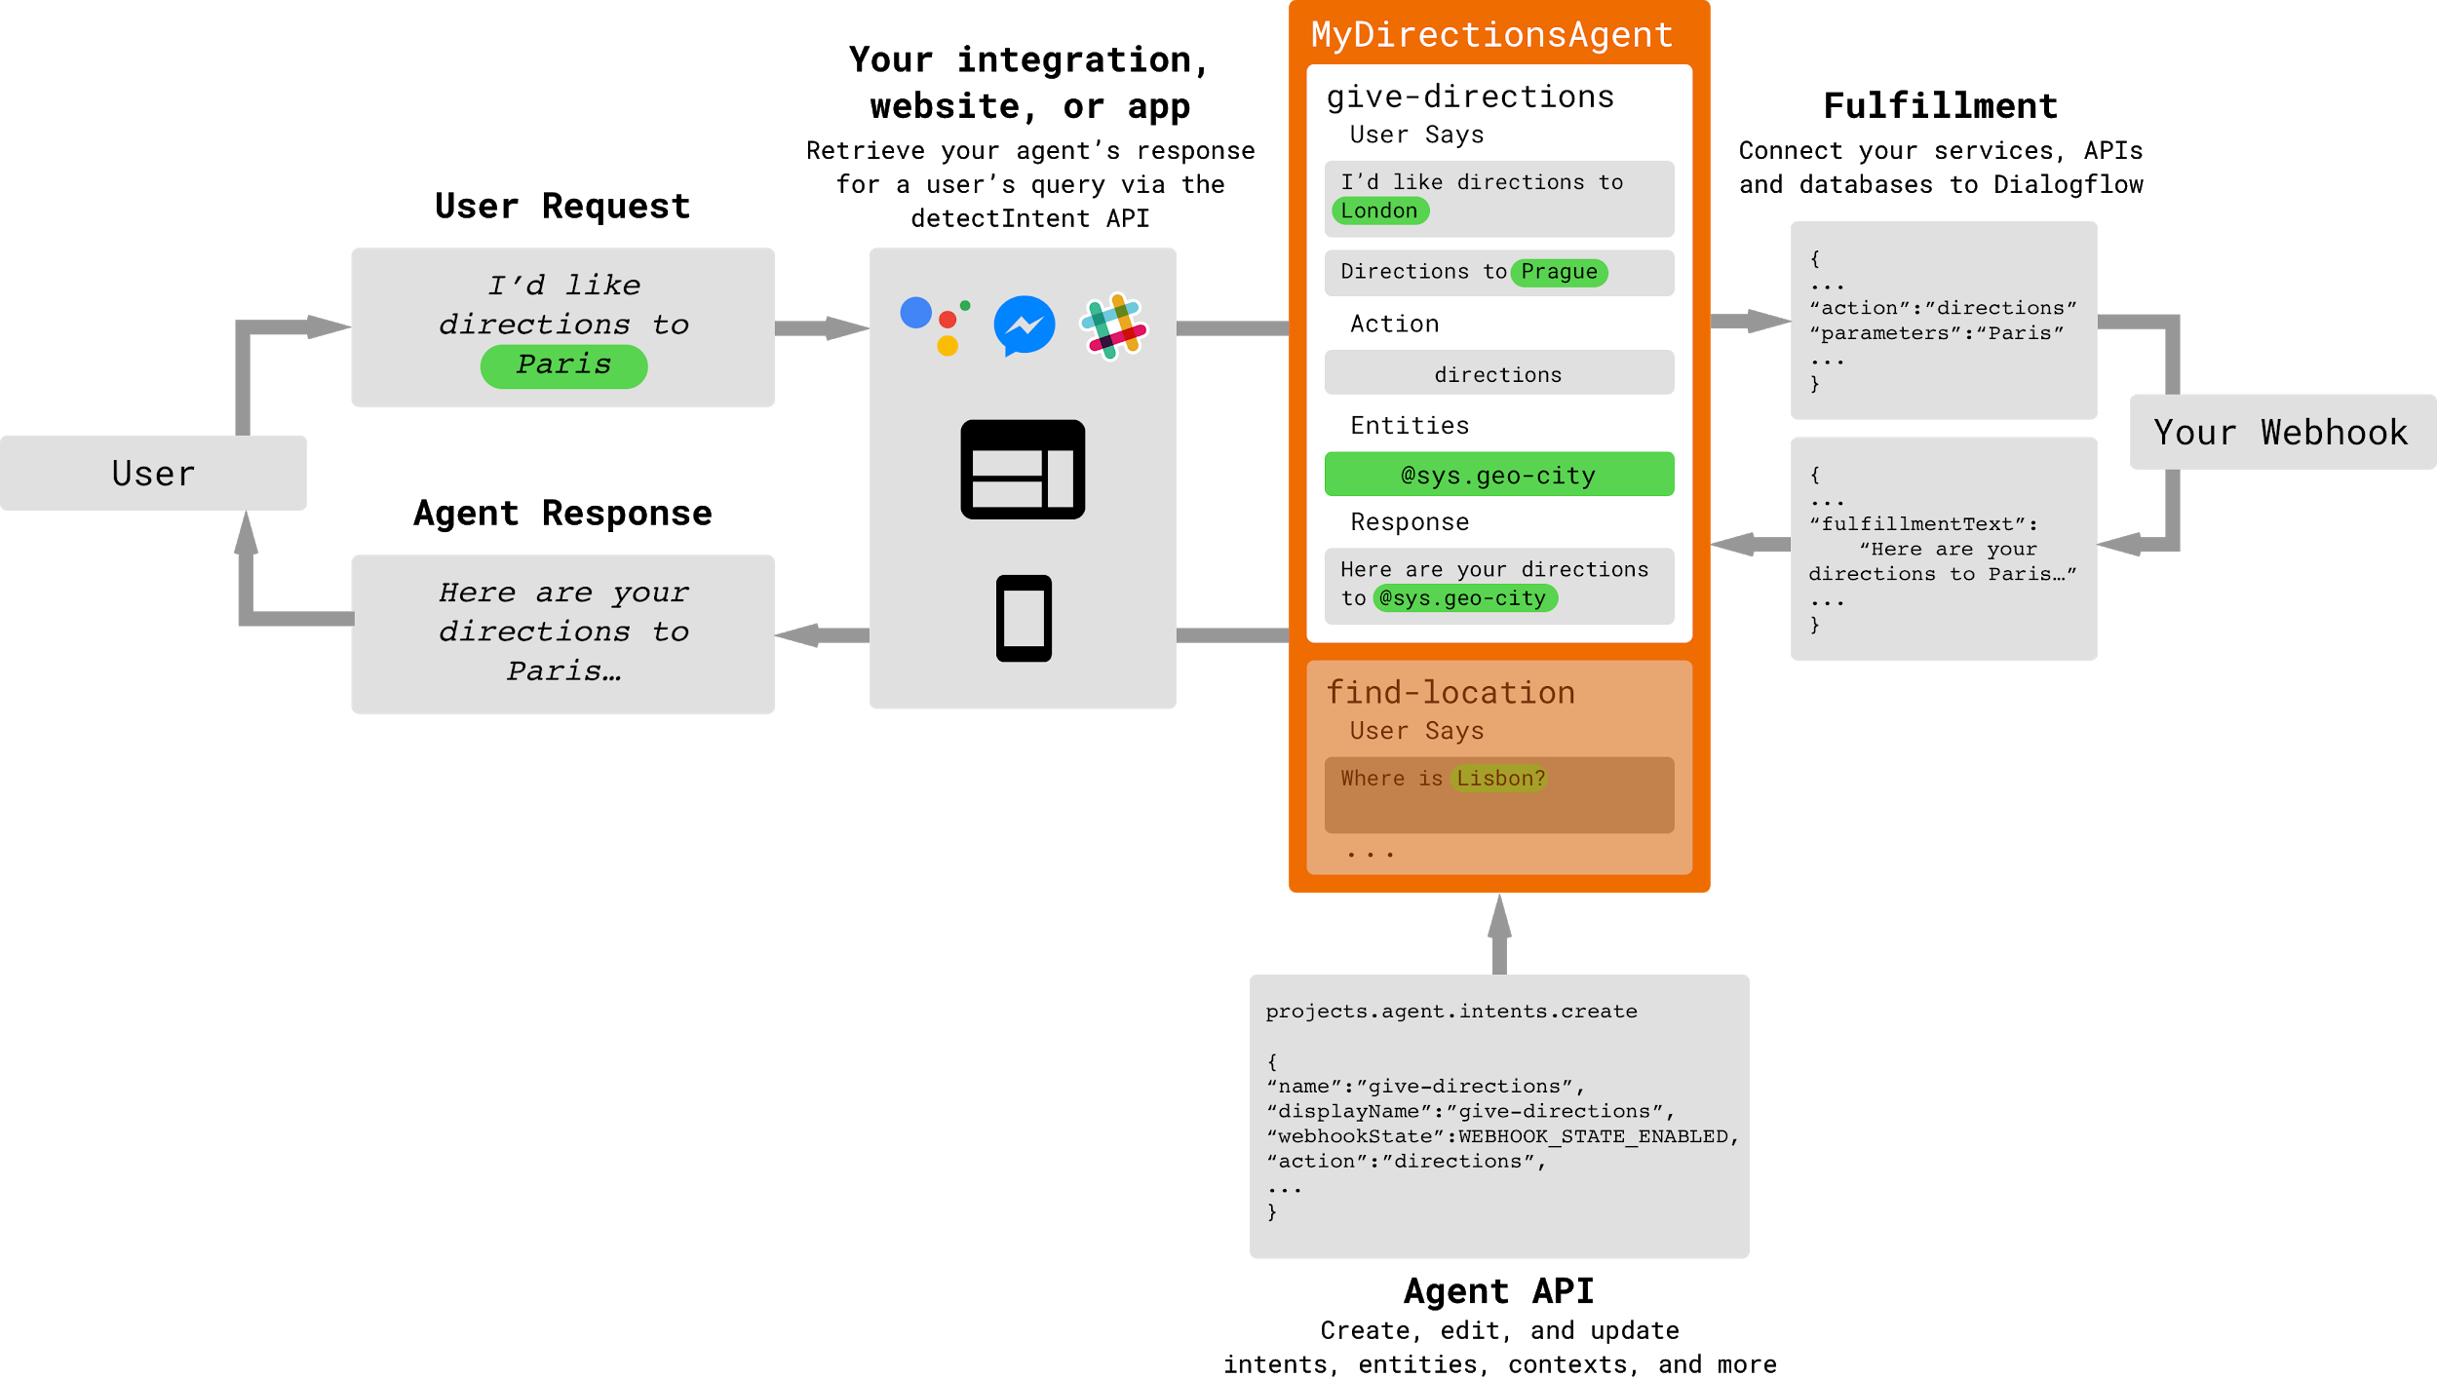
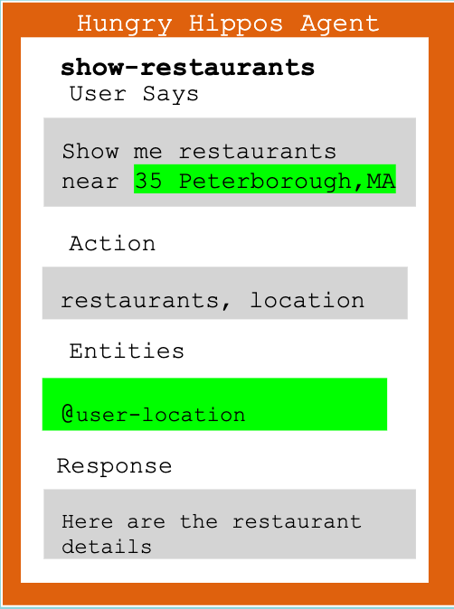
Dialogflow agent Architecture
search_business
Show me restaurants near 35 Peterborough,MA
{
...
“actions”: business,location
“parameters”: “Restaurants”,”35 Peterborough,MA”
...
}
Show me restaurants near 35 Peterborough,MA
business,location
{
...
“fulfillmentText”:”Here are the restaurant details”
...
}
Here are the restaurant details
@business-type,@user-location
projects.agent.intents.create
{
“name” : “search_business”,
“displayName”: “search_busniess”,
“webhookState”:WEBHOOK_STATE_ENABLED,
“action”:”business”,”location”,
...
}

Slide 6
Intent Detection Process
Preprocessing
1.Lowercase conversion
2.Tokenization
3.Vectorization
Classification Model
Hybrid Mode
ML only mode
Evaluation of model
Confidence Score
Training Phrases
Intents/Labels
Dialogflow uses Hybrid(Rule based and ML)mode for agents with small number of examples
It adopts ML only mode for agents with large number of examples in intents
A threshold value for confidence score is defined. If the returned value is less than the threshold, then a fallback intent is triggered

Slide 7
Use cases and intents
Welcome : Default welcome message for the user
Fallback : Default message when any intent is not matched
Reserve a table : book_tables
Yelp business information: search_business, search_business.details, restaurant Info
View events/specials : do_event_search
Place an order : item.start.generic, item.type.change , item.size.change,
item.amount.change, item.remove, item.confirm.yes,
item.confirm.no, item.type.start.negative, order.finish,
order.cancel, order.showbasket

Slide 8
Integrations
Slack
Google Assistant
Google Home
DialogFlow Phone Gateway
Voximplant
Twilio

Slide 9


Intent - Book Table
1. Intent invoked with such a query
2. Initially, started with providing all params in training phrases. In next, iterations started implementing Slot filling for missing params
3. Build logic for calculating which Saturday? Assumption, it's the coming Saturday, (so today + delta and then add time, timezone is UTC).
Limitation : Currently the date-time object is built on server side. This date-time needs to computed on the client side,

Slide 10
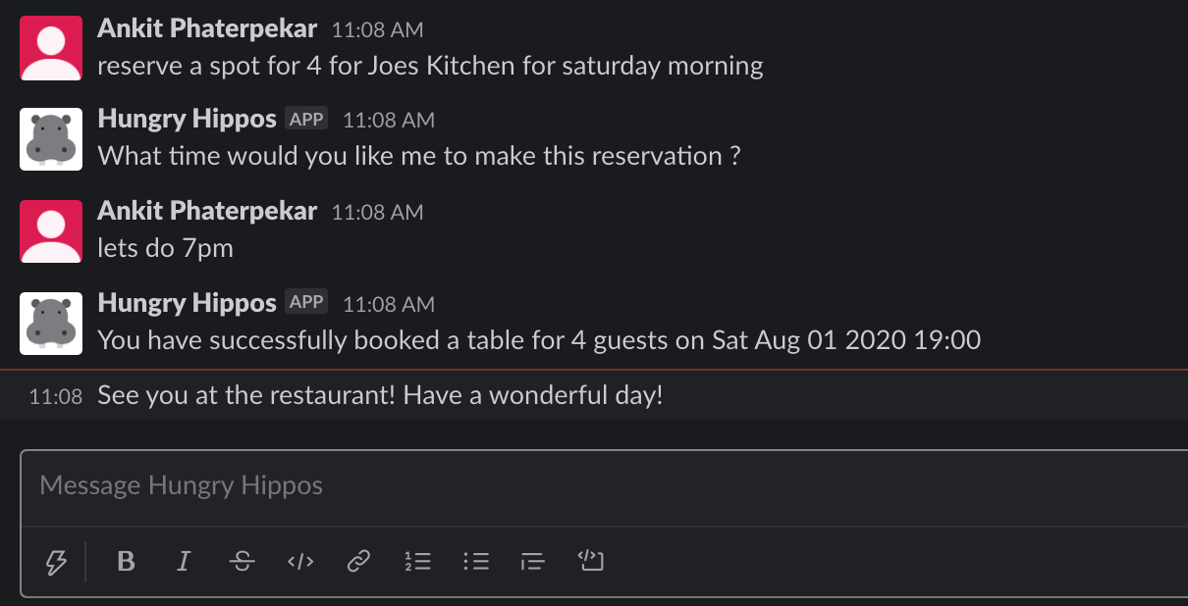
Intent - Book Table
4. If success, store this in Cloud Datastore. Send confirmation messages via agent, or else fail gracefully.

Slide 11


Intent - Search Business
1. Intent detected by a user query
Business Name is a required param, if not provided prompts the user to give one before proceeding
Location is an optional param, if provided overwrites default location
2. Query Yelp Business Search endpoint.
Extract relevant info from the JSON objects, like Store business.id, business.name, rating, address, phone no, price, urls, images
3. Using business.id, make another search to Yelp Review endpoint. Yelp current provides 3 review, so we fetch all those and send it to the Cloud Function.

Slide 12
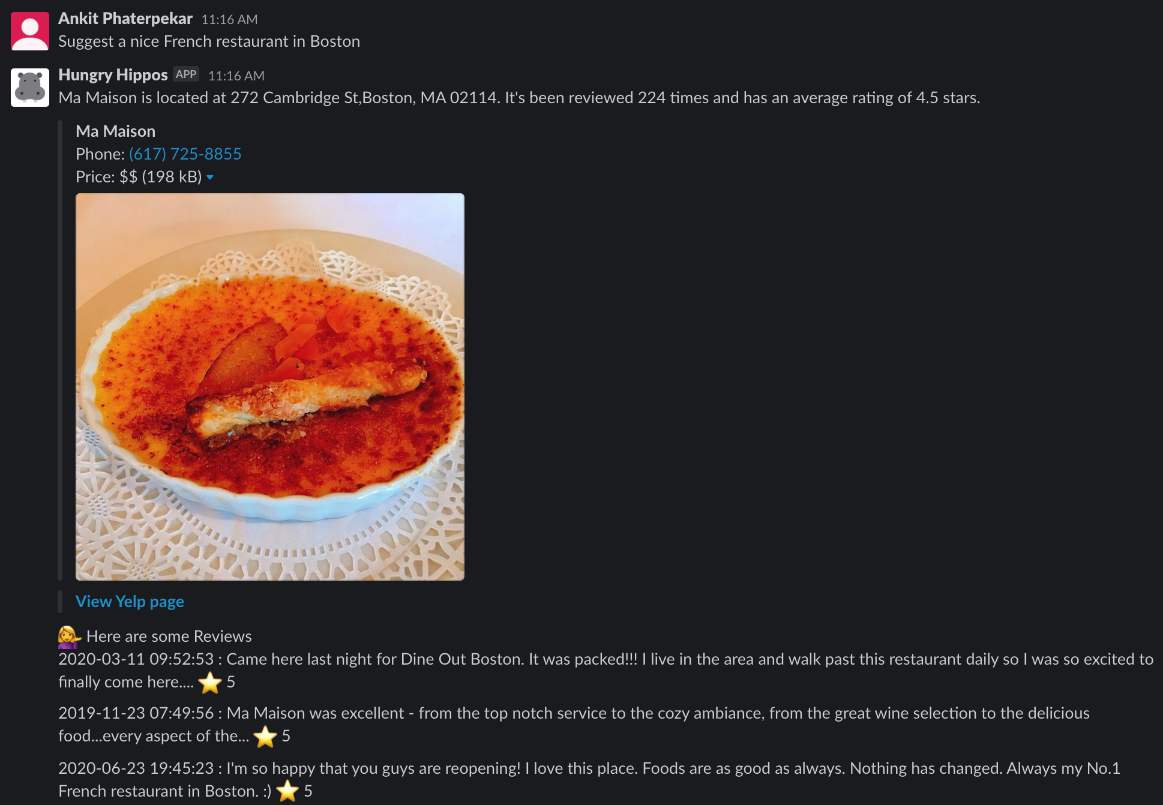
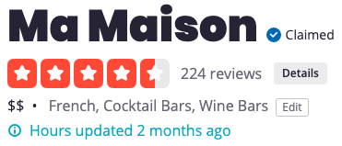
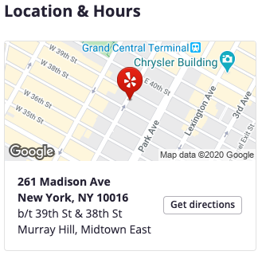
Intent - Search Business
4. Build a Card for Slack, and send back the formatted response to the user.

Slide 13


Business Details
1. Invoked with a such requests are detected
2. Needs to query Business-Details endpoint for getting operational hours. But first need to make a call to the Business-Search endpoint and retrieve the business.id.
3. Yelp stores Monday as Day 0, Javascript getDay() function stores Sunday as Day 0. Needs some mapping
4. Once that’s done, the operational hours are retrieved for the requested day.

Slide 14

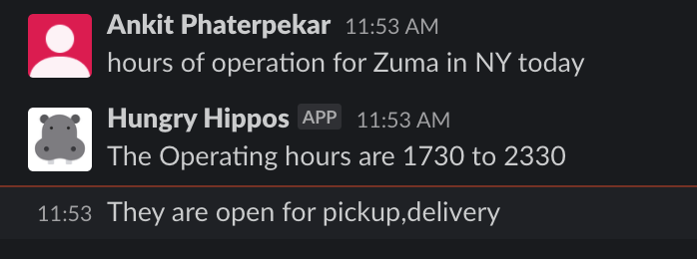
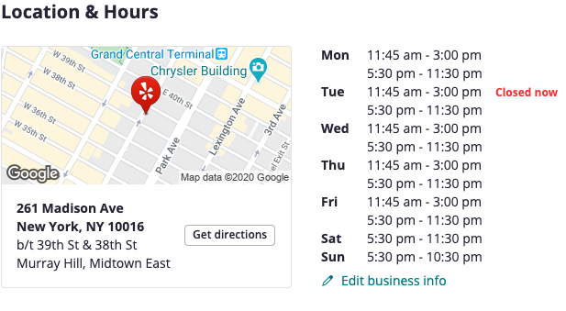
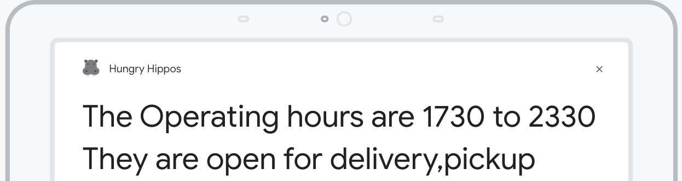
Business Details
Slack
Google Assistant

Slide 15
Event Search
1. Yelp has multiple categories to search from, the default we have used is 'food-and-drink'
2. Sorted by popularity, other options available are "time-sort"
3. Calculate start date, end date(t+1), convert in Unix time
4. Build Yelp Request, format the yelp response as JSON objects.
5. Grab the first event, retrieve Event Name, Event Description, Event Location
6. If nothing broke, build agent response

Slide 16
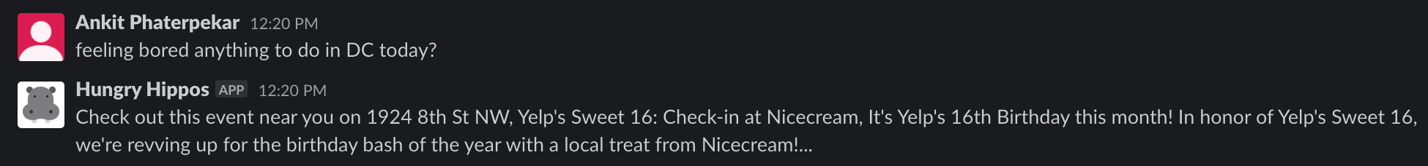
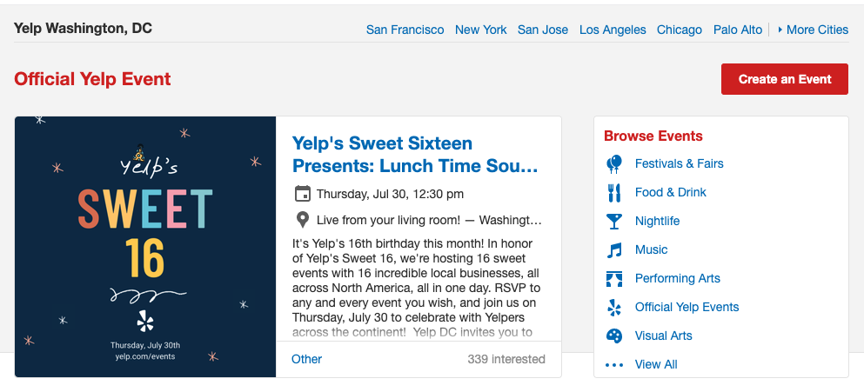
Use Case - Event Search

Slide 17
Pricing
A request is defined as any call to the Dialogflow service, whether direct with API usage or indirect with integration or console usage.
Depending on the task and design of the agent - the number of requests needed for an end-user to accomplish a task with a Dialogflow agent can vary greatly.

Slide 18
Pricing - Dialogflow Services
Features | Standard Edition | Enterprise Edition
Text | Free (180 requests per minute) | $0.002 per request (600 requests per minute)
Speech recognition Speech-to-text | Free 100 requests per minute 1,000 requests per day 15,000 requests per month | $0.0065 per 15 seconds of audio 300 requests per minute
Speech synthesis Text-to-speech | Free | $0.0065 per 15 seconds of audio Standard voices: $4 per 1 million characters WaveNet voices: $16 per 1 million characters

Slide 19
Pricing - GCP Services
Cloud Functions are priced based on :
- How many times it's invoked
First 2 million invocations - free
Beyond 2 million - $0.40 per million
- How long your function runs, How many resources you provision for the function
GB-second - $0.0000025 (Tier 1)
Ghz-second - $0.0000100 (Tier 1)
- Networking
Outbound Data (Egress) - $0.12
Outbound Data per month - 5GB Free
Inbound Data (Ingress) - Free
Outbound Data to Google APIs in the same region - Free

Slide 20
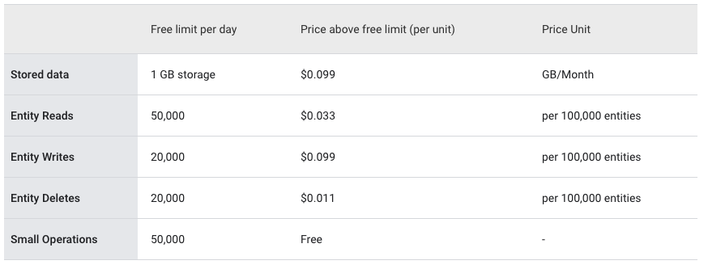
Pricing - GCP Services
Cloud Datastore

Slide 21
Pricing - GCP Services
GCP Firebase packages
Agent GCP Billing Console

Slide 22
Deployment and Release
Anytime any intent is updated, the respective Cloud function has to be re-deployed. On successful deployments, updated actions are available instantly
Slack Integrations are a one time setup.
For testing the Agent on Google Home, updates need to deployed as a new release.
Google has three stages for app deployment.
Alpha - Lets you test your Actions with up to 20 users without submitting for review first.
Beta - Can be extended up to 200 users.
Production - Lets you officially launch your Actions to all the Google Assistant users.

Slide 23
Packaging and Documentation
The Dialogflow agent can be exported as a zipped folder that contains the intents, entities and can be uploaded in Github
The cloud functions can be exported separately and imported within the end user’s GCP console.
Documentation regarding the workflow for each intent and the required parameters can be maintained along with steps for integration

Slide 24
Roadblocks and Limitations
Initiating an outbound call in Dialogflow using Voximplant and integrating with Google Assistant is not feasible
Limitation in integrating Dialogflow’s telephony with Google Assistant for forwarding a call
Yelp API can sometimes return Status - 500 Yelp Internal error

Slide 25
Learnings
Fun project to work on. Got acquainted with GCP components, node.js
Need to be savvy working with http requests & debugging failures in dialogflow can sometimes be head-scratcher
Dialogflow is evolving too, new capabilities are being added.
Needs some craft in designing complex conversation flows, leading and limiting users towards fewer branches, or else leads to complex code management

Slide 26
Future Work
Amazon Lex
Knowledge Base

Slide 27
Questions ?

