Slide 1


Task Manager
TEAM MEMBERS: CST 8285 Web Programming
Oliver O’Shea - Mario Valencia

Slide 2
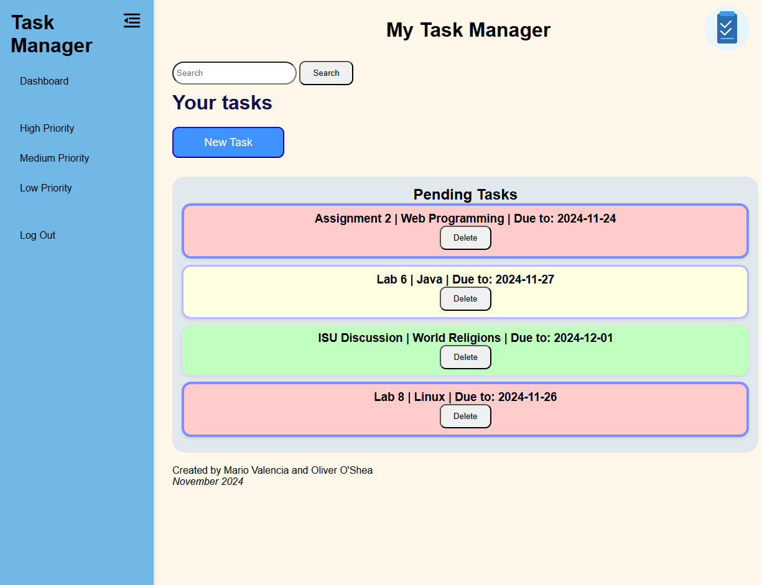
Task manager
Features:
Register – Login
Add and save tasks
Delete tasks
Filter tasks
Responsive Design

Slide 3
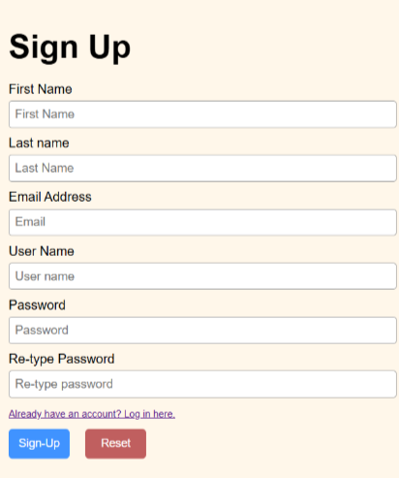
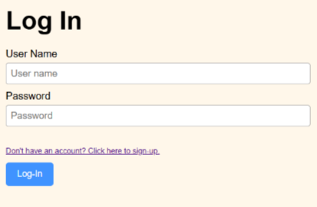
Register and Login

Slide 4
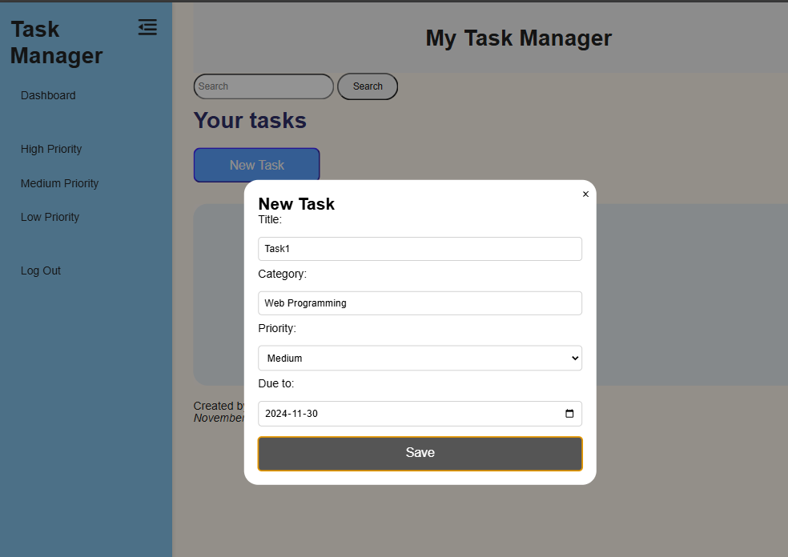
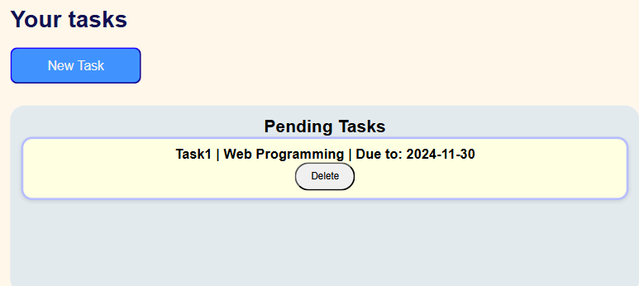

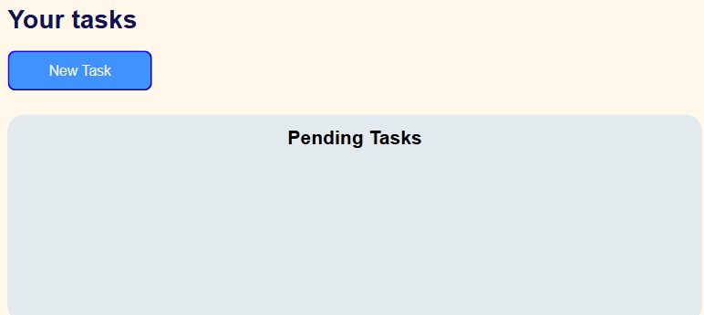
Adding and deleting tasks
Adding a new task
Deleting task

Slide 5
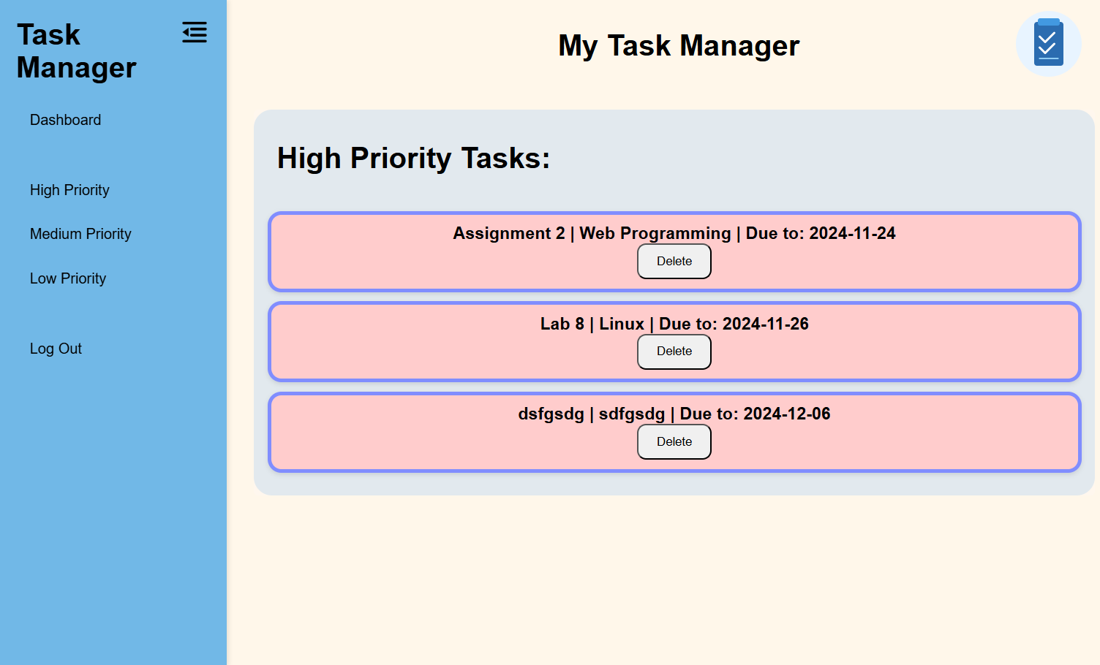


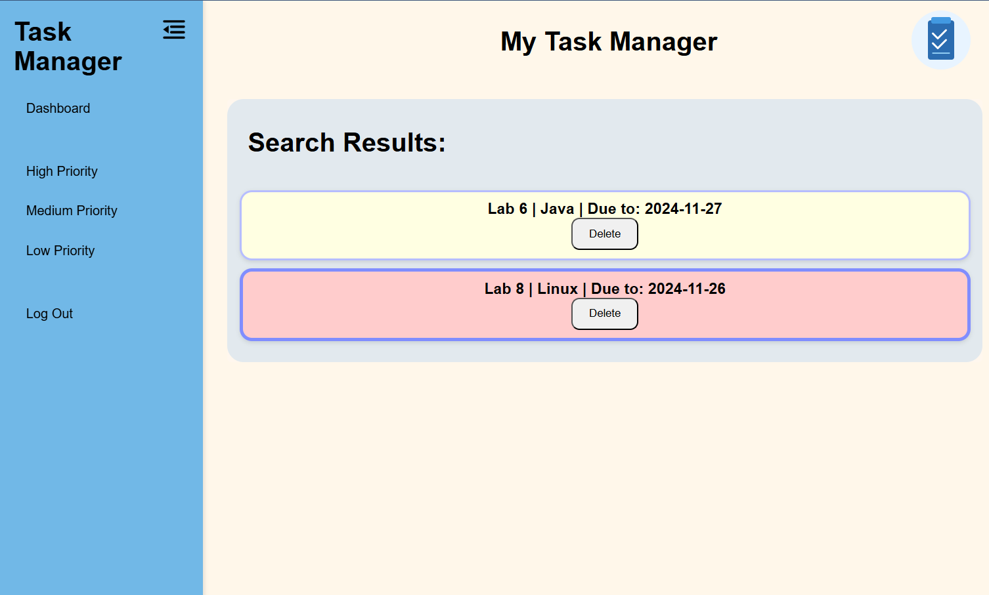
Filtering Tasks

Slide 6
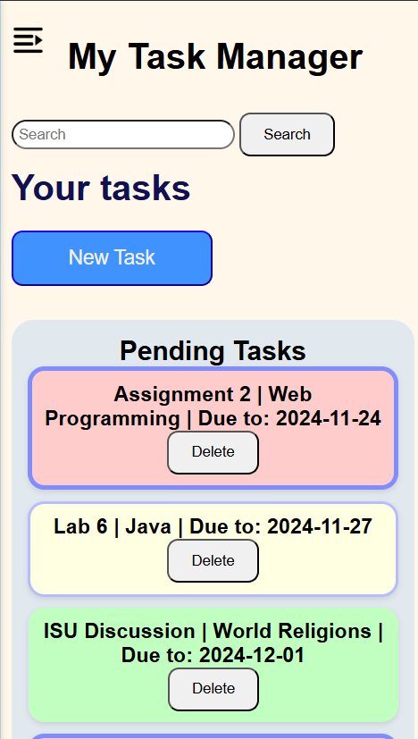
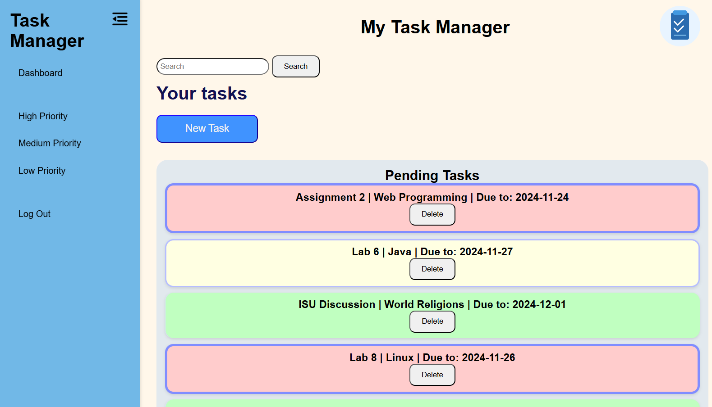
Responsive design
Standard Design view
Mobile design view

Slide 7
Thank you! Q&A time

