Slide 1
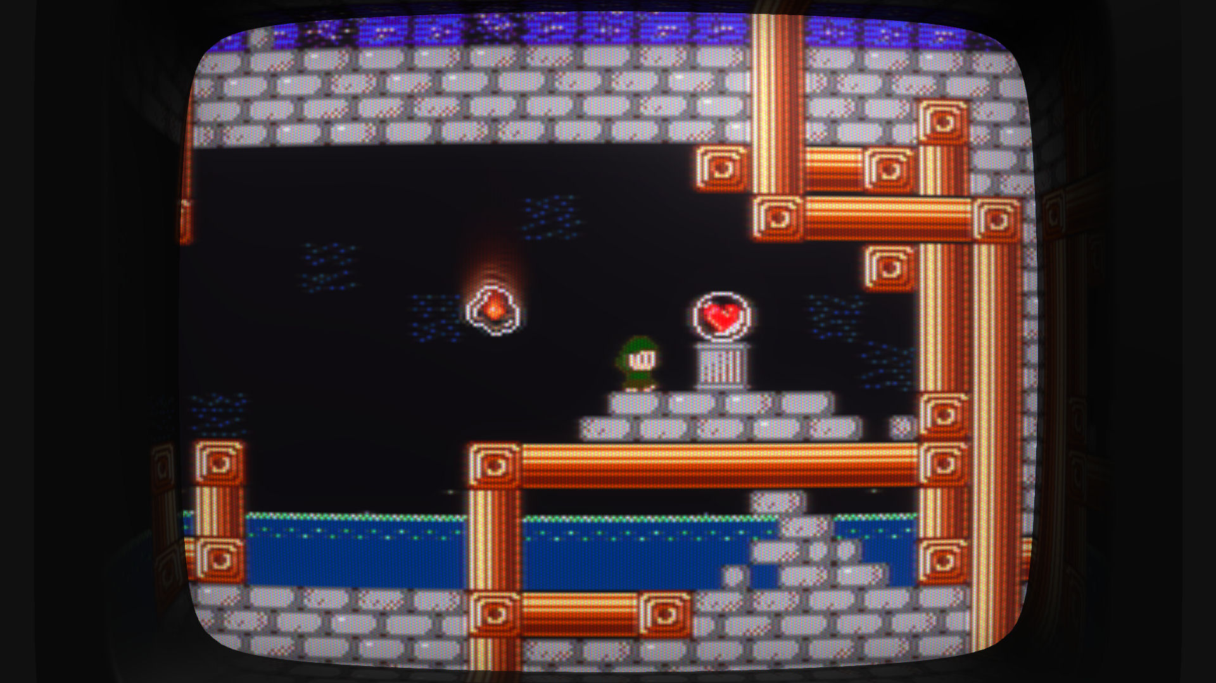
CRT Simulation in Super Win the Game specifically in regards to the NES and maybe also some notes on audio if there’s time
J. Kyle Pittman // Dallas Society of Play
Notes:
Intro. Who I am, what I do. How I got started, AAA dev, indie dev, engine development, etc.

Slide 2
Introduction
History
Began as a game jam project
Reused and improved over several games
Motivation
Believable, authentic retro presentation
Adhere to NES hardware limits where possible
Implementation
Aesthetic reconstruction vs. physical simulation
Research
Sites referenced
Hardware examined
Notes:
Also not talking about math or code or even pseudocode, but I can post slides and source later if anyone’s interested.

Slide 3
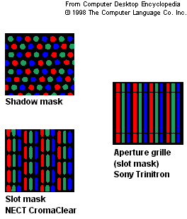

How a CRT works
Electron guns fire through a mask and activate phosphors on a fluorescent screen.
Three separate electron guns are used to activate the red, green, and blue phosphors.
Masks are used to target the correct phosphors more precisely.
Left: Real-world examples of masks and grilles
Below: The mask texture used in Super Win
Notes:
Note that the resolution of the mask does not correspond to the NES’s resolution. I fudged this for Super Win because I’m already starting to see Moire’ patterns appear at that resolution; going even smaller wouldn’t look appealing.

Slide 4
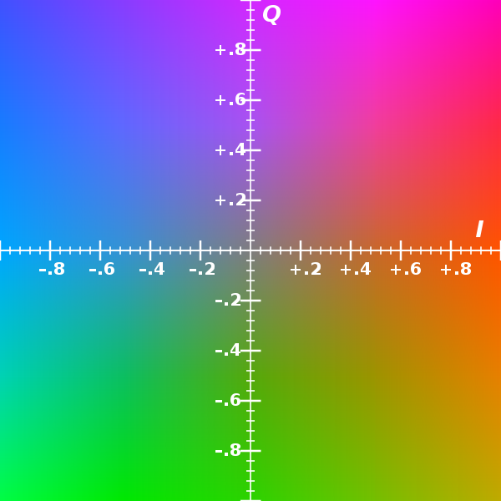
NTSC overview
YIQ color space
Separate luma (brightness) and chroma (hue, saturation) information
Compatible with B&W models
Y = luma
Chroma represented by two axes
I: In-phase, roughly blue to orange
Q: Quadrature, roughly green to purple
Comparable to YUV color space
Source: Wikipedia

Slide 5
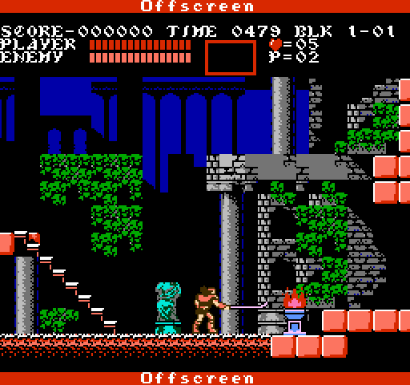
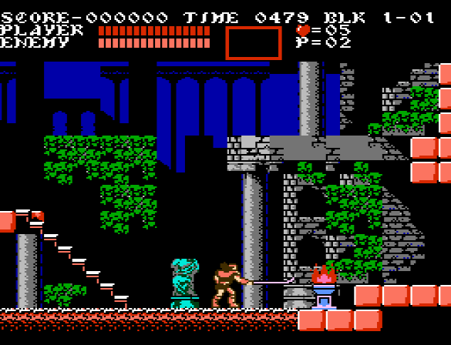
NES video output and NTSC artifacts
Screen resolution: 256x240 (256x224 visible)
Pixel aspect ratio: 8:7 (slightly wide)

Slide 6
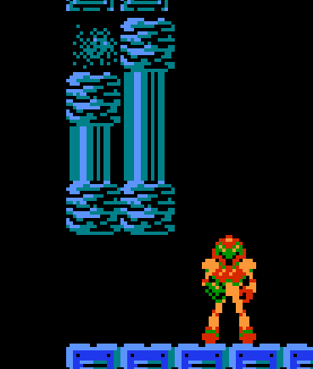
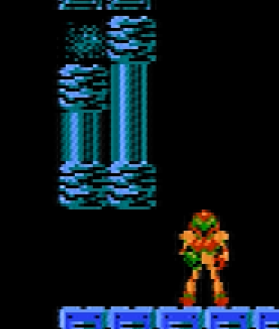
NES video output and NTSC artifacts
The NES produces fewer NTSC samples per pixel than necessary to produce a completely accurate image.
Color information overlaps adjacent pixels, producing the jagged lines or rainbow colors seen on vertical edges.

Slide 7



NES video output and NTSC artifacts
NTSC artifact mask used in Super Win
Source: http://wiki.nesdev.com/w/index.php/NTSC_video

Slide 8
Shader implementation
Goals
Target HLSL under Shader Model 2.0
Translate to GLSL
GLSL failure invalidates HLSL output
Still doesn’t catch all problems (const arrays)

Slide 9
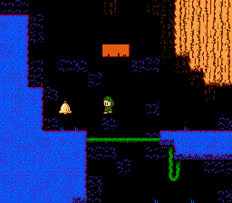
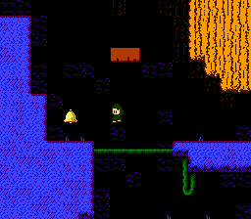
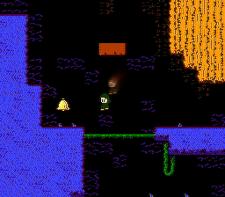
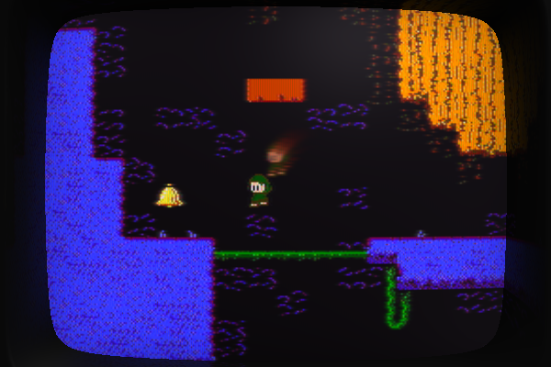
Shader implementation
1. “Clean” pixel art rendered 1:1
to a 256x224 buffer.
2. Pixel art transformed in color space
to simulate an NTSC signal.
3. Pixel art composited with previous frames
to produce trails and other “in-screen” effects
4. Output of compositing shader drawn as a texture
across the surface of a 3D model.

Slide 10
Pixel-space compositing shader
Phosphor decay (temporal bleeding, trails, framerate dependent)
Spatial bleeding (horizontal only)
Sharpness (ringing, horizontal only)
NTSC signal artifacts
“Rainbow” fuzz on high-contrast edges
Mask multiplied by difference between current pixel and adjacent pixels
Palette adjustment (actually done in a separate shader prior to compositing)
Based on Drag’s implementation: http://drag.wootest.net/misc/palgen.html
Generates a palette in YIQ space based on NES specs and converts to RGB values
Lookup table is constructed at run time using the reference palette shown on Wikipedia (also the palette I used for drawing the tiles and sprites)

Slide 11
Pixel-space compositing shader
Algorithm overview
Sample local and adjacent pixels for current frame
Use difference in luma values to weight NTSC artifact mask
Sample local and adjacent pixels for previous frame
Weight these to create temporal/spatial bleeding
Step left and right looking for high-contrast edges
Adjust the local pixel to create rings on nearby edges

Slide 12
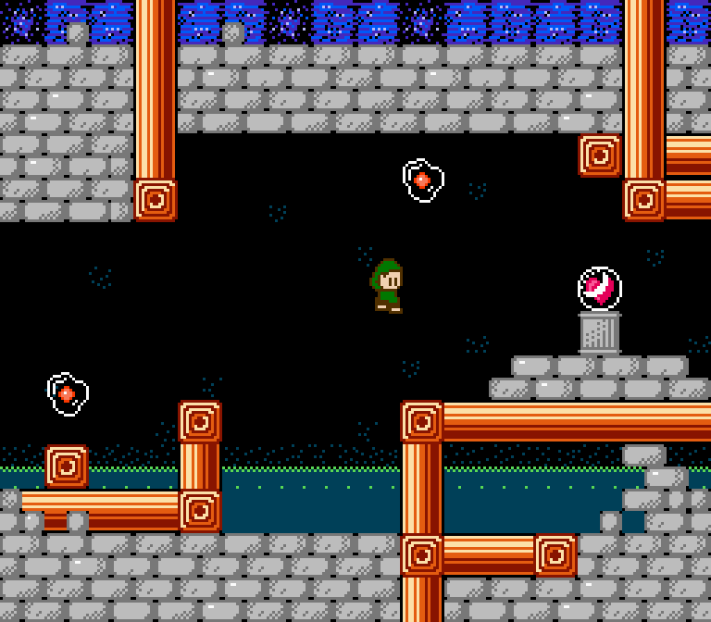
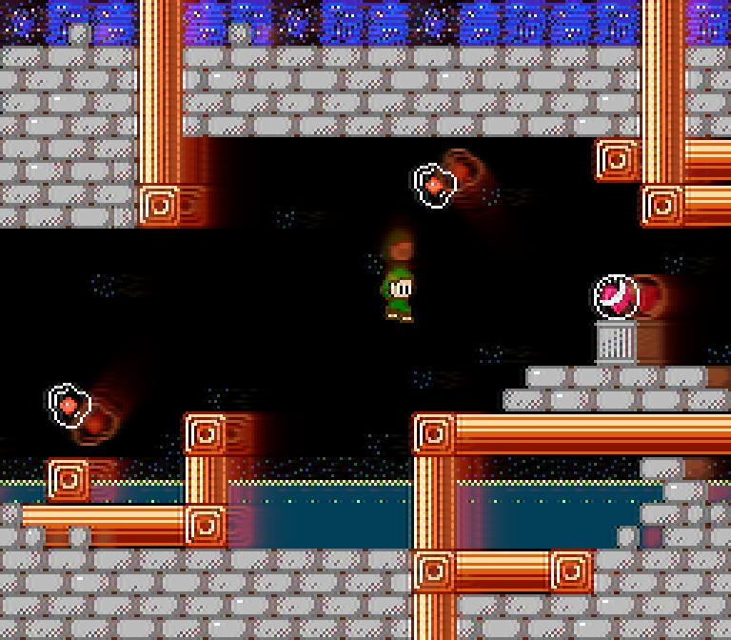
Pixel-space compositing shader

Slide 13
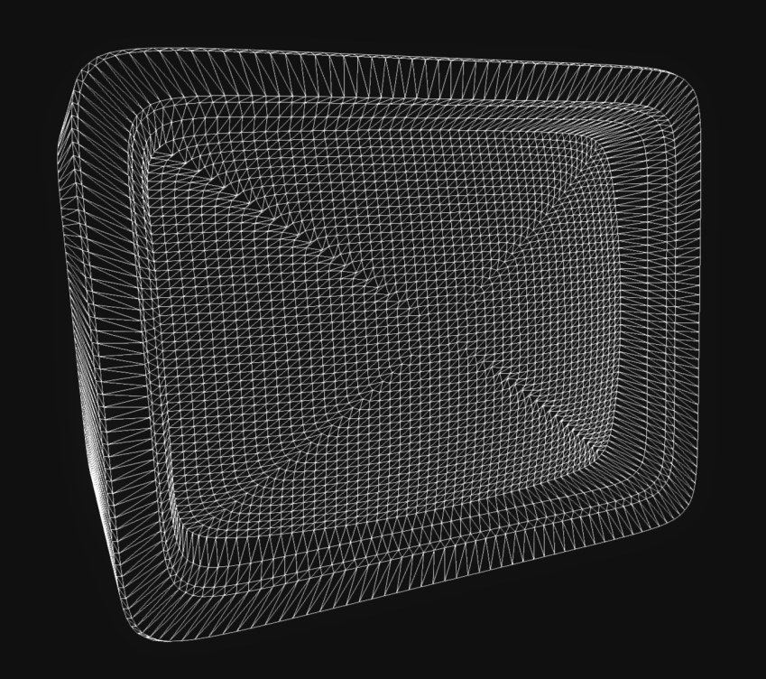
World-space screen mesh shader
Curvature (FOV)
Overscan
Barrel distortion
RGB shadow mask
Lighting
Edge reflection

Slide 14
World-space screen mesh shader
Algorithm overview
Sample the output of the compositing shader
Adjust the texture coordinates to apply overscan and barrel distortion
Multiply in the shadow mask, weighted to minimize darkening
Blinn-Phong lighting plus Fresnel rim lighting

Slide 15
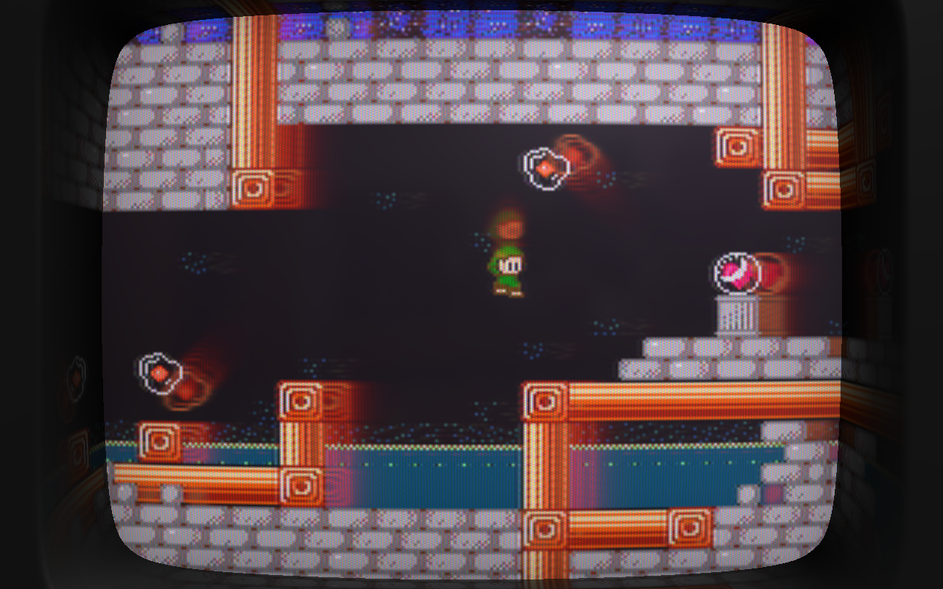
World-space screen mesh shader

Slide 16
Live demo!
CLCIK HEAR
Notes:
This slide will definitely make a lot of sense when I upload these.

Slide 17
What didn’t make the cut
Things I tried and discarded
Horizontal scanlines (noisy and redundant when combined with shadow mask)
Environmental reflection (costly, tended to be either distracting or invisible)
Things I didn’t try at all
Interlacing (too dependent on a 60Hz refresh)
Sprite flicker (nooope)
Slowdown (60fps feels good and is achievable)
Maximum 16 colors on-screen

Slide 18
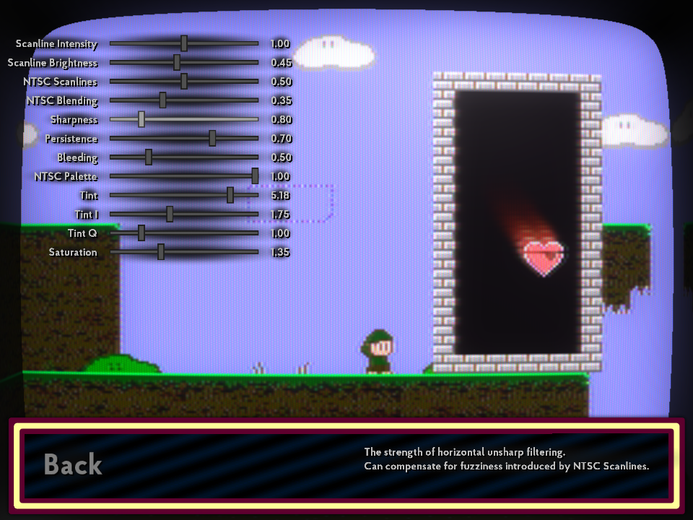
Etc.
A/B testing against classic games
Adding customization options

Slide 19
Notes on audio (if there’s time)
NES: four channel synthesizer
Two pulse waves (square/rectangle)
Variable duty cycle (12.5%, 25%, 50%, 75%)
Variable volume (16 levels)
Melody and harmony
One triangle wave
No variables
Triangle is implementing by stepping along the sixteen volume levels
Bass
One noise channel
Uses a LFSR to produce pseudo-random cycles of pulse waves
Variable volume (16 levels)
Drums and percussion
Also PCM but I chose to ignore that

Slide 20
Notes on audio (if there’s time)
Recreating NES sounds
Author music and sound effects as MIDI
Use a proprietary tool to load MIDI files, configure synthesizer properties (set DC, loop points, etc.), and output data in a custom file format
Load custom file and generate audio in real time
Why not convert to wave/MP3/Ogg Vorbis?
Not really any good reason at this point
Wanted the option to let channels stomp over each other
Real-time reverb doesn’t preclude the usage of those formats

Slide 21
Closing
http://www.superwinthegame.com/
http://www.minorkeygames.com/
http://www.piratehearts.com/
Twitter: @PirateHearts
Email: jpittman@gmail.com
Questions?

