Slide 1
Overview of WordNet
Sohaib Reza
Md. Iftekhar Hossain
Md. Nur Alam

Slide 2

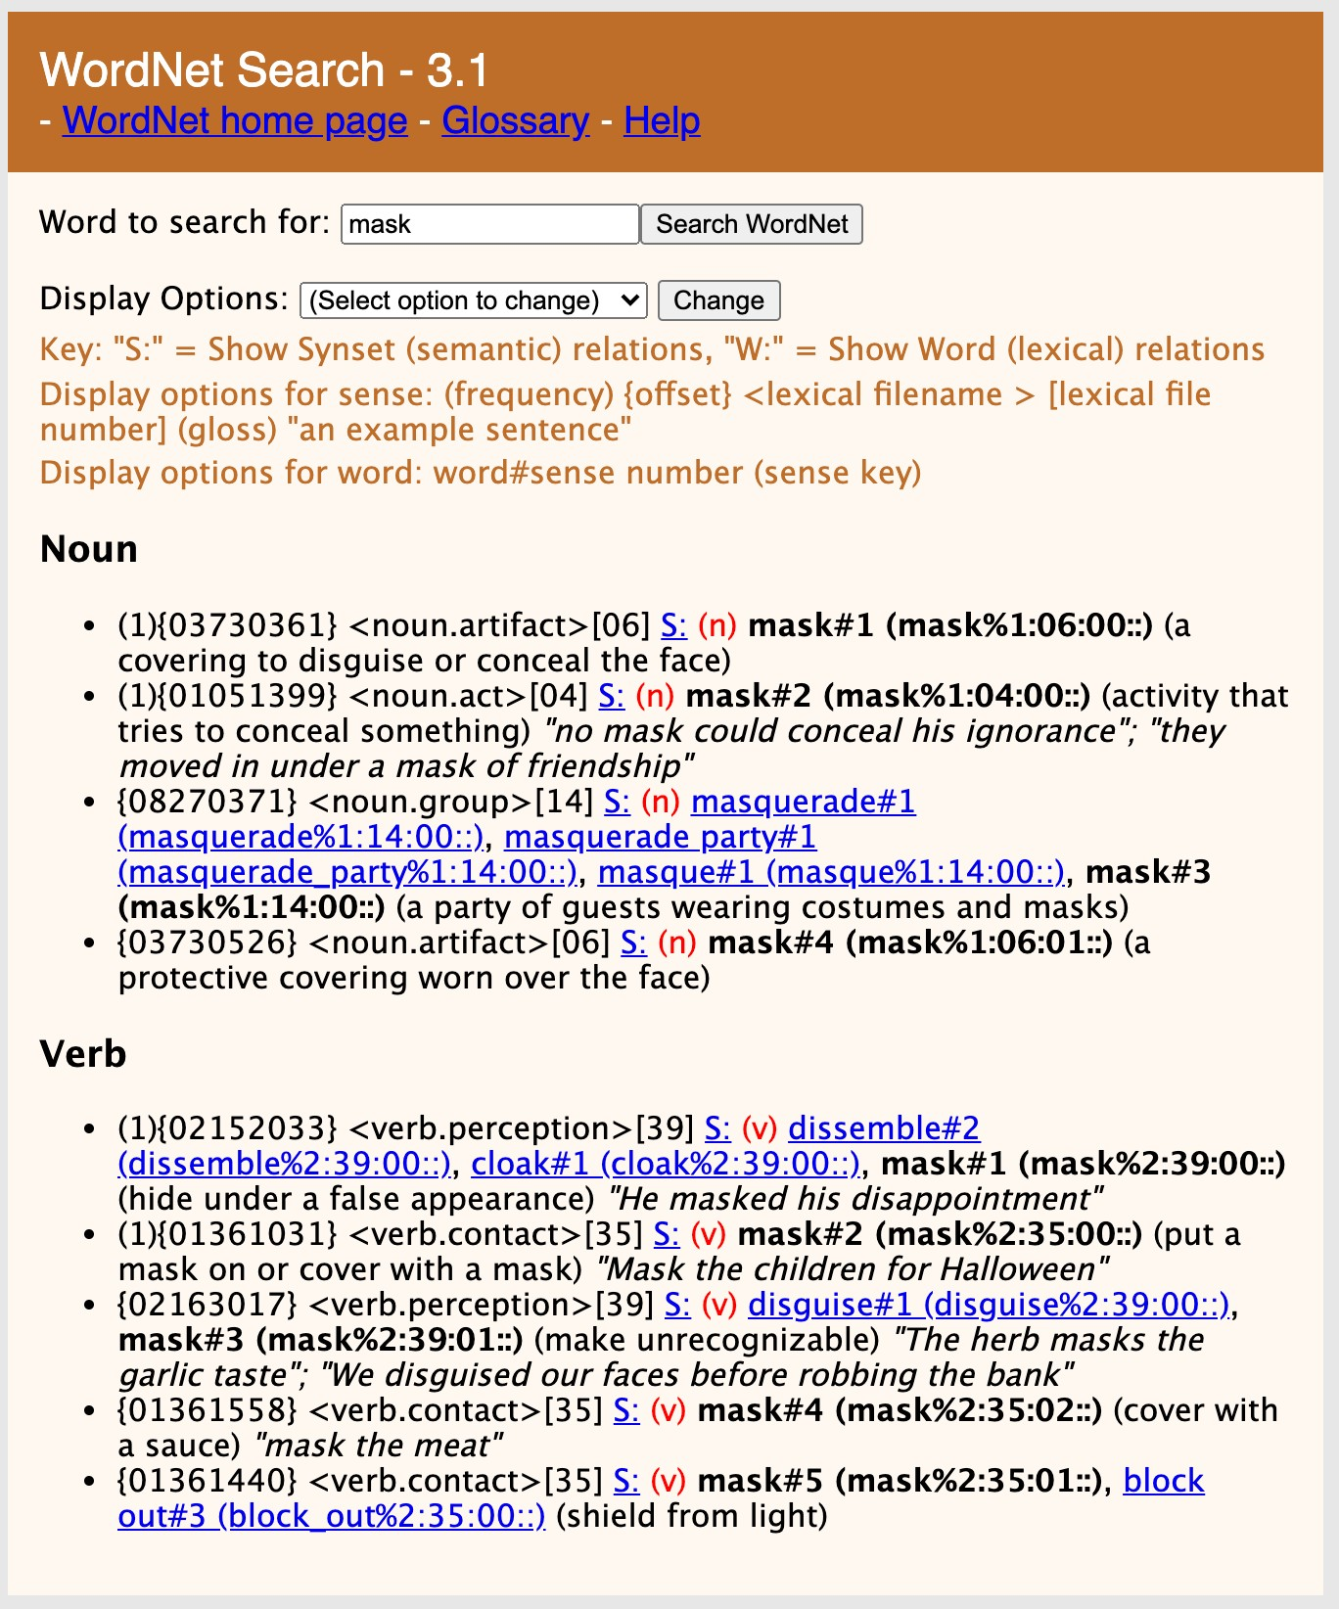
WordNet
Large lexical resource with information about:
Nouns
Verbs
Adjectives and adverbs
Each entry is annotated with one or more senses
Each sense provides a variety of information

Slide 3
WordNet Entries
Senses contain:
Gloss
A definition of the sense
List of synonyms
Commonly referred to as a
synset
(Sometimes) example sentence

Slide 4
Lexicographic Categories
Coarse-grained semantic categories
Often referred to as supersenses
Category | Example | Category | Example | Category | Example
ACT | service | GROUP | place | PLANT | tree
ANIMAL | dog | LOCATION | area | POSSESSION | price
ARTIFACT | car | MOTIVE | reason | PROCESS | process
ATTRIBUTE | quality | NATURAL EVENT | experience | QUANTITY | amount
BODY | hair | NATURAL OBJECT | flower | RELATION | portion
COGNITION | way | OTHER | stuff | SHAPE | square
COMMUNICATION | review | PERSON | people | STATE | pain
FEELING | discomfort | PHENOMENON | result | SUBSTANCE | oil
FOOD | food |  |  | TIME | day

Slide 5
Hypernym: Relation between a concept and its superordinate
Food is a hypernym of cake
Hyponym: Relation between a concept and its subordinate
Corgi is a hyponym of dog
Meronym: Relation between a part and its whole
Wheel is a meronym of car
Holonym: Relation between a whole and its parts
Car is a holonym of wheel
Antonym: Relation between two semantically opposite concepts
Leader is an antonym of follower
Sense Relations

Slide 6
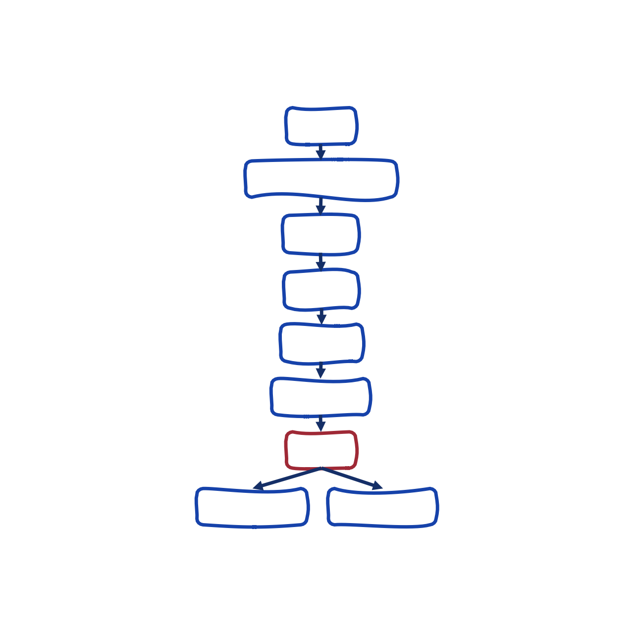
entity
physical entity
Hierarchical Structure
object
whole
artifact
covering
mask
eye mask
false face

