Slide 1
Sudoku Puzzle Solver
Owen Sowatzke
Georgia Institute of Technology
School of Electrical and Computer Engineering
ECE 3005 - Summer 2020

Slide 2
Presentation Outline
Algorithm
Implementation of the Algorithm
User-focused GUI

Slide 3

Algorithm Considerations
$6.671×{10}^{21}$ solutions to an empty sudoku puzzle [1]
Goal: minimize guessing to more rapidly solve puzzles
Cost: more lines of code
Seek to emulate human solver

Slide 4
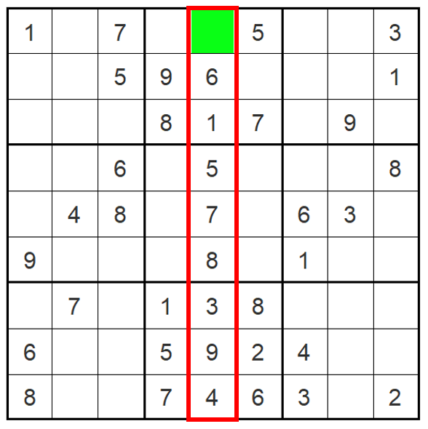
Placement of Single Candidates
If one number is missing in a given structure (box, column, row), add the missing number to the empty space in the structure.
Figure 1. All numbers except for two are in the boxed column. The number two is placed in the tile highlighted green

Slide 5
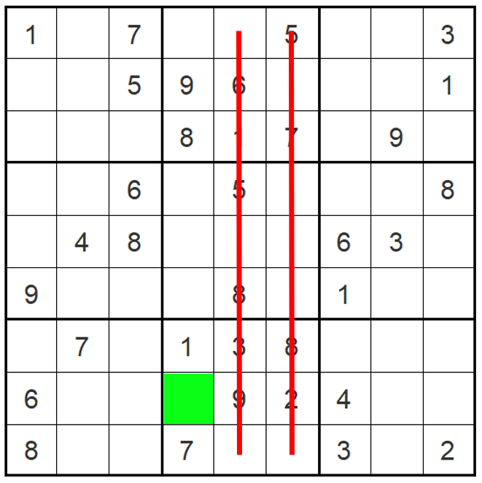
Cross-Hatching
Use the process of elimination to rule out the possibility of a given number being in an empty tile.
When using cross-hatching in a given structure (row, column, or box), numbers in the other two structures are used for elimination.
Figure 2. Using elimination to place a five in the bottom center box. Tiles with a red line through them are eliminated, while the tile highlighted in green is the solution.

Slide 6
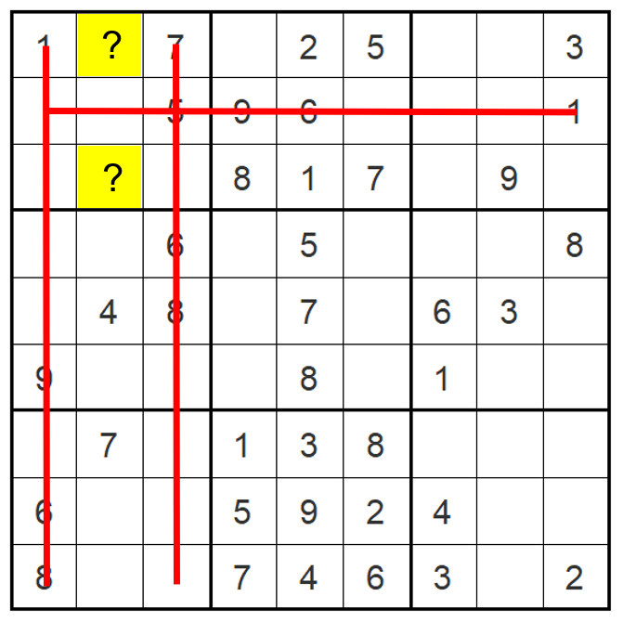
Guessing
Guessing should only be performed as a last resort if neither of the other technique yield progress.
Guessing is an extension of cross-hatching, where a given number can lie in more than one square.
One of these guess is chosen, and the puzzle is continued until it is either solved or an error is discovered.
Figure 3. Cross-hatching yields two possible tiles in which the number six can lie.

Slide 7
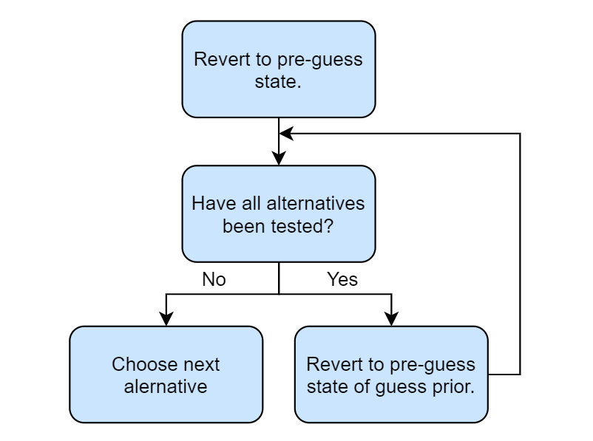
What If The Guess Was Wrong?
If the guess was incorrect (leads to an error), the puzzle is reverted to its pre-guess state and an alternative guess is chosen.
Note: when there is more than one tier of guesses, caution must be executed when reverting to a pre-guess state.
Figure 4. Flowchart illustrating how wrong guesses are handled when there are multiple tiers of guesses.

Slide 8
Implementation of Algorithm
User input is validated (no errors)
Place single candidates and apply cross-hatching
If there are no changes, make a guess.
Check for errors and choose alternative guess if necessary.
If all tiles are not filled, return to step 2.

Slide 9
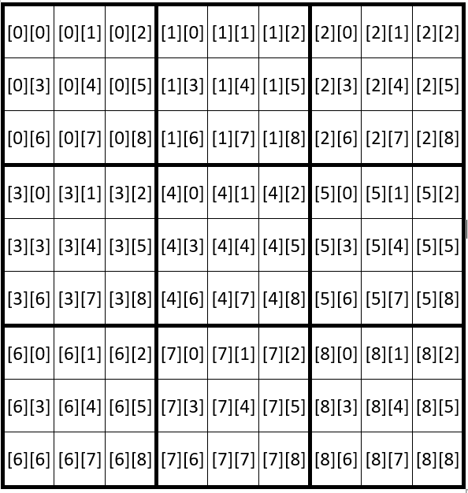
Efficient Storage of Sudoku Puzzle Entries
Sudoku puzzles are saved in a [9][9] array, where the first number refers to the box number and the second number refers to the box index.
Figure 5. Sudoku puzzle grid correlating array indices to tiles within the puzzle.

Slide 10
Efficient Access of Sudoku Puzzle Entries
When the array is accessed element-by-element using two for loops with syntax array[i][j]. All items in a row can be accessed according to the following if statement:
if (((i/3)==(row/3))&&((j/3)==(row%3)))
Similarly, all items in a column can be accessed according to the following if statement
if (((i%3)==(col/3))&&((j%3)==(col%3)))

Slide 11
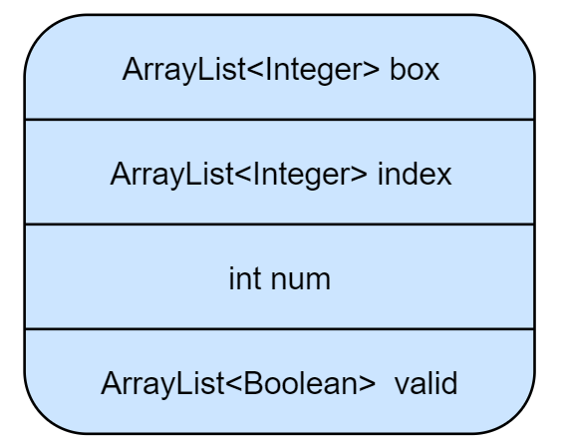
Efficient Storage and Access of Guesses
Define a guess class to hold a guess and its corresponding alternative guesses.
Class contains:
ArrayList of box numbers
ArrayList of indices
Number whose location is being guessed
ArrayList defining the validity of the guess and alternatives guesses
Figure 6. Data contained within guess class

Slide 12
Efficient Storage and Access of Guesses
A list of guesses with type ArrayList<guess> holds a list of all the guesses made.
Another list with type ArrayList<int[][]> holds screenshots of the pre-guess puzzles
New guess structures and pre-guess puzzles are added to their respective ArrayLists when new guesses are made.
They are both removed when a guess and all its alternatives guesses prove to be incorrect.

Slide 13
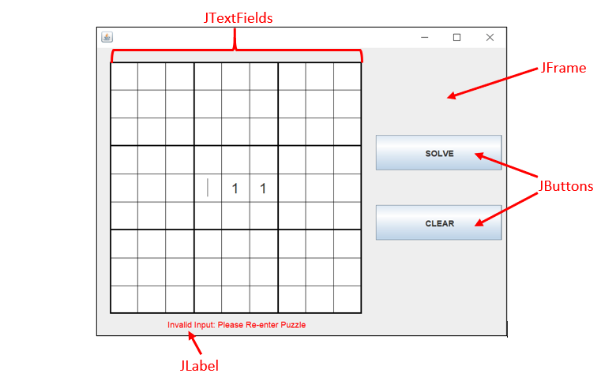
Application Graphics
Figure 7. Application graphics with component types highlighted.

Slide 14
Implementing Resizeability
No layout manager is used.
A component listener [2] listens for resizing events.
Components are resized based on the smallest GUI dimension (in relation to the GUI’s original size).
This ensures that the sudoku grid remainds square.

Slide 15
Collecting User Input
GUI components are defined globally.
An action listener [3] waits for a button press.
Before solving, the graphics class checks for errors and if there are any it makes the JLabel visible (displays an error message).

Slide 16
Conclusion
Algorithm
Mimics a Human Solver
Minimizes Guessing
Implementation of the Algorithm
[9][9] Array
Guess Class
Application Graphics
Resizeability
Collection of User-Data

Slide 17
References
[1] F. Jarvis, B. Felgenhauer, “Enumerating possible Sudoku grids,” June 20, 2005. Accessed on: July 12, 2020. [Online]. http://www.afjarvis .staff.shef.ac.uk/sudoku/felgenhauer_Jarvis_spec1.pdf
[2] Oracle, How to Write a Component Listener, Oracle. Accessed on: July 12, 2020. [Online]. Available: https://docs.oracle.com/javase/tutorial/ uiswing/events/componentlistener.html.
[3] Oracle, How to Write an Action Listener, Oracle. Accessed on: July 12, 2020. [Online]. Available:https://docs.oracle.com/javase/tutorial/ uiswing/events/actionlistener.html.

