Slide 1
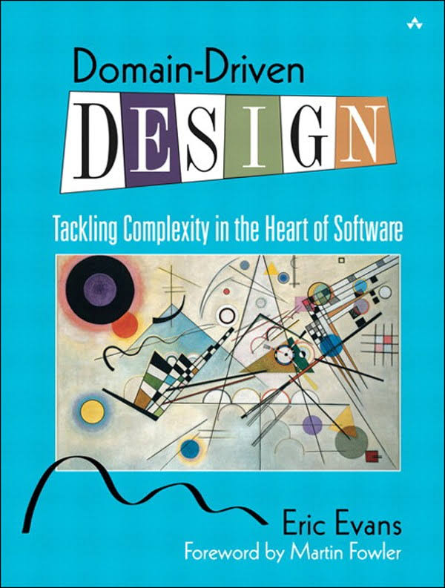
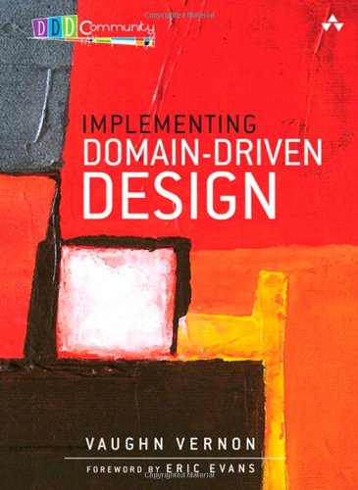
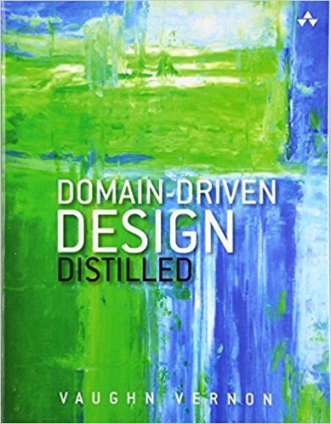
DomainDrivenDesign();
TackLıng COMPLEXITY IN THE HEART OF SOFTWARE

Slide 2
Problems of Enterprise Software
I wil use NH!
I will Use EF!
Maintenance, as software grows.
Mixing presentation, application and domain logics.
Mixing infrastructure and business code, makes hard to switch technology.
Testability
I will Use LLBLGEN!
-Wait… WTF ?????

Slide 3
Before DDD
Developers are such tool lovers and they believe that problems can solve only tools but re-considering of architecture
Let’s put Cassandra, Let’s put Messaging abstractions etc..
DB oriented systems
Tightly coupled services
The hidden business inside of UtilityHelpers, Providers, BullShitManagers!
Smart UI Antipattern
Put business logic to UserInterface
Create seperate user interface every application function
Duplicate business logic in Mobile, Mvc or inside other UI components
In Long-lived project lifetime, this is a nightmare

Slide 4
The Result is:
Architecture PER Developer!

Slide 5
What is DDD ?
NOT A TECHNOLOGY OR METHODOLOGY
Set of principles and patterns focusing to design effort

Slide 6
Why DDD ?
Deep understanding the Domain(subject area), object model, interactions
Distilling your daily work language as Ubiquitous Language
Arrange and cover learning challenges across people
Business Analyst, Domain Expert, Developer
Leads model driven design not Database!
Creates a language
Distilled by knowledge over the time

Slide 7
How can I decide to DDD?
Competitive Advantage
Complexity
Accounting
S
L
Public Web
L
S
Claims
L
L
Sales
S
S

Slide 8
Overall
Ubiquitous Language
Knowledge Crunching, Continuous Learning, Knowledge-Rich Design, Deep Models.
One team, one language
Code base should be based on that language
Bounded Context (Microservices?)
Layered Architecture
Domain, Application, Presentation, Infrastructure, Distributes Services

Slide 9
Layers
Domain Layer
Entities, Aggregates, Aggregate Roots, Value Objects, Repositories, Domain Services, Domain Events, Policies
Application Layer
Application Services, Data Transfer Objects (and their Validation), Unit Of Work, Authorization, Auditing…
Infrastructure Layer
Persistence, Sending Emails, Dependency Injection, Logging, Caching implementations…
Presentation Layer
Web, Mobile… specific technologies and tools

Slide 11
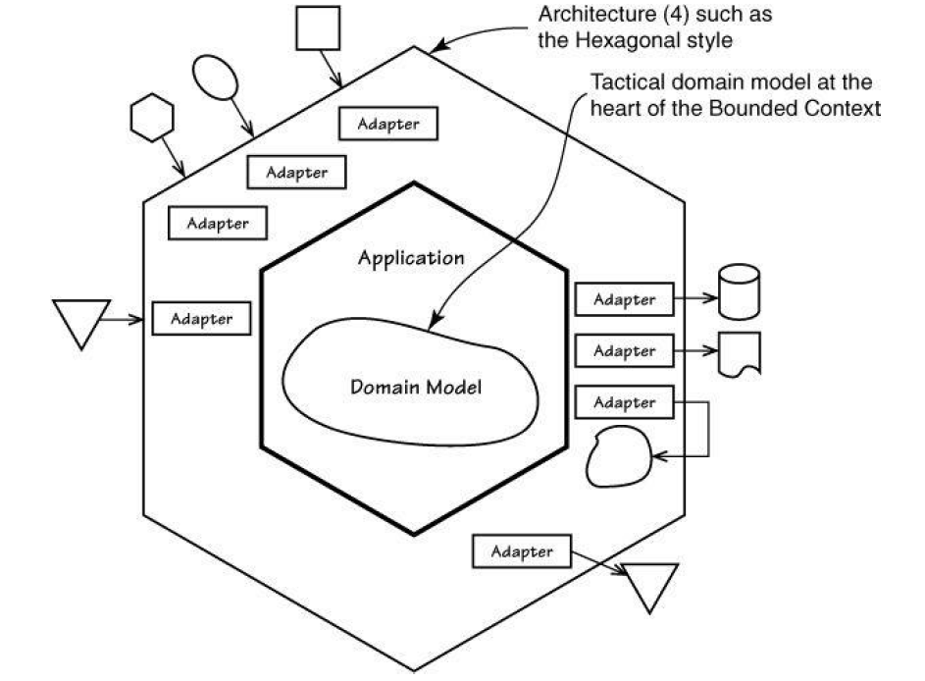

Slide 12
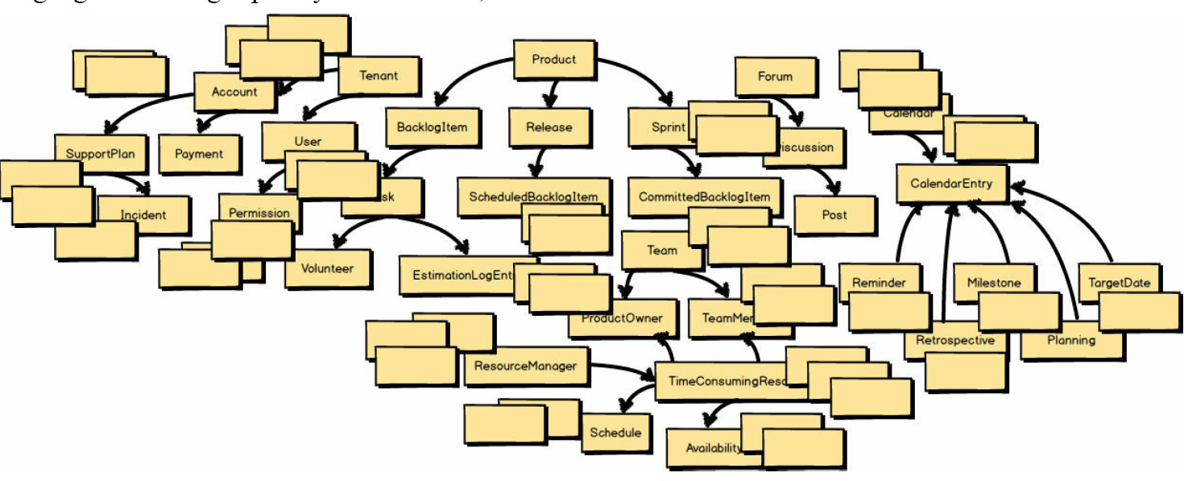
Non DDD Applied

Slide 13
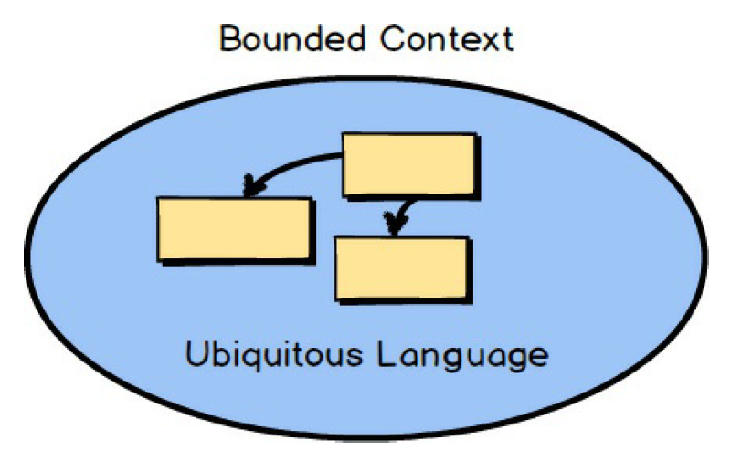
Bounded Contexts: Linguistic Boundary
Give meaning to your software model
Put your all relational models in same linguistic boundary
Define a ubiquitous language

Slide 14
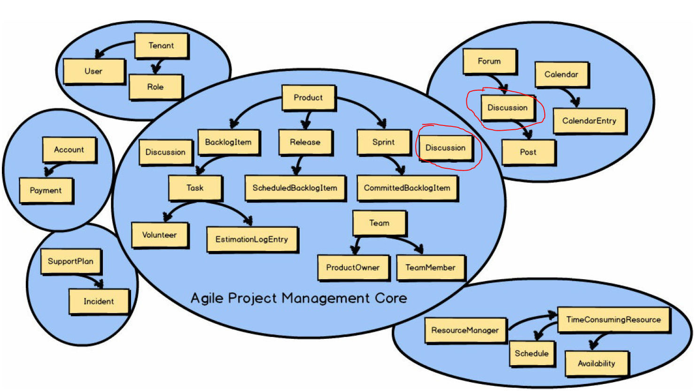
DDD Applied

Slide 15
Aggregate Roots
Handles the business of Entities and invariants
Core parts of your BoundedContext
Aggregate Roots should/can know each other only and only through their Id’s.
Manipulate one AggreateRoot in one UnitOfWork/Transaction Scope
If you need to talk other Aggregate Root then use Messaging/Eventing system. Otherwise if your coupling needs to put that relation under one Application Service method/Uow Scope then consider your modelling→
Otherwise your modelling is wrong.
If you smelled your modelling is wrong, then Re-Think.
Aggregate Roots & Entities must be persistence agnostic!
Because Aggregate Roots should be eventually consistent parts of your domain.

Slide 16
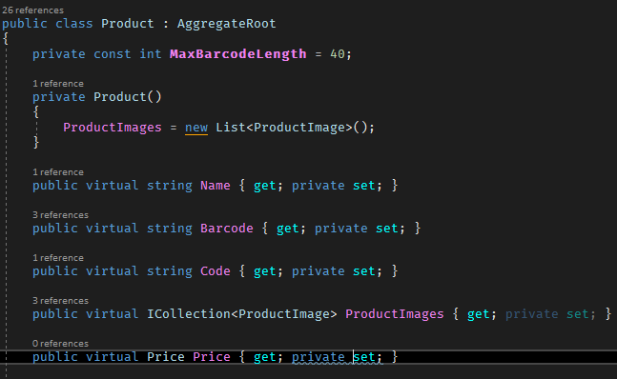
Aggregate Roots
Aggregate Roots can consists more than one Entities and ValueObjects
Base class for Events & Id
Value Object Of AR
Entity collections of AR

Slide 17
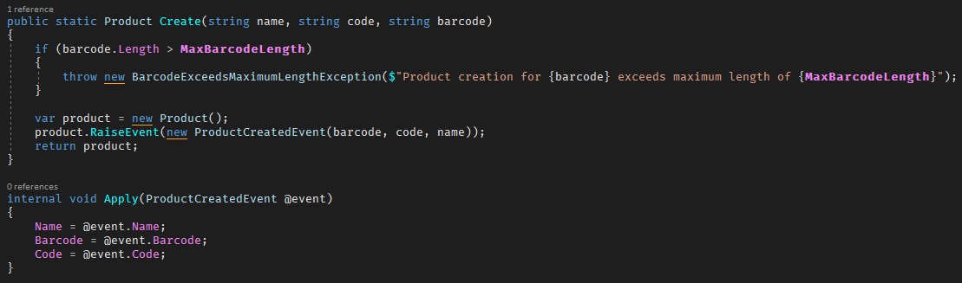
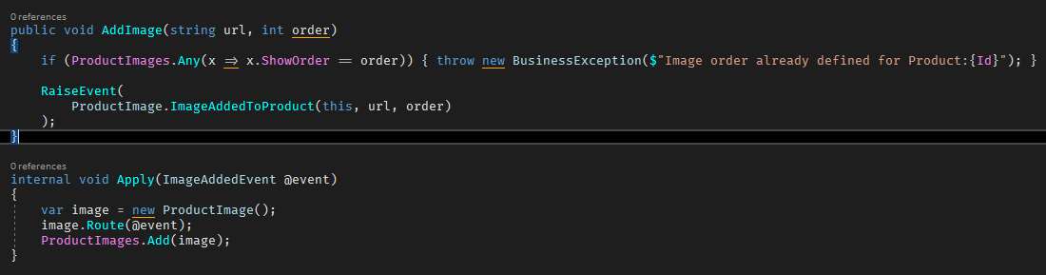

Slide 18
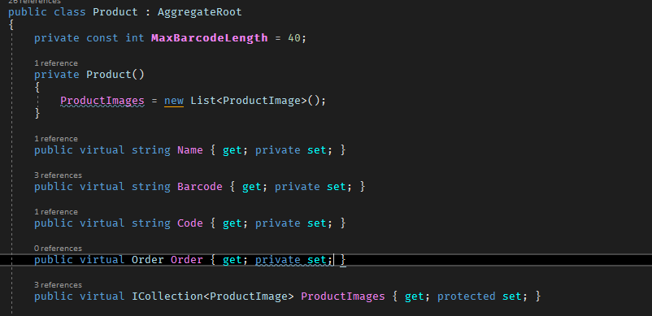
Aggregate Root Mistakes: Referring
public virtual int OrderId { get; private set; }

Slide 19
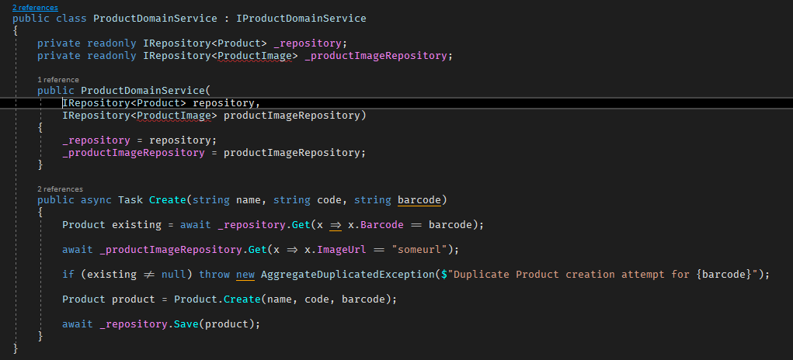
AR Mistakes: Entity Repo Injection

Slide 20
Entities
Have an identity which remains the same throughout the states of the software
Components of Aggregate Roots
Does not mean anything without its Aggregate Roots
AggregateRoot manages the Entities and AR is responsible for validate it.
Mutable(Attributes can change)
Should have business logic
Should be persistence agnostic

Slide 21
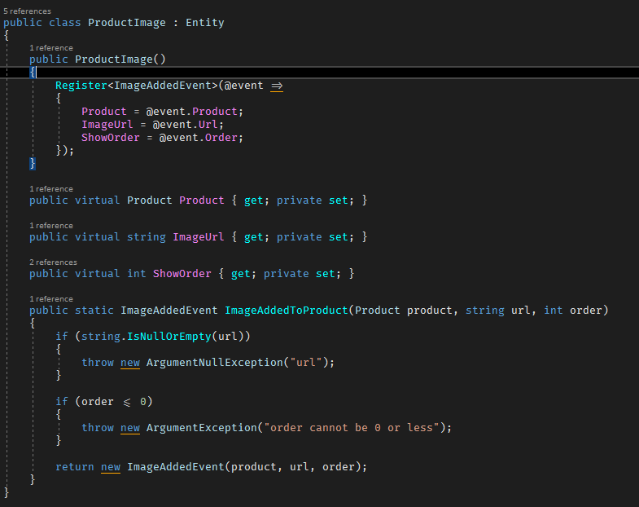
Sample Entity
Base class for Entity Behaviour with Id
When AR creates an Entity
Aggregate Root reference

Slide 22
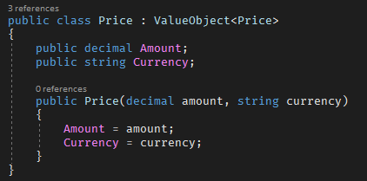
Value Objects
Immutable objects(Attributes can’t change, only replace whole)
Have no identities
Only purpose of describing some attributes of Aggregate Roots

Slide 23
Application Services
Use Cases/Capabilities of your Bounded Context
Manages the Transaction (Opens UoW)
Knows Infra(EmailSender, Queue, Authorization etc...)
Does not contain any business logic, does not hold any state!
Coordinates commands and behaviours of DomainServices.
Does not return never ever Domain objects to outside world! Only returns Data Transfer Objects(DTO)

Slide 24
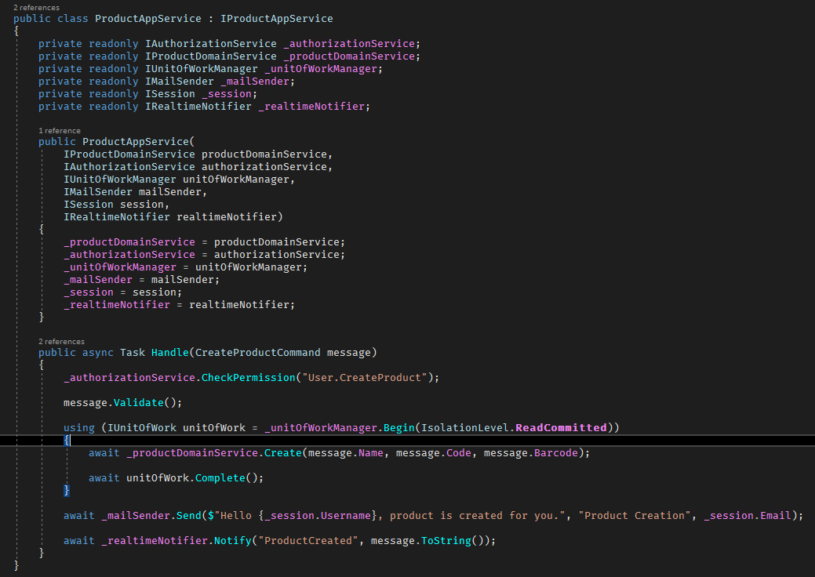
No DTO passing, just primitives or Domain Objects allowed
Transaction management
Domain Interaction
Infra & Messaging & Mailing

Slide 25
ApplicationService Mistakes
Leaked business logic from the DomainService
Utility, Helper, Provider driven coding intention
Over abstraction, Over Reflection and other bullshits...

Slide 26
Domain Services
Hearth of the domain
Interacts only domain objects(ARs, Entities, ValueObjects) and primitive types(decimal,int, string etc...)
ApplicationServices must not pass any DTO objects to DomainServices
Handles only business and domain objects states
Persistence agnostic(Does not know any DbContext or Nhibernate Session)

Slide 27
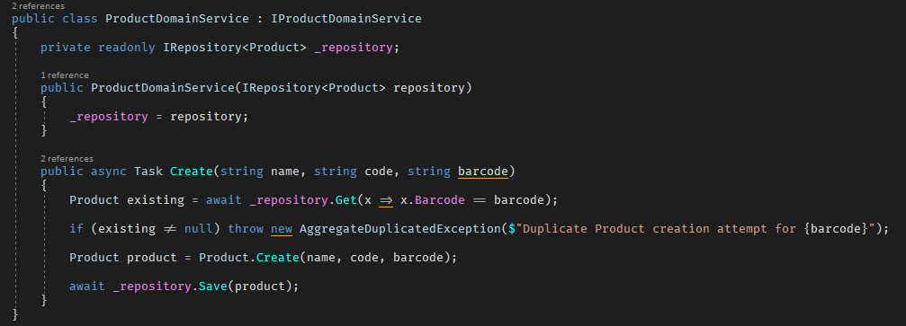
Domain Services
Repository Injection
AR Creation Responsibility
Persistence Agnostic

Slide 28
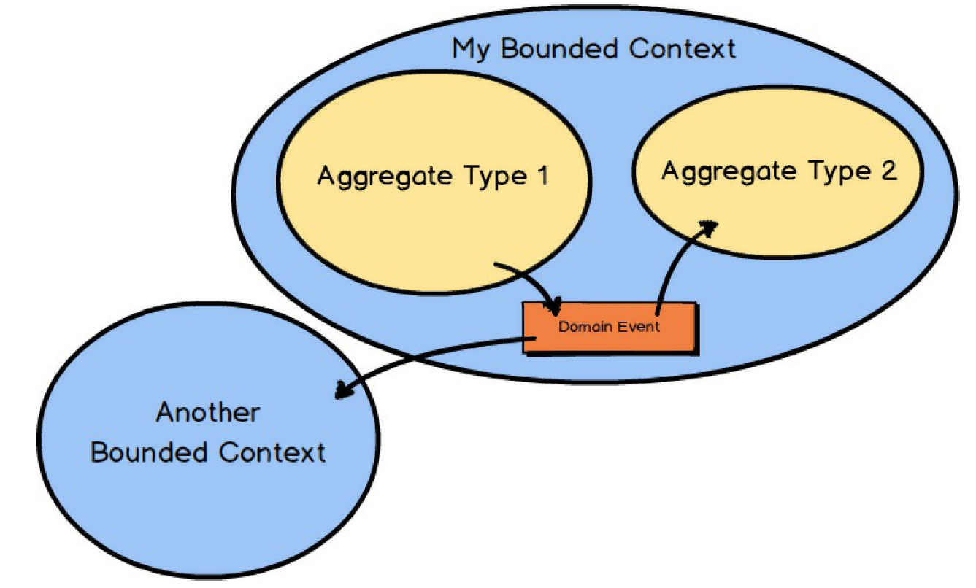
Two Bounded Context

Slide 29
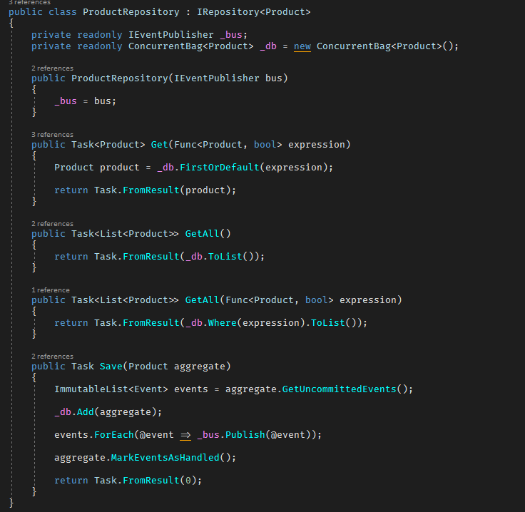
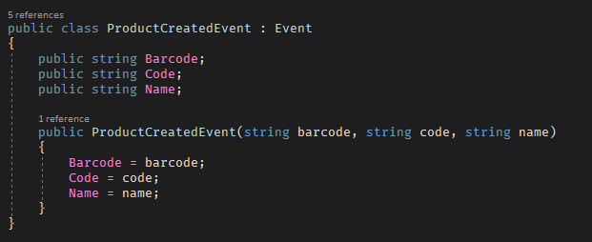
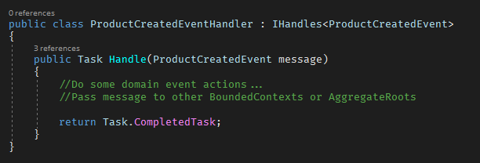
DomainEvents

Slide 30
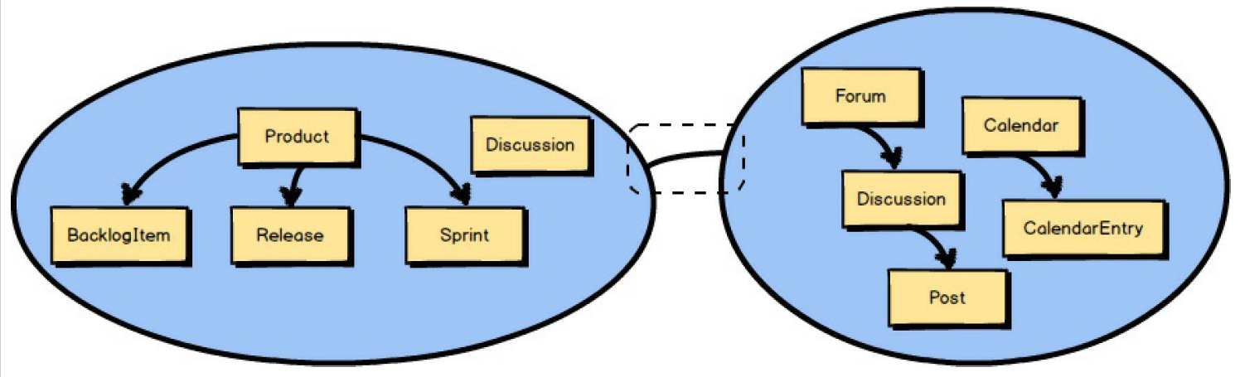
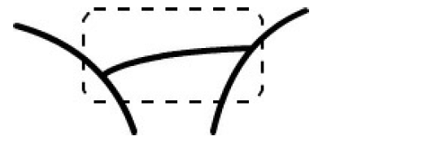
Communication Between Bounded Contexts

Slide 31
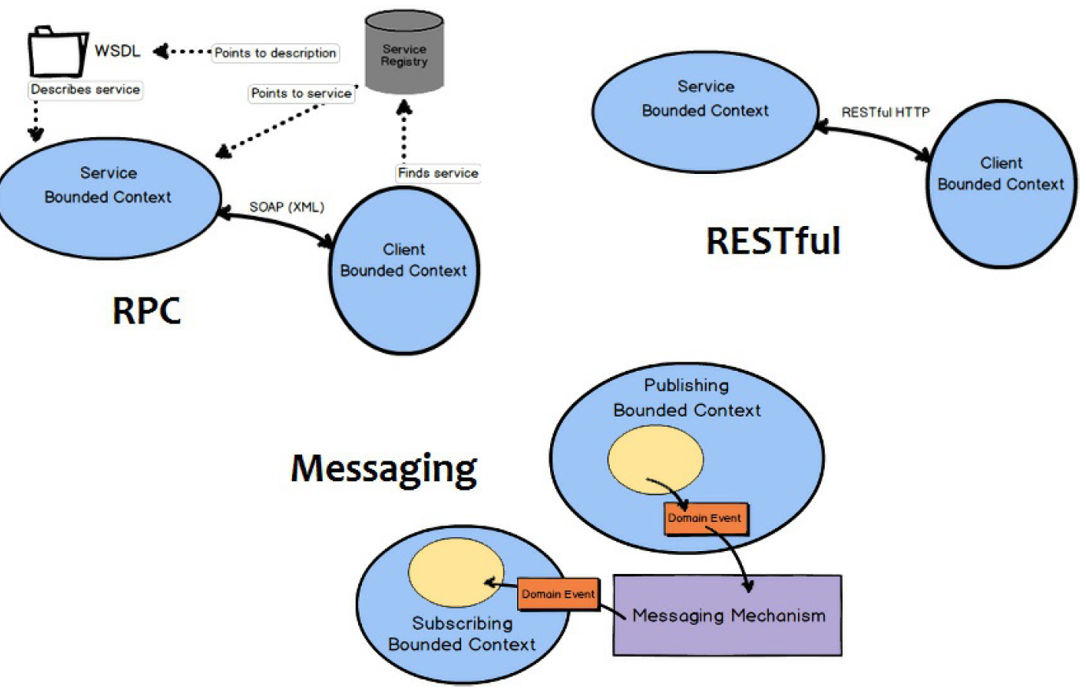
Robust Way of Communication:Messaging

Slide 32
Discussions & Consolidations
Persistence Ignorance
Not Database/ORM Driven Design, but Domain Driven Design!
Bounded Contextes
Entities should not be re-used between contextes even they represent same database table.
Aggregate Roots
Responsible for it’s own validity and integrity.
Can refer other Aggregates by only reference (by their id).
Should go over aggregate root to access an aggregate member.
Should be retrieved as a whole object (including collections) from repository (or support lazy load).
Applications
Create application layer per application (UI).
How to managing exceptions?
Infrastructure Exceptions (database connection… etc.)
Application Exceptions (like a null value sent to a method)
Authorization & Validation Exceptions
Domain Exceptions (business rules and validations)
Presentation logic vs application logic vs domain logic.
Validation
UI validation
DTO validation
Business validation
Application Service vs Domain Service
Write Model - Read Model / Reporting
DDD is mostly for changing the state, not reporting!

Slide 33
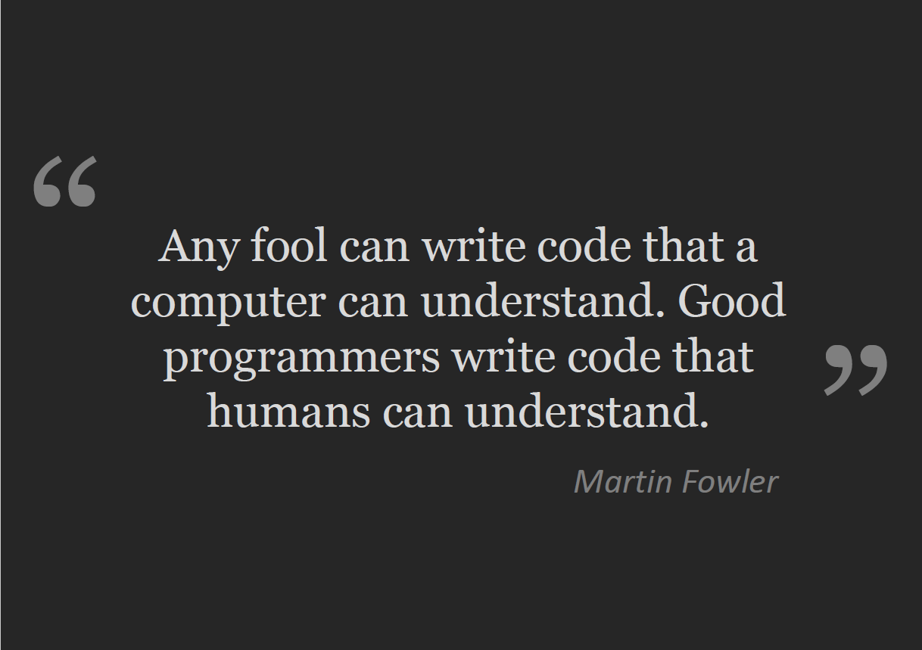

Slide 34
Thanks!
Source Code: https://github.com/osoykan/Samples/tree/master/DDDCourse
Oğuzhan Soykan

