Slide 1

Cake Build
Oğuzhan Soykan
Notes:
Instead, we are here to talk about Cake, the cross platform build and orchestration tool.
Some history/information
- Open Source
- Supports the most common tools out of the box
- Cross Platform (Windows OS X Linux)
- Small but slowly growing
- 387+ Pull Requests
- 50 Contributors
- About 38 third party addins
- 550 Stars
- 40000 downloads

Slide 2

Notes:
Sorry, but we are not here to talk about Cake of the edible form…

Slide 3
Definition…
“Cake (C# Make) is a cross platform build automation system with a C# DSL to do things like compiling code, copy files/folders, running unit tests, compress files and build NuGet packages.”
Reference
http://cakebuild.net/
Notes:
Built using Roslyn, and the Mono Compiler, allowing execution on both Windows, OS X and Linux
Script Processing to make sure things work the same on both

Slide 4

What is Cake? (http://cakebuild.net/)
Build automation system
C# Make (F# - Fake, Powershell - psake, …)
Learn a new language ☹
.NET shop
Built on top of Roslyn and Mono
Cross Platform
Detailed documentation
Built-in methods for common operations (C# DSL)
Build agnostic from Build Server

Slide 5
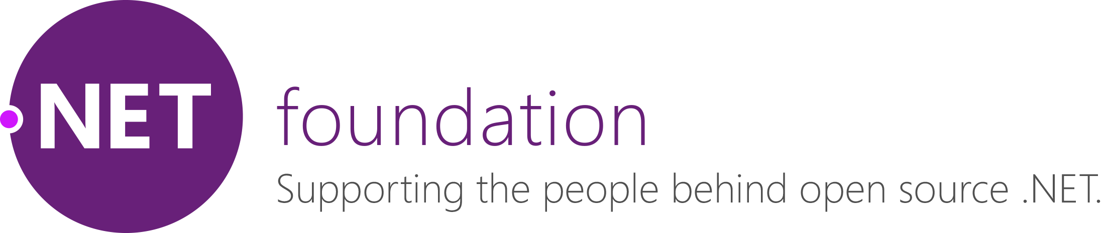

Slide 6
What are the main philosophies of Cake?
Non intrusive
It should “just” work
Be highly configurable
No binaries should be checked into your repository
Easy to implement your own tools
Build should behave the same way regardless of
Operating System
Environment

Slide 7






How does Cake work?
nupkg
Exe
Msi
Tests
Anything you can think of
build.cake
cake.exe
Arguments
Configuration
#tool
#addin
#reference
#load
Roslyn
or
Mono

Slide 8
Typical Build Workflow
Package Restore
Clean
StyleCop
FxCop
Build
DupFinder
InspectCode
Unit Tests
Test Coverage
Package
Publish
Notes:
Cake creates a Directed acyclic graph of each of the tasks
Makes sure that each task is only run one

Slide 9
What Tools am I able to use with Cake?
Roundhouse
GitReleaseNotes
ReSharperReports
ElasticLoadBalancing
Orchard
XCode
GitVersion
CloudFront
FluentMigrator
OctopusDeploy
DocFx
Npm
Wyam
DupFinder
Chocolatey
Xamarin
ReportUnit
Gulp
OpenCover
IIS
CMake
ILRepack
InspectCode
MSTest
Kudu
WebDeploy
XdtTransform
Slack
Yaml
GitLink
SpecFlow
DotCover
XBuild
GitReleaseManager
PowerShell
StyleCop
EC2
SignTool
Json
ILMerge
WiX
MSBuild
XUnit
S3
NSIS
TopShelf
Gitter
Docker
DNU
VsCode
TextTransform
NUnit
Fixie
ReportGenerator
StrongNameTool
Notes:
Black ones are built in and ship with Cake
Blue ones are those that have been created by the community
There are aliases that span across
* Unit Testing Frameworks
* Test Coverage
* Static Code Analysis
* JavaScript Runners
* Documentation Generators
* Chat Systems
* Publishing

Slide 10
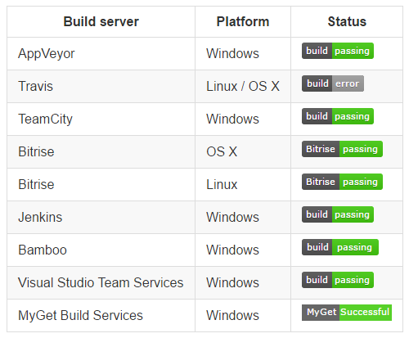
Cake on…
8 different CI Servers
3 different operating systems

Slide 11
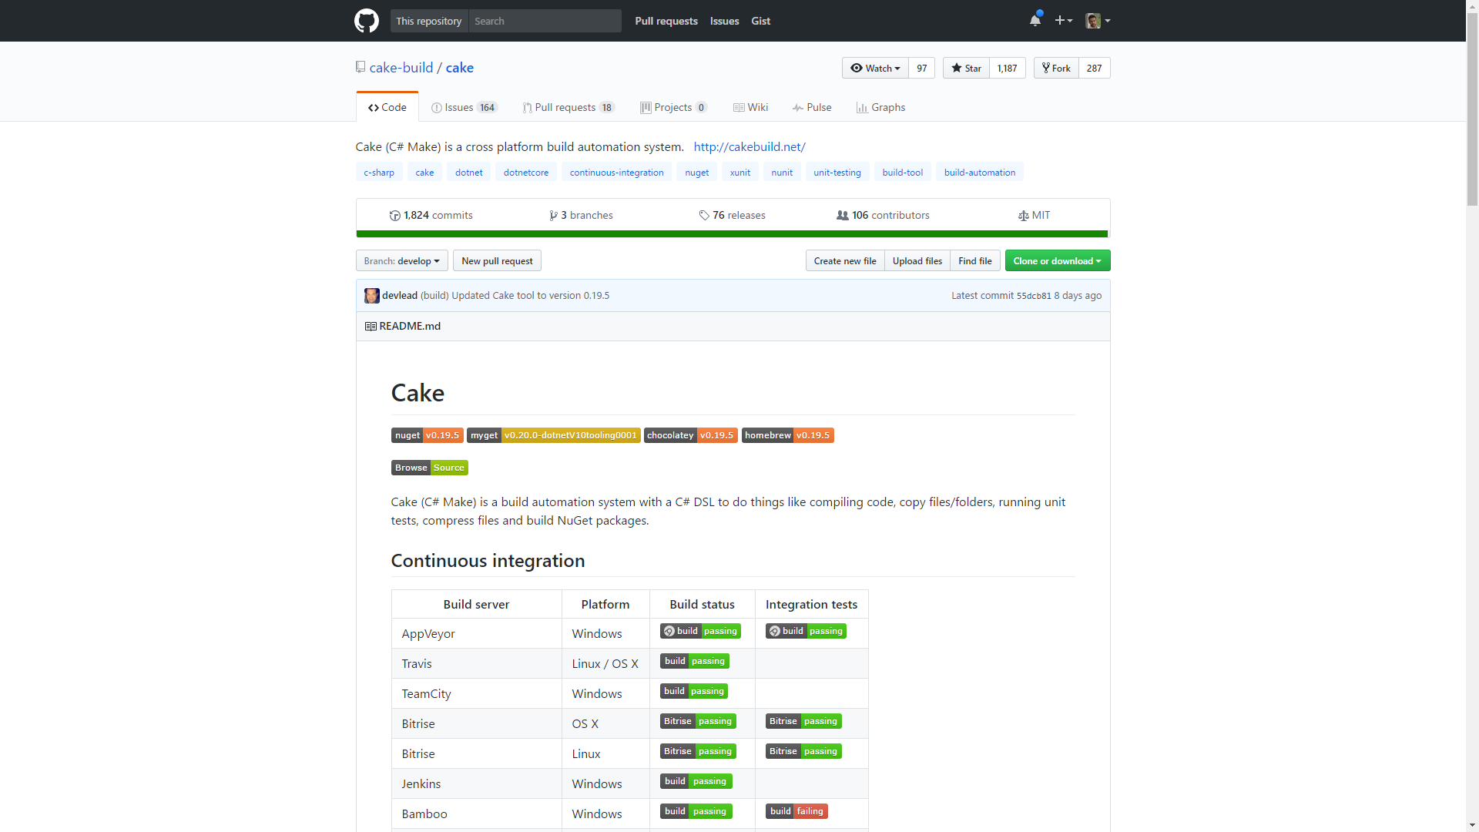
Open souce – healthy community

Slide 12
















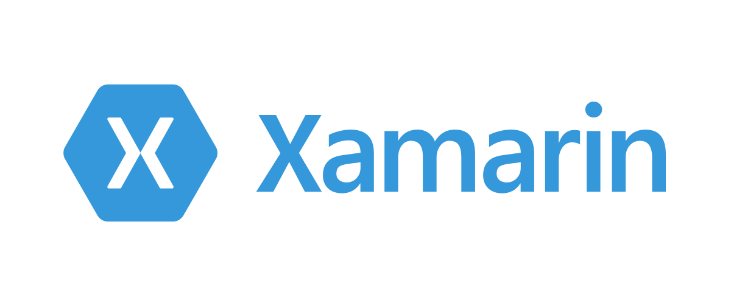


Slide 13
C# DSL

Slide 14
Task
Task("Clean")
.Does(() =>
{
CleanDirectory(buildDir);
});

Slide 15
Dependencies
Task("Clean")
.Does(() =>
{
CleanDirectory(buildDir);
});
Task("Restore-NuGet-Packages")
.IsDependentOn("Clean")
.Does(() =>
{
DotNetCoreRestore("./src/");
});

Slide 16
Criteria
Task("Deploy")
.IsDependentOn("Run-Unit-Tests")
.WithCriteria(TeamCity.IsRunningOnTeamCity)
.Does(() =>
{
});

Slide 17
Error Handling
Task("Deploy")
.Does(() =>
{
}).OnError(exception =>
{
// Handle the error here.
});

Slide 18
Setup and Teardown
Setup(context =>
{
// Executed BEFORE the first task.
});
Teardown(context =>
{
// Executed AFTER the last task.
});

Slide 19
Arguments And Environment Variables
var octopusDeployPackageName = Argument("octopuspackagename", "WebApp");
PS c:\> .\build.ps1 -ScriptArgs ‘-octopuspackagename=“MyWebApp”’
var octopusDeployPackageName = EnvironmentVariable("octopuspackagename") ?? "WebApp";

Slide 20
Build workflow
Clean
Test Coverage
Package
Package Restore
Build
Run Unit Tests
Deploy
ASP.NET Core
Octopus Deploy
nuget
xUnit.net

Slide 21
Build workflow
Clean
Test Coverage
Package
Package Restore
Build
Run Unit Tests
Deploy

Slide 22
How I do it?
GIT / Visual Studio Team Services
TeamCity
Octopus Deploy
nuget
npm
msbuild
xUnit V2
Gulp
Jest
SpecFlow

Slide 23
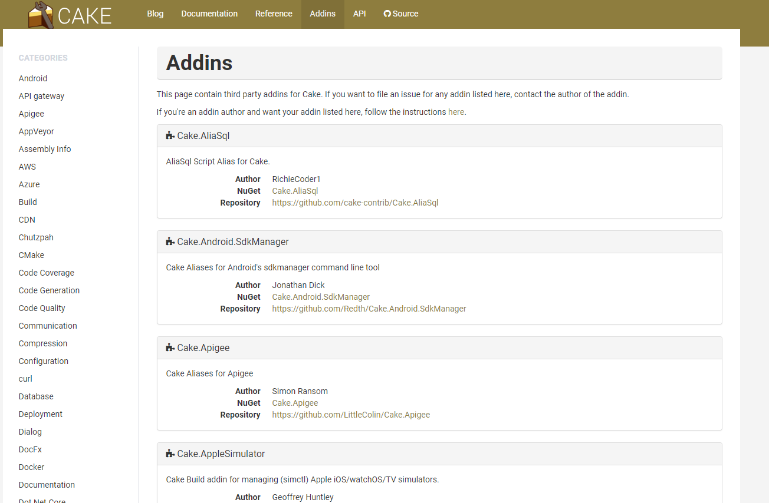
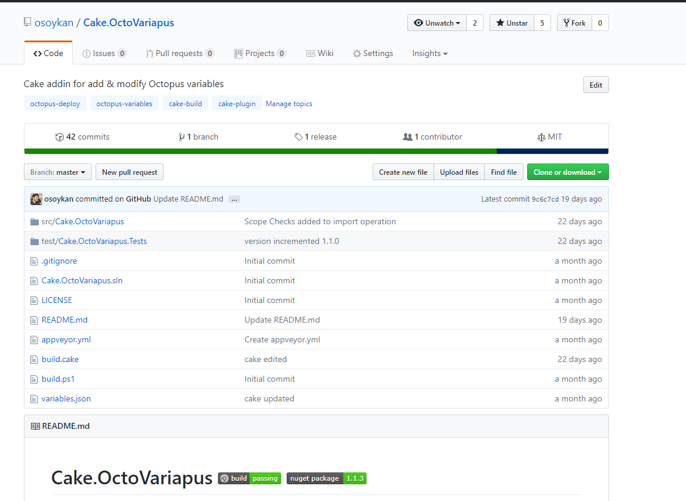
Addins

Slide 24

Extensions: Atom
Syntax Highlighting

Slide 25
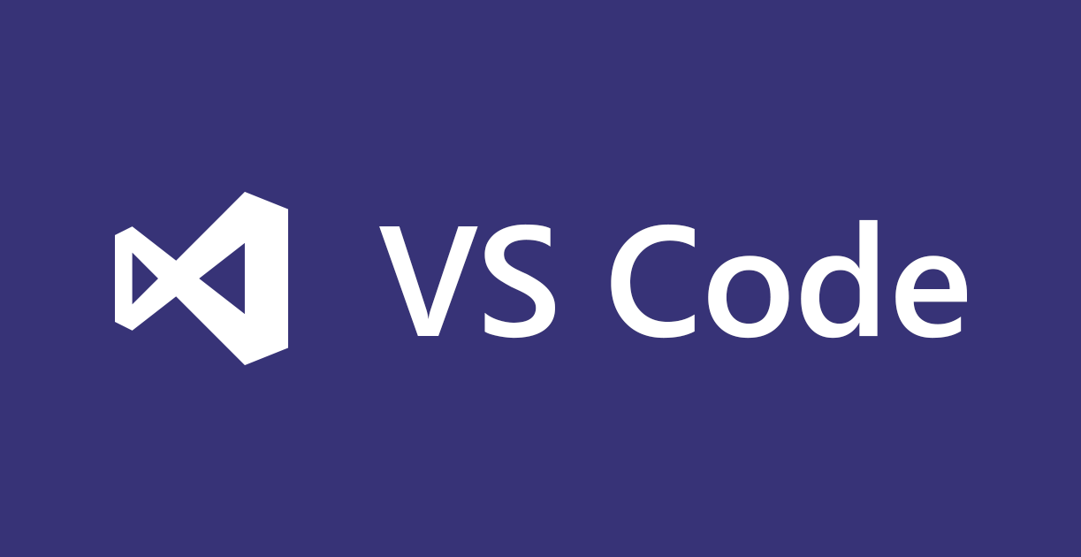
Extensions: VS Code
Syntax Highlighting
Snippets

Slide 26

Extensions: Visual Studio
Syntax Highlighting
Templates
Task Runner

Slide 27
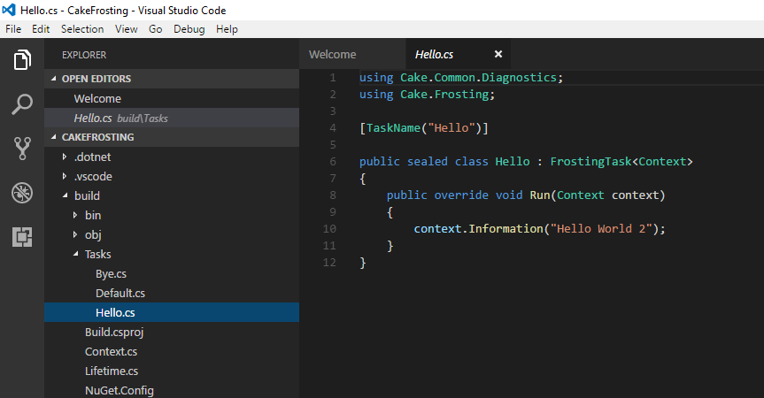
Cake Frosting
.NET Core runner and host for Cake
Build scripts as a portable console application

Slide 28

Intellisense

Slide 29
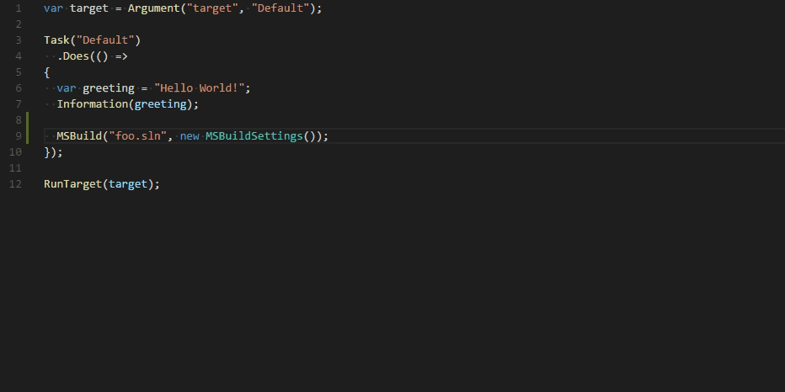
Intellisense

Slide 30
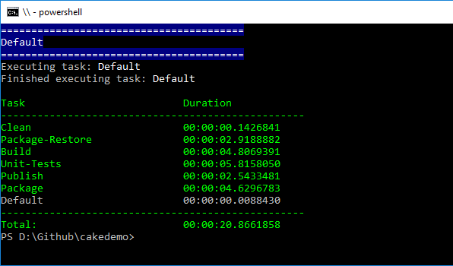
Wrapping up
Versioned Build Script
Use your C# Super Powers
Cross Platform
Extensible
Healthy community
More than 100 addins
A piece of cake!

Slide 31
Thanks

