Slide 1

Analyze of News
What kind of news do Kazakhstanis read?
What are they more interested in?
How many people read the news?
How much time do Kazakhstanis spend on reading the news?
What worries the people of Kazakhstan the most?
How identify fake news?

Slide 2

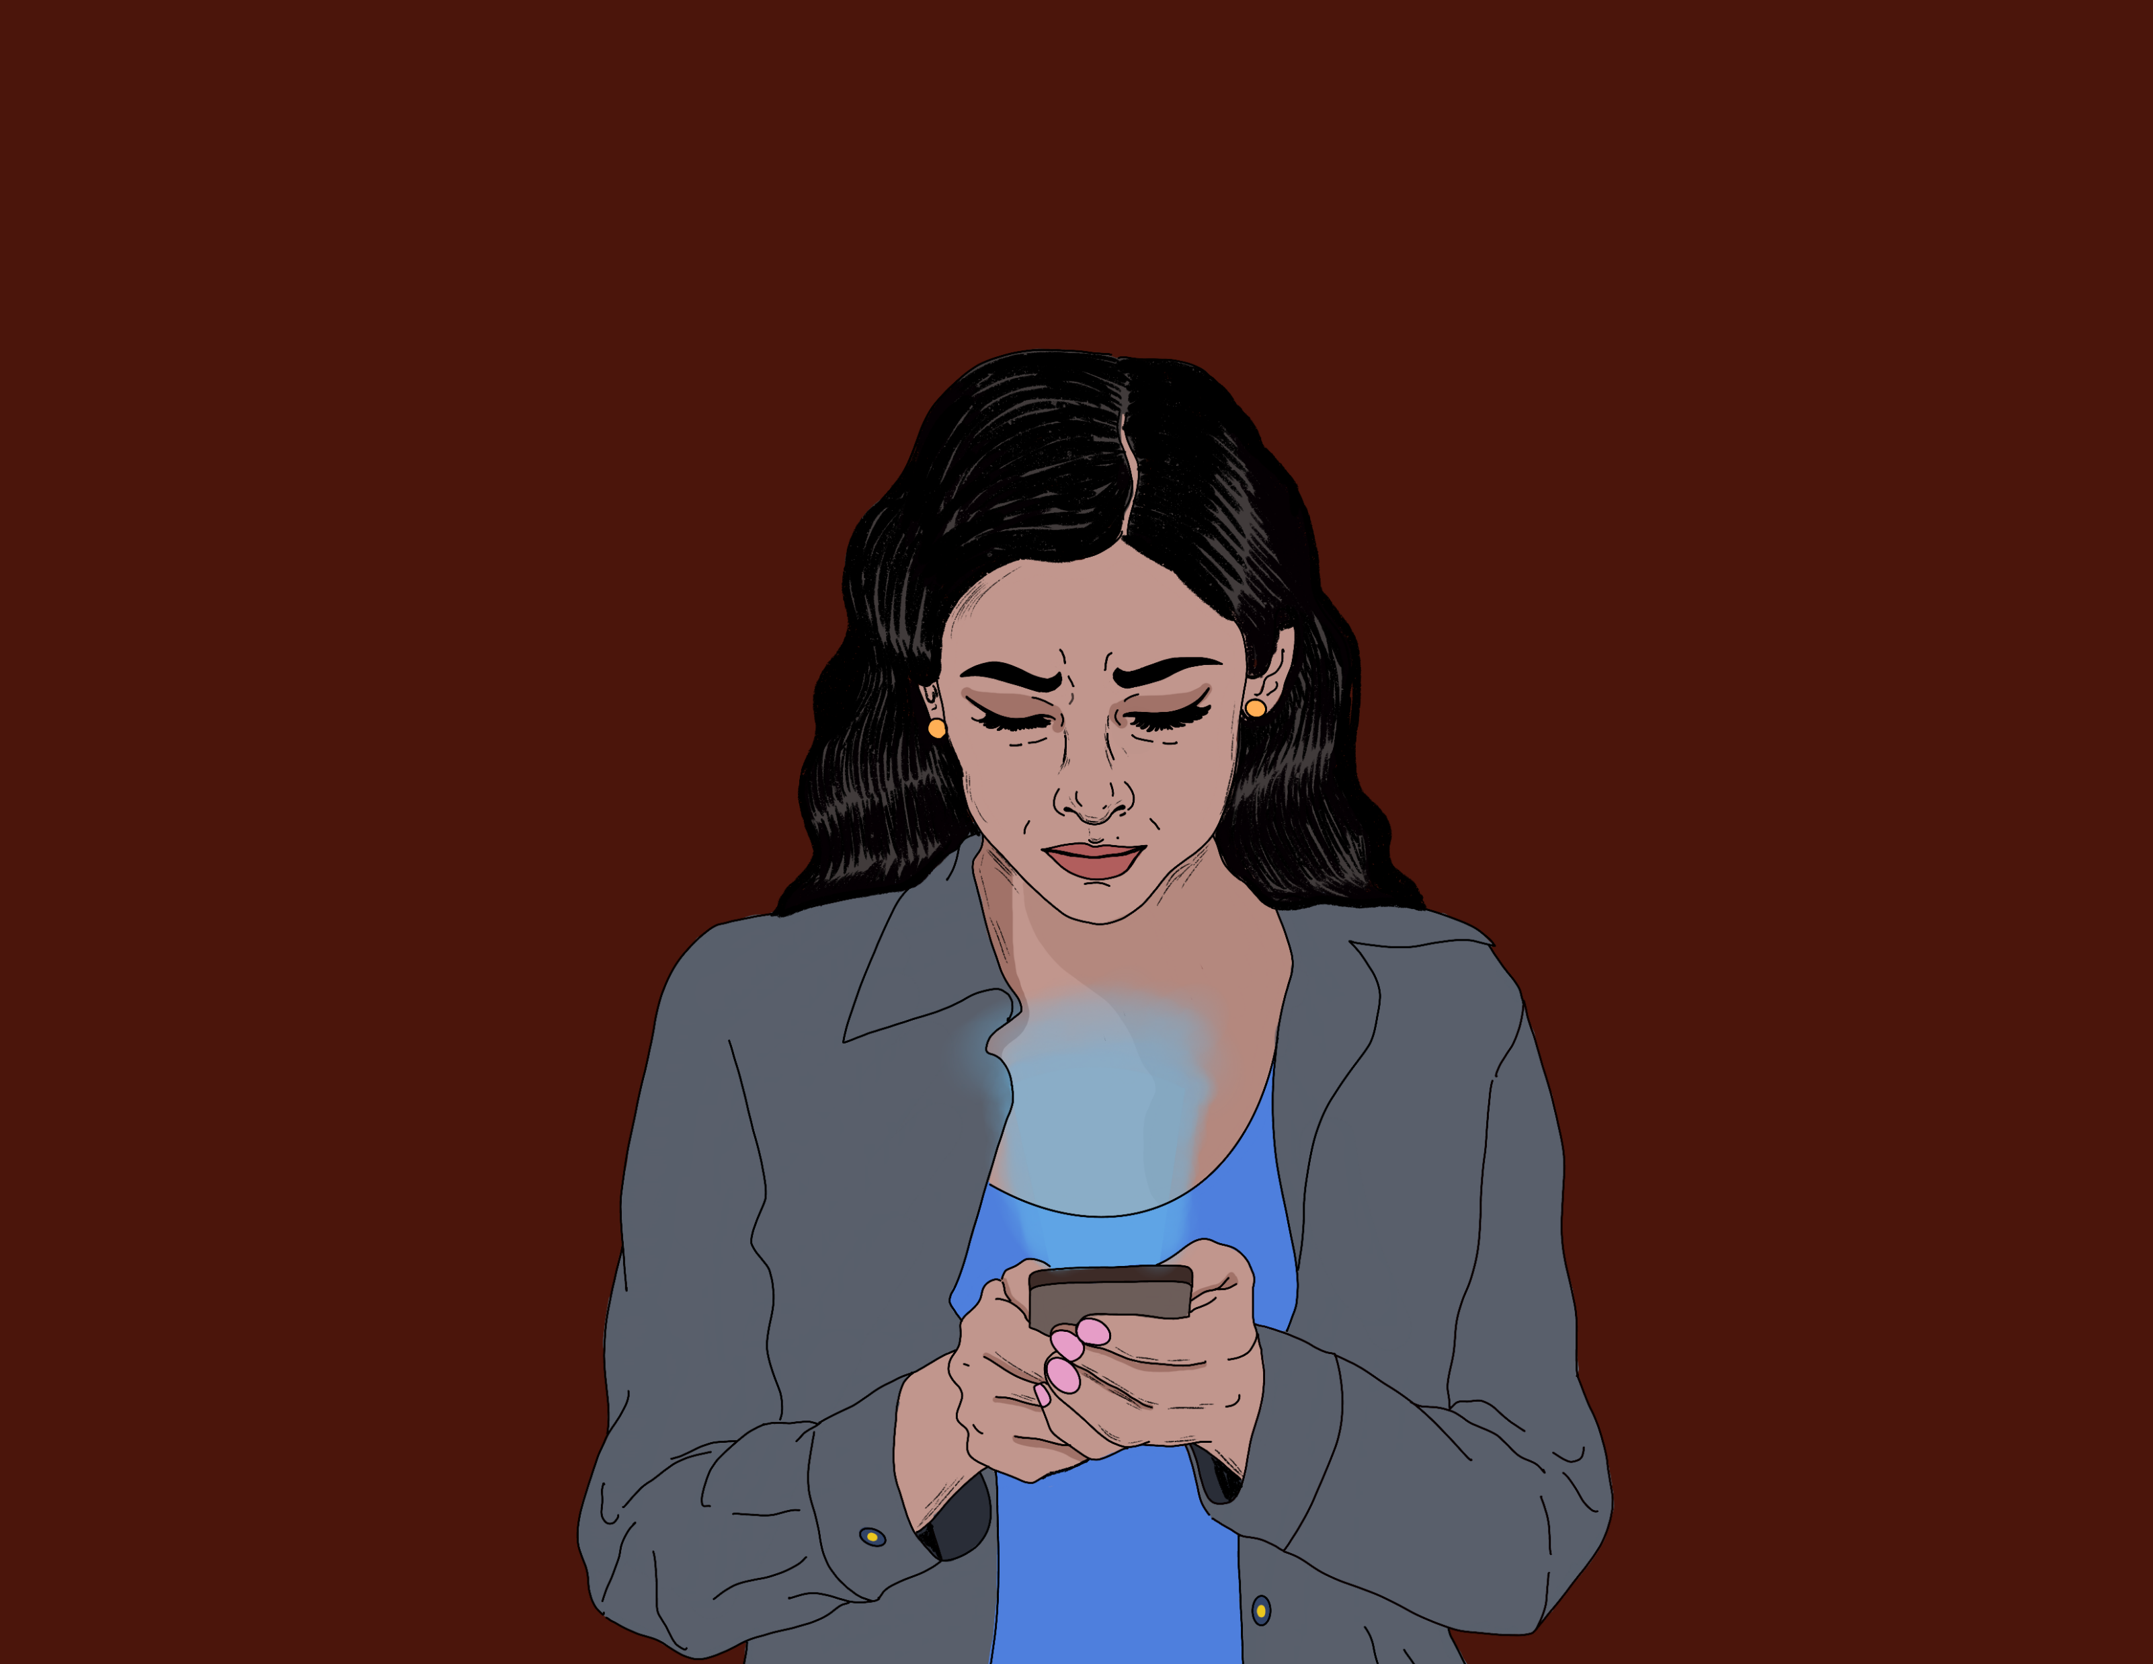

(H) Has there been more negative news than in the past in Kazakhstan? (by years)
(H) Are negative news more interesting than positive news and do they get more views? If yes, why?

Slide 3



Dataset sources:
Tengrinews
Informburo
Zakon.kz
Social Networks
International Resources

Slide 4
Methods: Parse(Title, Comments, Likes, Date, Sources(From another country Medias),Content
Categorization of News, Show Relations(cor), Most popular topic, Most liked comments, Most Spread Titles, Cosine Function( Function of Similarity Text)
Main problem(Identify and classify Russian and Kazakh words)

