Slide 1
Analyze of anomaly traffic in services KazakhTelecom
Ospanov Dulat
Karim Adilet

Slide 2
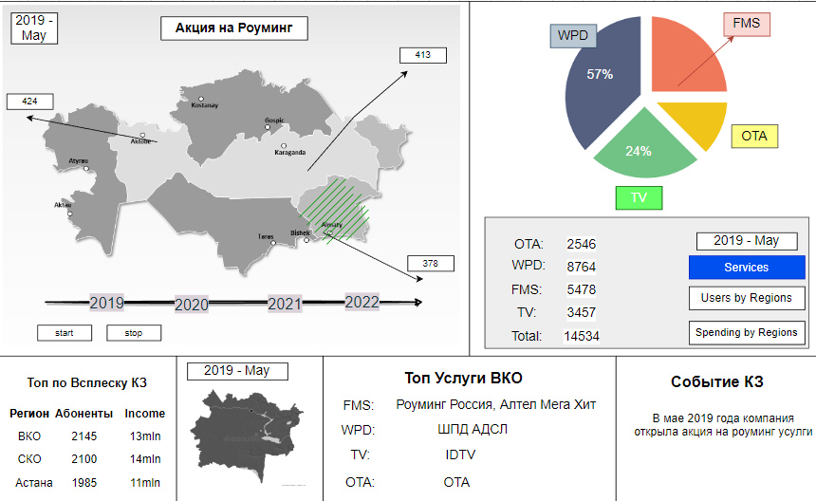


Slide 3
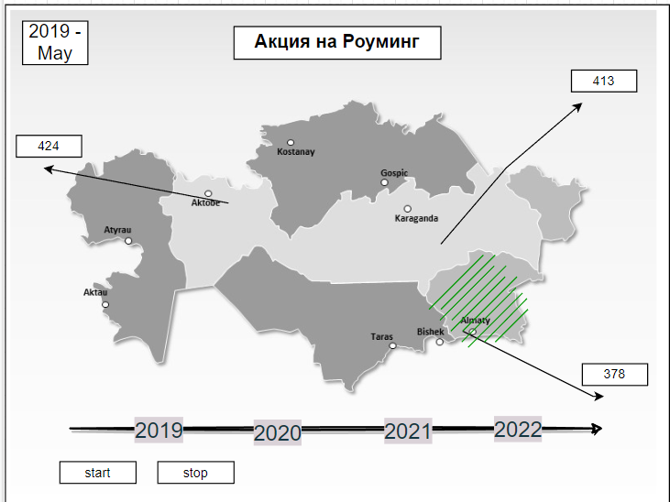
The main graph that represents important traffic information on the map of Kazakhstan

Slide 4
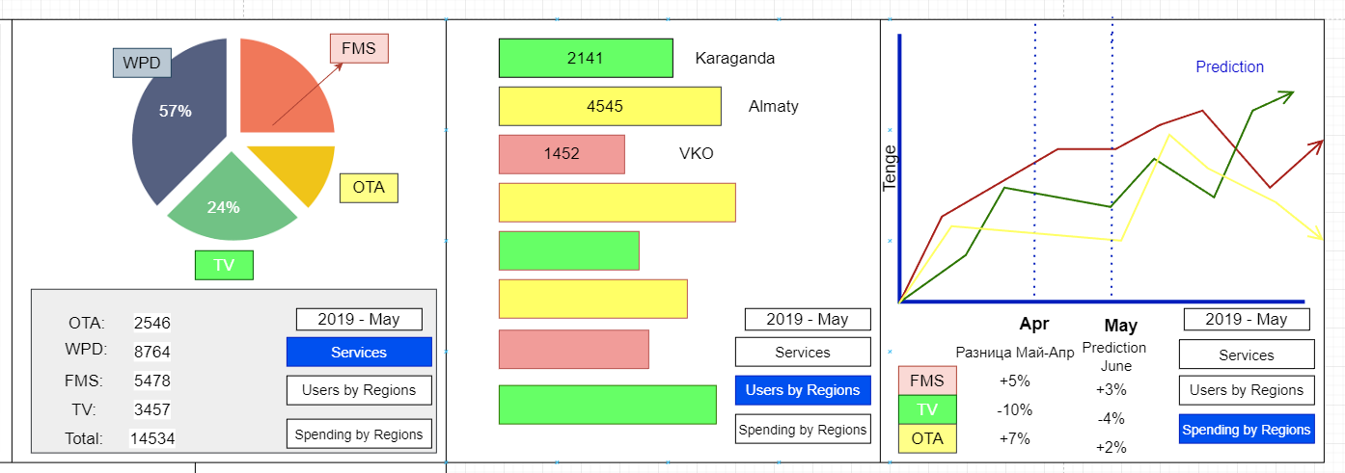
By pressing the buttons we view basic traffic information
Prediction model: Linear Regression

Slide 5
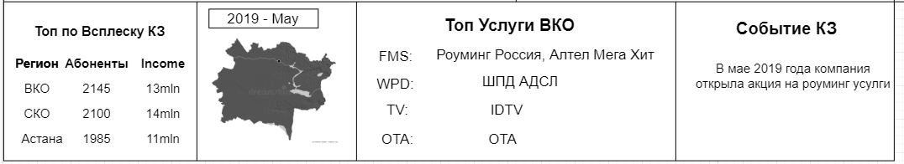
Information About higher traffic Region
Top Regions
Events that happened during...
2019 May

Slide 6
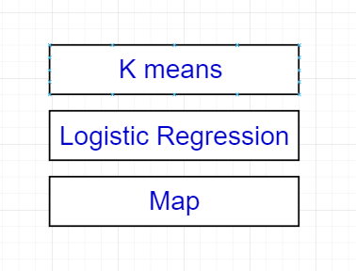
Our Hypothesis:
The number of abonents who have a high traffic depends on the regions
Events(Карантин, Акции) strongly influence the increase in traffic
If the traffic is high, it’s fraud?

Slide 7
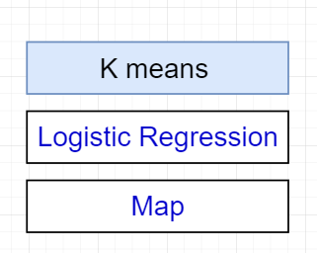
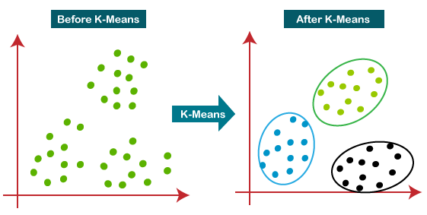
Clustering by features debit,region, event -> Will be Traffic or Not

Slide 8
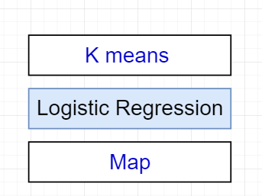
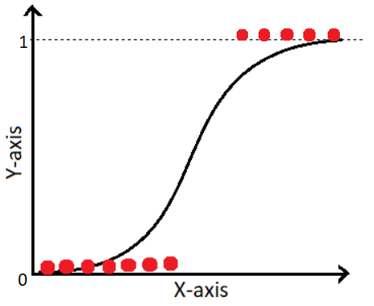
Fraud or not?

Slide 9
