Slide 1
Business Plans/Planning As a Process

Slide 2
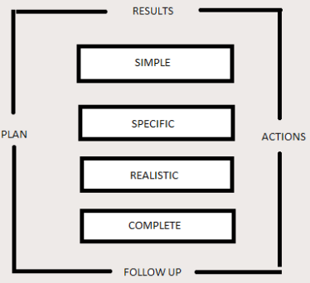

Slide 3
Elements
Simple
Is the plan simple?, easy to understand and to act on?
Does it communicate its contents easily and practically?

Slide 4
Specific
Is the plan specific?, are its objectives concrete and measurable?.
Does it include specific action and dates of its completion specific persons responsible and specific budget.

Slide 5
Realistic
Is the plan realistic?, are sales good?, expense budgets and Milestones dates realistics?
Nothing STFLES implementation like unrealistic goals.

Slide 6
Complete
Is the pan complete, requirements of a business plan vary depending on the control.

Slide 7
Uses of Business Plan
Define and fix objectives
Create regular business review and course correction.
Support a loan application
Define agreements between partner.
Set a value on a business for sale or legal purposes.
Defining a new product line promotion or expansion.
Define a new business

Slide 8
Business Plan Don’t(s)
Don’t use business plan to show how much you know about your business.
Nobody read a long winded business plan,

Slide 9
Importance of Graphics
Tables and Charts present
Information in visual formats with greater impact than words alone.

Slide 10
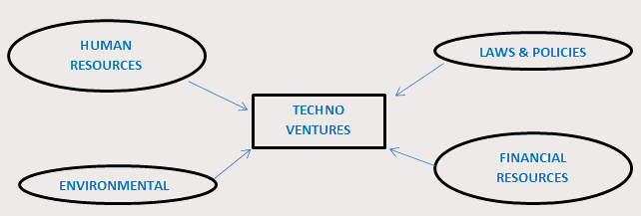
Technology Ecosystem

Slide 11
Human Resources Components
Research (Thinker, Idea Generator and Innovator)
Developers/Development (Implementer, Technical people)
Marketing People
Financier

Slide 12
Environment Component
Science parts, incubation centers
Academic Institutions, Research and Development centers
Internet Access, communication and other services
Geographic Accessibility

Slide 13
Laws and Policies
Intellectual Property Rights
Technology Licensing Office
Technology Licensing office
Legal Serviices

Slide 14
Financial Resources
Inventors
Business Sectors
Funding Agencies

Slide 15
Types of Entreprenuers
Incremental – routine business, modest novelty (New Coffee shop)
Imitative – imitation of a venture, same business model and template. (new regional branch, franchise operations)
Rent-seeking – business that utilizes standards, regulations and laws to share in value of enterprise (licensing of patented ideas, products)
Innovative – business based on innovation. (new cure for infection diseases)

Slide 16
Technopreneurship in IT Viewpoint
Hightech ventures in ICT, Electronic, Internet and Biotech. (Cisco, Microsoft, Apple, Google,Intel)
Service firms where technology is critical to their misson. (E-Bay, FEDEX, Smart Money Transfer, e-Learning)
Delivery or design high-tech products like comp hardware or devices.
Uses of technology in the delivery of conduct of normal business activities, a combination of both.

Slide 17
Three Elements of the Intellectual Capital
Human Capital – the skills, capabilities, and knowledge of the firm’s people.
Organizational Capital – the patents, technologies, processes, databases, and networks.
Social Capital – the quality of the relationship with customers, suppliers and partners.

