Slide 1
Mobile Web For Controlling Cloud

Slide 2
Some WH? on cloud controlling
What is current scenario in real world?
Which tools they are using?
What problem they are facing?
What we did?
Notes:
Before developing our application we did a little survey of existing app.
Found some major flaws in existing app and tried to overcome them

Slide 3
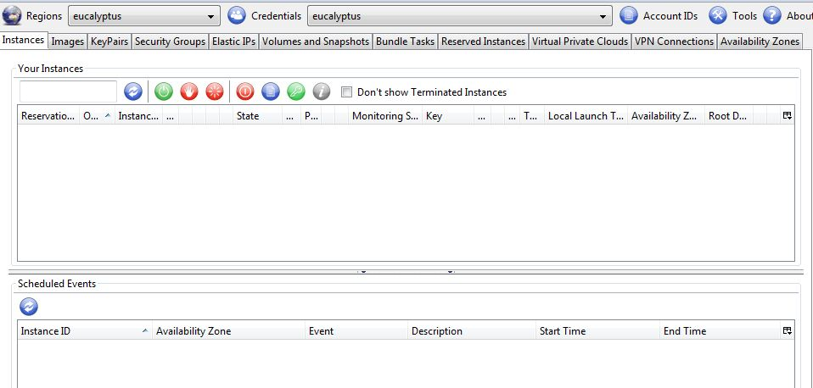
Hybrid-fox
One of the favorite tool of cloud admin to monitor cloud
Which is only supported in Firefox.
No Mobile Support, So Admin on a tour / OOTO cannot use it!
No updates from last 10 months!

Slide 4
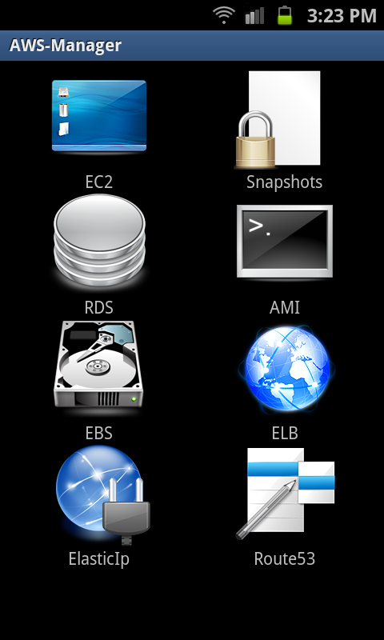
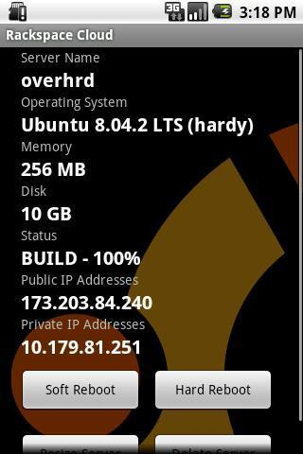
AWS Manager
Rackspace Cloud
No login Authentication. So if mobile get lost! Then cloud security will be in danger!!
Commercial and only support Rackspace based cloud

Slide 5
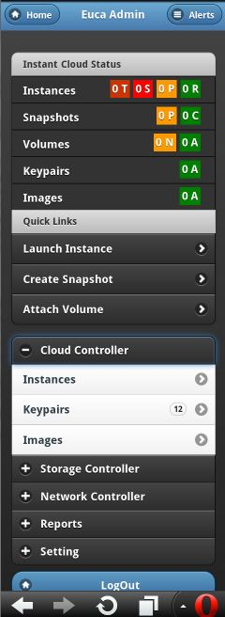
What we did?
Instant Cloud Updates
Quick links for Snapshots, Instance, Volume etc.
Tab view just like hybrid-fox so as keep Admin familiar with App
Implemented about 25 use cases
Compatible to Any Euca or AWS based cloud
Zero Server Side Config.

Slide 6
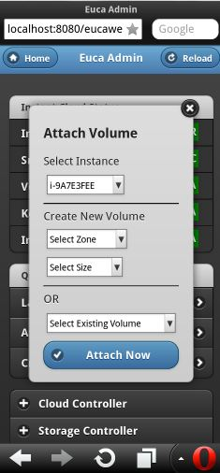
Continue..
Quick links opens pre-fetched dialog box.
Provides multiple optional use case.

Slide 7
Competitive Advantages
Immediacy - Instantly Available
Compatibility - Compatible Across Devices
Upgradability - Can Be Updated Instantly
Find ability - Can be Found Easily
Share ability - Can be Shared Easily by Publishers, and Between Users
Time and Cost - Easier and Less Expensive

Slide 8
Thank You

