Slide 1
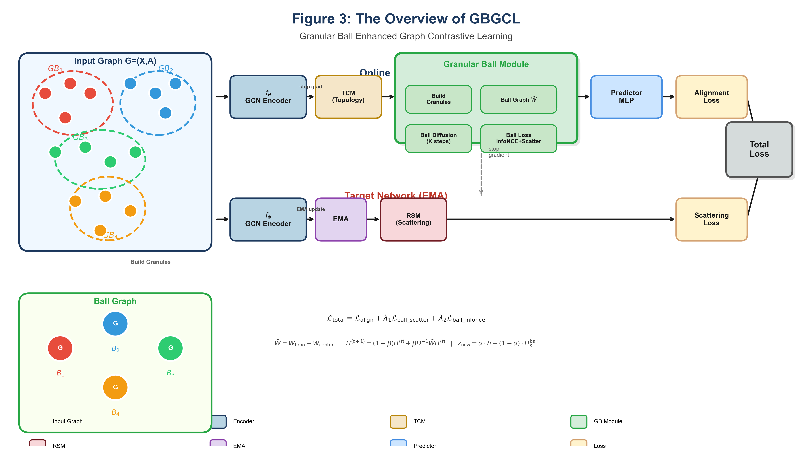
Figure 3: The Overview of GBGCL
Granular Ball Enhanced Graph Contrastive Learning
L_total = L_align + λ1·L_ball_scatter + λ2·L_ball_infonce
W̃ = W_topo + W_center | H^(t+1) = (1-β)H^(t) + βD⁻¹WH^(t) | z_new = α·h + (1-α)·H_K^ball

