Slide 1
PRE GAME
GRUPPO 10
Ambrosone Alessandro
Ciaravolo Ciro
Galasso Giorgio
Guarino Gaetano
AA 2022/2023

Slide 2

Product Funzionality
We want to produce an application that allows the user to draw a set of predefinite shape.
The user will have the opportunity to:
Add a new shape inizialized in the drawing window and saved in a local file.
Save and Load drawing
Zoom into the drawing and enable a grid
Modify a shape present in workspace changing the principals parameters.
The user can add also a string in the workspace.
GOAL:
IMPLEMENTATION OF SOFTWARE FOR GEOMETRIC DRAWING

Slide 3
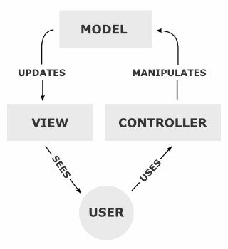
Model-View-Controller
Architectural Design
Is an architectural design pattern that divide the presentesion logic from the business logic.
Key Roles:
the model provides methods for accessing data useful to the application;
the view displays the data contained in the model and handles user and agent interaction;
the controller receives user commands (usually through the view) and implements them by changing the state of the other two components.

Slide 4
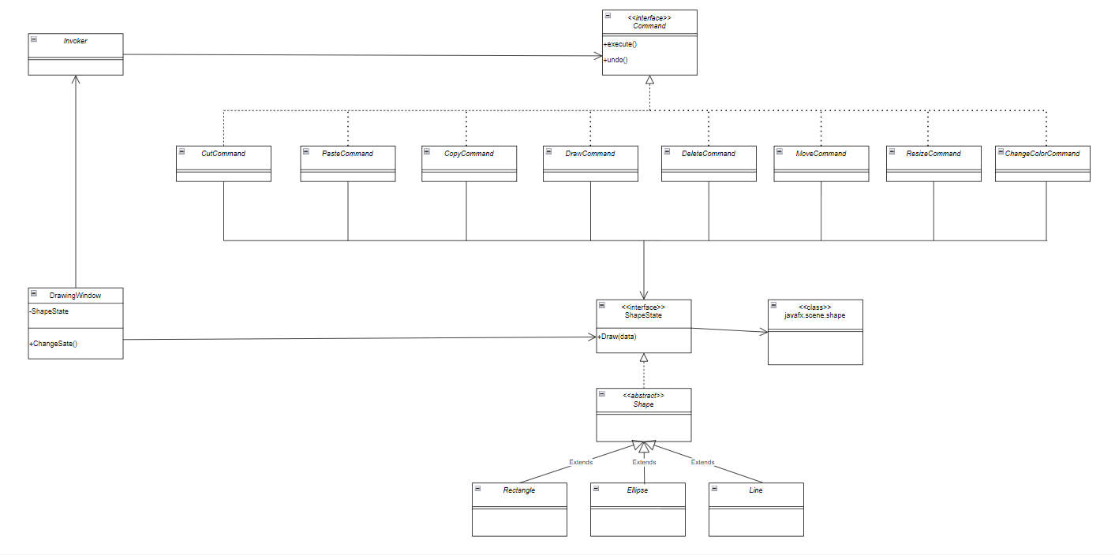
Software Architecture
This UML diagram represent the business logic.
Used Pattern
Pattern State is used for keep reference to actual program’s state and alter his behaviour when it’s internal state changes;
Pattern Adapter(object) is choosen to using java.scene.shape class with our interface;
With pattern Command we execute the several commands and implement the undo function.

Slide 5
Sprint Planning:
Project velocity estimate : 25
Straight Line;
Rectangle;
Ellipse;
Outiline color;
Interior color;
Story point
5
5
5
3
3

