Slide 1
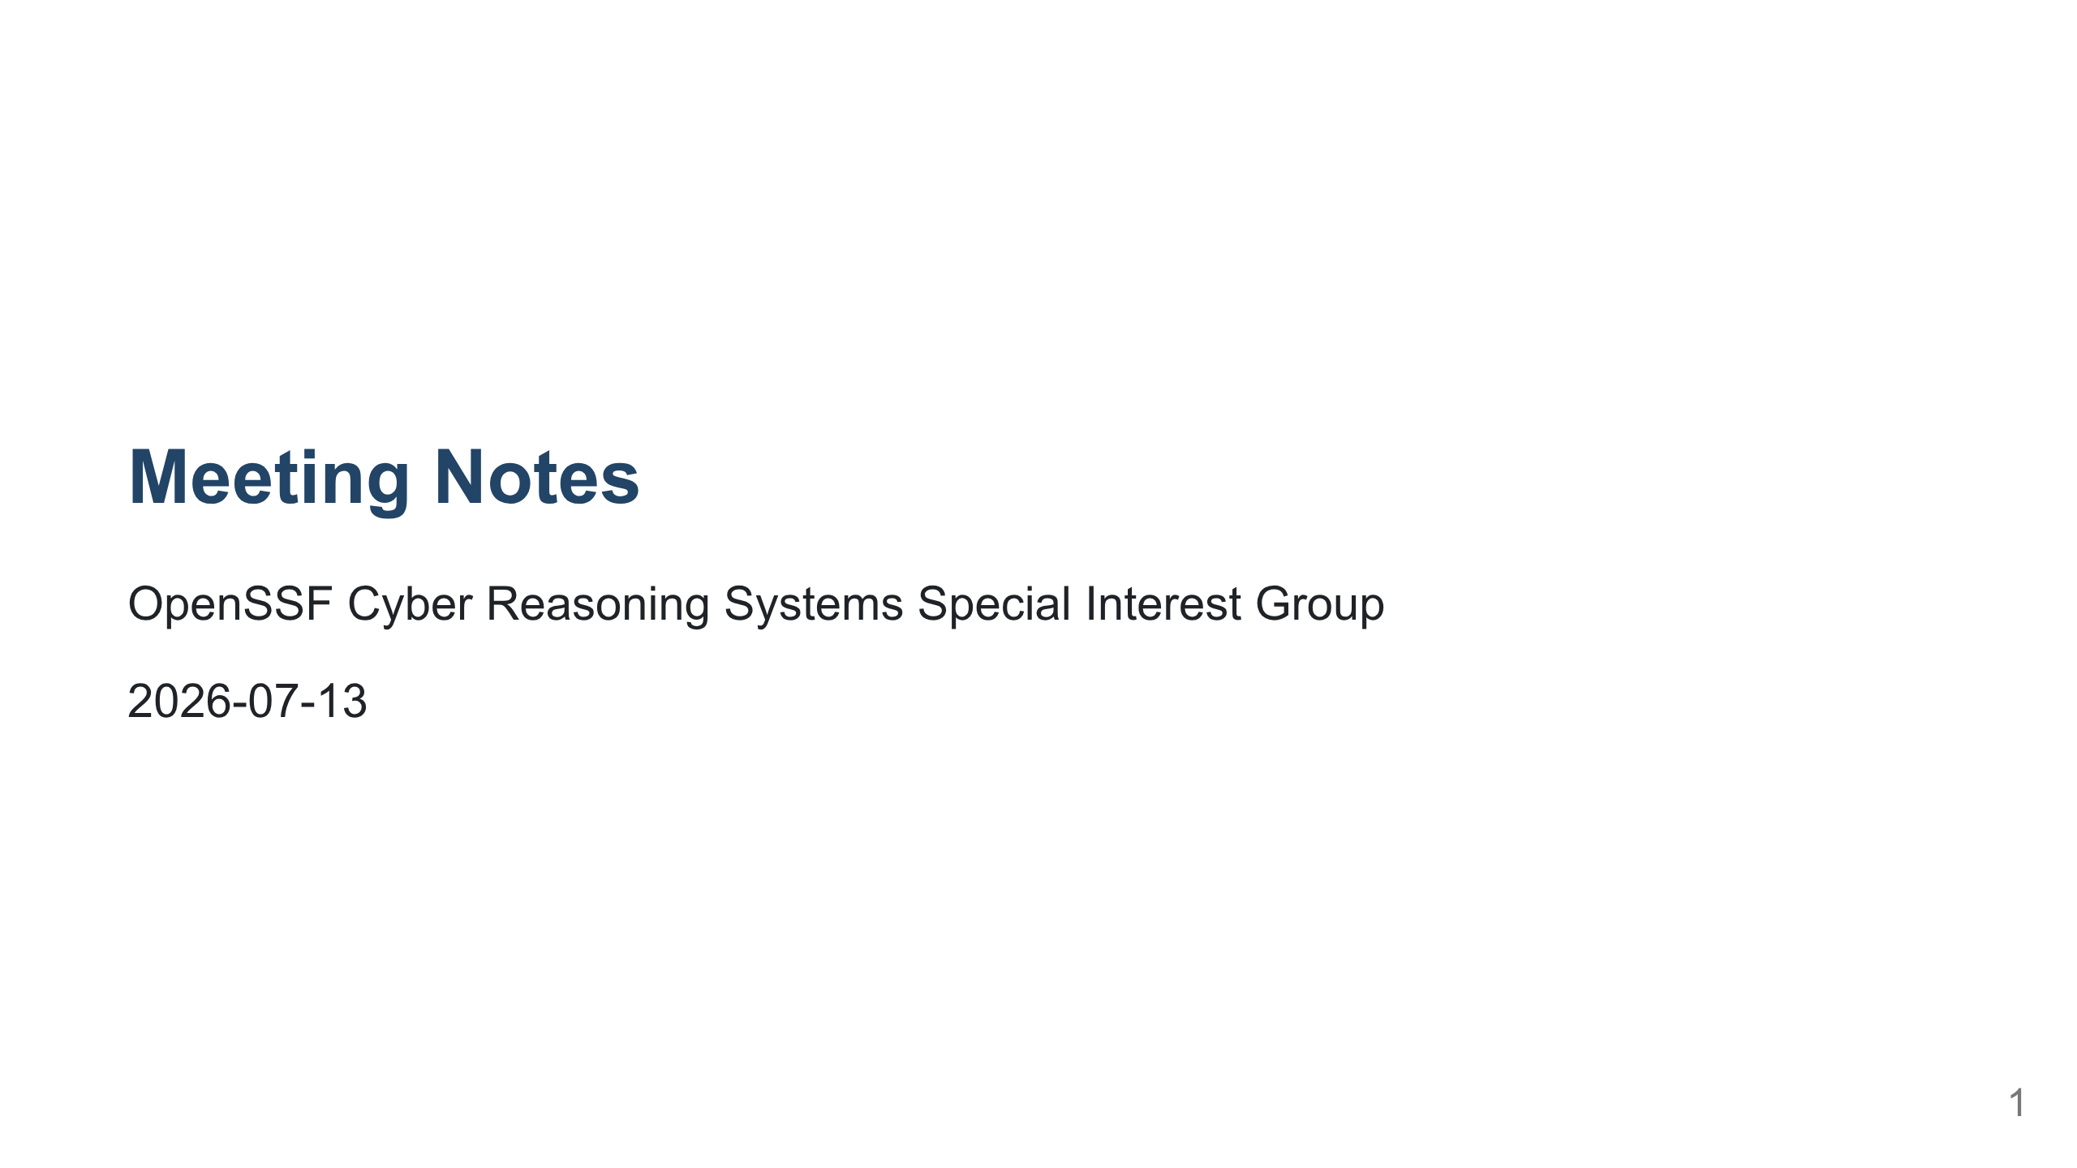

Slide 2
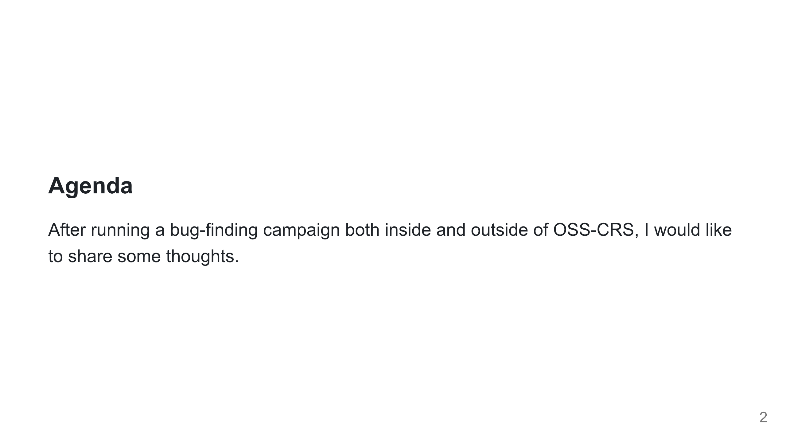
Notes:
TODO change this a bit - Bug-finding workflow - Multi-source single agent - Knowledge across time - Knowledge across tools - Bug-Fixing and Report Generation - Rust CRS - Target selection Scope: a single bug-finding agent performs quite well OSS-CRS should systemize the bug-finding agent in a way that it can be deployed against a single target, and be done hands-off Problem: store context across multiple projects Problem: store context over time

Slide 3
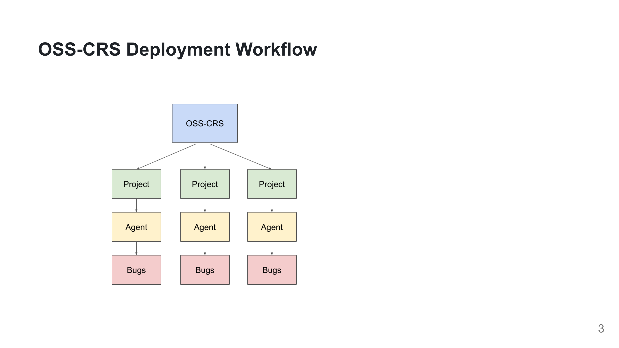

Slide 4
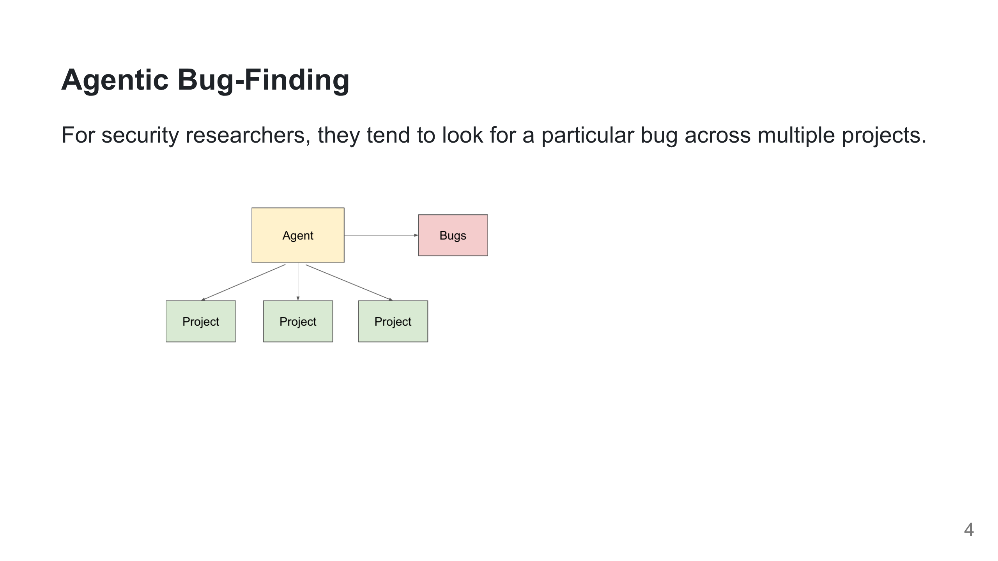

Slide 5
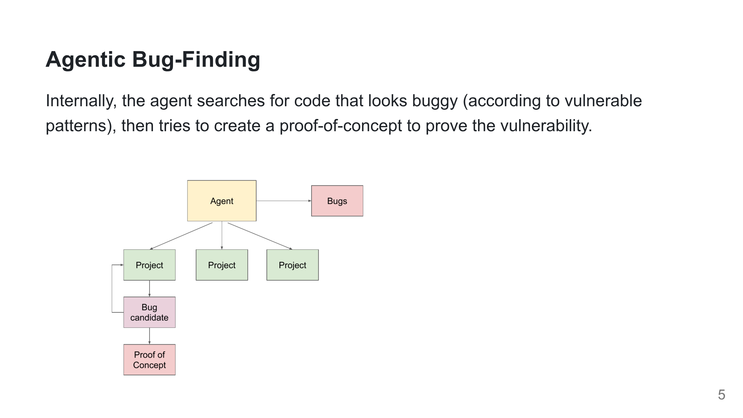

Slide 6
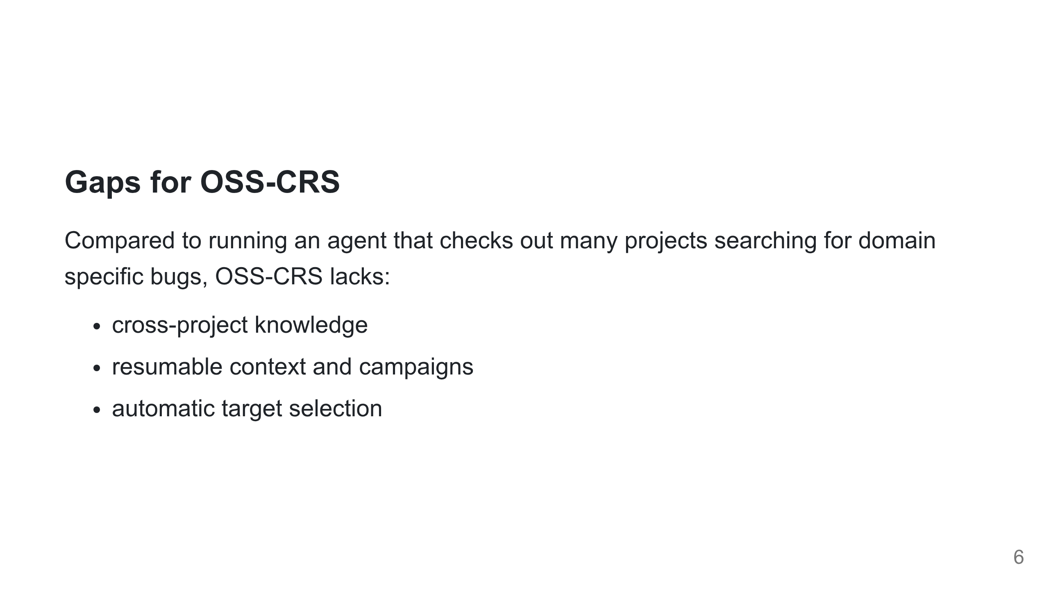

Slide 7
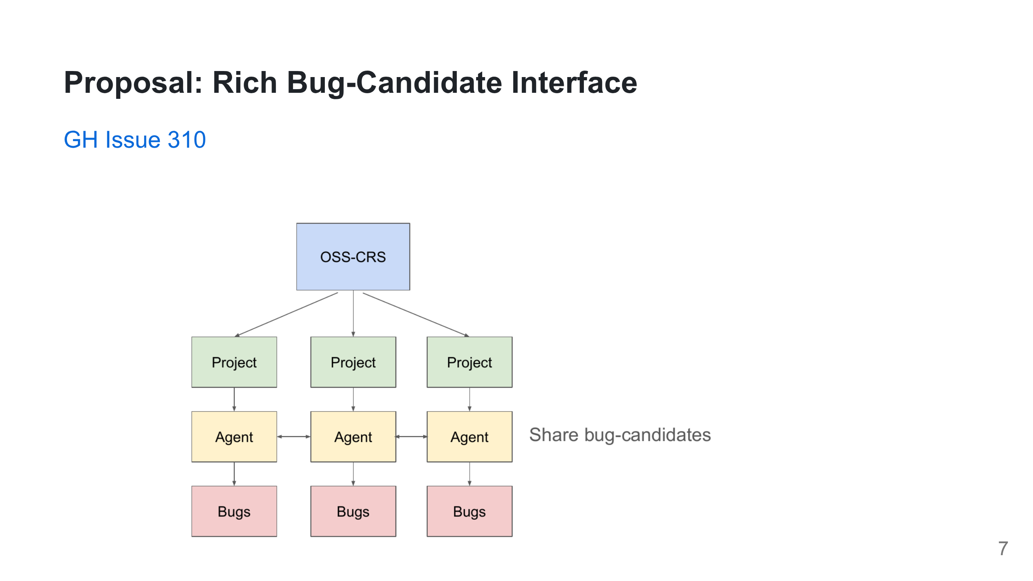

Slide 8
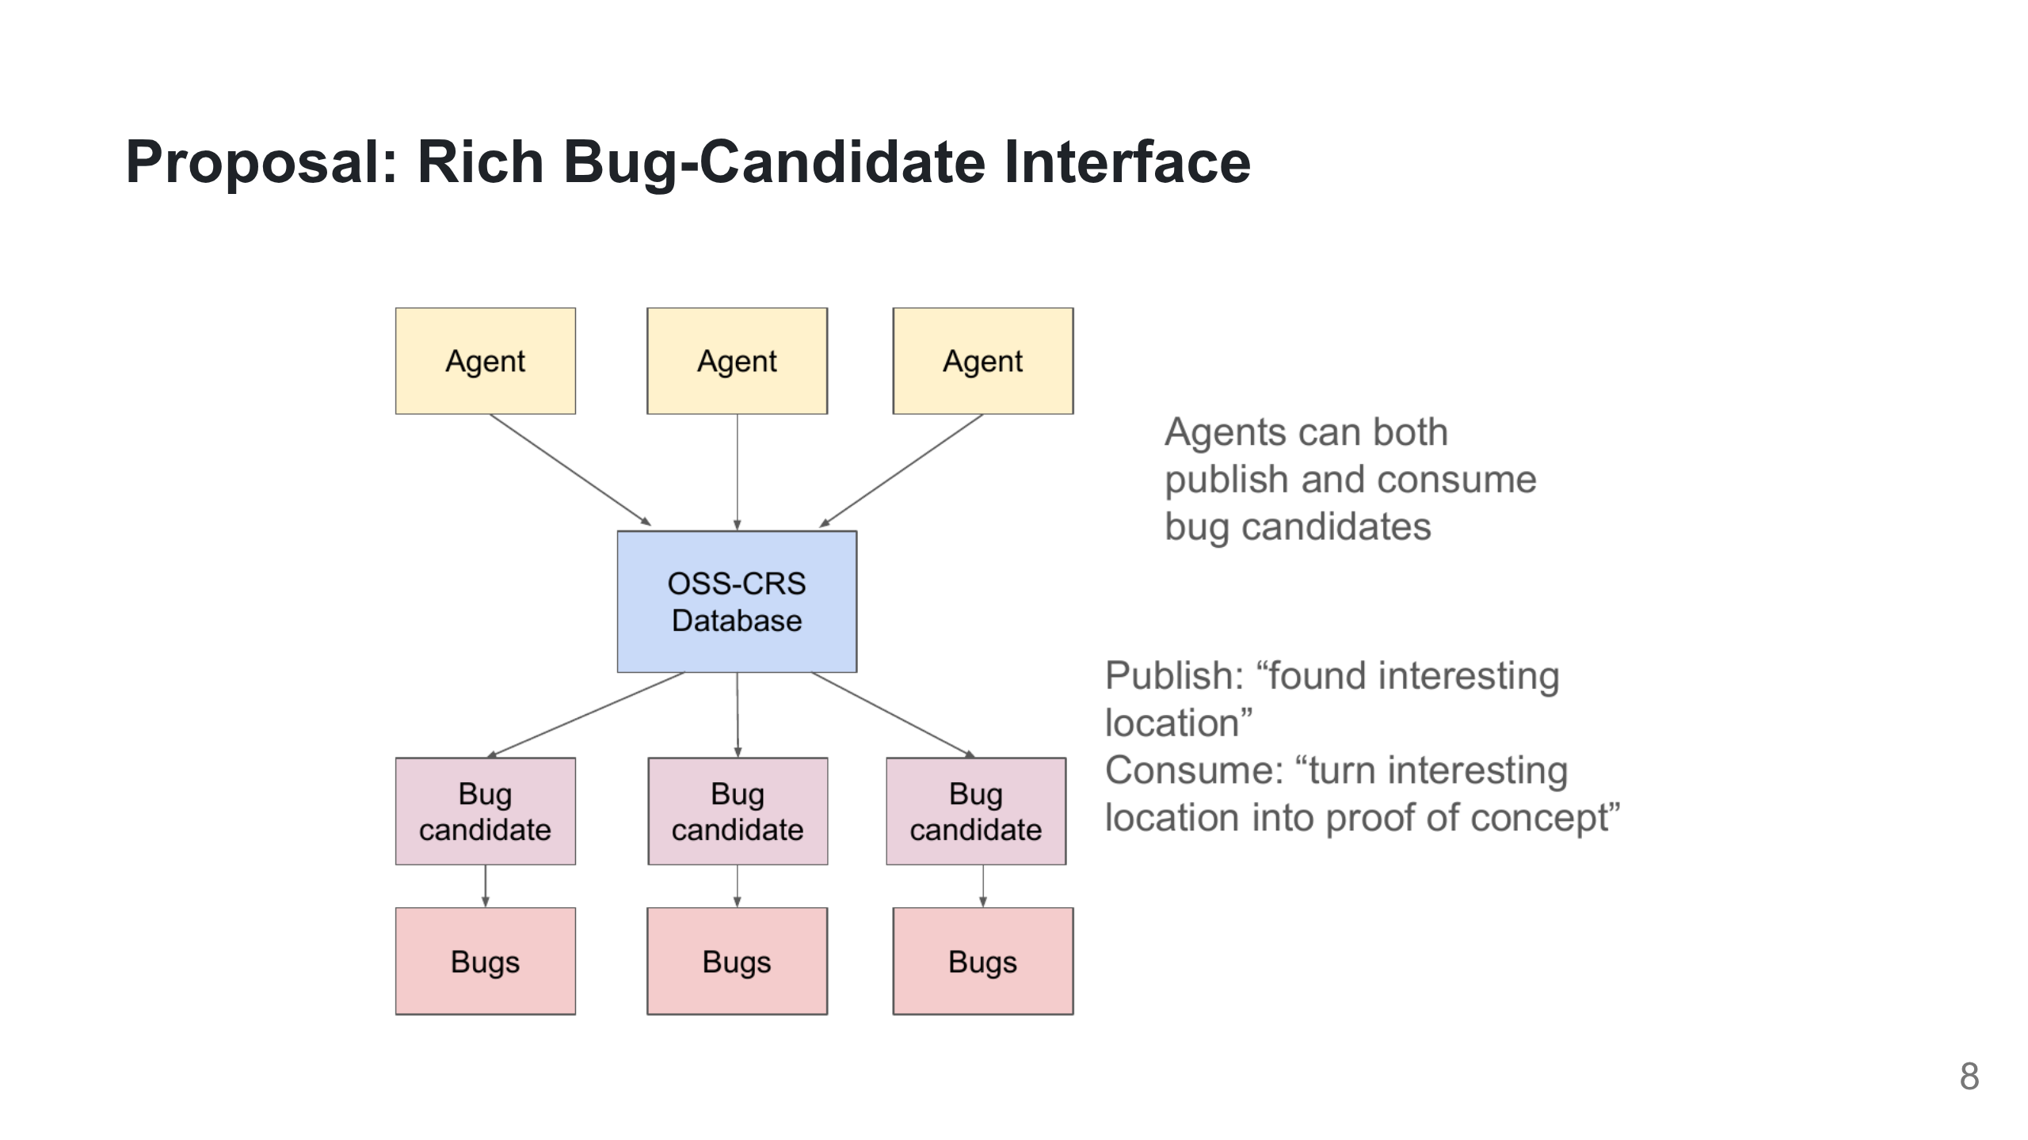

Slide 9
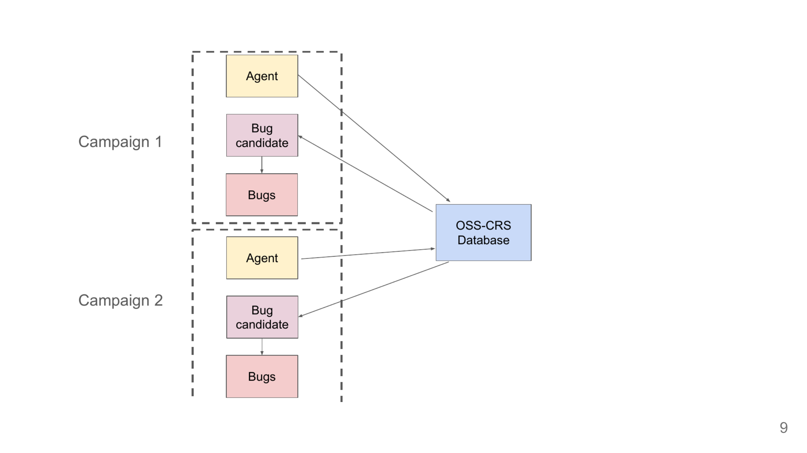

Slide 10
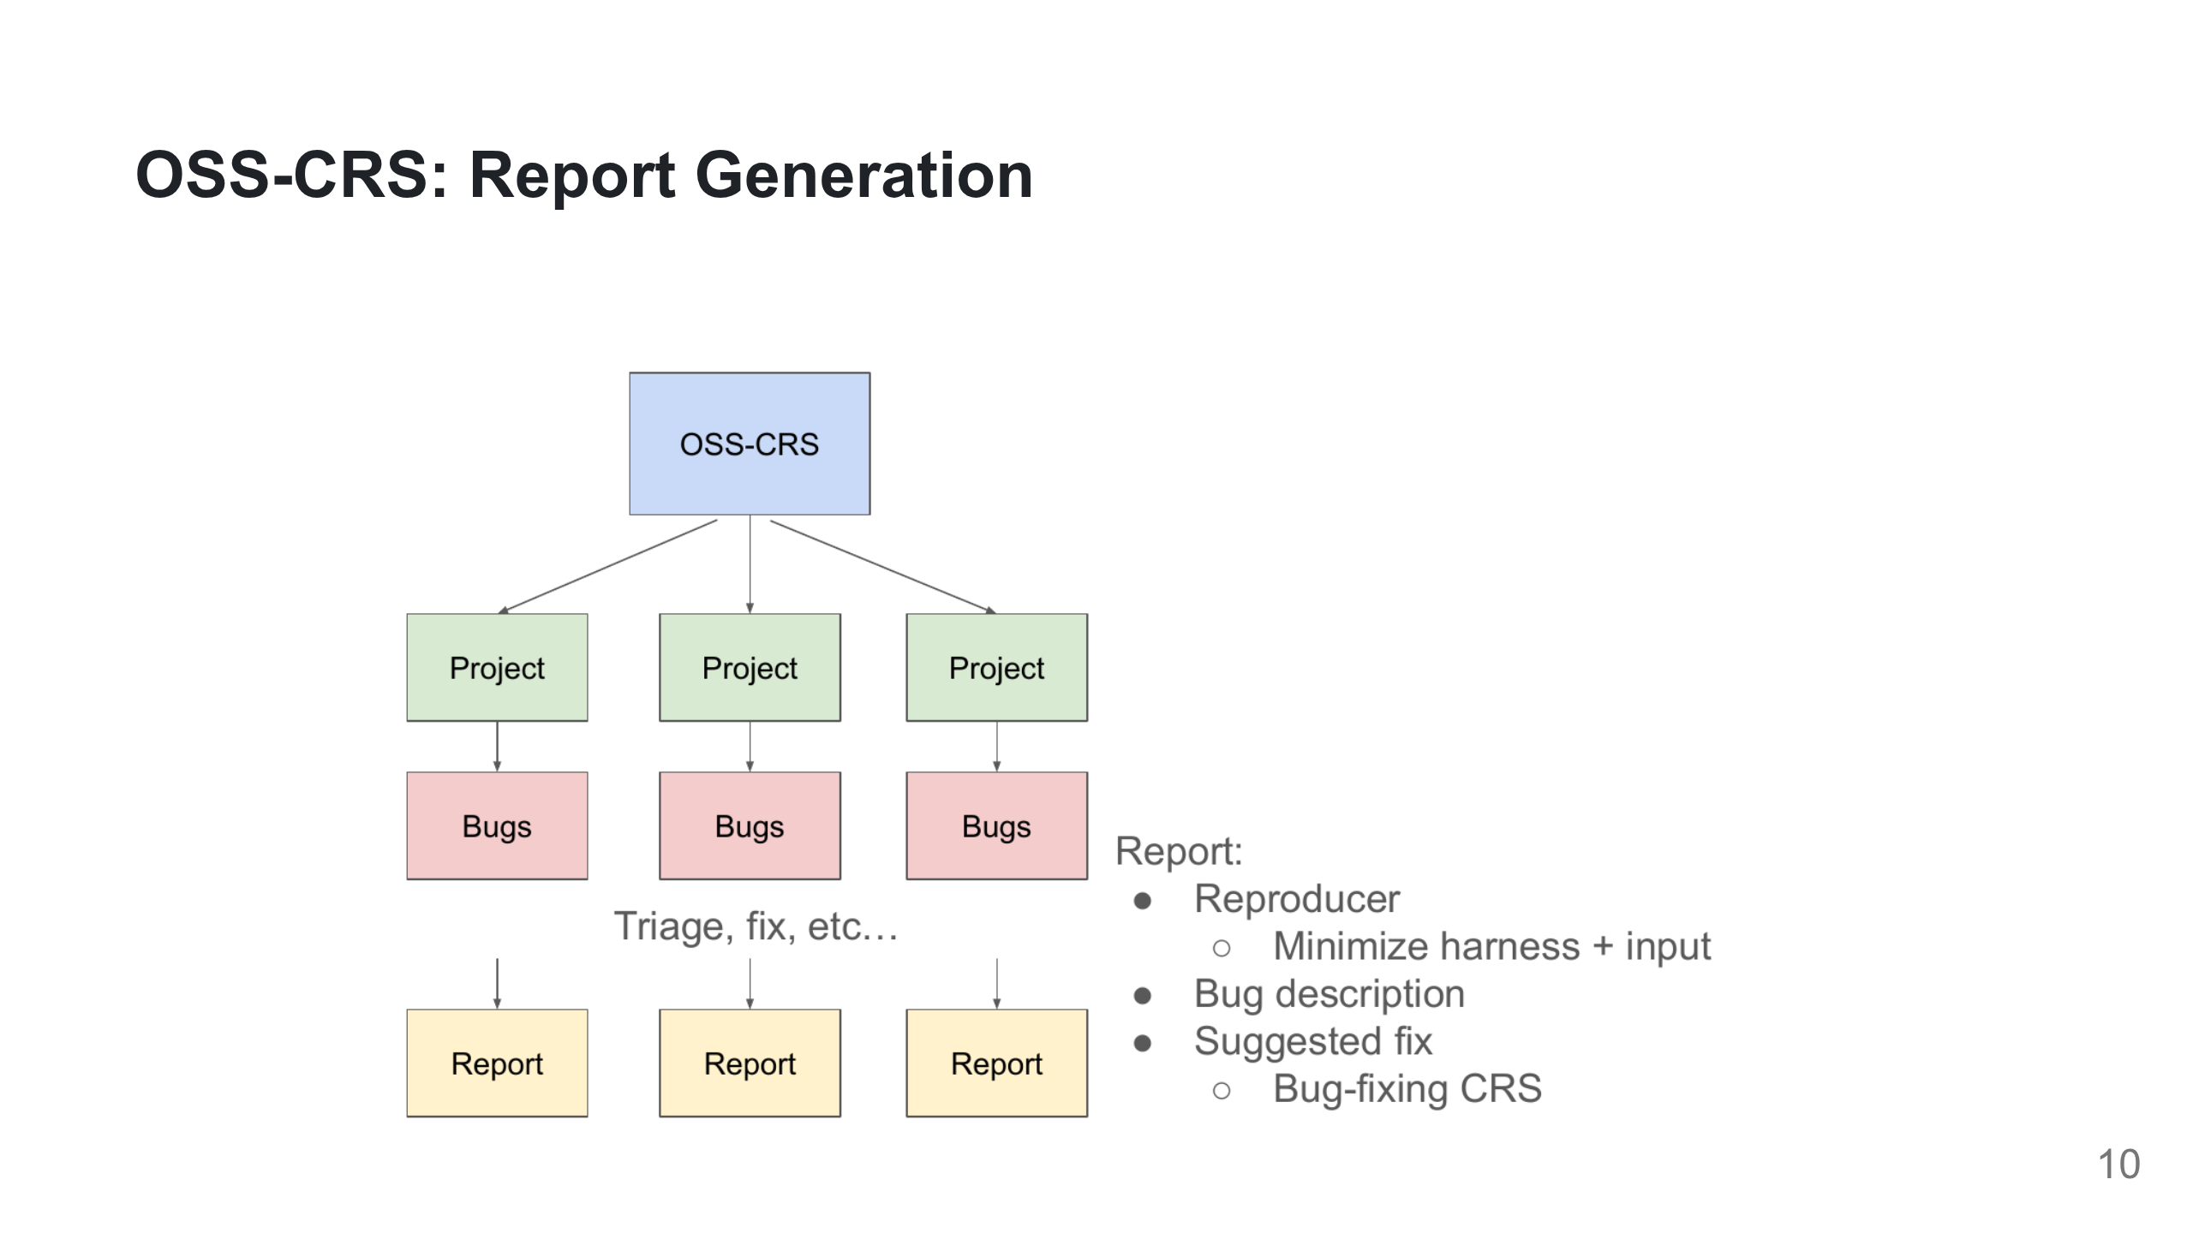

Slide 11
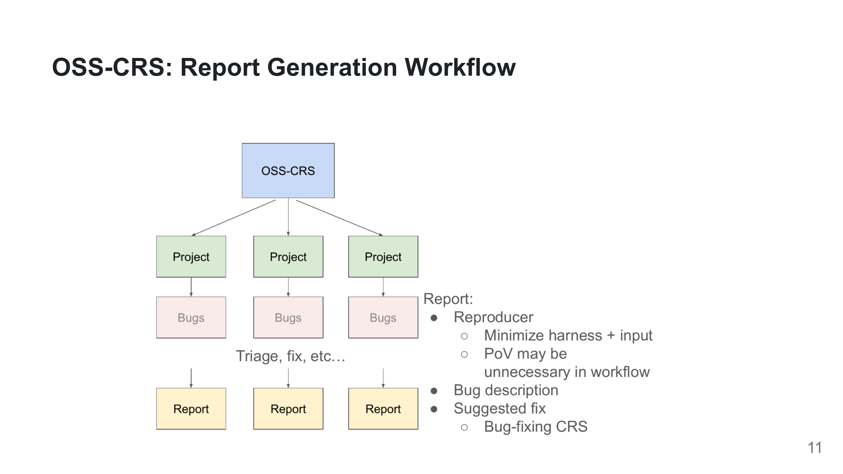

Slide 12
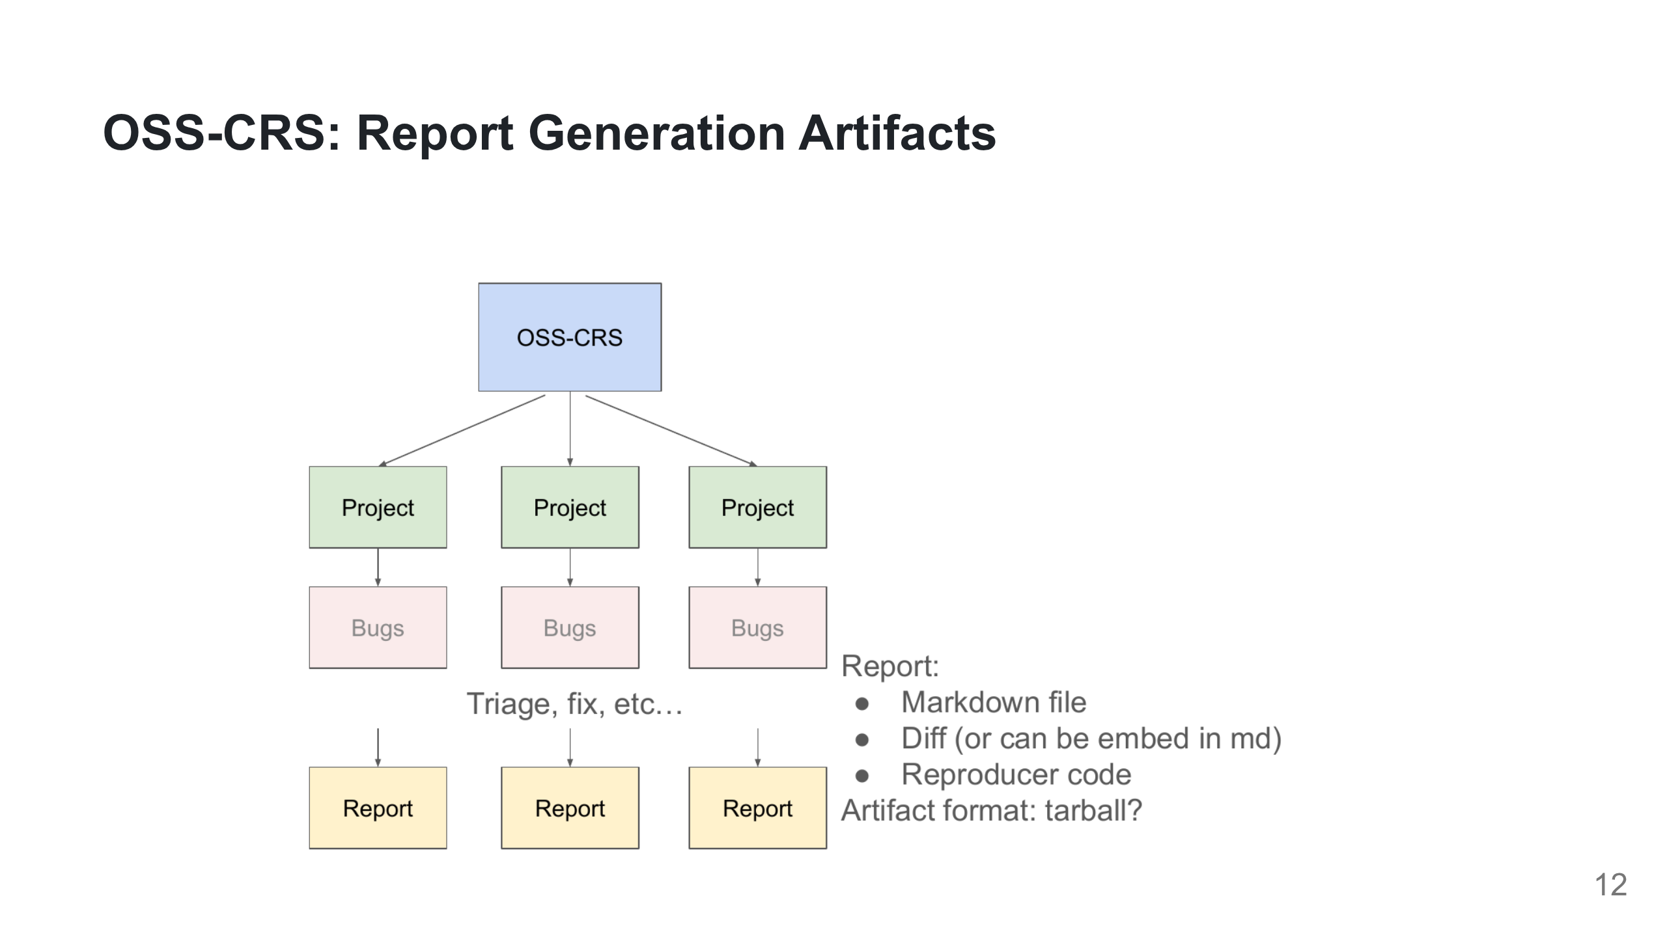

Slide 13
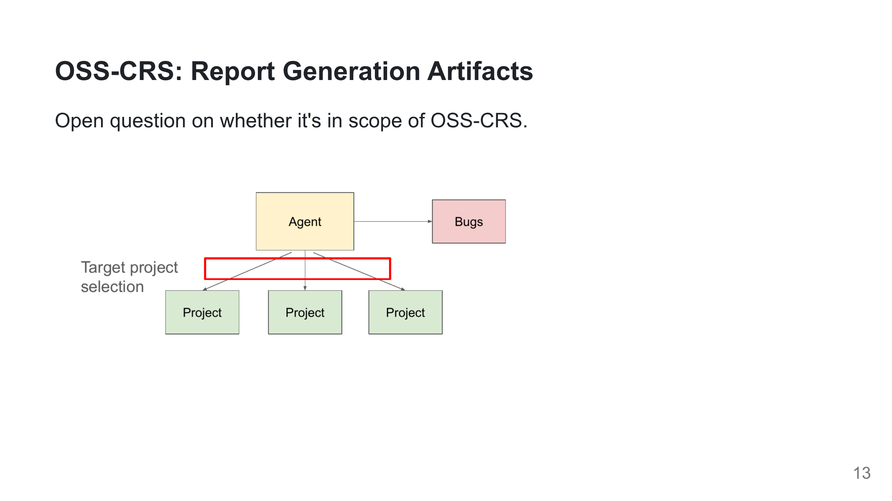

Slide 14
