Slide 1
Session 6
Session By: Wafaa Atef
Slides By: Omnia , Yomna

Slide 2
Table of contents </>
1 -
2 -
3 -
4 -
5 -
Intro to Authentication & Authorization
Authentication concept
Token & cookies
Sign up/in flow
Authorization concept
6 -
Admin Panel
7 -
Kahoot !

Slide 3
Introduction to
Authentication &
Authorization

Slide 4
Story!

Slide 5


Slide 6
Authentication

Slide 7
Authentication
Who are you?
Authentication = verifying identity
Happens before authorization
Authentication in Real Life
Showing your ID card
Entering a password to unlock your phone
Using fingerprint / Face ID

Slide 8
Authentication
Authentication in Applications
Login

Slide 9
Question!
Http is stateless or not?

Slide 10

Http is stateless!
which means each request is independent and the server does not remember previous requests by default

Slide 11
And There is a Problem
Login is done once
so , When a user logs in successfully, the backend needs a way to remember them in future requests.
That ‘memory’ is done using either sessions or tokens.

Slide 12
Session-Based Authentication
vs
Token-Based Authentication

Slide 13
Session-Based Auth
After login, the server creates a session
The session data is stored on the server (memory or database)
A session ID is generated
The session ID is sent to the client as a cookie

Slide 15
cookies
Cookies are small pieces of data created by the backend and stored in the user’s browser.
They are automatically sent with every request to the backend
Why Are cookies Important in Backend?
Because HTTP is stateless, the backend uses cookies to maintain user state across multiple requests. Cookies allow the server to recognize the same user without requiring repeated authentication
Notes:
Show cookie ان براوزر

Slide 16
Token-Based Auth
After login, the server generates a token
The token contains user data
The token is sent to the client
The client stores it (usually in a cookie)

Slide 17
Token
A token is a secure string used to represent an authenticated user.
It is generated by the server after successful authentication and sent to the client to prove the user’s identity in future requests
Why Tokens Are Important in Backend?
Tokens enable stateless authentication, meaning the server does not need to store session data.
They allow the backend to identify the user on every request without asking for credentials again.
Tokens help maintain secure communication between the frontend and backend.

Slide 18
Role of Tokens in Authentication & Authorization
In Authentication, tokens confirm that the user has successfully logged in.
In Authorization, tokens carry information as “user ID “or “role” that helps determine what the user is allowed to access.
Tokens are validated by the backend on each request to ensure the request is legitimate

Slide 19
Break . . .

Slide 20
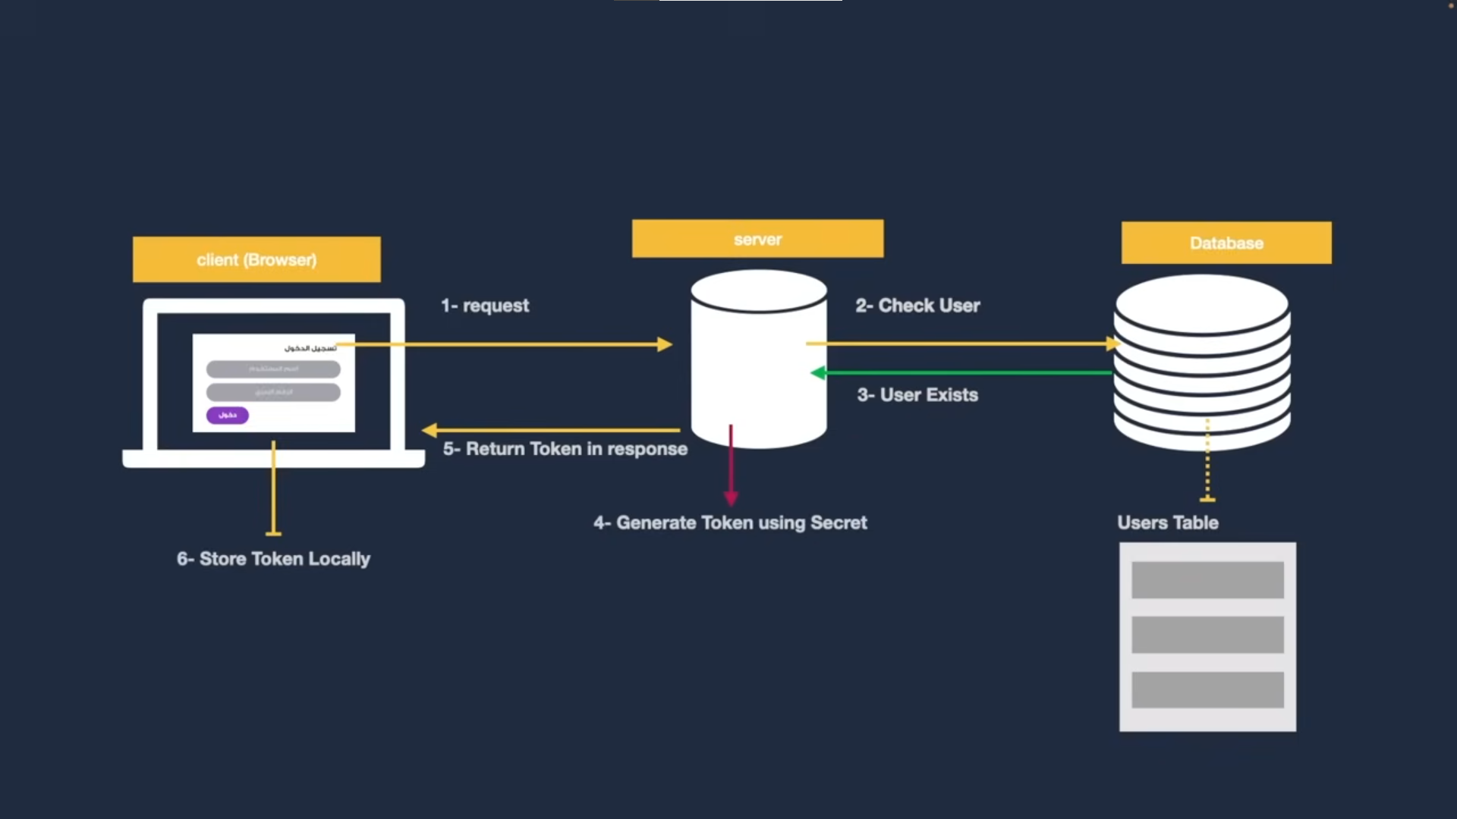

Slide 21
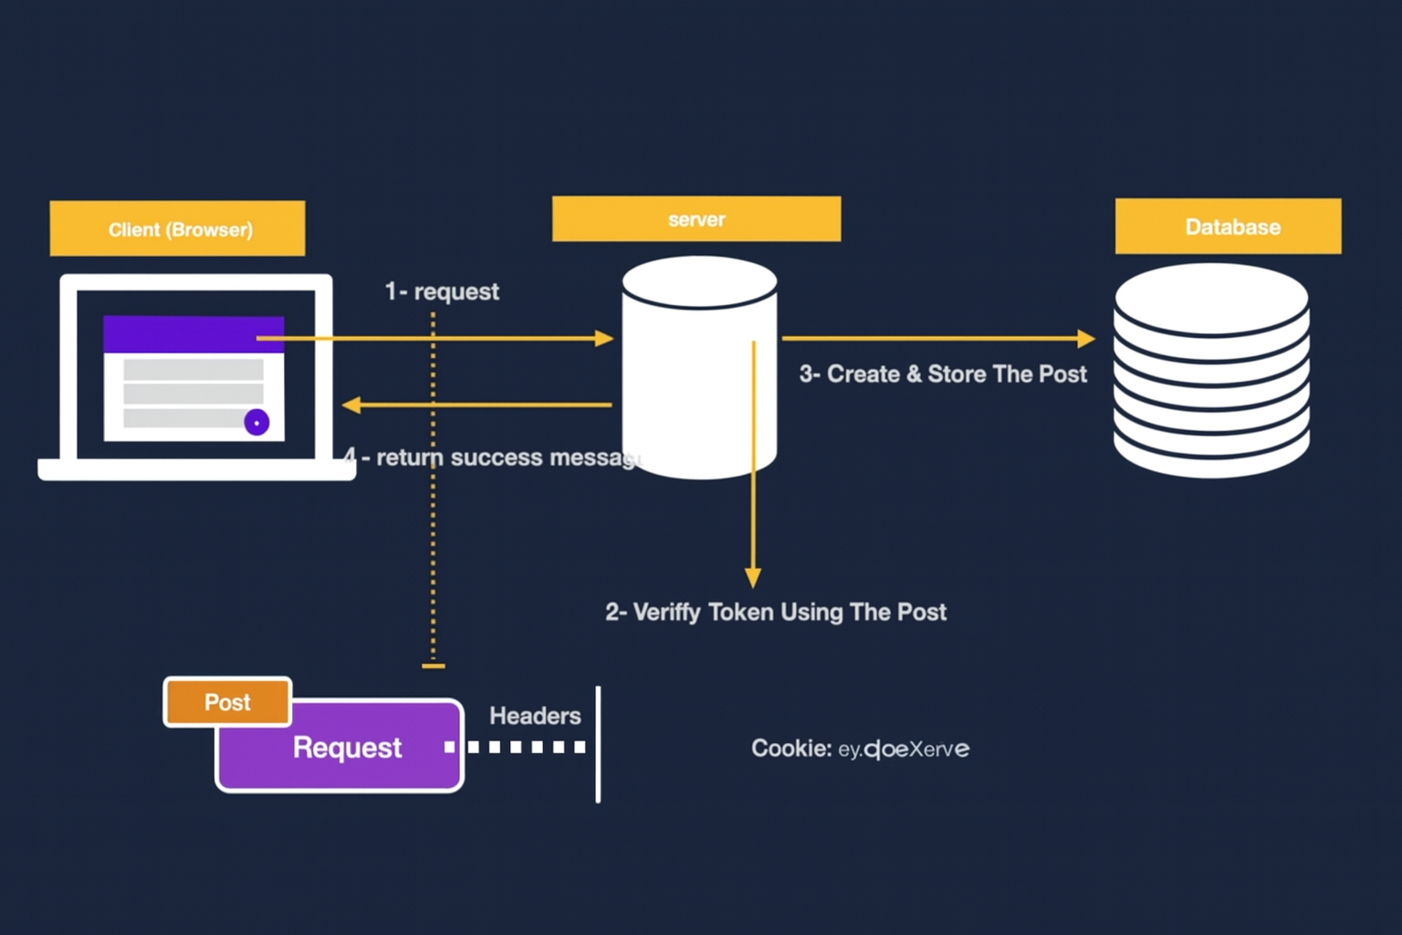

Slide 22
JSON Web Token (JWT)
A compact, secure token used for authentication
Sent from backend → client after successful login
Used in every request to identify the user
JWT consists of 3 parts: (jwt.io)
Header.Payload.Signature
Header → token type & algorithm
Payload → user data (id, role, email)
Signature → ensures token is not tampered with

Slide 23
Sign up/in flow

Slide 24
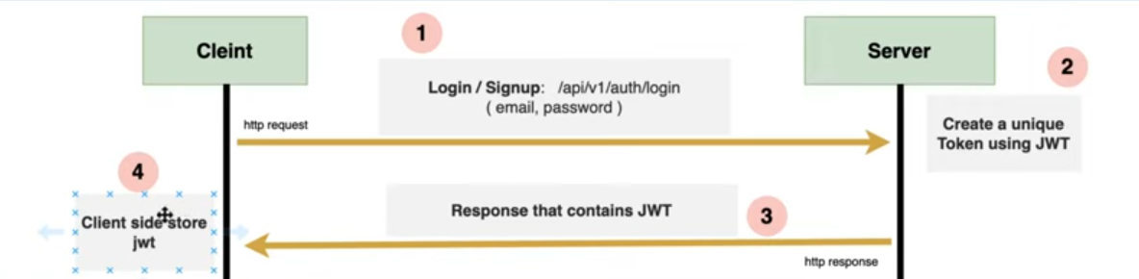

Slide 25
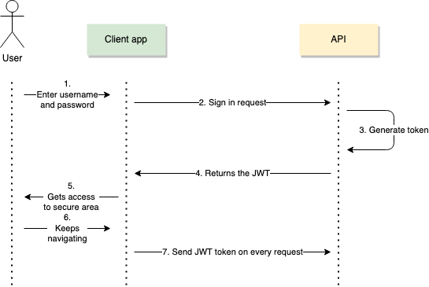

Slide 27
Authorization concept

Slide 28
Authorization
What do you do?
Authorization = verifying role
Is the process of determining what actions an authenticated user is allowed to perform
Authorization in Real Life
Being allowed to delete a post as an admin
Accessing your bank account features based on your role
Viewing restricted content after logging in
Opening specific apps or settings on your phone based on permissions

Slide 29
Admin Panel Demo !

Slide 30

Kahoot !

Slide 31
Thanks!
Do you have any questions?

