Slide 1
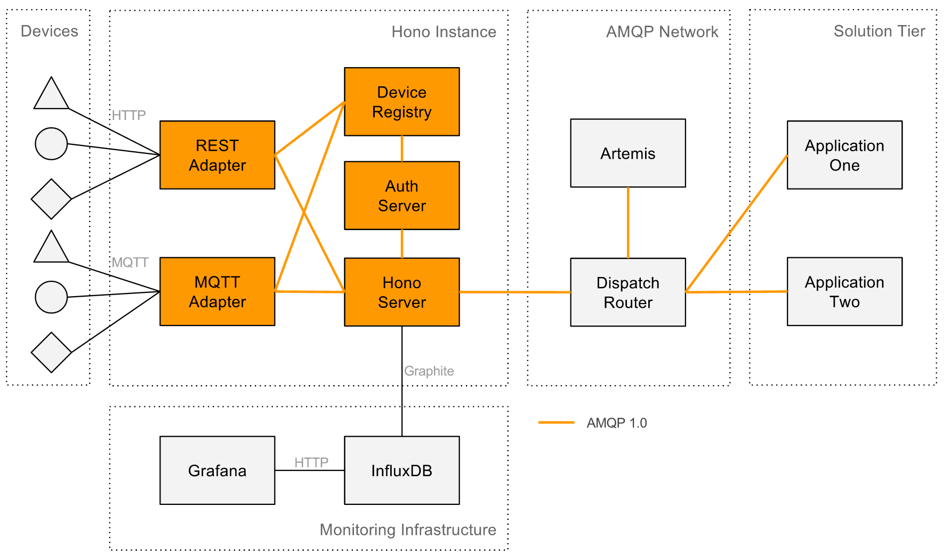
Thing
Twins
IoT Analytics Engine
Kafka
Zookeeper

