Slide 1
Hello, Penguins!
Andrew

Slide 2
Data
For this analysis we’ll use the penguins dataset from the palmerpenguins R package.
# A tibble: 344 × 8 species island bill_length_mm bill_depth_mm flipper_length_mm body_mass_g <fct> <fct> <dbl> <dbl> <int> <int> 1 Adelie Torgersen 39.1 18.7 181 3750 2 Adelie Torgersen 39.5 17.4 186 3800 3 Adelie Torgersen 40.3 18 195 3250 4 Adelie Torgersen NA NA NA NA 5 Adelie Torgersen 36.7 19.3 193 3450 6 Adelie Torgersen 39.3 20.6 190 3650 7 Adelie Torgersen 38.9 17.8 181 3625 8 Adelie Torgersen 39.2 19.6 195 4675 9 Adelie Torgersen 34.1 18.1 193 3475 10 Adelie Torgersen 42 20.2 190 4250 # ℹ 334 more rows # ℹ 2 more variables: sex <fct>, year <int>

Slide 3
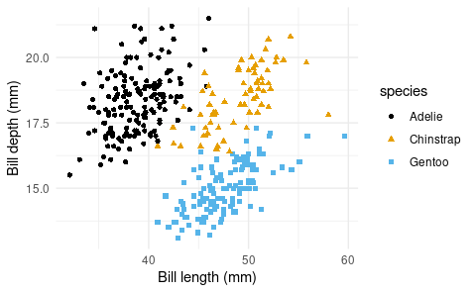
Species
The figure below is a scatterplot of species of penguins.

Slide 4
Penguins
species | island | bill_length_mm | bill_depth_mm
Adelie | Torgersen | 39.1 | 18.7
Adelie | Torgersen | 39.5 | 17.4
Adelie | Torgersen | 40.3 | 18.0
Adelie | Torgersen | NA | NA
Adelie | Torgersen | 36.7 | 19.3
Adelie | Torgersen | 39.3 | 20.6
Adelie | Torgersen | 38.9 | 17.8
Adelie | Torgersen | 39.2 | 19.6
Adelie | Torgersen | 34.1 | 18.1
Adelie | Torgersen | 42.0 | 20.2
The table below shows the first 10 penguins from the dataset.

