Slide 1
Hello, Penguins!
mother nature

Slide 2
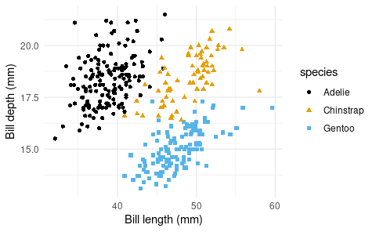
Introduction
Data
For this analysis we’ll use the penguins dataset from the palmerpenguins R package.
Species
The figure below is a scatterplot of species of penguins.
ggplot(data = penguins,
mapping = aes(x = bill_length_mm,
y = bill_depth_mm,
color = species,
shape = species)) +
geom_point() +
scale_color_colorblind() +
labs(x = "Bill length (mm)", y = "Bill depth (mm)") +
theme_minimal()

Slide 3
species | island | bill_length_mm | bill_depth_mm
Adelie | Torgersen | 39.1 | 18.7
Adelie | Torgersen | 39.5 | 17.4
Adelie | Torgersen | 40.3 | 18.0
Adelie | Torgersen | NA | NA
Adelie | Torgersen | 36.7 | 19.3
Adelie | Torgersen | 39.3 | 20.6
Adelie | Torgersen | 38.9 | 17.8
Adelie | Torgersen | 39.2 | 19.6
Adelie | Torgersen | 34.1 | 18.1
Adelie | Torgersen | 42.0 | 20.2
Penguins
The table below shows the first 10 penguins from the dataset.

Slide 4
Analysis
bullet 1
bullet 2

Slide 5
References

