Slide 1
Hello, Penguins!
Lars Schöbitz

Slide 2
Introduction

Slide 3
Data
For this analysis we’ll use the penguins dataset from the palmerpenguins R package.

Slide 4
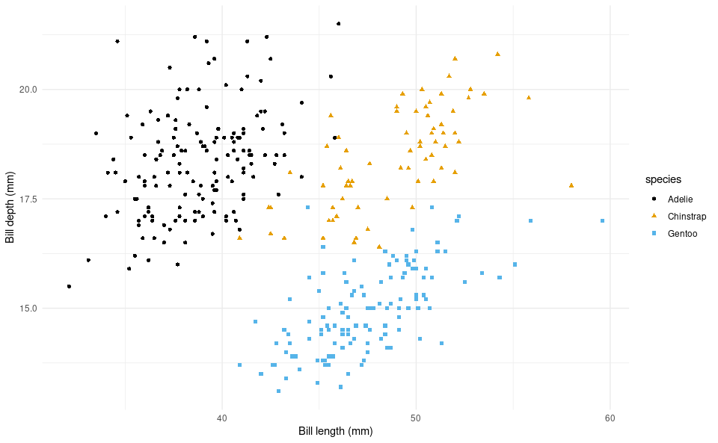
Species
The figure below is a scatterplot of species of penguins.
ggplot(data = penguins, mapping = aes(x = bill_length_mm, y = bill_depth_mm, color = species, shape = species)) + geom_point() + scale_color_colorblind() + labs(x = "Bill length (mm)", y = "Bill depth (mm)") + theme_minimal()

Slide 5
Penguins
species | island | bill_length_mm | bill_depth_mm
Adelie | Torgersen | 39.1 | 18.7
Adelie | Torgersen | 39.5 | 17.4
Adelie | Torgersen | 40.3 | 18.0
Adelie | Torgersen | NA | NA
Adelie | Torgersen | 36.7 | 19.3
Adelie | Torgersen | 39.3 | 20.6
Adelie | Torgersen | 38.9 | 17.8
Adelie | Torgersen | 39.2 | 19.6
Adelie | Torgersen | 34.1 | 18.1
Adelie | Torgersen | 42.0 | 20.2
The table below shows the first 10 penguins from the dataset.

Slide 6
Analysis

Slide 7
Modeling
info about the model
text about results
comments about shortcomings

Slide 8
References

