Slide 1


Basic Data Structures to Support Algorithms
Oleksii Starov
Dmytro Rusin
November 7, 2013

Slide 2
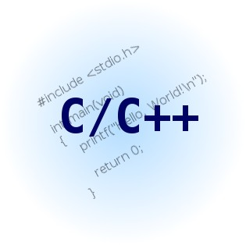

Initial Knowledge
Static Arrays
Dynamic Arrays
Structure/Class
Linked Lists…
Stack and Queue
No doubts should occur during implementation!

Slide 3
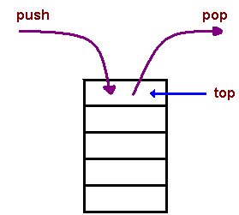
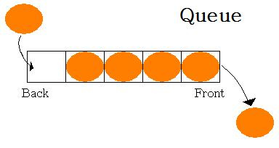
Queue & Stack
FIFO and LIFO
How to implement on array?

Slide 4
Stack
How to implement (add) MinValue() operation?
Keeping Pop and Push operations with the same complexity. Can we do it with O(1)?
getCurrentMinElement()

Slide 5
Queue
How to implement (add) MinValue() operation?
(Examples & Brainstorming on the Chalkboard)

Slide 6
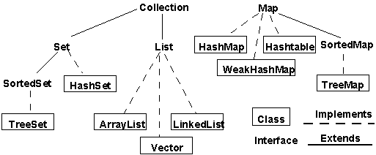
Standard (Provided) Collections
This is for Java, discuss STL (…)

Slide 7
DS for Search Algorithms
Binary Search (on a sorted array)
1
3
2
37?
1 3 4 7 19 22 34 35 37 42 67 88 91 98
N (e.g. 14)
T(N) = T(N/2) + O(1) => O(log N)

Slide 8
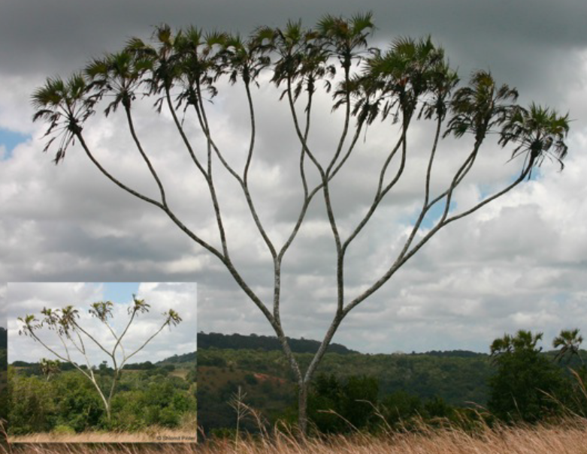
DS for Binary Search
Binary Tree (e.g. B-trees are used in Data Bases)
Notes:
At first questions about height of the tree, branch factor, etc.

Slide 9
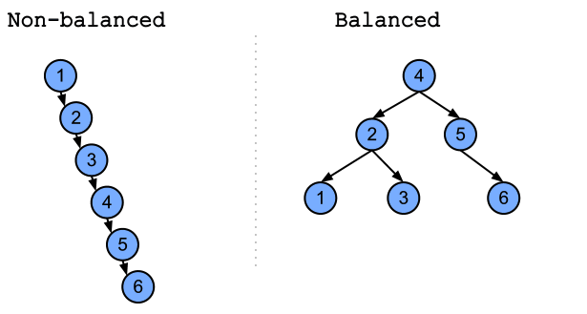
Balanced & No ☹
How can we balance any tree easily solving “offline”?

Slide 10
Further topics
Practice of implementing trees (…)
Standard library implementations
Useful “balancing” methods and trees
Useful extensions of a tree’s functionality!
Related divide-and-conquer applications
Trees in real-life software
Notes:
Even of a tree from standard library

