Slide 1
Quantum Mechanics of Electrical Current Circuits
An informal lecture
Dr. Oleg Starykh
Department of Physics
University of Utah
April 14, 2006

Slide 2
Outline
Basic Quantum Mechanics: particle-wave duality
Quantum wires: man-made and natural
Q.M. + Ohm = quantum wire: resistance is quantized!
Tunneling into carbon nanotubes: violation of Ohm’s law
Charge density waves

Slide 3
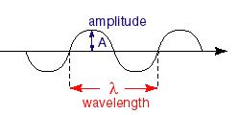

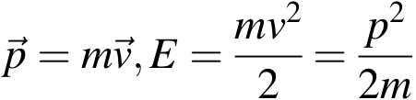
Basic Quantum Mechanics
Max Planck (1900) - wave motion (thermal radiation, light) is quantized
E = n h f , n =0,1,2,3,…
Planck’s constant h=6.626 . 10⁻³⁴ Joule.sec
Frequency = f , period T = 1/f
Albert Einstein (1905) - light (frequency f) is a particle (photon)
E = h f
Louis de Broglie (1924) - matter is wave: E=hf, p = h/λ
wavelength = λ
p=mv
?

Slide 4
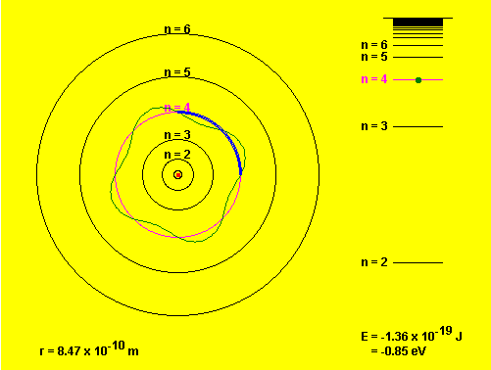
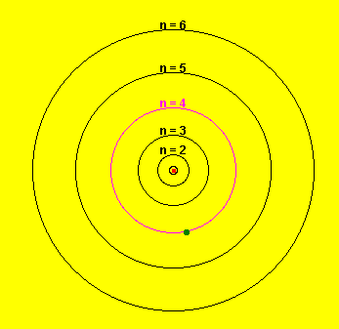
Particle-wave duality: Bohr’s atom (1913)
-e
-e moves in a circular orbit (like a planet
around the Sun)
r
+e
2. Only certain quantized orbits are allowed:
those with circumference = multiple of
(-e) wavelength λ: 2πr = n λ
(standing wave forms the orbit!)
1
2

Slide 5
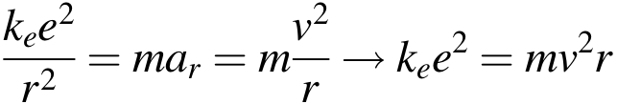
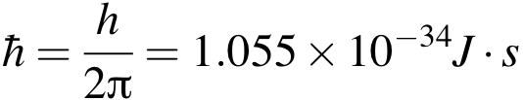
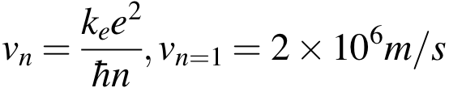
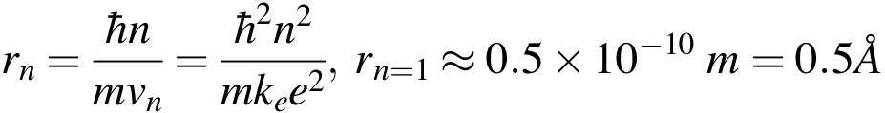
A bit of algebra
v
From (1):
r
a_{r}
(Newton’s 2nd law for Coulomb force)
+e
Orbital angular momentum is conserved:
L=mv r = pr = const
From (2): 2πr= nλ => r=n λ/(2π) and p = h/λ.
Thus L=p r = (h/λ) (nλ/2π) = n h/2π is quantized!
n=1,2,3,…is integer
Find - speed and radius are quantized:

Slide 6
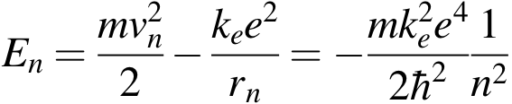
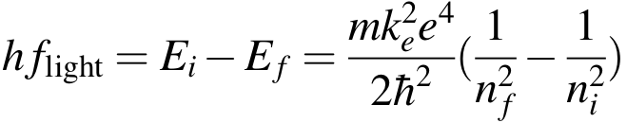

And energy is quantized as well - it’s quantum mechanics!
n=3
This explains emission and absorption
spectra of Hydrogen (Balmer series):
-e
n=2
n=1
+e
n=4 => n=2
n=3 => n=2 (656 nm)

Slide 7
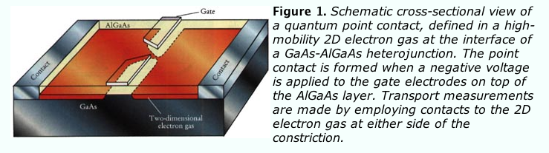
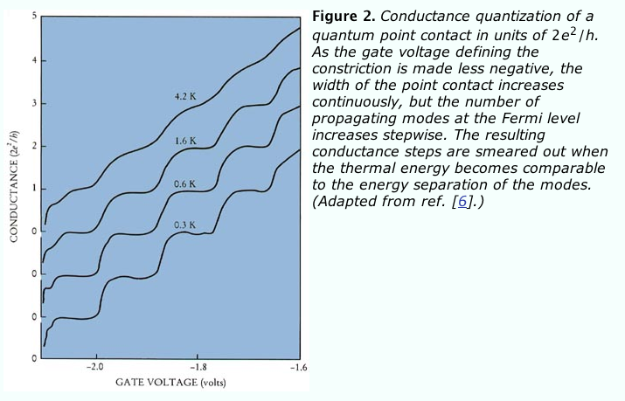
Semiconductor quantum point contact
Cross-sectional area
is controlled
by the gate voltage.
B. J. van Wees, H. van Houten, C. W. J. Beenakker,
J. G. Williamson, L. P. Kouwenhoven, D. van der Marel,
C. T. Foxon, Phys. Rev. Lett. 60, 848 (1988);
Phys. Rev. B 43, 12431 (1991).

Slide 8
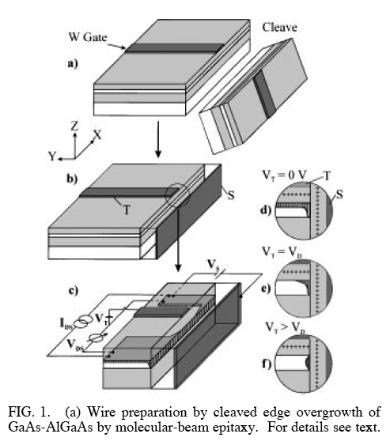
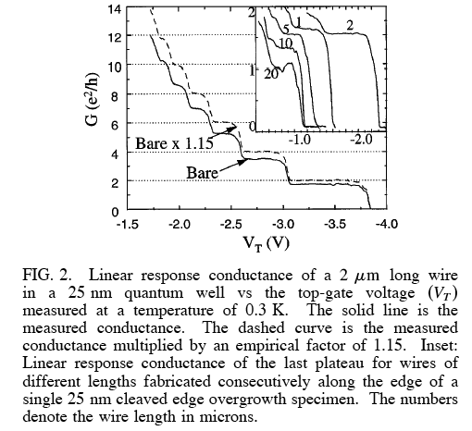
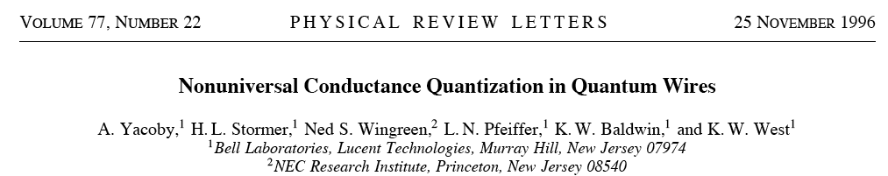
Semiconductor quantum wire

Slide 9

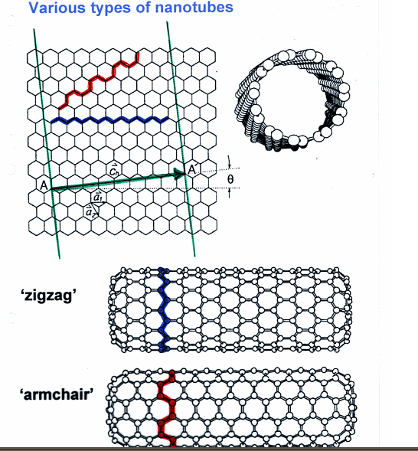
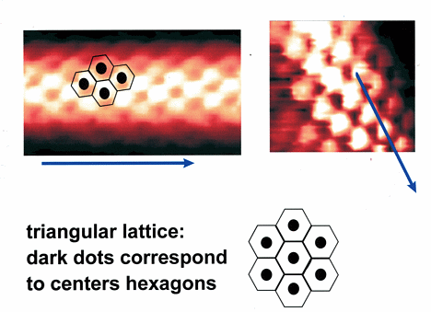
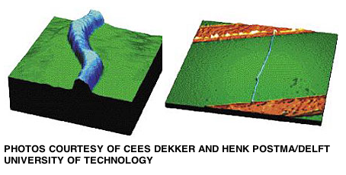
Carbon Nanotubes (discovered by S. Ijiima in 1991)
Cees Dekker,
Delft Univ. of Technology

Slide 10
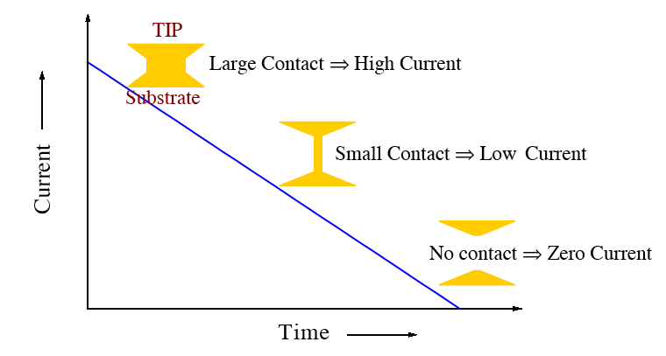
Break-junction: let’s pull the wire!
L₂
F
F
=>
A₂
A₁
Volume is the same: A₁L₁=A₂L₂
L₁
G=ne²t (Volume)/[m L²] => G₁ > G₂ because L₁ < L₂.
That is, the resistance will increase R₁ < R₂ and current decrease, I₁ > I₂
Expect:
(proportional to deformation)

Slide 11
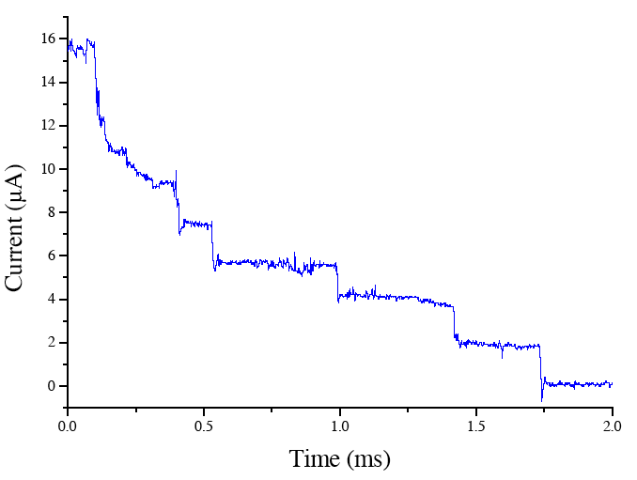
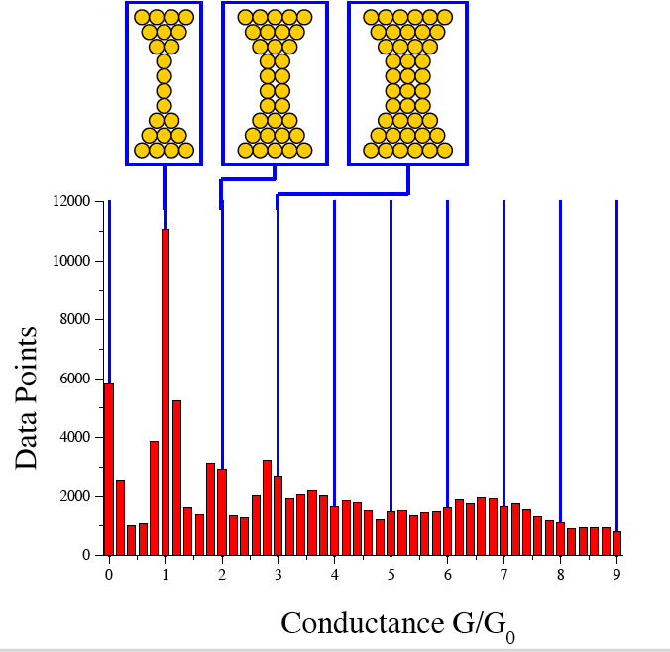
Experimental data [LG. Soukiassian, R. Reifenberger, Purdue Univ.2000]
Step-wise decrease of the current!
Histogram of conductance G = I/V, V=25.8 mV

Slide 12
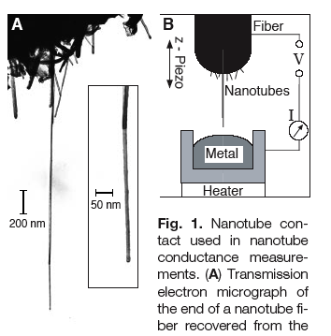
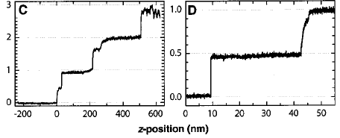
Conductance measurements
S. Franck et al., Science 280,
1744 (1998).
Complication - difficult to
make good contacts.
G/G₀

Slide 13
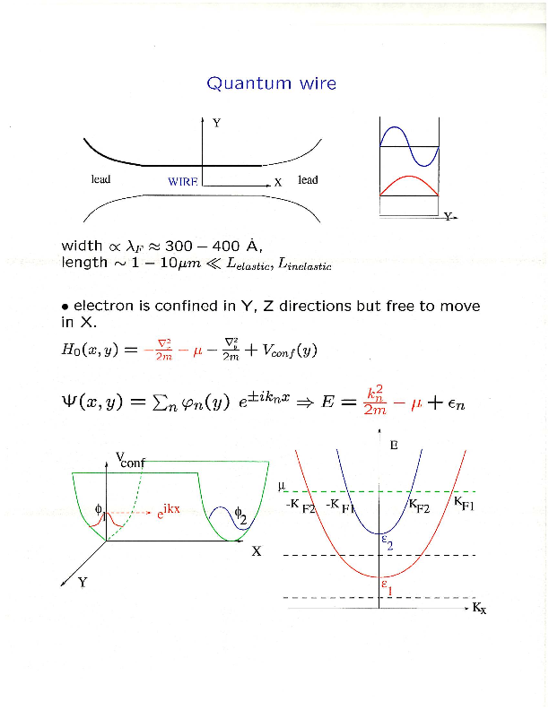
Standing waves
in transverse (Y and Z)
directions
Plane wave along the wire
(X axis)

Slide 14
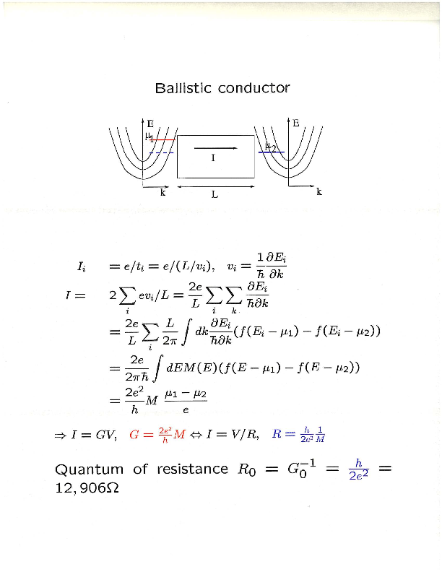
index i = subband
Μ: # subbands
spin
degeneracy
Fermi distribution
function

Slide 15


Left lead
Right lead
wire
Electrons moving to the Right
Electrons moving to the Left
The difference at T=0:
μ₁ − μ₂
= e V
V = potential difference
Thus the current I = (2e²/h) V for one conducting channel
Hence: conductance G = 2*(e²/h)*(# conducting channels/transverse subbands)

Slide 16
Dimensional Analysis
What are the units of e²/h ?
[e]=charge= Coulomb = C
[h]=Planck’s constant = Joule*sec =J s
[e²/h]=C²/(J s) = (C/s) (C/J)
Current = Charge per second = C/s = Ampere = A
Electric potential = Voltage = Volts = V= Work per unit charge = J/C
Thus, C/J = 1/V, and [e²/h] = A/V
I = V/R => Resistance = R = V/I = Volt/Ampere = Ohm = Ω
Finally, [e²/h] = A/V = 1/Ω = 1/Ohm = 1/(Resistance) = Conductance

Slide 17
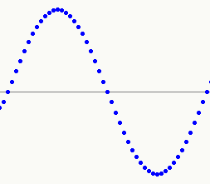
Go backward: increase the cross-sectional area
I
Suppose two “minimal” waves can fit in:
λ
=
λ
+
λ
=
R₀
R₀
2 λ
I
Two “maximal” resistors in parallel: I = 2 V/R₀ => R=R₀/2=h/(4e²)
Hence, double conductance G= 2G₀=2 (2e²/h) = 4e²/h
Thus expect G = N G₀ = N (2e²/h) : step-wise increase of conductance
as the number of conducting channels increases with cross-section A,
N=1,2,3,…
This is conductance quantization

Slide 18
Bigger (macroscopic) wire: Ohm’s law
I = V/R = G V R=resistance, G=conductance
+
-
Electrons move with
randomly oriented
u =10⁶ m/s;
d=mean-free path
(average distance
between impurities;
10⁻⁷-10⁻⁶ m)
V=E L
I
I
u
d
-e
area A
F
-e
E
L
F=e E
F=m a
a=eE/m
t=d/u
Velocity change between two consecutive
collisions (drift velocity) v_{d}=at=eEt/m
[for copper v_{d}=1 m/s << u=10⁶ m/s]
Current I = (n e v_{d}) A = ne²tA/(mL) V = G V , G=1/R =ne²t A/(mL)
n = number of electrons per unit volume
(concentration)
(Drude formula)

Slide 19
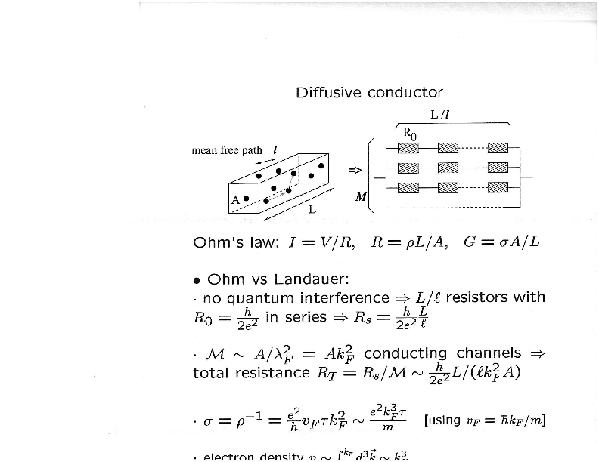

Slide 20
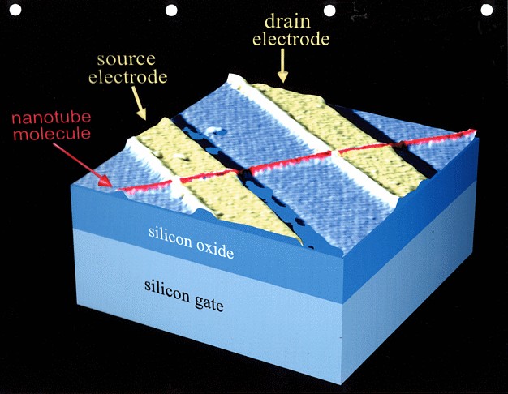
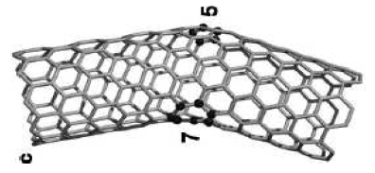
Conclusions
Quantum Mechanics governs atoms (size ~ 10⁻¹⁰ m) and nano-scale
conductors (size ~ 10⁻⁸-10⁻⁶ m).
Electron is both particle and wave.
Particle-like: electrical current in macroscopic samples (L > λ = h/p).
Wave-like: current in nano-scale samples (quantum point contacts
and quantum wires; size L < λ=wavelength).
Conductance (and resistance) is quantized: G = N G₀ , G₀ = 2e²/h
N=(number of channels)=0,1,2,3,… R=1/G = R₀/ N , R₀ = h/(2e²)
Nanotechnology:
Small is beautiful (and useful)

