Slide 1
Laszlo Systems
Declarative Presentation
XTech 2005
Oliver Steele
Chief Software Architect
Laszlo Systems, Inc.
May 25, 2005
Notes:
Is this really proprietary and confidential

Slide 2
Outline
The OpenLaszlo Project
What is an RIA?
Declarative Programming
Declarative dynamism
Fun with Constraints
How to Get Involved

Slide 3
OpenLaszlo Project
Sponsorship – Laszlo Systems, Inc.
  Laszlo uses the platform to develop proprietary applications
  Laszlo sells services and support to ISPs and ISVs
Project history
  2001: Laszlo Systems funded; implementation begins
  2002: Preview release; deployment by Behr; Laszlo series A
  2003: LPS 1.0; deployments on Earthlink home page, Yahoo
  2004: LPS 2.0; open source; additional deployments; Laszlo Mail announced; Series B
  2005: OpenLaszlo 3.0 – serverless; external contributions; additional commercial and first open source deployments
Project status
  10 external developers, 15 individual and corporate contributions
  Related projects: IDE4Laszlo (IBM), LPS4Biz, NetKernel, LazDoc
  User groups in US, Germany, Japan
  Docs being translated to Japanese
Notes:
Like Mono, Mozilla, PHP

Slide 4
OpenLaszlo in a nutshell
Source files: XML + JavaScript
Compiler: J2EE servlet
Compiles to: Flash movie file (today), JVM or DHTML (under investigation)
<canvas>
<window>
<button>Hello XTech!</button>
</window>
</canvas>

Slide 5
Alphabet Soup
HTML
SVG
XUL
XAML
MXML
XWT

Slide 6
OpenLaszlo Goals
Consumer-quality
  The quality of web applications should rival that of desktop applications: graphic design, fluid user interaction, single-page experience.
Zero-install
  Applications should run on the majority of browsers without a download alert or install dialog. This means out-of-box configurations of Macintosh and Windows IE, Safari, Netscape, and Firefox.
Developer-friendly
  Powerful
  Concise
  Nonproprietary

Slide 7
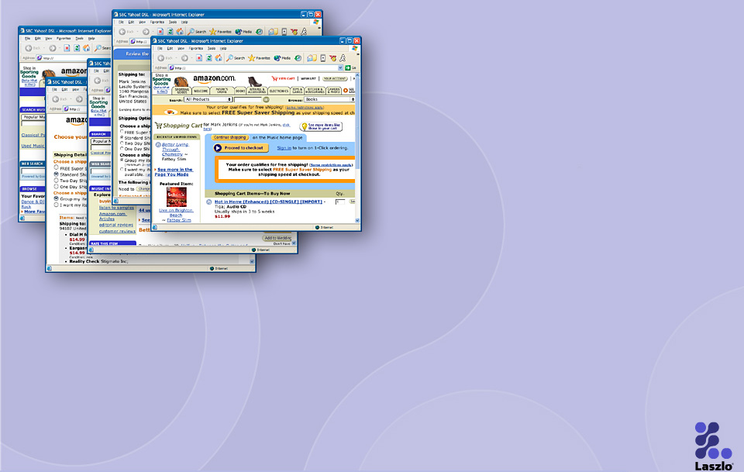
HTML Strengths and Weaknesses
Strengths
  Document display
  Static box layout
  Ubiquity
Weaknesses
  Graphics
  Animation
  Client applications
Challenge tasks
  Organizing email
  Moving appointments
  Managing lists
  Signup
  Checkout

Slide 8
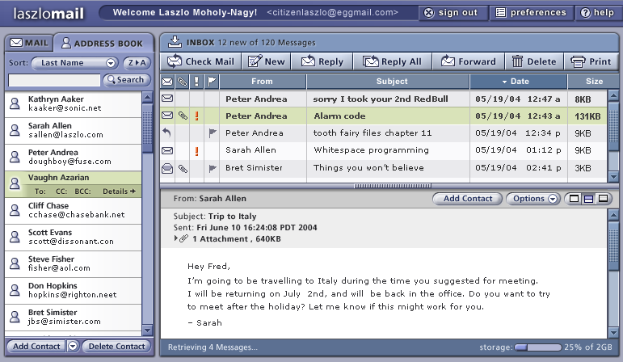
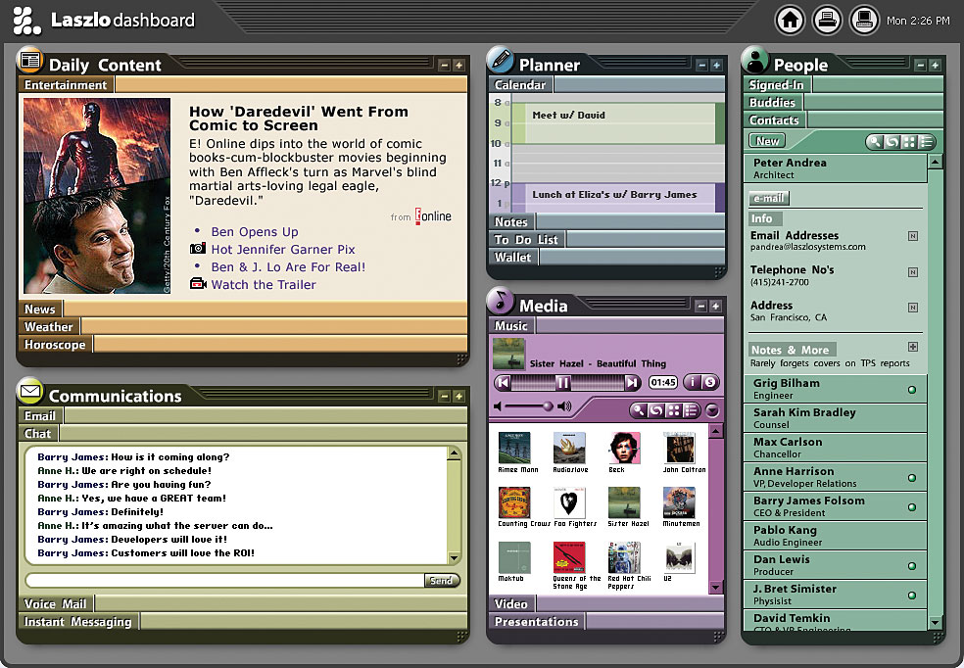
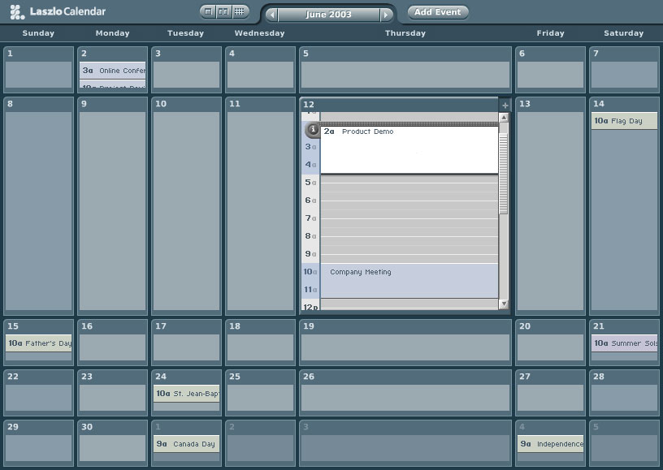
Demos
Demos
Notes:
As fast and usable as desktop email
Desktop style single-screen experience
Drag and drop support for mail tasks
Full keyboard control and navigation
Clear and appealing graphical interface
Integrated Email and Address Book applications
Ubiquitous access from any popular Web browser on Windows, Linux and MacOS

Slide 9
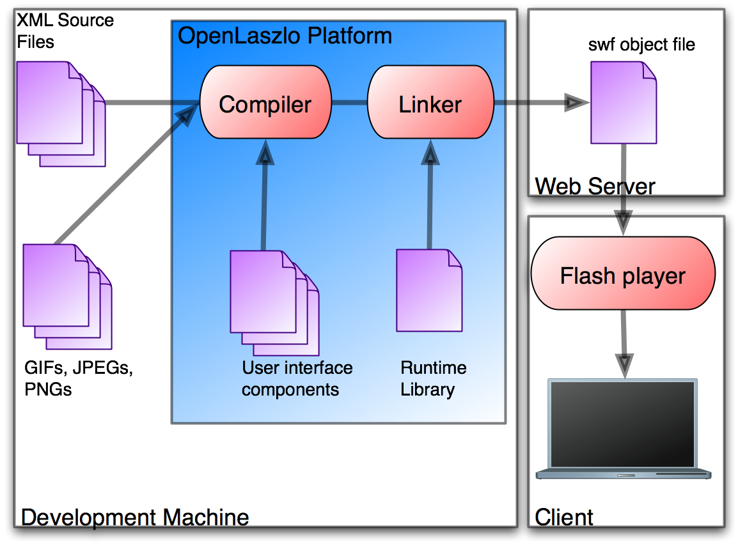
Deployment Architecture

Slide 10
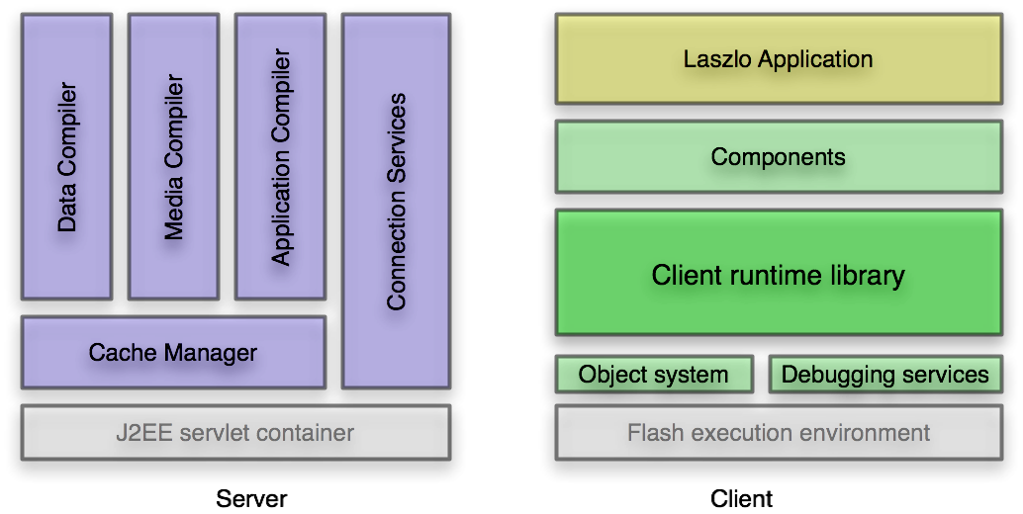
Platform Architecture

Slide 11
OpenLaszlo Platform API
XML with Javascript
Tags for views, data, layout
JavaScript APIs for runtime services
<canvas>
<button>Hello XTech</button>
</canvas>

Slide 12
Hitting the wall with declarative programming
“The Procedural Wall”
Dynamic + Declarative
Declarative dynamism: change of state over time/event sequence

Slide 13
Presentation state changes as a function of…
Time – animation
User Events – click, rollover
Data – changes to the model
Other Views – flow, relative position

Slide 14
Constraints the hard way
Requirements
• Width of view is a function of parent’s width and view’s ‘border’ property
• Width is updated whenever parent’s width changes
• Width is updated whenever ‘border’ property value changes
Observer Pattern
<view>
<method event=”oninit”>
registerListener(parent, ‘width’, myWidthListener);
registerListener(this, ‘border’, myWidthListener);
myWidthListener();
</method>
<method name=”myWidthListener”>
this.width = parent.width - 2*this.border;
</method>
</view>
Constraint Expression
<view width=“${parent.width - 2 * this.border}”/>

Slide 15
Mechanisms for handling state change
Animators
Constraints
States
Data Binding

Slide 16
Declarative Programming Sampler

Slide 17
More Info
http://openlaszlo.org
  Downloads – MacOS, Windows, Linux, source
  Demos
  Documentation
  Mailing lists
  Wiki
  Bug tracking (JIRA)
  Development branch (subversion)

Slide 18
Q&A
Standard objections:
“But Flash is proprietary!”
“But Java is proprietary!”
Standard questions:
“Why not use XUL for everything?”
“Why not use SVG for everything?”
More interesting questions:
What is the trade-off between using Laszlo and HTML/SVG/XUL?
What were the challenges? What are the challenges going forward?
What could be used in other languages/systems/platforms?
What can I do to help?

Slide 19
Appendix

Slide 20
OpenLaszlo Platform
Open source (CPL)
Third-generation, proven technology
Standards-based XML-native language
Excellent cross-browser compatibility
Independent of client runtime
Ubiquitous zero-install deployment
ANY BROWSER
Laszlo Application
Web SERVER
APP SERVER
OpenLaszlo 3.0*
* Optional for deployment
Notes:
Consumer Web common use cases

Slide 21
OpenLaszlo 3.0
Laszlo Presentation Server 1.0 – January 2003
  XML tag syntax and JavaScript compiler
  Concurrent with commercial use by Yahoo, Behr
Laszlo Presentation Server 2.0 –
  Components framework
  Startup accelerator
Laszlo Presentation Server 2.2 – October 2005
  Open source release
  License restriction removed
OpenLaszo 3.0 – April 2005
  Server is optional for deployment
  Unicode and fast text
  Graphics API and browser integration
  Includes open source contributions
  Renamed to OpenLaszlo

Slide 22
OpenLaszlo: Proven in large-scale deployments
~50K developer downloads
Millions of end-users
http://openlaszlo.org/showcase/

Slide 23
Biography
Programming Languages
  Apple Cambridge: Dylan
Graphics
  Apple: Quickdraw GX
  Alphamask
Knowledge Representation
  Method Software
  Apple ATG
  Lexeme

Slide 24
Related Work
Functional reactive programming
SVG/SMIL
XSTL

Slide 25
Future work
Performance
Transitions
Aspects
  CSS
  Open classes
  “Code-behind”

Slide 26
Constraint Implementation

Slide 27
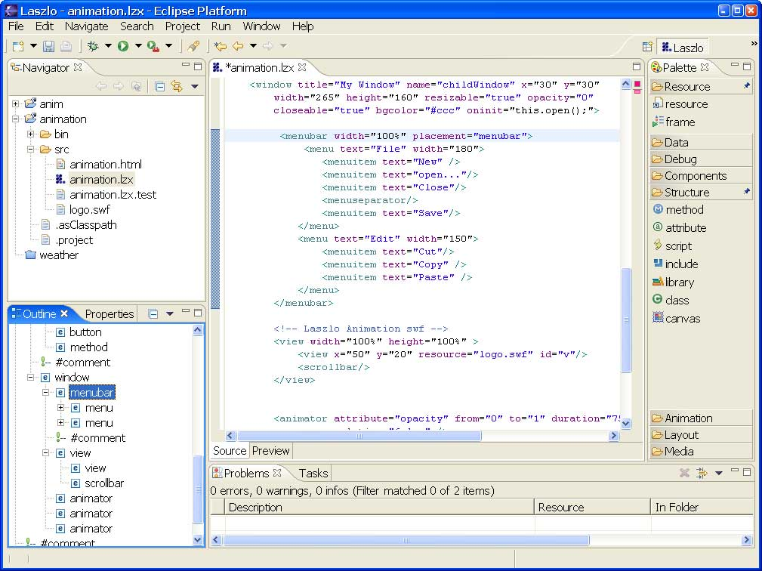
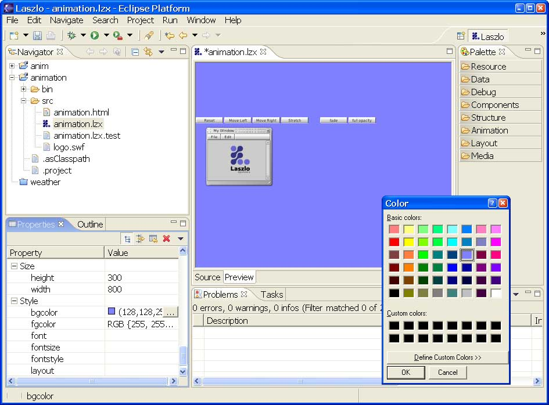
IBM Eclipse: IDE for OpenLaszlo
Notes:
Currently over 1000 downloads per month from AlphaWorks
One of their most successful downloads
Over 70 requests for licenses (note that AlphaWorks, as the name implies, is a project and only for evaluation) This is highly unusual and demonstrates the demand for this product.

Slide 28
To Do
Online
  Review alphabet soup
  Backup
Set up the demo framework
Review demos
Example of gui, round trip
Show examples of what can’t be done
  Animation
  Conditional on ui
  Iteration
Workflow
Insert remaining movies
Screenshots
Format code
Add IDE4Laszlo slide
Time the talk (30m+10m q&a?)
Notes:
What I would like to say: no scripting
What I can say: less scripting

